Slide 1
Title
His Master Saw That The LORD Was With Him Gen. 39:2
Gen. 39:1 Now Joseph had been taken down to Egypt. And Potiphar, an officer of Pharaoh, captain of the guard, an Egyptian, bought him from the Ishmaelites who had taken him down there.
2 The LORD was with Joseph, and he was a successful man; and he was in the house of his master the Egyptian.
3 And his master saw that the LORD was with him and that the LORD made all he did to prosper in his hand.
b hastings newlebanoncoc.com

Slide 2
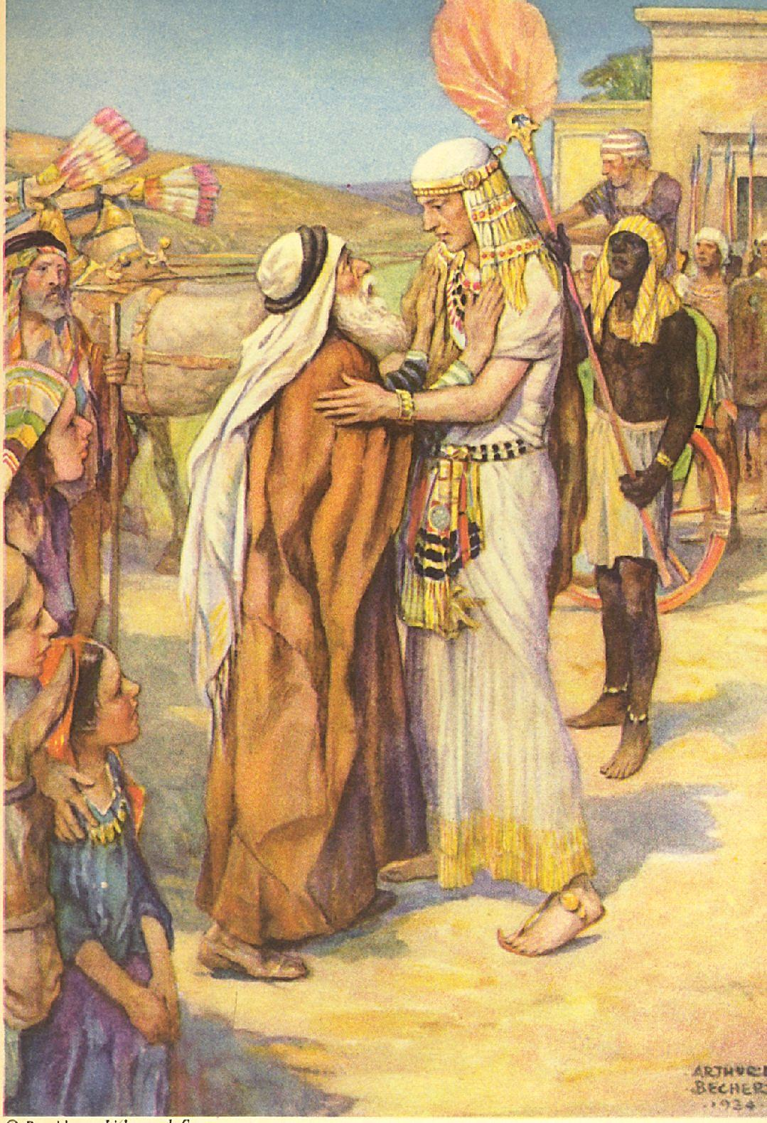
Title
His Master Saw That The LORD Was With Him Gen. 39:2
Lessons from the life of Joseph.
b hastings newlebanoncoc.com

Slide 3

Please open your hearts, your ears, and your Bible and follow along.
If you have any questions about anything I say, if you disagree anything I say, please say something to me after the service and I will be glad to sit down with you and God’s word and study so that we can come to know His truth

Slide 4
Title
His Master Saw That The LORD Was With Him Gen. 39:2
Many lessons we can learn from Joseph that will help us through out life.

Slide 5
Title
His Master Saw That The LORD Was With Him Gen. 39:2
Lessons from the life of Joseph
1.Your family does not determine your destiny.
Gen. 34:25-30,
Gen. 37:3-5
b hastings newlebanoncoc.com

Slide 6
Title
His Master Saw That The LORD Was With Him Gen. 39:2
Gen. 34:25 Now it came to pass on the third day, when they were in pain, that two of the sons of Jacob, Simeon and Levi, Dinah's brothers, each took his sword and came boldly upon the city and killed all the males.
26 And they killed Hamor and Shechem his son with the edge of the sword, and took Dinah from Shechem's house, and went out.
27 The sons of Jacob came upon the slain, and plundered the city, because their sister had been defiled.
28 They took their sheep, their oxen, and their donkeys, what was in the city and what was in the field,
29 and all their wealth. All their little ones and their wives they took captive; and they plundered even all that was in the houses.
30 Then Jacob said to Simeon and Levi, "You have troubled me by making me obnoxious among the inhabitants of the land, among the Canaanites and the Perizzites; and since I am few in number, they will gather themselves together against me and kill me. I shall be destroyed, my household and I."
b hastings newlebanoncoc.com

Slide 7
Title
His Master Saw That The LORD Was With Him Gen. 39:2
Your family does not determine your destiny.
Gen. 37:3 Now Israel loved Joseph more than all his children, because he was the son of his old age. Also he made him a tunic of many colors.
4 But when his brothers saw that their father loved him more than all his brothers, they hated him and could not speak peaceably to him.
5 Now Joseph had a dream, and he told it to his brothers; and they hated him even more.
b hastings newlebanoncoc.com

Slide 8
Title
His Master Saw That The LORD Was With Him Gen. 39:2
Lessons from the life of Joseph
Your family does not determine your destiny.
Have you ever blamed your family for how your life has turned out? Consider Joseph:
His father had 4 wives.
Grew up in an environment of jealousy, favoritism, envy.
Brothers hated him, wanted to kill him.
Their father Jacob said Joseph’s brothers made his name stink among other nations.
Joseph did not use his family as an excuse, neither should we.
Joseph is one of a few individuals in bible where nothing negative is recorded about him.
b hastings newlebanoncoc.com

Slide 9
Title
His Master Saw That The LORD Was With Him Gen. 39:2
Lessons from the life of Joseph
2.Individual responsibility and choice.
Phil. 4:8 Finally, brethren, whatever things are true, whatever things are noble, whatever things are just, whatever things are pure, whatever things are lovely, whatever things are of good report, if there is any virtue and if there is anything praiseworthy--meditate on these things.
b hastings newlebanoncoc.com

Slide 10
Title
His Master Saw That The LORD Was With Him Gen. 39:2
Lessons from the life of Joseph
Individual responsibility and choice.
Responsibility= ability to choose correct response.
Includes our thoughts, feelings, attitudes. Joseph had ability to control his feelings. So do we.
We can’t let anybody make us feel any way we don’t choose to feel.
If they could- they would have more control over us than we have over our self.
Think about that and let that sink in.
b hastings newlebanoncoc.com

Slide 11

Title
His Master Saw That The LORD Was With Him Gen. 39:2
Lessons from the life of Joseph
Individual responsibility and choice.
b hastings newlebanoncoc.com

Slide 12
Title
His Master Saw That The LORD Was With Him Gen. 39:2
Lessons from the life of Joseph
3. Concern for evil.
Gen. 37:2 This is the history of Jacob. Joseph, being seventeen years old, was feeding the flock with his brothers. And the lad was with the sons of Bilhah and the sons of Zilpah, his father's wives; and Joseph brought a bad report of them to his father.
b hastings newlebanoncoc.com

Slide 13
Title
His Master Saw That The LORD Was With Him Gen. 39:2
Lessons from the life of Joseph
Concern for evil.
We need to learn Silence gives approval.
Do we keep quiet about wrong or speak out against it?
Do we talk to people in sin, or keep our mouths shut and let them keep going down the road to hell.
b hastings newlebanoncoc.com

Slide 14
Title
His Master Saw That The LORD Was With Him Gen. 39:2
Lessons from the life of Joseph
4. Purity Gen. 39:7-12
Gen 39:7 And it came to pass after these things that his master's wife cast longing eyes on Joseph, and she said, "Lie with me."
8 But he refused and said to his master's wife, "Look, my master does not know what is with me in the house, and he has committed all that he has to my hand.
9 "There is no one greater in this house than I, nor has he kept back anything from me but you, because you are his wife. How then can I do this great wickedness, and sin against God?"
10 So it was, as she spoke to Joseph day by day, that he did not heed her, to lie with her or to be with her.
11 But it happened about this time, when Joseph went into the house to do his work, and none of the men of the house was inside,
12 that she caught him by his garment, saying, "Lie with me." But he left his garment in her hand, and fled and ran outside.
b hastings newlebanoncoc.com

Slide 15
Title
His Master Saw That The LORD Was With Him Gen. 39:2
Purity Gen. 39:7-12
Glass of water with foreign matter mixed in. – Contaminated!
We can not have the world mixed in to our lives.
We are personal ambassadors for the king of kings.
Flee sin like Joseph did.
b hastings newlebanoncoc.com

Slide 16
Title
His Master Saw That The LORD Was With Him Gen. 39:2
Lessons from the life of Joseph
5. Do what is right, not what is popular.
Rom. 12:1 I beseech you therefore, brethren, by the mercies of God, that you present your bodies a living sacrifice, holy, acceptable to God, which is your reasonable service.
2 And do not be conformed to this world, but be transformed by the renewing of your mind, that you may prove what is that good and acceptable and perfect will of God.
b hastings newlebanoncoc.com

Slide 17
Title
His Master Saw That The LORD Was With Him Gen. 39:2
Lessons from the life of Joseph
Do what is right, not what is popular.
Joseph had a moral compass.
Pressure to do wrong.
Rejected by his family.
Away from home.
Living in an immoral and idolatrous land.
b hastings newlebanoncoc.com

Slide 18
Title
His Master Saw That The LORD Was With Him Gen. 39:2
Lessons from the life of Joseph
6. Sin is against God.
Gen. 39:9 "There is no one greater in this house than I, nor has he kept back anything from me but you, because you are his wife. How then can I do this great wickedness, and sin against God?"
b hastings newlebanoncoc.com

Slide 19
Title
His Master Saw That The LORD Was With Him Gen. 39:2
Lessons from the life of Joseph
Sin is against God.
“You lied to me. You hurt me. You offended me. You sinned against me.”
Joseph realized he was not center of universe.
Joseph recognized we have no laws. Only God has a law.
Joseph recognized ALL MEN are under God’s law.
(How did he recognize this???)
We shouldn’t put our self in God’s place.
b hastings newlebanoncoc.com

Slide 20
Title
His Master Saw That The LORD Was With Him Gen. 39:2
Lessons from the life of Joseph
7. Dress appropriately.
Gen. 41:14 Then Pharaoh sent and called Joseph, and they brought him quickly out of the dungeon; and he shaved, changed his clothing, and came to Pharaoh.
.
b hastings newlebanoncoc.com

Slide 21
Title
His Master Saw That The LORD Was With Him Gen. 39:2
Lessons from the life of Joseph
Dress appropriately.
Our appearance is important.
Dress for the occasion.
We show honor and respect by how we prepare and present ourselves.
Joseph didn’t “Come as you are”
Joseph teaches us that our appearance preaches a lesson to others. What is our sermon teaching them?
b hastings newlebanoncoc.com

Slide 22
Title
His Master Saw That The LORD Was With Him Gen. 39:2
Lessons from the life of Joseph
8. Suffering
Suffering – to endure affliction, to bear up under.
I have never been plotted against to be killed.
I have never been thrown into a pit by my brothers. (They did tie me down on a picnic table once).
I have never been sold into slavery.
I have never been falsely accused and thrown into prison.
I have never been separated from my family over 20 years.
b hastings newlebanoncoc.com

Slide 23
Title
His Master Saw That The LORD Was With Him Gen. 39:2
Lessons from the life of Joseph
9. Save during the days of plenty.
1. Save is a word that has almost become obsolete.
Gen. 41:33 "Now therefore, let Pharaoh select a discerning and wise man, and set him over the land of Egypt.
34 "Let Pharaoh do this, and let him appoint officers over the land, to collect one-fifth of the produce of the land of Egypt in the seven plentiful years.
35 "And let them gather all the food of those good years that are coming, and store up grain under the authority of Pharaoh, and let them keep food in the cities.
36 "Then that food shall be as a reserve for the land for the seven years of famine which shall be in the land of Egypt, that the land may not perish during the famine."
37 So the advice was good in the eyes of Pharaoh and in the eyes of all his servants.
b hastings newlebanoncoc.com

Slide 24
Title
His Master Saw That The LORD Was With Him Gen. 39:2
Lessons from the life of Joseph
10. Men need to express their feelings to their family.
Gen. 45:1-5 Then Joseph could not restrain himself before all those who stood by him, and he cried out, "Make everyone go out from me!" So no one stood with him while Joseph made himself known to his brothers.
2 And he wept aloud, and the Egyptians and the house of Pharaoh heard it. 3 Then Joseph said to his brothers, "I am Joseph; does my father still live?" But his brothers could not answer him, for they were dismayed in his presence.
4 And Joseph said to his brothers, "Please come near to me." So they came near. Then he said: "I am Joseph your brother, whom you sold into Egypt.5 "But now, do not therefore be grieved or angry with yourselves because you sold me here; for God sent me before you to preserve life.
b hastings newlebanoncoc.com

Slide 25
Title
His Master Saw That The LORD Was With Him Gen. 39:2
Lessons from the life of Joseph
11. Balance. Gen. 41:38-46
Joseph in the world but not of the world.
Had a great responsibility for multitude of people- at a young age. Not a 9-5 job but a 24 hour a day, 7 days a week job!
Thrown into the middle of the most powerful country at the time.
Responsible for the survival of many nations.
b hastings newlebanoncoc.com

Slide 26
Title
His Master Saw That The LORD Was With Him Gen. 39:2
Lessons from the life of Joseph
12. Providence. Gen. 39:2,3, 21
Gen. 39:2-3 The LORD was with Joseph, and he was a successful man; and he was in the house of his master the Egyptian. 3 And his master saw that the LORD was with him and that the LORD made all he did to prosper in his hand.
Gen. 39:21 But the LORD was with Joseph and showed him mercy, and He gave him favor in the sight of the keeper of the prison.
b hastings newlebanoncoc.com

Slide 27
Title
His Master Saw That The LORD Was With Him Gen. 39:2
Lessons from the life of Joseph
12. Providence. Gen. 39:2,3, 21
Jeremiah 29:11 For I know the plans I have for you, says the LORD, plans for welfare and not for evil, to give you a future and a hope. (RSV)
God was with Joseph.
And, God is with us….if we are serving Him.
b hastings newlebanoncoc.com

Slide 28
Title
His Master Saw That The LORD Was With Him Gen. 39:2
1.Your family does not determine your destiny.
2.Individual responsibility and choice. 3. Concern for evil. 4. Purity. 5. Do what is right, not what is popular. 6. Sin is against God. 7. Dress appropriately. 8. Suffering. 9. Save during the days of plenty. 10. Men need to express their feelings to their family. 11. Balance. 12. Providence.
b hastings newlebanoncoc.com

