Slide 1
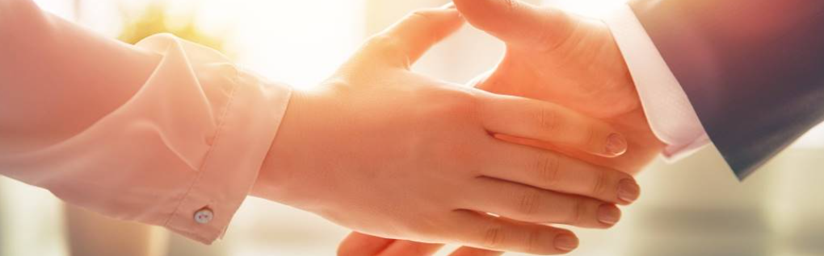
Welcome to our services
New Lebanon Church of Christ
We are Simply Christians.
Our Emphasis is Spiritual, Not Material or Social.
We are striving to be The Same Church as Described in The New Testament.
Please Come Back Again

Slide 2
1 My hope is built on nothing less
than Jesus' blood and righteousness;
I dare not trust the sweetest frame,
but wholly lean on Jesus' name.
Refrain:
On Christ, the solid Rock, I stand:
all other ground is sinking sand;
all other ground is sinking sand.
2 When darkness veils his lovely face,
I rest on his unchanging grace;
in every high and stormy gale,
my anchor holds within the veil. [Refrain]

Slide 3
3 His oath, his covenant, his blood,
support me in the whelming flood;
when all around my soul gives way,
he then is all my hope and stay. [Refrain]
4 When he shall come with trumpet sound,
O may I then in him be found:
dressed in his righteousness alone,
faultless to stand before the throne. [Refrain]
Author: Edward Mote (1834)

Slide 4


Slide 5
My Hope Is Built On Nothing Less
pngtree.com
Eph. 2:12-13

Slide 6
Ephesians 2:12 that at that time you were without Christ, being aliens from the commonwealth of Israel and strangers from the covenants of promise, having no hope and without God in the world. 13 But now in Christ Jesus you who once were far off have been brought near by the blood of Christ.
pngtree.com

Slide 7

My Hope Is Built On Nothing Less
What is hope?

Slide 8

My Hope Is Built On Nothing Less
Hope does not arise from your
desires or wishes but from God,
who is Himself the believer's hope: "My hope is in You" (Psalm 39:7).

Slide 9
My Hope Is Built On Nothing Less
Hope distinguishes the Christian from the unbeliever, who has no hope

Slide 10
My Hope Is Built On Nothing Less
In contrast to Old Testament hope, your hope is superior
His grace
His Word
His gospel

Slide 11
My Hope Is Built On Nothing Less
And your Hope should be directed back toward God and Christ

Slide 12
My Hope Is Built On Nothing Less
The objects of hope are:
eternal life
Salvation
the glory of God
the appearing of Christ
and the resurrection from the dead

Slide 13
My Hope Is Built On Nothing Less
Hope is the anchor
of the soul.

Slide 14
My Hope Is Built On Nothing Less
God wants you to be able to tell people about your wonderful hope.

Slide 15
My Hope Is Built On Nothing Less
1Peter 1:3 Blessed be the God and Father of our Lord Jesus Christ, who according to His abundant mercy has begotten us again to a living hope through the resurrection of Jesus Christ from the dead,
1Peter 3:15 But sanctify the Lord God in your hearts, and always be ready to give a defense to everyone who asks you a reason for the hope that is in you, with meekness and fear;

Slide 16
Questions?
Want to learn more about the Bible?
We will be glad to study the Bible with you.
New Lebanon
New Lebanon
Church of Christ
Church of Christ
New Lebanon, OH
newlebanoncoc.com
newlebanoncoc@gmail.com

Slide 17

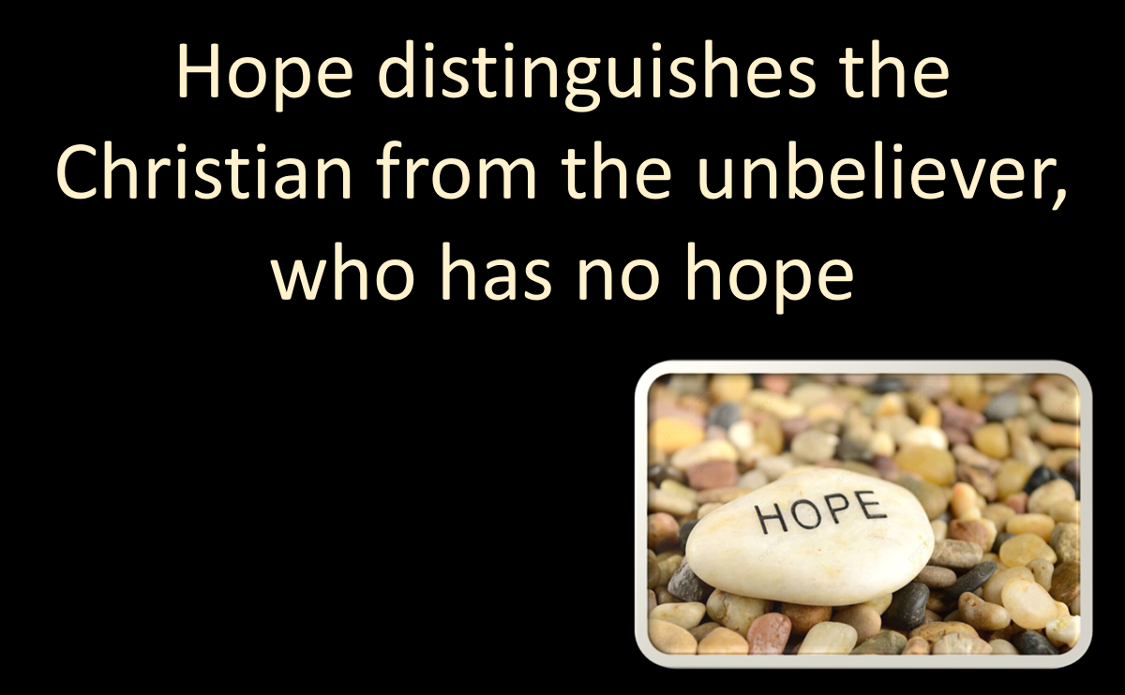


My Hope Is Built On Nothing Less
Nehemiah 2:18

