Slide 1
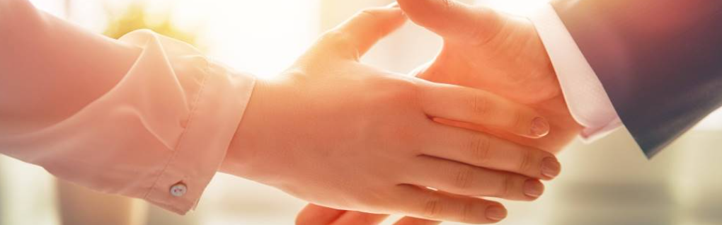
Welcome to our services
New Lebanon Church of Christ
We are Simply Christians.
Our Emphasis is Spiritual, Not Material or Social.
We are striving to be The Same Church as Described in The New Testament.
Please Come Back Again

Slide 2
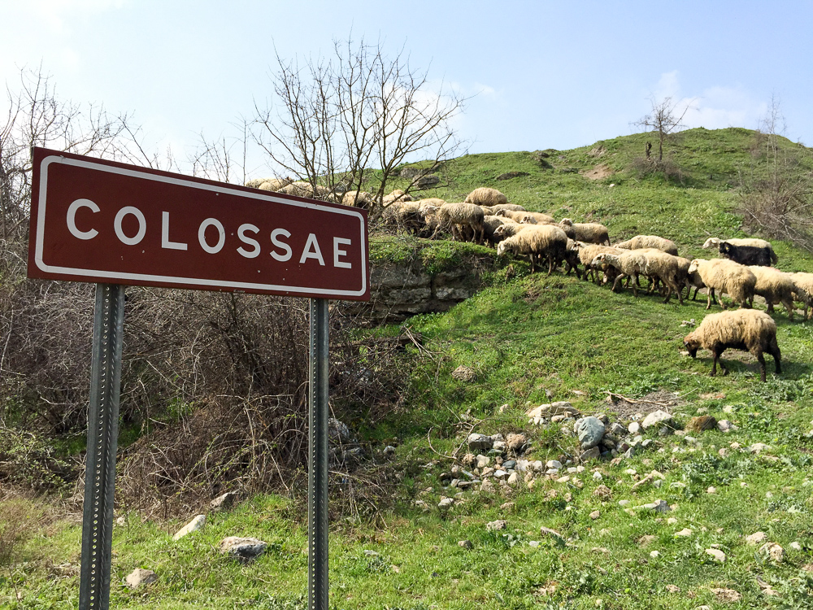
1. He Is My Everything
2. All The Fullness Of The Godhead
3. Background And People
4. Paul’s Concern For The Brethren
5. The Conversion Of The Colossians
6. The Power Of The Glorified Christ

Slide 3
Lesson 6- The Power Of Christ
Col.1:9 For this reason we also, since the day we heard it, do not cease to pray for you, and to ask that you may be filled with the knowledge of His will in all wisdom and spiritual understanding;
10. that you may walk worthy of the Lord, fully pleasing Him, being fruitful in every good work and increasing in the knowledge of God;
11. strengthened with all might, according to His glorious power, for all patience and longsuffering with joy;
12. giving thanks to the Father who has qualified us to be partakers of the inheritance of the saints in the light.
13. He has delivered us from the power of darkness and conveyed us into the kingdom of the Son of His love,
14. in whom we have redemption through His blood, the forgiveness of sins.
newlebanoncoc.com

Slide 4
Questions?
Want to learn more about the Bible?
We will be glad to study the Bible with you.
New Lebanon
New Lebanon
Church of Christ
Church of Christ
New Lebanon, OH
newlebanoncoc.com
newlebanoncoc@gmail.com

