Slide 1
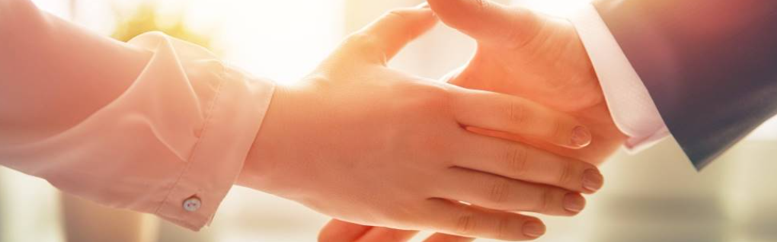
Welcome to our services
New Lebanon Church of Christ
We are Simply Christians.
Our Emphasis is Spiritual, Not Material or Social.
We are striving to be The Same Church as Described in The New Testament.
Please Come Back Again

Slide 2
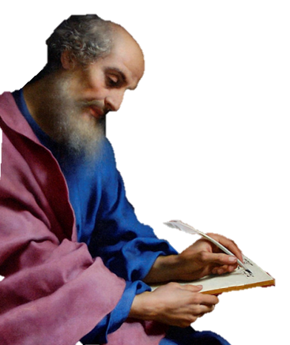
Lesson Four –
Paul’s Concern For The Brethren
Colossians 2:1 For I want you to know what a great conflict I have for you and those in Laodicea, and for as many as have not seen my face in the flesh, 2 that their hearts may be encouraged, being knit together in love, and attaining to all riches of the full assurance of understanding, to the knowledge of the mystery of God, both of the Father and of Christ,

Slide 3
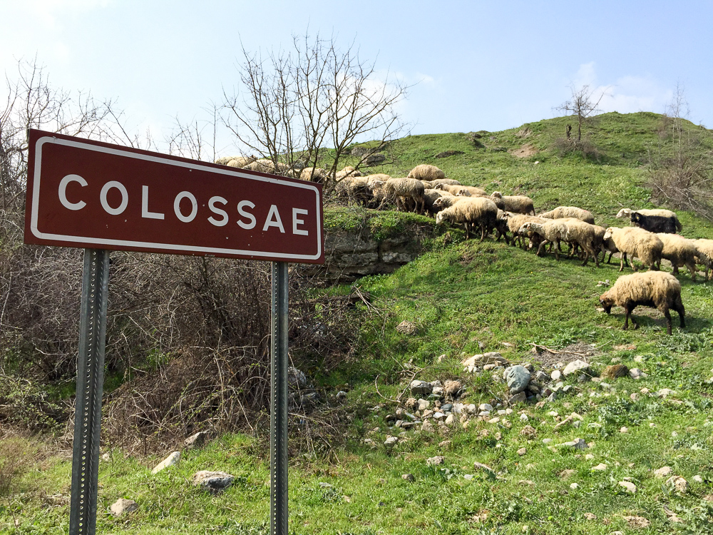
To the saints and faithful brothers in Christ who are at Colossae
Lesson One – He Is my Everything
He Is My Everything. He Is My All.
He Is My Everything, Both Great And Small.
He Gave His Life For Me, Made Everything New.
He Is My Everything. Now How About You?
Notes:
Colossae was probably severely damaged in the same earthquake that hit Laodicea and Hierapolis circa AD 61. This is about the time when Paul wrote this letter to the Colossians, and since the city was not quickly rebuilt, it is unlikely that a pseudonymous writer would have chosen Colossae as a destination for a letter “from Paul” at a later date. This history supports the traditional view that Colossians is a genuine Pauline epistle. In later history, Colossae continued to mint coins from AD 150 to 250, when many people of the city moved to nearby Chonae. Saracens filled the abandoned area in the seventh and eighth centuries. The Turks destroyed the church building in the 12th century.
shs031215355

Slide 4
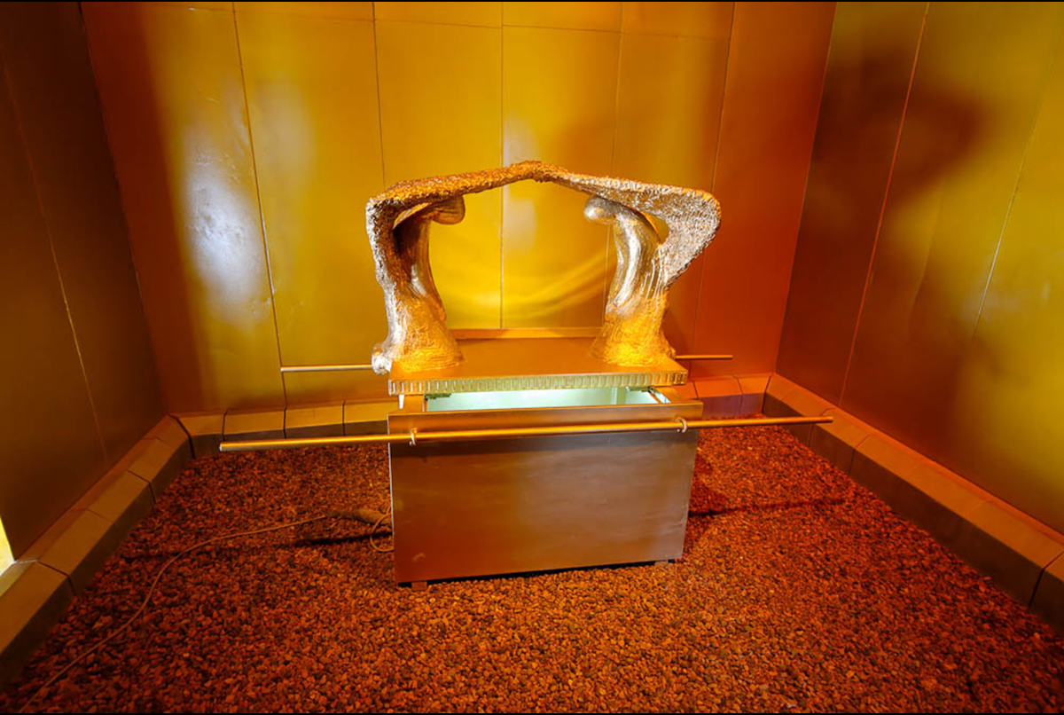
To the saints and faithful brothers in Christ who are at Colossae
Lesson Two – All The Fullness Of The Godhead
Col. 2:9-23
Paul’s language recalls God’s dwelling among His people in the Holy of Holies of the Tabernacle, and later in the Temple. As Immanuel (“God with us”), Jesus perfected this idea as God incarnate who dwelt (lit. “tabernacled”) among us. The verb “to dwell” is used to describe God dwelling in both earthly and heavenly temples. The model of the ark pictured here was photographed at Timna National Park in southern Israel.
Notes:
Colossae was probably severely damaged in the same earthquake that hit Laodicea and Hierapolis circa AD 61. This is about the time when Paul wrote this letter to the Colossians, and since the city was not quickly rebuilt, it is unlikely that a pseudonymous writer would have chosen Colossae as a destination for a letter “from Paul” at a later date. This history supports the traditional view that Colossians is a genuine Pauline epistle. In later history, Colossae continued to mint coins from AD 150 to 250, when many people of the city moved to nearby Chonae. Saracens filled the abandoned area in the seventh and eighth centuries. The Turks destroyed the church building in the 12th century.
shs031215355

Slide 5
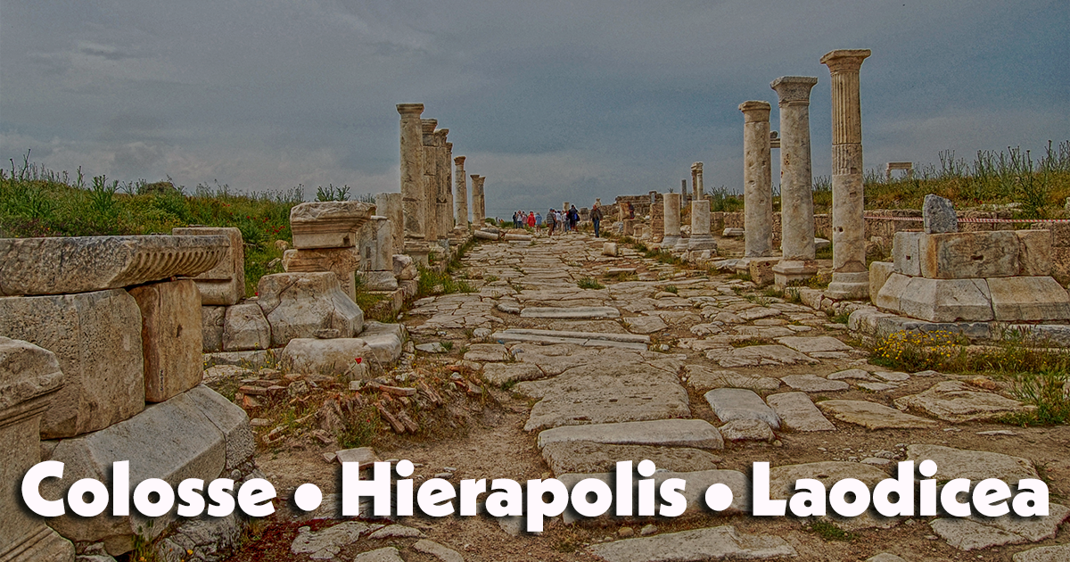

Slide 6
Col 1:1 Paul, an apostle of Jesus Christ by the will of God, and Timotheus our brother,
1:7 As ye also learned of Epaphras our dear fellowservant, who is for you a faithful minister of Christ; 8 Who also declared unto us your love in the Spirit.
4:7 All my state shall Tychicus declare unto you, who is a beloved brother, and a faithful minister and fellowservant in the Lord: 8 Whom I have sent unto you for the same purpose, that he might know your estate, and comfort your hearts;
4:9 With Onesimus, a faithful and beloved brother, who is one of you. They shall make known unto you all things which are done here.

Slide 7
4:10 Aristarchus my fellowprisoner saluteth you, and Marcus, sister's son to Barnabas, (touching whom ye received commandments: if he come unto you, receive him;)
4:11 And Jesus, which is called Justus, who are of the circumcision. These only are my fellowworkers unto the kingdom of God, which have been a comfort unto me.
12 Epaphras, who is one of you, a servant of Christ, saluteth you, always labouring fervently for you in prayers, that ye may stand perfect and complete in all the will of God.
13 For I bear him record, that he hath a great zeal for you, and them that are in Laodicea, and them in Hierapolis.
4:14 Luke, the beloved physician, and Demas, greet you.

Slide 8
4:15 Salute the brethren which are in Laodicea, and Nymphas, and the church which is in his house. 16 And when this epistle is read among you, cause that it be read also in the church of the Laodiceans; and that ye likewise read the epistle from Laodicea
17 And say to Archippus, Take heed to the ministry which thou hast received in the Lord, that thou fulfil it.
18 The salutation by the hand of me Paul. Remember my bonds. Grace be with you. Amen. <<Written from Rome to Colossians by Tychicus and Onesimus.>>

Slide 9
While a prisoner Paul was dependent upon the churches to render assistance unto him to live. They sent relief by messengers, each church sending its own messenger. Paul sent in turn messengers to the churches to let them know his condition and to instruct the churches in the truth.
The association of Tychicus with Paul in his last journey to Jerusalem led to a devoted attachment on the part of Tychicus to Paul.
At the time this epistle was written Tychicus was with Paul in his imprisonment at Rome. He was about to be sent home in charge of Onesimus, on whose account the apostle sends a letter to Philemon.

Slide 10

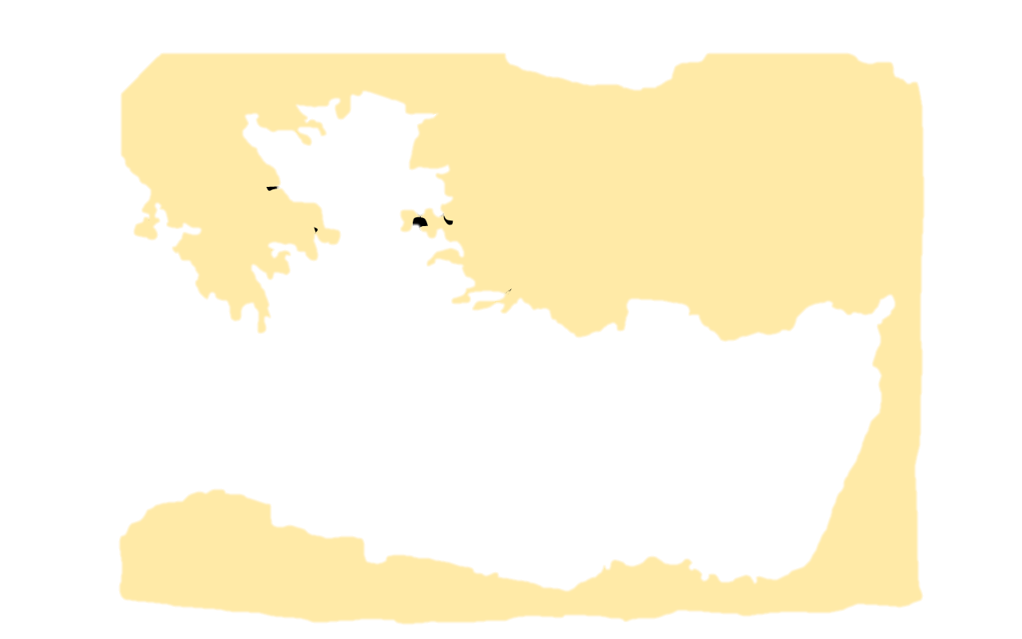
BITHYNIA AND PONTUS
ASIA
MACEDONIA
AEGEAN SEA
Ephesus
Laodicea
GALATIA
Corinth
Colosse
CAPPADOCIA
LYCIA
PAMPHYLIA
CILICIA
CRETE
CYPRUS
Colosse was overshadowed in
importance by Laodicea, and its ruins at the present time show it to have been a much smaller city.
SYRIA
Jerusalem
AFRICA
EGYPT

Slide 11
Lesson Four – Paul’s Concern For The Brethren
Acts 19:1 And it happened, while Apollos was at Corinth, that Paul, having passed through the upper regions, came to Ephesus. And finding some disciples
2 he said to them, "Did you receive the Holy Spirit when you believed?" So they said to him, "We have not so much as heard whether there is a Holy Spirit."
3 And he said to them, "Into what then were you baptized?" So they said, "Into John's baptism." 4 Then Paul said, "John indeed baptized with a baptism of repentance, saying to the people that they should believe on Him who would come after him, that is, on Christ Jesus.“
5 When they heard this, they were baptized in the name of the Lord Jesus.
6 And when Paul had laid hands on them, the Holy Spirit came upon them, and they spoke with tongues and prophesied. 7 Now the men were about twelve in all.
8 And he went into the synagogue and spoke boldly for three months, reasoning and persuading concerning the things of the kingdom of God.
9 But when some were hardened and did not believe, but spoke evil of the Way before the multitude, he departed from them and withdrew the disciples, reasoning daily in the school of Tyrannus. 10 And this continued for two years, so that all who dwelt in Asia heard the word of the Lord Jesus, both Jews and Greeks.

Slide 12
Lesson Four – Paul’s Concern For The Brethren
1. For I want you to know what a great conflict I have for you and those in Laodicea, and for as many as have not seen my face in the flesh

Slide 13
Lesson Four – Paul’s Concern For The Brethren
2. that their hearts may be encouraged, being knit together in love, and attaining to all riches of the full assurance of understanding, to the knowledge of the mystery of God, both of the Father and of Christ,

Slide 14
Lesson Four – Paul’s Concern For The Brethren
3. in whom are hidden all the treasures of wisdom and knowledge.

Slide 15
Lesson Four – Paul’s Concern For The Brethren
4 Now this I say lest anyone should deceive you with persuasive words.
5 For though I am absent in the flesh, yet I am with you in spirit, rejoicing to see your good order and the steadfastness of your faith in Christ.

Slide 16
Lesson Four – Paul’s Concern For The Brethren
6 As you have therefore received Christ Jesus the Lord, so walk in Him,
7 rooted and built up in Him and established in the faith, as you have been taught, abounding in it with thanksgiving.

Slide 17
Lesson Four – Paul’s Concern For The Brethren
8 Beware lest anyone cheat you through philosophy and empty deceit, according to the tradition of men, according to the basic principles of the world, and not according to Christ.

Slide 18
Questions?
Want to learn more about the Bible?
We will be glad to study the Bible with you.
New Lebanon
New Lebanon
Church of Christ
Church of Christ
New Lebanon, OH
newlebanoncoc.com
newlebanoncoc@gmail.com

