Slide 1
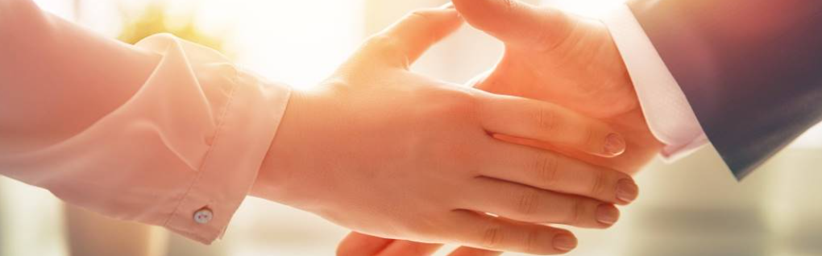
Welcome to our services
New Lebanon Church of Christ
We are Simply Christians.
Our Emphasis is Spiritual, Not Material or Social.
We are striving to be The Same Church as Described in The New Testament.
Please Come Back Again

Slide 2
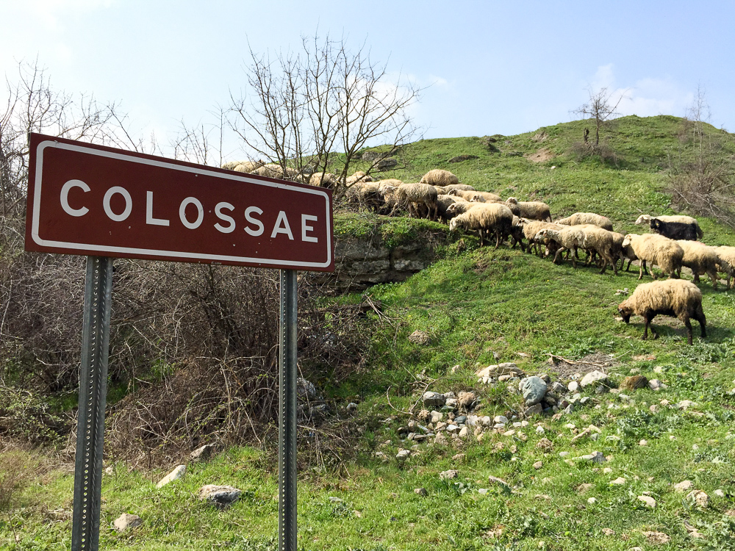
1. He Is My Everything
2. All The Fullness Of The Godhead
3. Background And People
4. Paul’s Concern For The Brethren
5. The Conversion Of The Colossians
6. The Power Of The Glorified Christ
7. Mortify The Flesh

Slide 3
Col 3:5 Therefore put to death your members which are on the earth: fornication, uncleanness,
passion,
evil desire,
and covetousness,
which is idolatry.
3

Slide 4
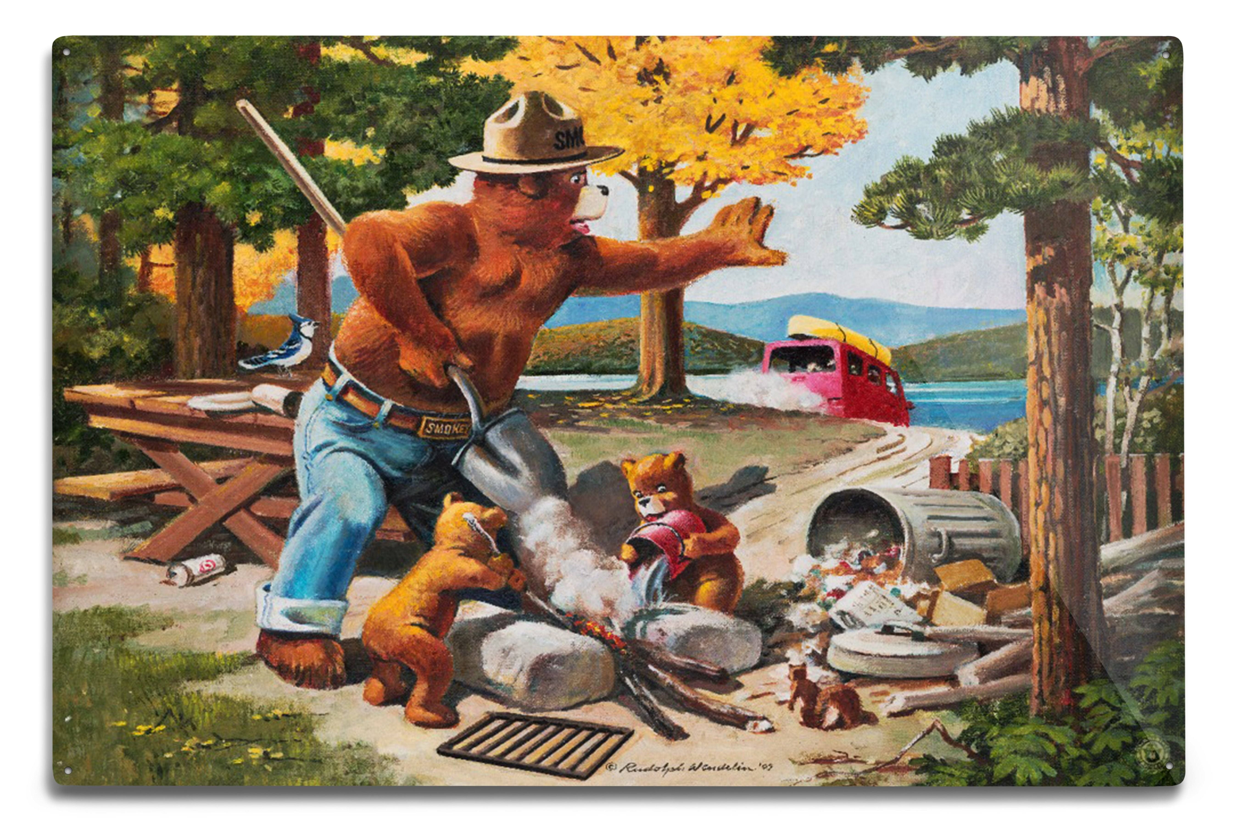
Lesson 7 – Mortify The Flesh
Extinguish The Flame
Smokey Bear, Extinguishing Left Campfire, Officially Licensed Vintage ... pinterest.com

Slide 5

Col 3:5 Therefore put to death your members which are on the earth: fornication, uncleanness,
passion,
evil desire,
and covetousness,
which is idolatry.
4

Slide 6
Col 3:5 Therefore put to death your members which are on the earth: fornication, uncleanness,
passion,
evil desire,
and covetousness,
which is idolatry.
Starts
here
6

Slide 7



Sin starts with
Idolatry, then
Covetousness, then
Evil desire, then
Passion, then
Uncleanness (general) then
Fornication (specific) then
DEATH
7

Slide 8
Lesson 7 – Mortify The Flesh
Extinguish The Flame - COMPLETELY
Smokey Bear, Extinguishing Left Campfire, Officially Licensed Vintage ... pinterest.com

Slide 9
Questions?
Want to learn more about the Bible?
We will be glad to study the Bible with you.
New Lebanon
New Lebanon
Church of Christ
Church of Christ
New Lebanon, OH
newlebanoncoc.com
newlebanoncoc@gmail.com

