Slide 1
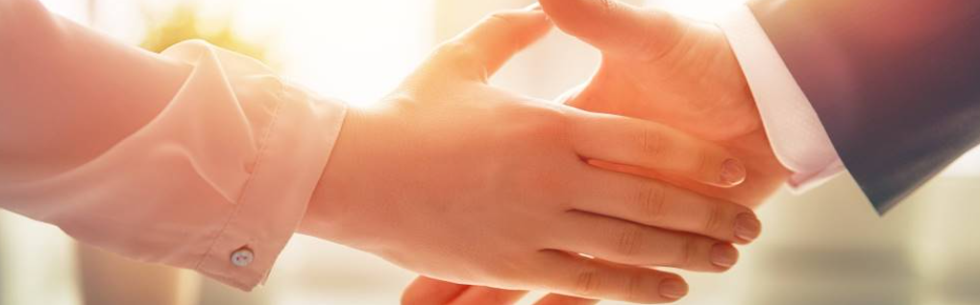
Welcome to our services
New Lebanon Church of Christ
We are Simply Christians.
Our Emphasis is Spiritual, Not Material or Social.
We are striving to be The Same Church as Described in The New Testament.
Please Come Back Again

Slide 2
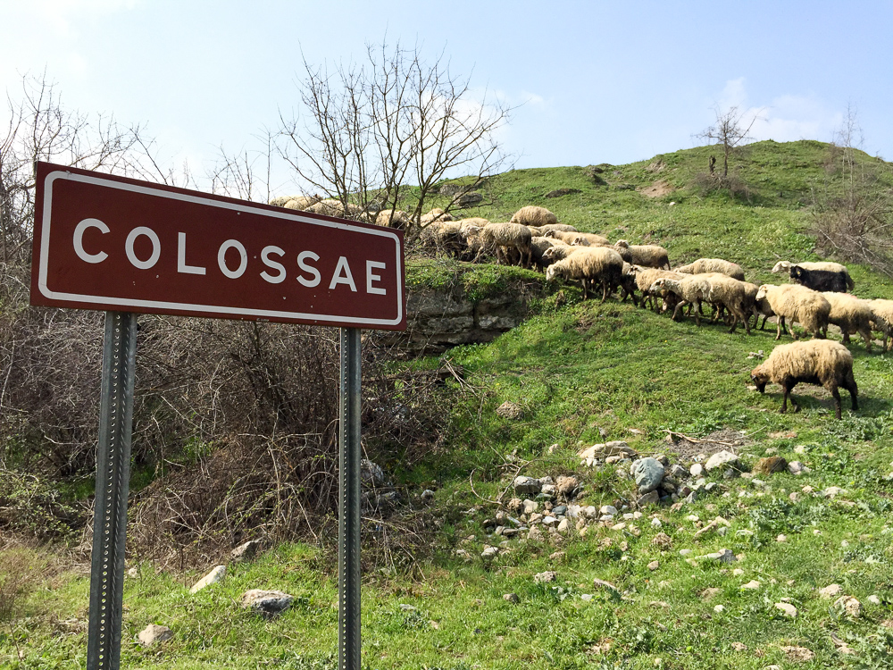
1. He Is My Everything
2. All The Fullness Of The Godhead
3. Background And People
4. Paul’s Concern For The Brethren
5. The Conversion Of The Colossians

Slide 3
Lesson 5- The Conversion Of The Colossians
Col. 1:20 and by Him to reconcile all things to Himself, by Him, whether things on earth or things in heaven, having made peace through the blood of His cross. 21 And you, who once were alienated and enemies in your mind by wicked works, yet now He has reconciled
22 in the body of His flesh through death, to present you holy, and blameless, and above reproach in His sight--23 if indeed you continue in the faith, grounded and steadfast, and are not moved away from the hope of the gospel which you heard, which was preached to every creature under heaven, of which I, Paul, became a minister.
newlebanoncoc.com

Slide 4

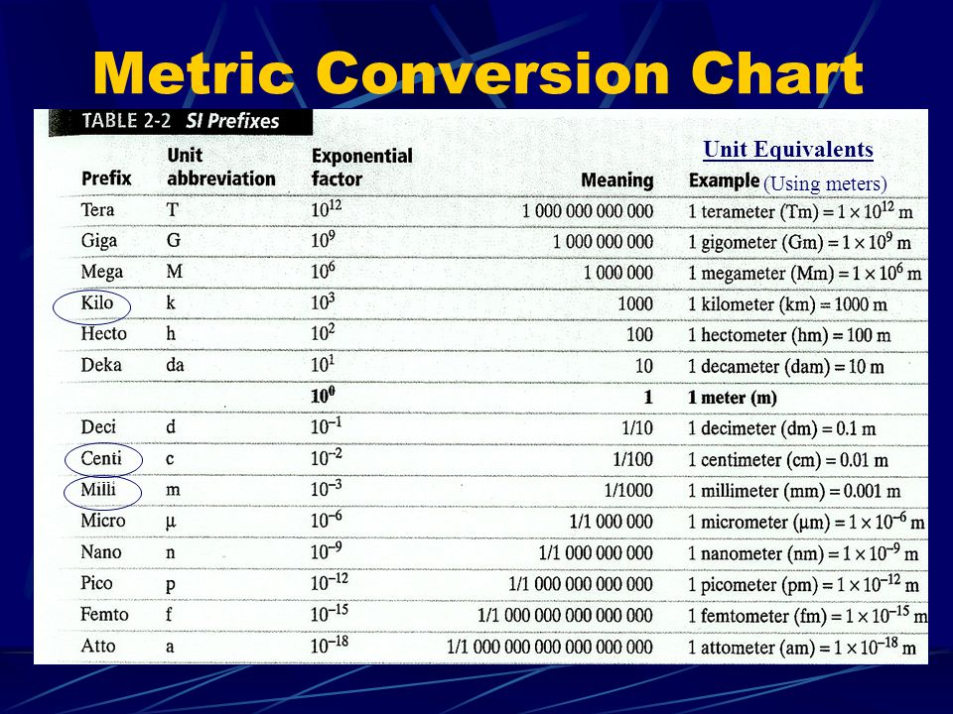
Lesson 5 – The Conversion of The Colossians
Conversion -To change from one form to another
Conversion – Redemption - Reconciliation

Slide 5
Lesson 5- The Conversion Of The Colossians
21 And you, who once were alienated and enemies in your mind by wicked works, yet now He has reconciled
newlebanoncoc.com

Slide 6
Lesson 5- The Conversion Of The Colossians
22 in the body of His flesh through death, to present you holy, and blameless, and above reproach in His sight--
newlebanoncoc.com

Slide 7
Lesson 5- The Conversion Of The Colossians
Col. 1:23 if indeed you continue in the faith, grounded and steadfast, and are not moved away from the hope of the gospel which you heard, which was preached to every creature under heaven, of which I, Paul, became a minister.
newlebanoncoc.com

Slide 8
Lesson 5- The Conversion Of The Colossians
Have you obeyed the gospel? If not, why not now?
Remember it was Jesus who said in Matt. 28:19 "Go therefore and make disciples of all the nations, baptizing them in the name of the Father and of the Son and of the Holy Spirit,
20 "teaching them to observe all things that I have commanded you; and lo, I am with you always, even to the end of the age." Amen.
newlebanoncoc.com

Slide 9
Lesson 5 – The Conversion of The Colossians
Conversion -To change from one form to another
Conversion – Redemption - Reconciliation

Slide 10
Questions?
Want to learn more about the Bible?
We will be glad to study the Bible with you.
New Lebanon
New Lebanon
Church of Christ
Church of Christ
New Lebanon, OH
newlebanoncoc.com
newlebanoncoc@gmail.com

