Slide 1
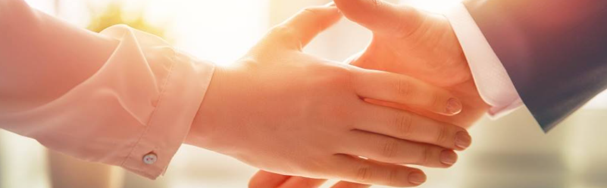
Welcome to our services
New Lebanon Church of Christ
We are Simply Christians.
Our Emphasis is Spiritual, Not Material or Social.
We are striving to be The Same Church as Described in The New Testament.
Please Come Back Again

Slide 2
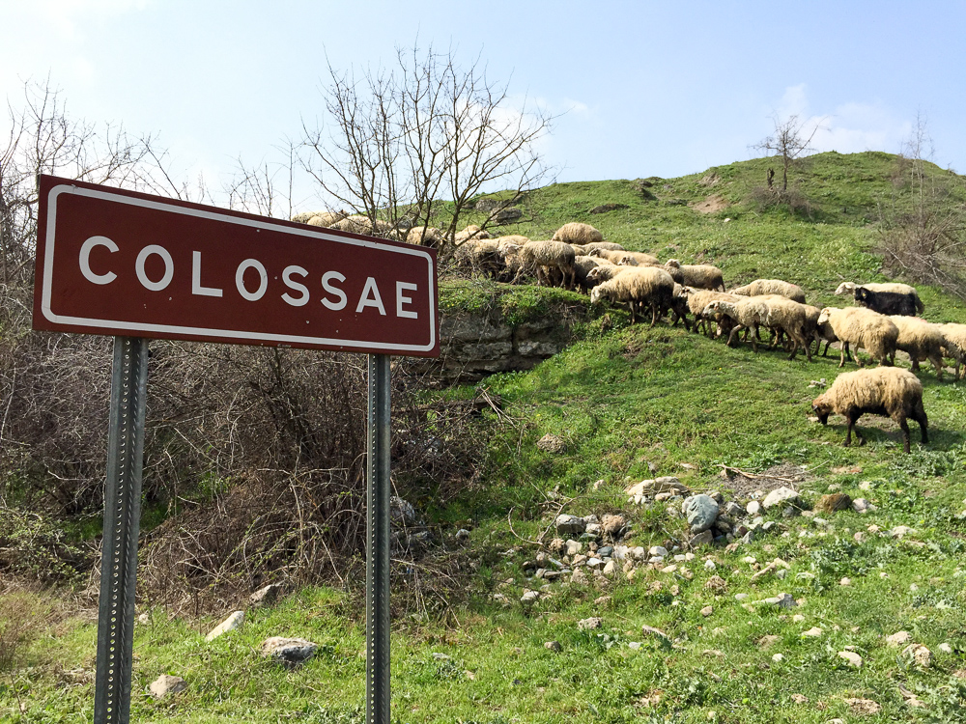
To the saints and faithful brothers in Christ who are at Colossae
Colossae with a flock of sheep
1:2
Notes:
Colossae was probably severely damaged in the same earthquake that hit Laodicea and Hierapolis circa AD 61. This is about the time when Paul wrote this letter to the Colossians, and since the city was not quickly rebuilt, it is unlikely that a pseudonymous writer would have chosen Colossae as a destination for a letter “from Paul” at a later date. This history supports the traditional view that Colossians is a genuine Pauline epistle. In later history, Colossae continued to mint coins from AD 150 to 250, when many people of the city moved to nearby Chonae. Saracens filled the abandoned area in the seventh and eighth centuries. The Turks destroyed the church building in the 12th century.
shs031215355

Slide 3
To the saints and faithful brothers in Christ who are at Colossae
Lesson One – He Is my Everything
He Is My Everything. He Is My All.
He Is My Everything, Both Great And Small.
He Gave His Life For Me, Made Everything New.
He Is My Everything. Now How About You?
Notes:
Colossae was probably severely damaged in the same earthquake that hit Laodicea and Hierapolis circa AD 61. This is about the time when Paul wrote this letter to the Colossians, and since the city was not quickly rebuilt, it is unlikely that a pseudonymous writer would have chosen Colossae as a destination for a letter “from Paul” at a later date. This history supports the traditional view that Colossians is a genuine Pauline epistle. In later history, Colossae continued to mint coins from AD 150 to 250, when many people of the city moved to nearby Chonae. Saracens filled the abandoned area in the seventh and eighth centuries. The Turks destroyed the church building in the 12th century.
shs031215355

Slide 4
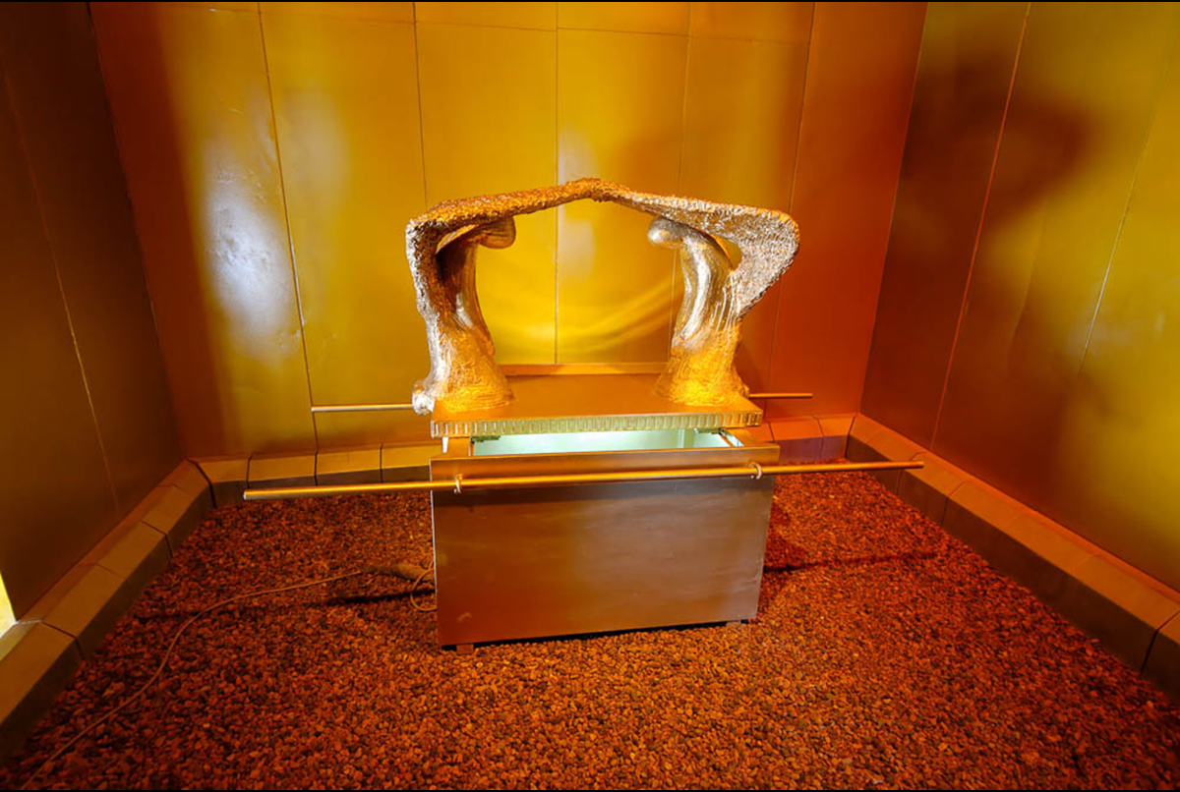
To the saints and faithful brothers in Christ who are at Colossae
Lesson Two – All The Fullness Of The Godhead
Col. 2:9-23
Paul’s language recalls God’s dwelling among His people in the Holy of Holies of the Tabernacle, and later in the Temple. As Immanuel (“God with us”), Jesus perfected this idea as God incarnate who dwelt (lit. “tabernacled”) among us. The verb “to dwell” is used to describe God dwelling in both earthly and heavenly temples. The model of the ark pictured here was photographed at Timna National Park in southern Israel.
Notes:
Colossae was probably severely damaged in the same earthquake that hit Laodicea and Hierapolis circa AD 61. This is about the time when Paul wrote this letter to the Colossians, and since the city was not quickly rebuilt, it is unlikely that a pseudonymous writer would have chosen Colossae as a destination for a letter “from Paul” at a later date. This history supports the traditional view that Colossians is a genuine Pauline epistle. In later history, Colossae continued to mint coins from AD 150 to 250, when many people of the city moved to nearby Chonae. Saracens filled the abandoned area in the seventh and eighth centuries. The Turks destroyed the church building in the 12th century.
shs031215355

Slide 5
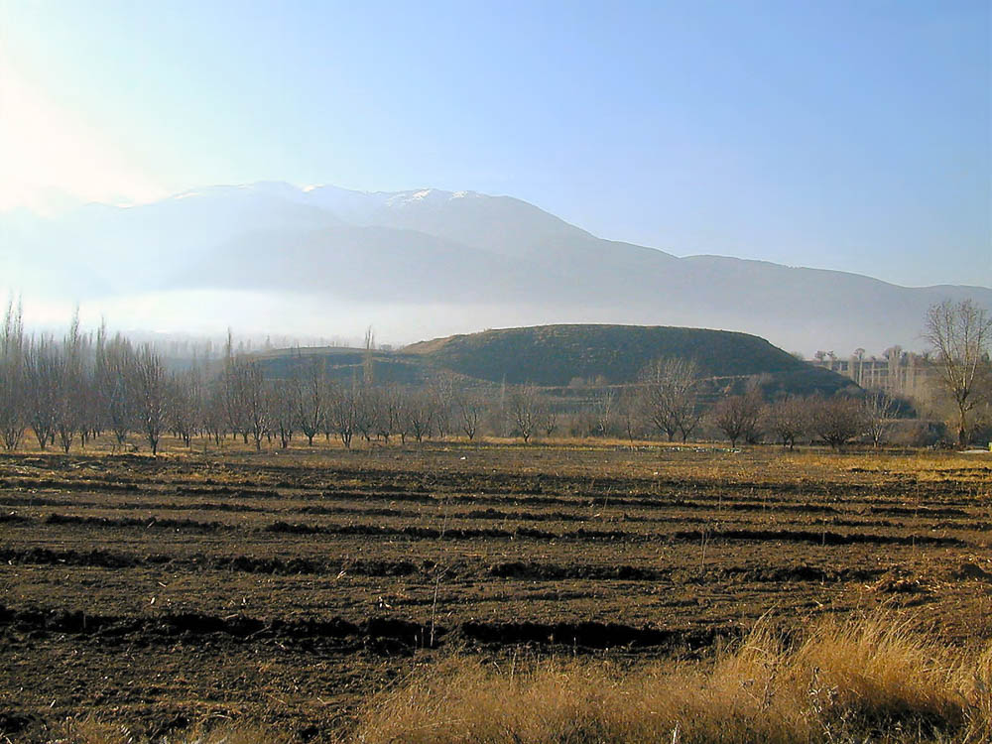
Colossians Lesson Three –
Background And The People In The Letter
Colossae (from the north)
1:2
Notes:
Part of the Roman territory of Asia Minor at the height of the Roman Empire, Colossae was located 120 miles (193 km) east of Ephesus in the Lycus River Valley in ancient Phrygia. It was one of a triad of cities in the area (the other two being Laodicea and Hierapolis), and it rested at the foot of Mount Cadmus. The tell was discovered by W. J. Hamilton in 1835 but has never been excavated. Excavations were scheduled to begin in the summer of 2003 by Flinders University of Australia, but in a published note in 2011, they cited the lack of interest from their Turkish partner for the delay (Trainor 2011: 134). As of 2020, the site remains unexcavated. Two volumes have been published about the site in preparation for archaeological work (Cadwallader 2015; Cadwallader and Trainor 2011).
The earliest known reference to the city is Xerxes’s invasion of Anatolia (480 BC); Herodotus calls Colossae “a great city in Phrygia” (Histories 7.30.1). Xenophon notes that Cyrus the Younger camped at Colossae for seven days on his march to Persia in 401 BC (Anabasis 1.2.6). He calls the city “prosperous and large.” Colossae was known for its production of wool, dyed a shade of purple named for the city, “colossinus,” according to Pliny the Elder. The city was prominent at the time, but lost importance as Laodicea and Hierapolis produced more wool.
References:
Cadwallader, Alan H.
2015 Fragments of Colossae: Sifting through the Traces. Hindmarsh, S. Australia: ATF Press.
Cadwallader, Alan H., and Trainor, Michael, eds.
2011 Colossae in Space and Time: Linking to an Ancient City. Novum Testamentum et Orbis Antiquus, Studien zur Umwelt des Neuen Testaments 94. Göttingen, Germany: Vandenhoeck & Ruprecht.
Trainor, Michael.
2011 Colossae: The State of Forthcoming Excavations. Journal for the Study of Paul and His Letters 1: 133–35.
tb010301501

Slide 6
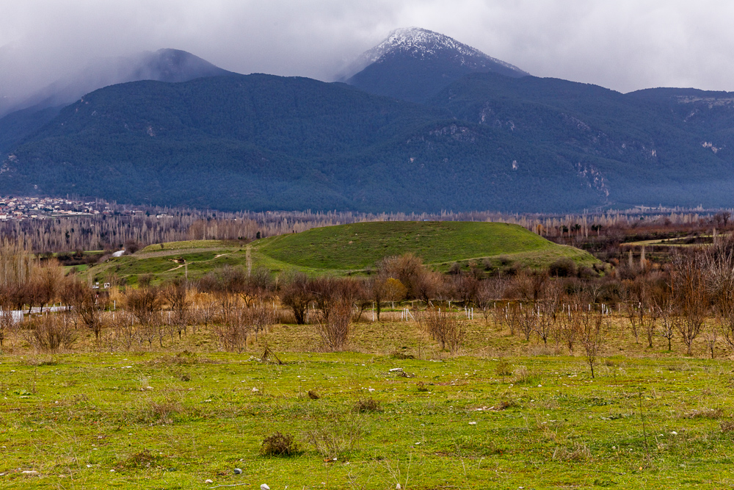
To the saints and faithful brothers in Christ who are at Colossae
Colossae (from the north)
1:2
Notes:
Paul had never visited Colossae when he composed his epistle to the church there (Col 2:1), but he does imply (in Col 1:7-8; 4:12-13) that Epaphras founded the church, along with those at Laodicea and Hierapolis. This was probably during Paul’s third missionary journey, when he preached in Ephesus for three years, “so that all who lived in Asia heard the word of the Lord Jesus, both Jews and Greeks” (Acts 19:10). Members of the church at Colossae included Philemon and his slave Onesimus (Col 4:9; Phlm 1:10), along with Archippus and Apphia.
jc1231149681

Slide 7
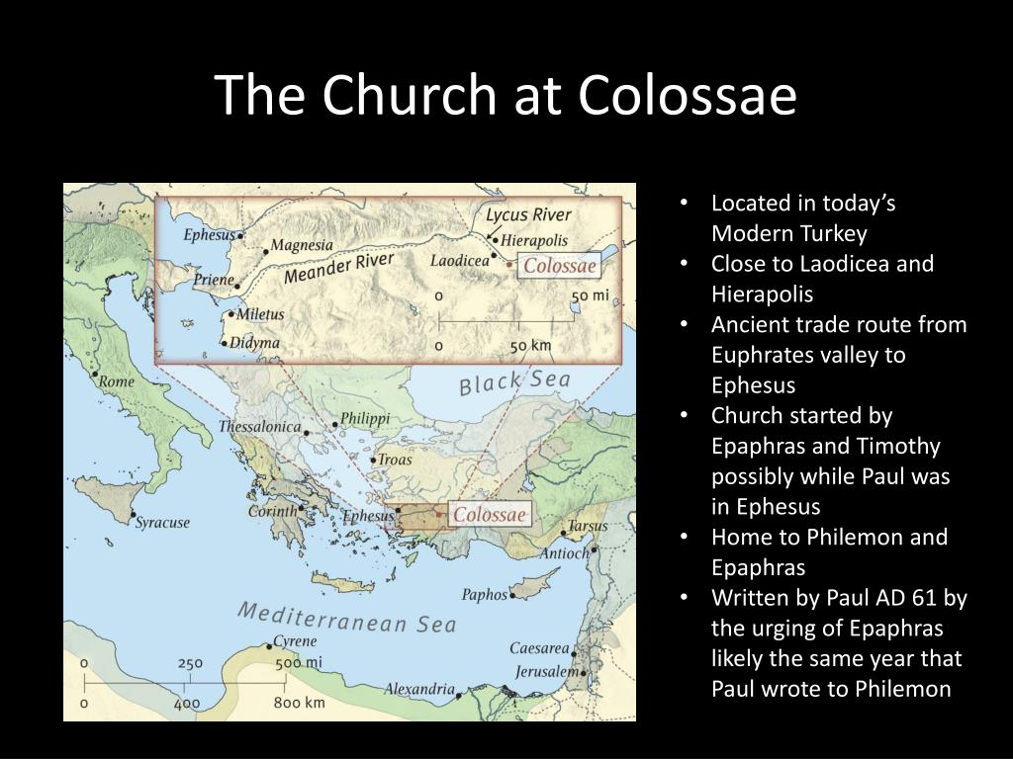

Slide 8
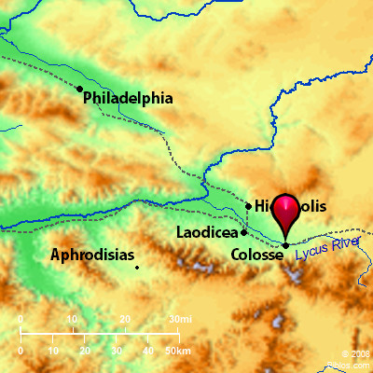

Slide 9
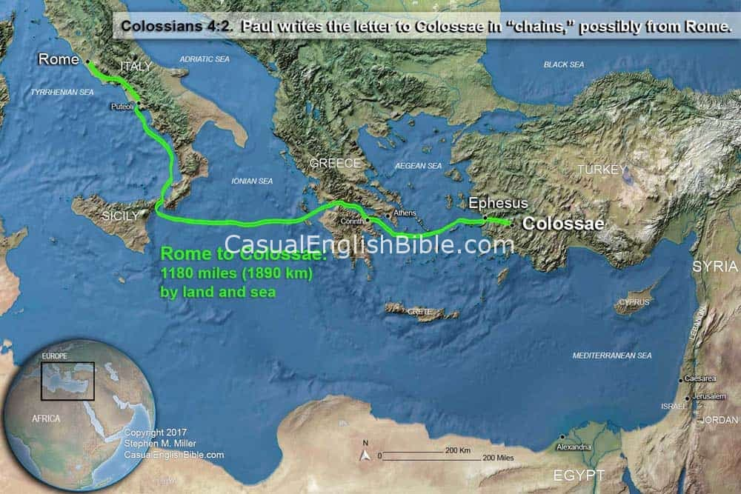

Slide 10

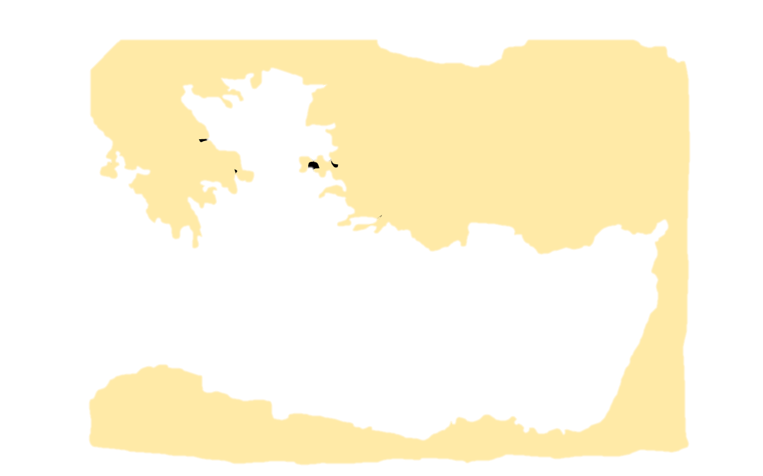
BITHYNIA AND PONTUS
ASIA
MACEDONIA
AEGEAN SEA
Ephesus
Laodicea
GALATIA
Corinth
Colosse
CAPPADOCIA
LYCIA
PAMPHYLIA
CILICIA
CRETE
CYPRUS
Colosse was overshadowed in
importance by Laodicea, and its ruins at the present time show it to have been a much smaller city.
SYRIA
Jerusalem
AFRICA
EGYPT

Slide 11
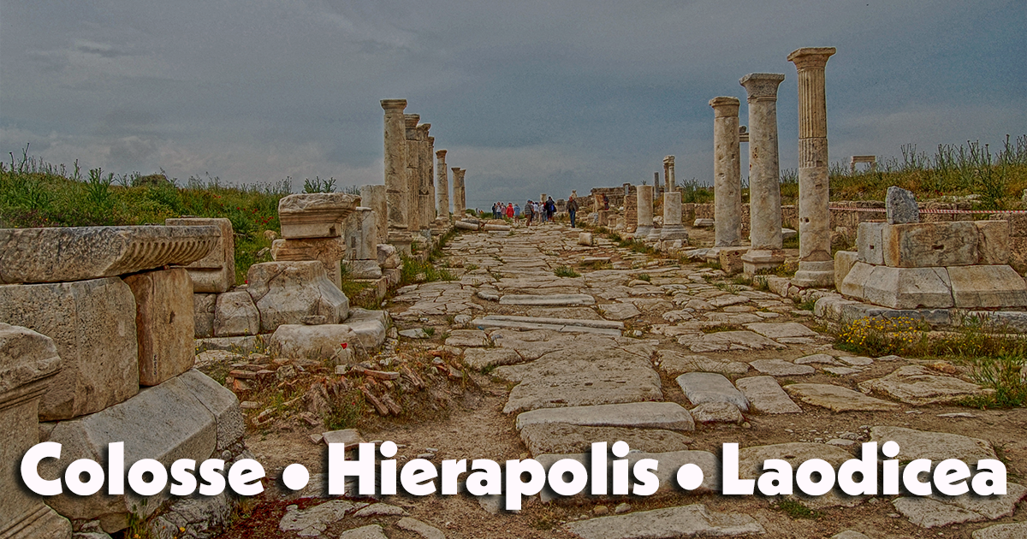

Slide 12
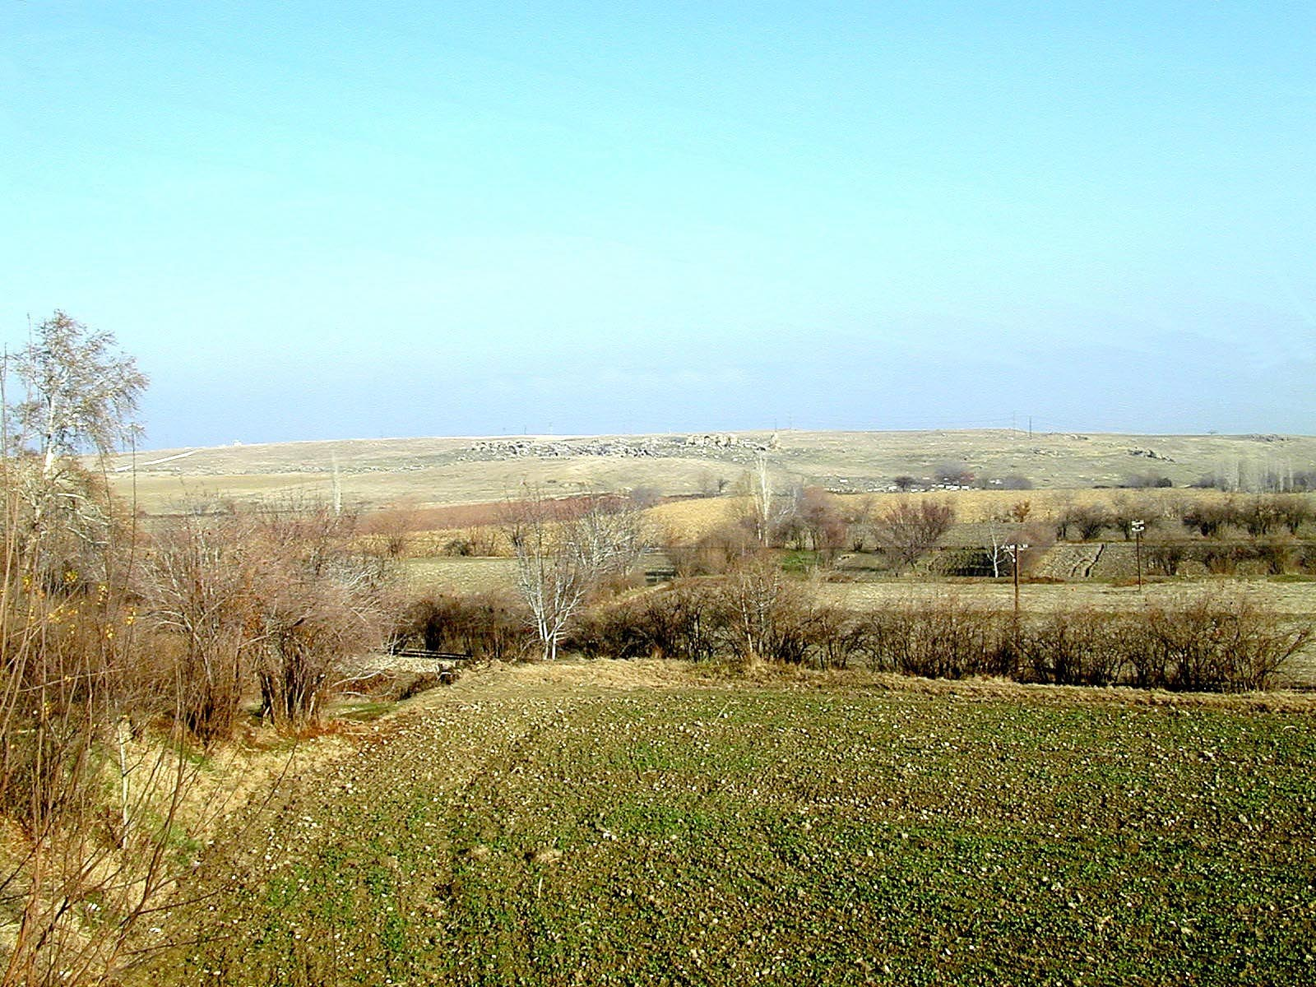
I bear him witness, that he has deep concern for . . . those who are in Laodicea and Hierapolis
Laodicea (from the south)
4:13
Notes:
The ruins in the center distance of this photo are those of Laodicea.
tb010301690

Slide 13
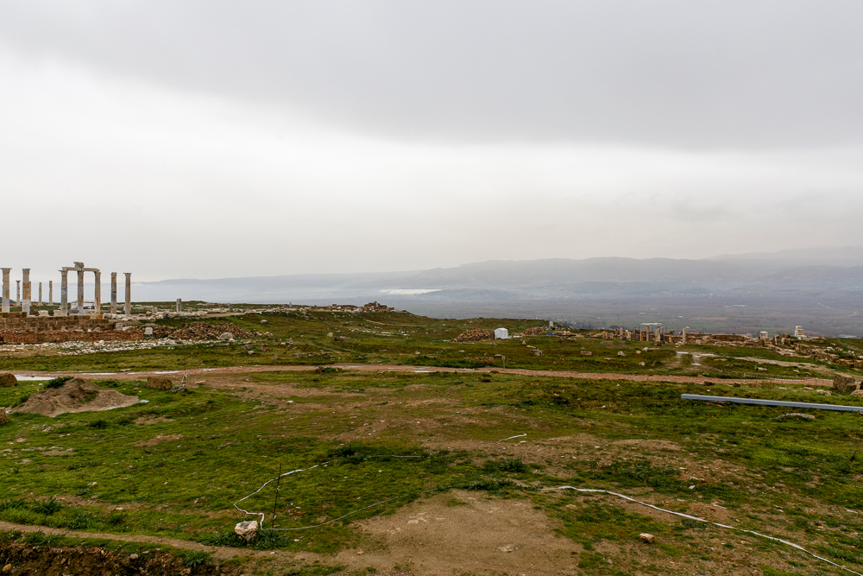
I bear him witness, that he has deep concern for . . . those who are in Laodicea and Hierapolis
Hierapolis
View to Hierapolis from Laodicea
4:13
Notes:
Hierapolis is easily visible from Laodicea; it is 6 miles (10 km) due north. In this photo, it is located behind the white area that marks the mineral springs of Pamukkale on its southern slope.
jc1231149728

Slide 14
Col 1:1 Paul, an apostle of Jesus Christ by the will of God, and Timotheus our brother,
1:7 As ye also learned of Epaphras our dear fellowservant, who is for you a faithful minister of Christ; 8 Who also declared unto us your love in the Spirit.
4:7 All my state shall Tychicus declare unto you, who is a beloved brother, and a faithful minister and fellowservant in the Lord: 8 Whom I have sent unto you for the same purpose, that he might know your estate, and comfort your hearts;
4:9 With Onesimus, a faithful and beloved brother, who is one of you. They shall make known unto you all things which are done here.

Slide 15
4:10 Aristarchus my fellowprisoner saluteth you, and Marcus, sister's son to Barnabas, (touching whom ye received commandments: if he come unto you, receive him;)
4:11 And Jesus, which is called Justus, who are of the circumcision. These only are my fellowworkers unto the kingdom of God, which have been a comfort unto me.
12 Epaphras, who is one of you, a servant of Christ, salutes you, always laboring fervently for you in prayers, that ye may stand perfect and complete in all the will of God.
13 For I bear him record, that he hath a great zeal for you, and them that are in Laodicea, and them in Hierapolis.
4:14 Luke, the beloved physician, and Demas, greet you.

Slide 16
Of all Paul’s friends none was dearer to him or more serviceable than Luke, the author of the gospel of Luke and the book of Acts where we observe he was Paul’s traveling companion (note the pronoun we in the book of Acts).
He was a Gentile Christian born at Antioch in Syria. The date of his conversion is uncertain. He was not among those “who from the beginning were eyewitnesses and ministers of the word” (Luke 1:1-2).
Luke remained at the side of Paul during both his imprisonments. Second Timothy 4:11 shows that Luke remained with Paul to the end of his affliction. After the death of Paul the record of Luke end.

Slide 17
4:15 Salute the brethren which are in Laodicea, and Nymphas, and the church which is in his house. 16 And when this epistle is read among you, cause that it be read also in the church of the Laodiceans; and that ye likewise read the epistle from Laodicea
17 And say to Archippus, Take heed to the ministry which thou hast received in the Lord, that thou fulfil it.
18 The salutation by the hand of me Paul. Remember my bonds. Grace be with you. Amen. <<Written from Rome to Colossians by Tychicus and Onesimus.>>

Slide 18
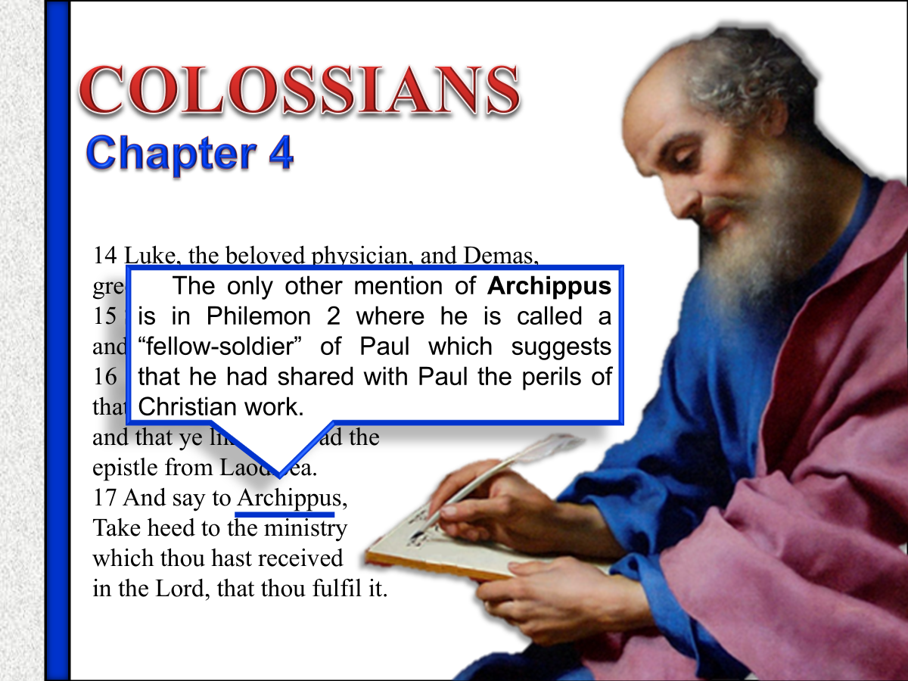

Slide 19
While a prisoner Paul was dependent upon the churches to render assistance unto him to live. They sent relief by messengers, each church sending its own messenger. Paul sent in turn messengers to the churches to let them know his condition and to instruct the churches in the truth.
The association of Tychicus with Paul in his last journey to Jerusalem led to a devoted attachment on the part of Tychicus to Paul.
At the time this epistle was written Tychicus was with Paul in his imprisonment at Rome. He was about to be sent home in charge of Onesimus, on whose account the apostle sends a letter to Philemon.

Slide 20
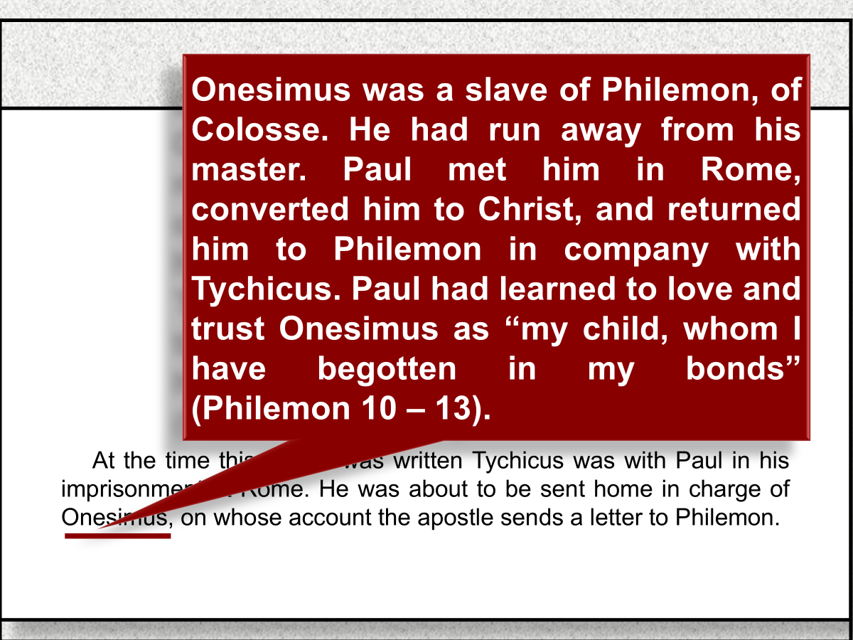

Slide 21

A.D. 70
Destruction of Jerusalem, continued scattering, and growth of the church
A.D. 48 49 50 53 57 63 67 68 95
Fourth Missionary Journey
First Missionary Journey
Galatia
Second Missionary Journey
Macedonia
Achaia
Greece
Third Missionary Journey
Asia
First Roman Imprisonment
60 - 63
Rome
Second Roman Imprisonment
67 - 68
Rome
In the interval between the first imprisonment in Rome and the second Paul revisits the Asiatic churches [see 1 Timothy 1:3] and Tychicus rejoins him; for we find Paul proposing to send Tychicus to Titus in Crete (Titus 3:12), and finally sending him from Rome once more to Ephesus (2 Timothy 4:12).
Ephesians
Place: Rome
Date: 60 - 63
Ephesians
Place: Rome
Date: 60 - 63
1 Timothy
Place: Macedonia
Date: 62 - 66
2 Timothy
Place: Rome
Date: 66 - 67
Colossians
Place: Rome
Date: 60 - 63
Colossians
Place: Rome
Date: 60 - 63
Titus
Place: Macedonia
Date: 62 - 66
Philemon
Place: Rome
Date: 60 - 63
Philippians
Place: Rome
Date: 60 - 63

Slide 22

Jerusalem Council
Trials
Paul Before Caesar
Second Missionary Journey
Macedonia
Achaia
Greece
Third Missionary Journey
Asia
First Roman Imprisonment
60 - 63
Rome
Second Roman Imprisonment
67 - 68
Rome
A.D. 51 53 57 60 66 70
1 Thess.
Place: Corinth
Date: 51 - 52
1 Corinthians
Place: Ephesus
Date: 56 - 57
Ephesians
Place: Rome
Date: 60 - 63
1 Timothy
Place: Macedonia
Date: 63 - 66
A.D. 70
Destruction of Jerusalem, continued scattering, and growth of the church
Date: 70
2 Thess.
Place: Corinth
Date: 51 - 52
2 Corinthians
Place: Macedonia
Date: 56 - 57
Colossians
Place: Rome
Date: 60 - 63
Colossians
Place: Rome
Date: 60 - 63
Titus
Place: Macedonia
Date: 63 - 66
Galatians
Place: Antioch
Date: 57
Philemon
Place: Rome
Date: 60 - 63
Colossians was the second letter Paul wrote while a prisoner in Rome.
2 Timothy
Place: Rome
Date: 67 - 68
Romans
Place: Corinth
Date: 57
Philippians
Place: Rome
Date: 60 - 63

Slide 23
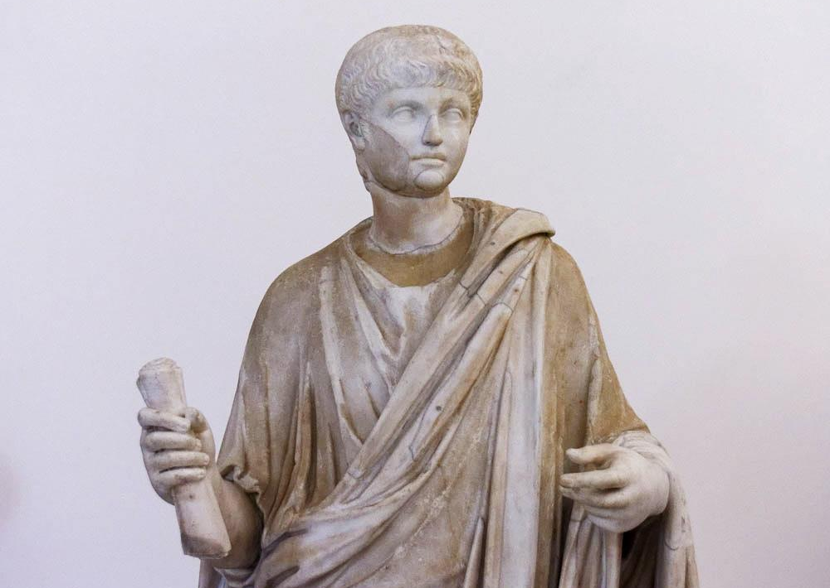
I have sent him to you for this very purpose
Young boy holding a scroll, 1st century AD
4:8
Notes:
The letter to the Colossians was short enough that it was likely sent by Paul in the form of a small scroll. Tychicus was to carry the letter, perhaps like the young man portrayed in this statue. The body and head on this statue were originally from different statues. It is thought that the body dates to about AD 100, whereas the head dates to about AD 54–68. This statue was photographed at the Naples Archaeological Museum.
tb0515171546

Slide 24
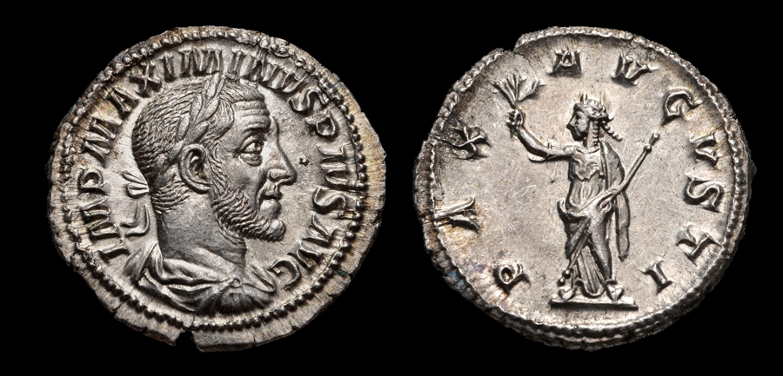
Having made peace
Silver denarius depicting the “Peace of Augustus,” Roman mint, AD 236
1:20
Notes:
The Roman people were proud of the Pax Romana (“Roman Peace”), a period of relative peace beginning with the reign of Augustus (27 BC – AD 14). The coin shown here illustrates the importance of peace to the Romans. The obverse depicts the Roman emperor Maximinus I and reads “Imperator Maximinus Pius Augustus” (IMP MAXIMINUS PIUS AUG). The reverse depicts a figure with a laurel wreath, draped, and wearing a cuirass, holding an olive branch and scepter. It reads “Peace of Augustus” (PAX AUGUSTI). For Paul, of course, it was the work of Christ that inaugurated the greatest peace of all—peace with God (cf. the slides on Rom 12:18). This image comes from Classical Numismatic Group and is licensed under CC-BY-SA-2.5, via Wikimedia Commons: https://commons.wikimedia.org/wiki/File:MAXIMINUS_I-RIC_IV_12-876901.jpg
wiki876901b

Slide 25
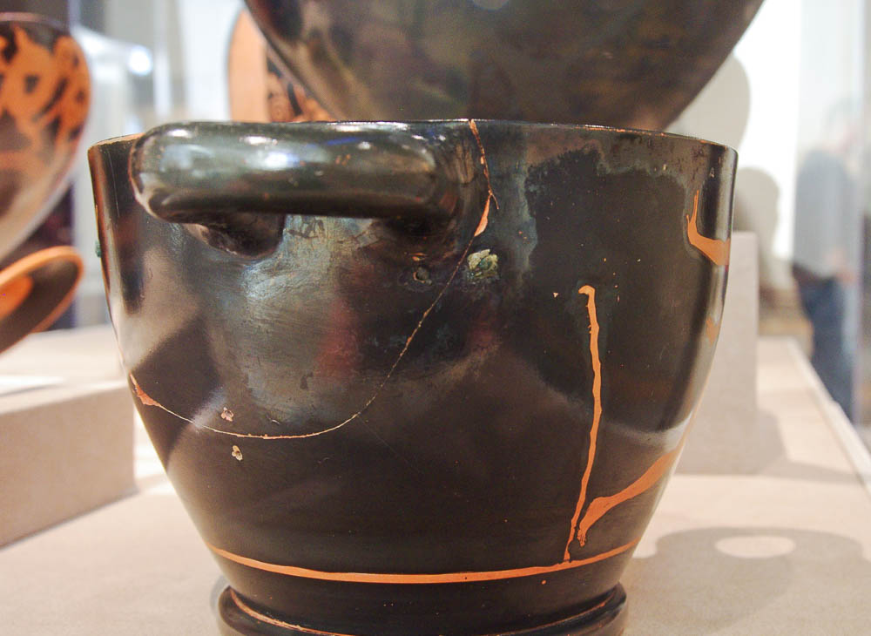
That their hearts may be encouraged, having been knit together in love
Attic red-figure skyphos with ancient repairs using copper alloy clamps, 475–450 BC
2:2
Notes:
The handle and a large piece of the side of this skyphos broke in antiquity. Three points of repair, where holes were drilled and copper clamps were attached to “knit” the pieces back together, are visible in this photo. The clamp on the far left can only be seen in profile. This was photographed at the Walters Art Museum in Baltimore.
adr1311245686

Slide 26
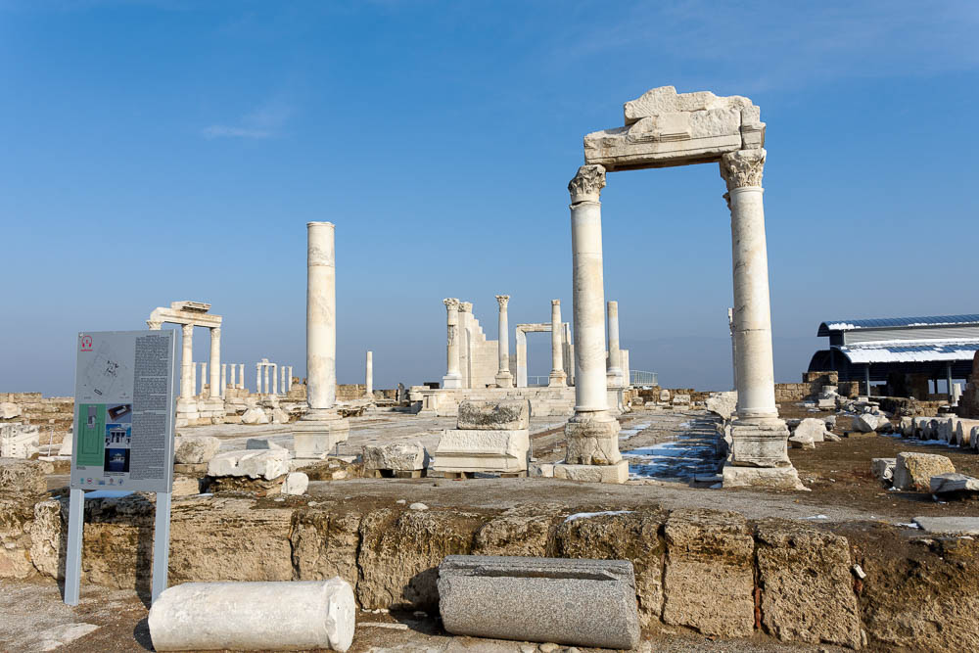
I want you to know how great a struggle I have for you, and for those at Laodicea
Imperial cult temple at Laodicea
2:1
Notes:
Laodicea was a nearby city, located only 9 miles (14.5 km) to the west of Colossae. Apparently Paul was concerned that the churches in both cities faced some of the same dangers. Significant remains of the Roman period are visible at Laodicea.
tb010117317

Slide 27
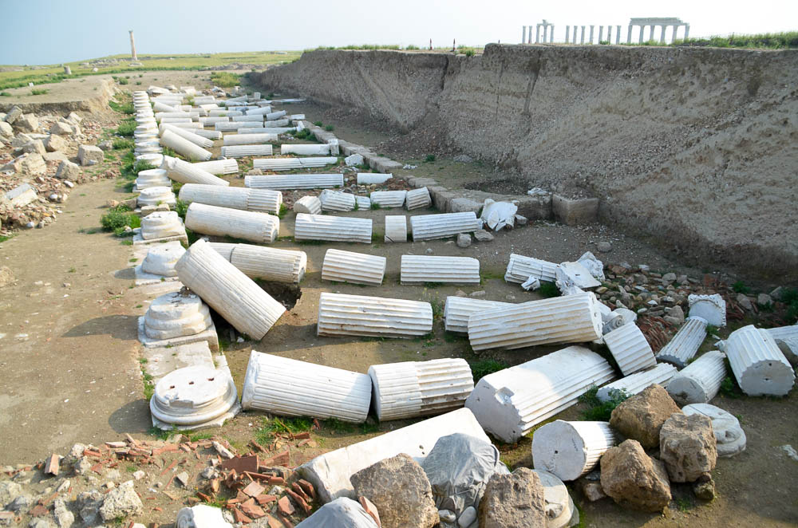
I want you to know how great a struggle I have for you, and for those at Laodicea
Recently excavated street at Laodicea
2:1
Notes:
Excavations at Laodicea are ongoing and have produced significant remains from the Roman period. This colonnaded street appears to have been destroyed by an earthquake, as all the columns lie at nearly the same angle.
shs031215709

Slide 28
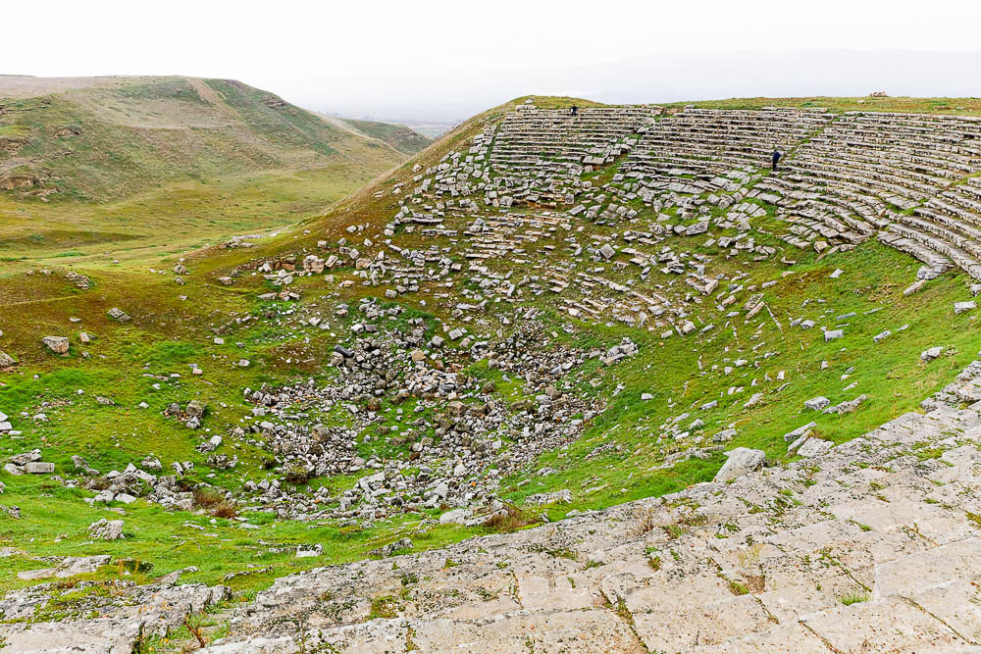
I want you to know how great a struggle I have for you, and for those at Laodicea
Small Roman theater at Laodicea
2:1
Notes:
The city of Laodicea was regarded as an extremely wealthy city in antiquity. Evidence of this may be seen in the remains of this theater, which is the smaller of two at Laodicea.
jc1231149755

Slide 29
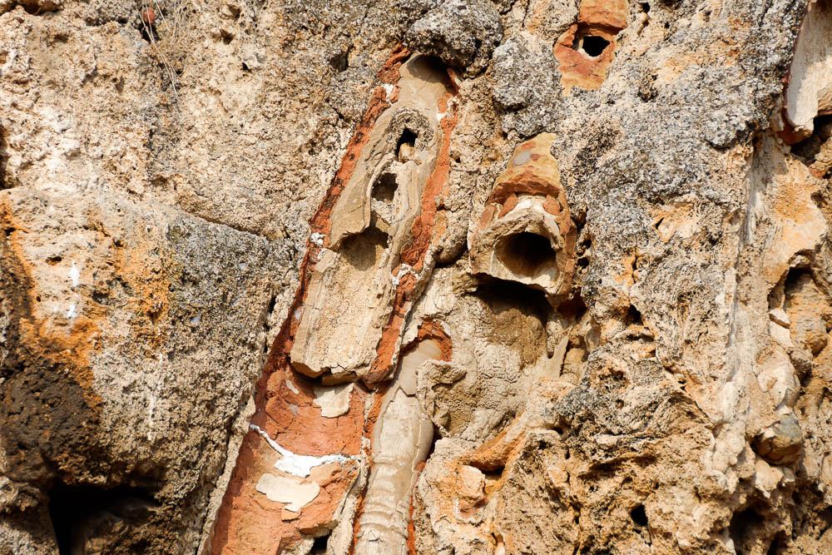
I want you to know how great a struggle I have for you, and for those at Laodicea
Laodicea south water distribution center with heavily mineralized pipes
2:1
Notes:
One of the water sources for Laodicea was the hot springs at Hierapolis, some 6 miles (10 km) to the north. This water was brought across the valley to Laodicea utilizing pipes and an aqueduct. The hot spring water was heavily mineralized, a nuisance that caused the pipes themselves to become blocked over time, as evidenced in this photo. Also, by the time the water arrived at Laodicea, it was tepid and unpalatable, something that Jesus alluded to when he described the church there as neither hot nor cold, but lukewarm (Rev 3:16).
tb010117421

Slide 30
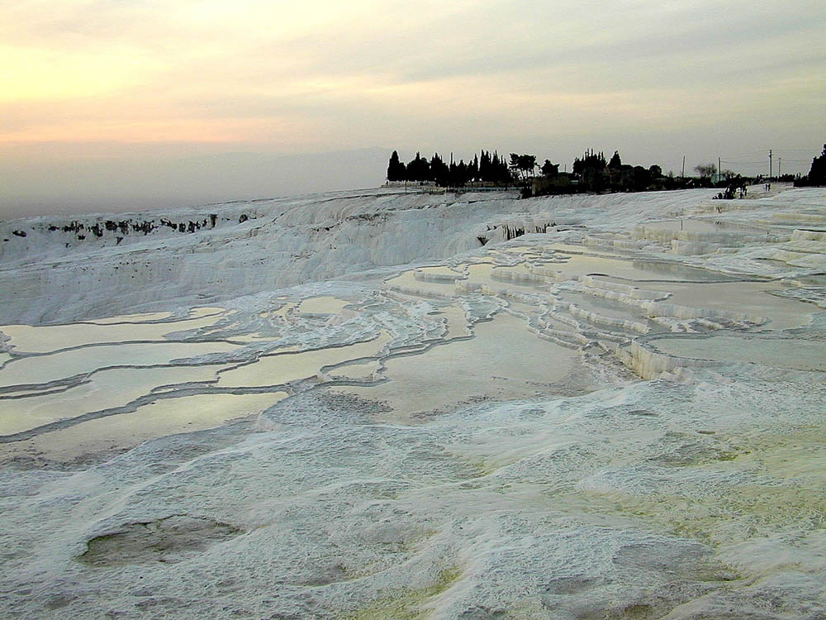
I bear him witness, that he has deep concern for . . . those who are in Laodicea and Hierapolis
Mineral springs and terraces of calcium deposits at Hierapolis
4:13
Notes:
A series of mineral springs on the southern edge of ancient Hierapolis were popular then and now for bathing. Because Hierapolis is not longer inhabited, these springs are known by the name of the nearby modern town, Pamukkale.
tb010301749

Slide 31
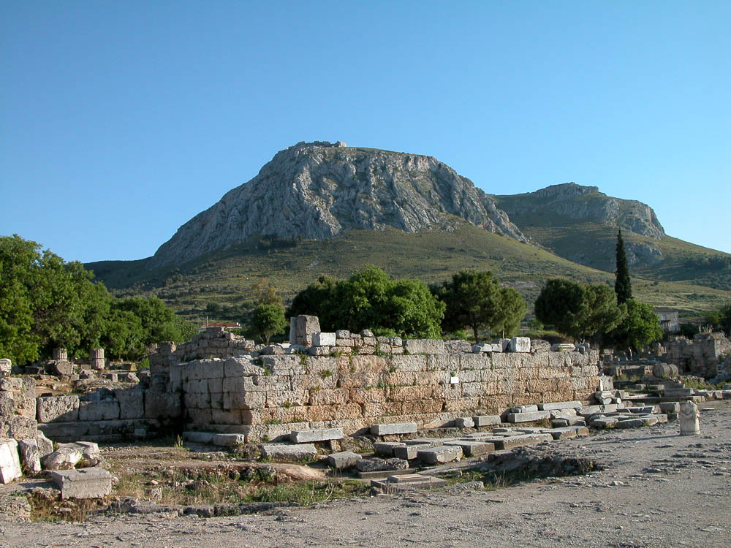
Now I rejoice in my sufferings for your sake
Bema (judgment seat) in Corinth
1:24
Notes:
Paul often suffered for the sake of the gospel. Paul was brought before the judgment seat at Corinth, charged with teaching that was contrary to Jewish custom. His friend Sosthenes was beaten before the proconsul, Gallio, who refused to intervene (Acts 18:12-17). The stone platform visible in this photo is what remains of the judgment seat (bema) at Corinth. The next slide includes a highlight of this structure.
tb050803070

Slide 32
Now I rejoice in my sufferings for your sake
Bema (judgment seat) in Corinth
1:24
Notes:
Paul often suffered for the sake of the gospel. Paul was brought before the judgment seat at Corinth, charged with teaching that was contrary to Jewish custom. His friend Sosthenes was beaten before the proconsul, Gallio, who refused to intervene (Acts 18:12-17). The stone platform visible in this photo is what remains of the judgment seat (bema) at Corinth.
tb050803070

Slide 33
COLOSSIANS
THEME
CHRIST IS ALL IN ALL
In His Deity— the image of the invisible God 1:5
In creation— Creator of the universe (1:15; John 1:1)
In pre-eminence— reconciling sinners by His blood (1:20:22)
In leadership— over principalities and powers (1:18 – 2:14)
In His church— the head of the body )1:18 – 2:19)
In His indwelling presence— the Christians hope (1:27)

Slide 34
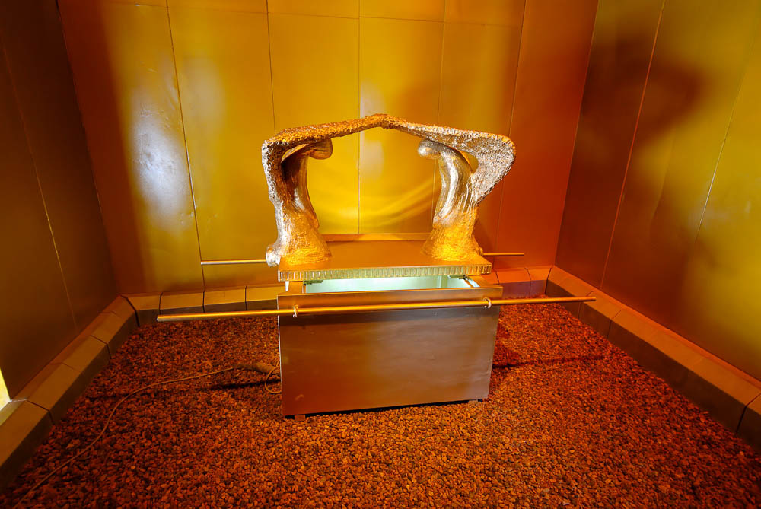
For in Him dwells all the fullness of the Godhead bodily
Ark of the covenant in a model of the tabernacle
2:9
Notes:
Paul’s language here recalls God’s dwelling among His people in the Holy of Holies of the Tabernacle, and later in the Temple. As Immanuel (“God with us”), Jesus perfected this idea as God incarnate who dwelt (lit. “tabernacled”) among us (John 1:14). The verb “to dwell” (Gk. katoikeō, κατοικέω) is used in the Septuagint to describe God dwelling in both earthly and heavenly temples (e.g., 2 Kgs 7:6; 11:11; 1 Chr 17:5; Isa 40:22). The life-sized model of the ark pictured here was photographed at Timna National Park in southern Israel.
tb052208369

Slide 35
COLOSSIANS
OUTLINE
CHAPTER 1
Christ is the Head
CHAPTER 2
Warnings Against False Teachers
CHAPTERS 3 & 4
New Life in Christ

Slide 36
Colossians 3:12-15 lists characteristics of righteousness that Christians must “put on” like holiness, kindness, humbleness, meekness, longsuffering, forbearance, forgiveness, love, and peace.
Isaiah prophesied concerning how the righteousness of God would be reflected through his people.—
“For Zion’s sake will I not hold my peace, and for Jerusalem’s sake I will not rest, until the righteousness thereof go forth as brightness, and the salvation thereof as a lamp that burns. And the Gentiles shall see thy righteousness, and all kings thy glory: and thou shalt be called by a new name, which the mouth of the LORD shall name” (Isaiah 62:1-2).

Slide 37
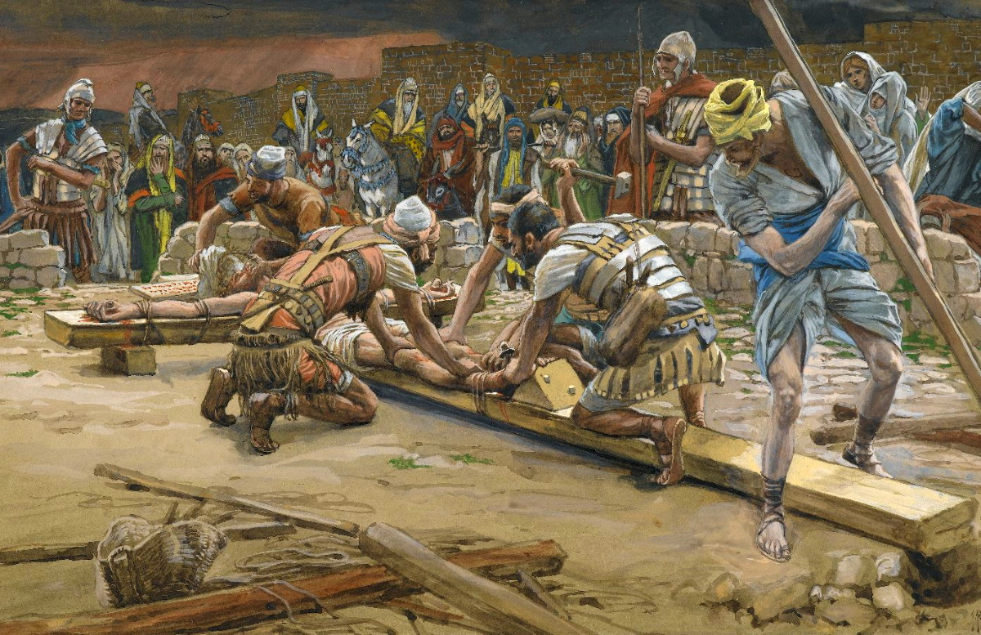
The record of debt . . . He has taken out of the way, nailing it to the cross
The Nail for the Feet, by James Tissot, circa 1890
2:14
Notes:
This image is in the public domain, via the Brooklyn Museum: https://www.brooklynmuseum.org/opencollection/objects/13505.
bmny13505

Slide 38
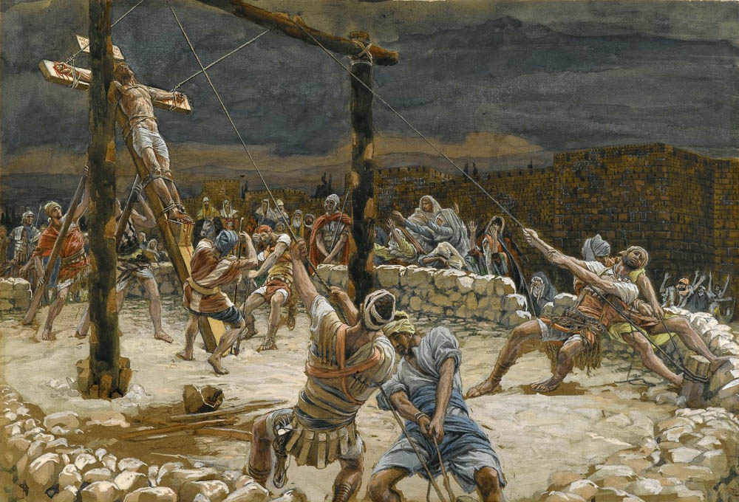
If you died with Christ to the elementary principles of the world
The Raising of the Cross, by James Tissot, circa 1890
2:20
Notes:
This painting by James Tissot was executed using opaque watercolor over graphite on gray wove paper. This image is in the public domain, via the Brooklyn Museum: https://www.brooklynmuseum.org/opencollection/objects/4587.
bmny001592944587

Slide 39
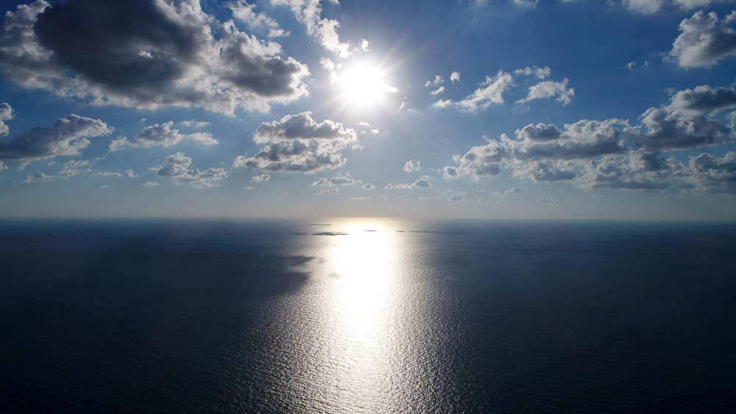
When Christ, who is our life, is revealed, then you also will be revealed with Him in glory
Sun breaking through the clouds over the Mediterranean Sea (aerial view from the east)
3:4
Notes:
ws101417131

Slide 40
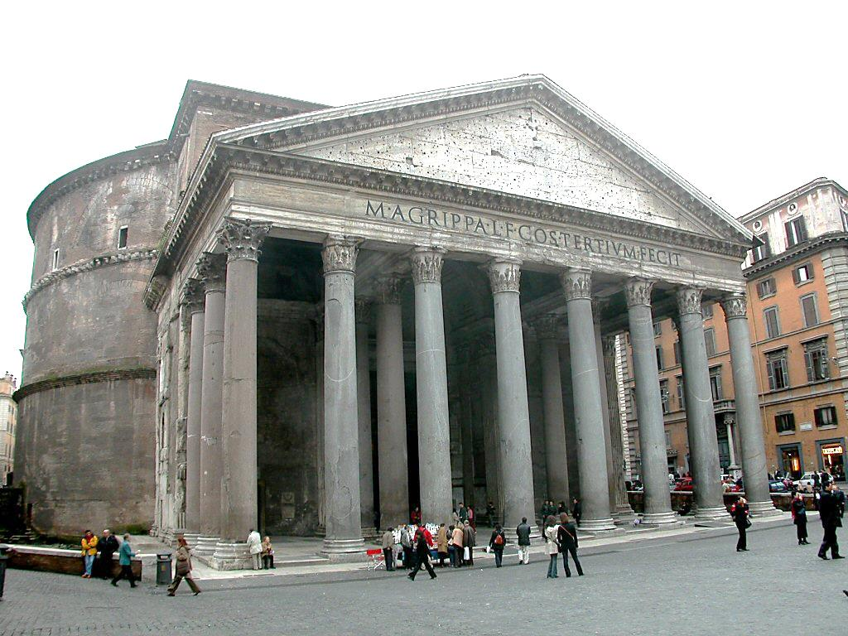
Covetousness, which is idolatry
Pantheon in Rome, circa 1st century AD
3:5
Notes:
One of the most significant centers of idolatry in Paul’s day was the Pantheon in Rome, the columned structure shown here. The name Pantheon means “of all the gods,” although many scholars are doubtful that the temple was actually dedicated to all the gods. The building was constructed by Marcus Agrippa during the reign of Augustus (27 BC – AD 14), so it would have been standing when Paul wrote this letter. It was rebuilt in some fashion by Hadrian in the 2nd century AD, but the original inscription referring to Agrippa was retained and is still visible above the columns. The building is unique in being round but having a rectangular porch. Although some portions of the building pre-date Paul, it is uncertain exactly what it looked like in his day.
tb111902413

Slide 41
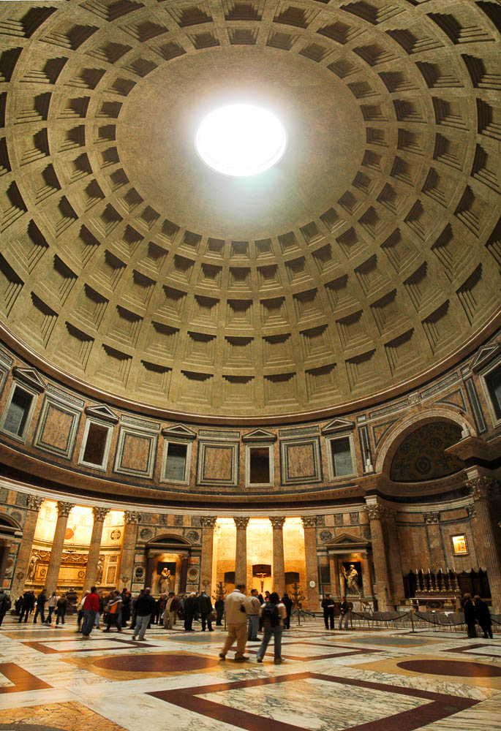
Covetousness, which is idolatry
Interior of the Pantheon in Rome, 1st century AD
3:5
Notes:
The five rows of 28 coffers (sunken decorative panels) in the dome of the Pantheon decrease in size as they near the top, thus providing the appearance of decreased mass (of the dome) and increased space and light. The dome itself is immense, more massive even than St Peter’s. At 142 feet (43 m) in both diameter and height from the floor, it was the largest dome in the world until 1958. In AD 609, the Pantheon was converted from a temple to a church (St. Mary of the Martyrs, by Boniface IV); this set a precedent for innumerable other Roman temples to be converted to churches. Despite later destruction and reconstruction, the Pantheon’s conversion to a church preserved it over the centuries. There are several alcoves in the wall surrounding the interior of the rotunda, each having two Corinthian columns. These small rooms once held cult statues but were later adapted as chapels and even tombs.
tb11210515p

Slide 42
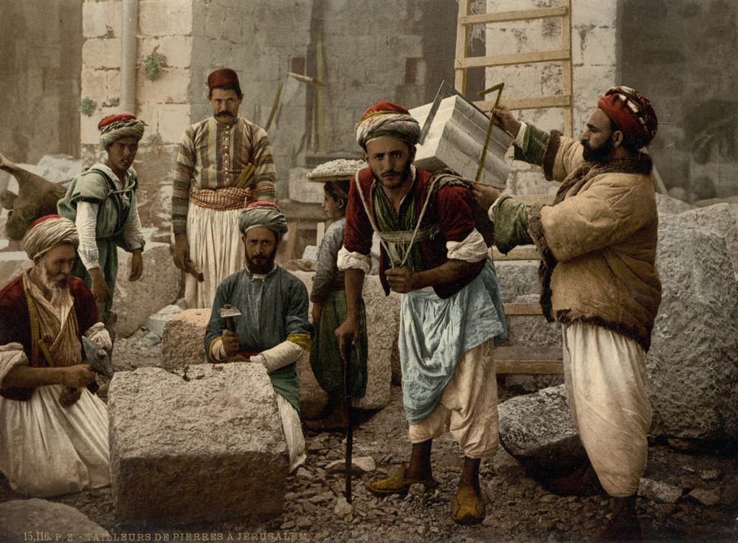
Whatever you do, work heartily, as for the Lord, and not for men
Stone cutters of Jerusalem
3:23
Notes:
This photochrom image was taken in the 1890s.
pcm02758

Slide 43
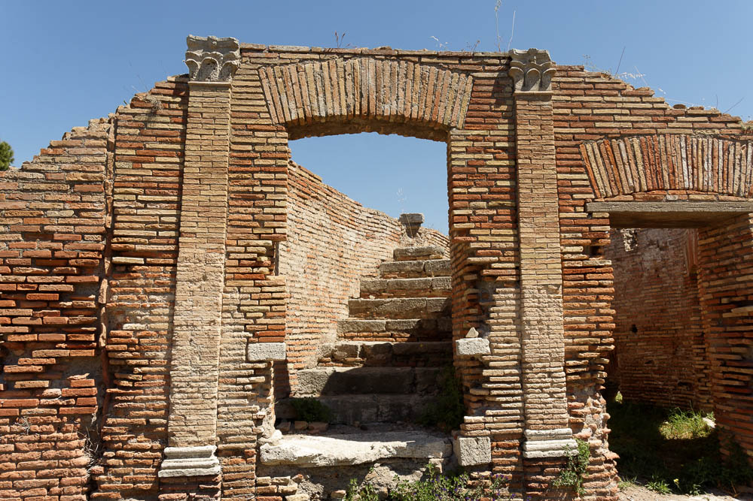
Praying for us also, that God may open to us a door for the word
Doorway and staircase along the Cardo Maximus in Ostia
4:3
Notes:
Ostia was the port city of Rome, where Paul was confined when he wrote this epistle.
tb0517172666

Slide 44
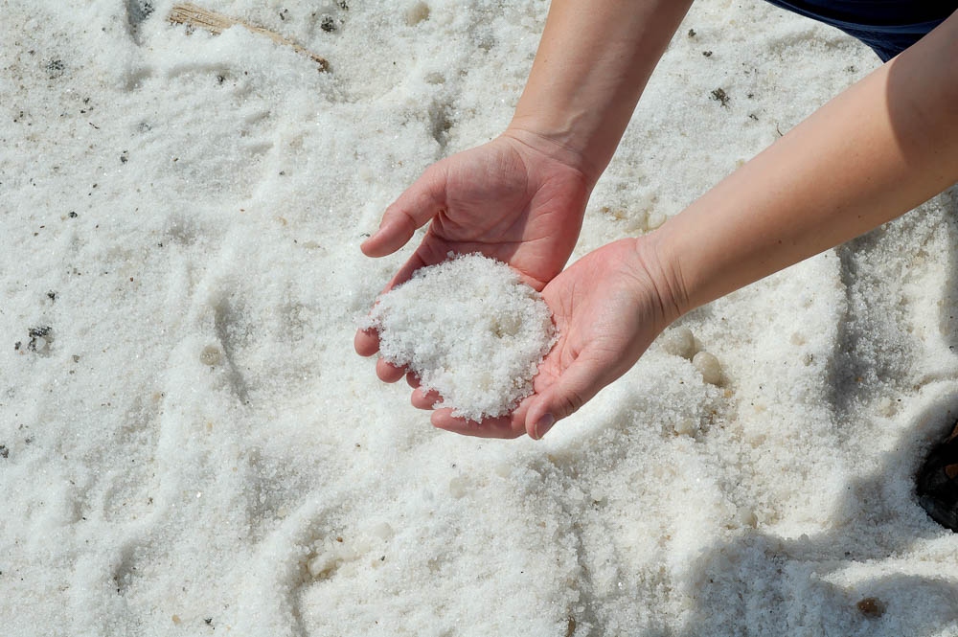
Let your speech always be with grace, seasoned with salt
Salt crystals along the Dead Sea
4:6
Notes:
Salt has always been prized for the taste it adds to various dishes (cf. Matt 5:13). Salt was procured from a variety of sources in Paul’s day. It was certainly available in large quantities from the Dead Sea, although many other sources were also available.
tb030206535

Slide 45
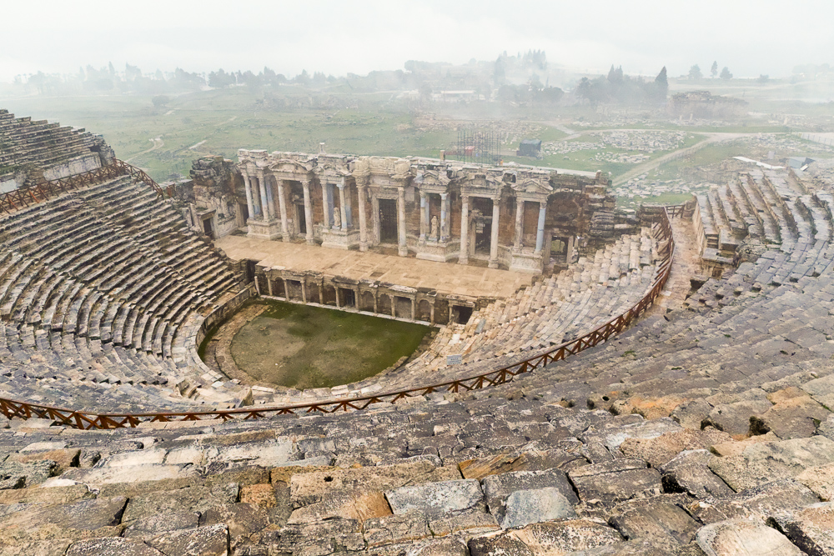
I bear him witness, that he has deep concern for . . . those who are in Laodicea and Hierapolis
Roman theater at Hierapolis
4:13
Notes:
Although much of Hierapolis remains unexcavated, the city does boast a very well-preserved Greco-Roman theater.
jc1231149825

Slide 46
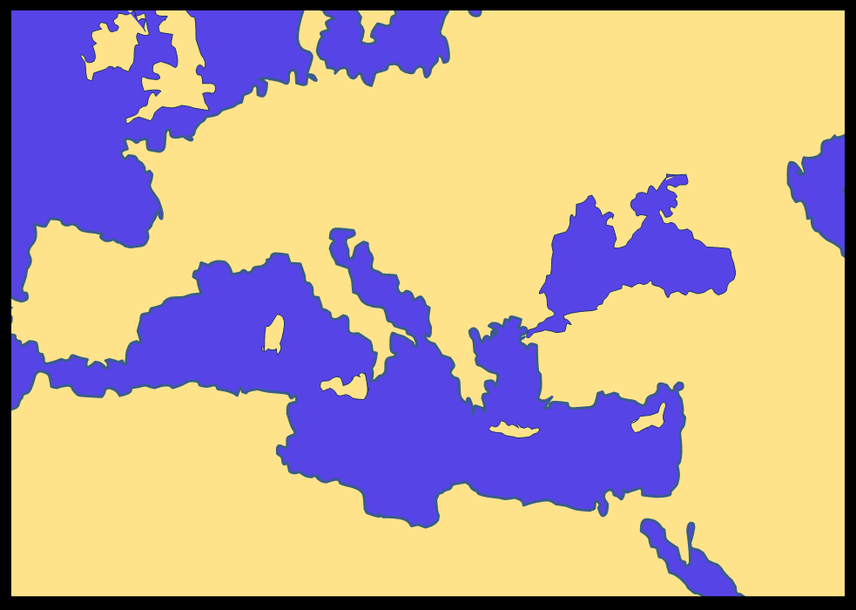
COLOSSIANS
Chapter 4
18 The salutation by the hand of me Paul. Remember my bonds. Grace be with you. Amen. Written from Rome to Colossians by Tychicus and Onesimus.
GERMANY
Rome
SPAIN
ITALY
Colosse
ASIA
GREECE
SYRIA
SAMARIA
JUDEA
AFRICA
EGYPT

Slide 47
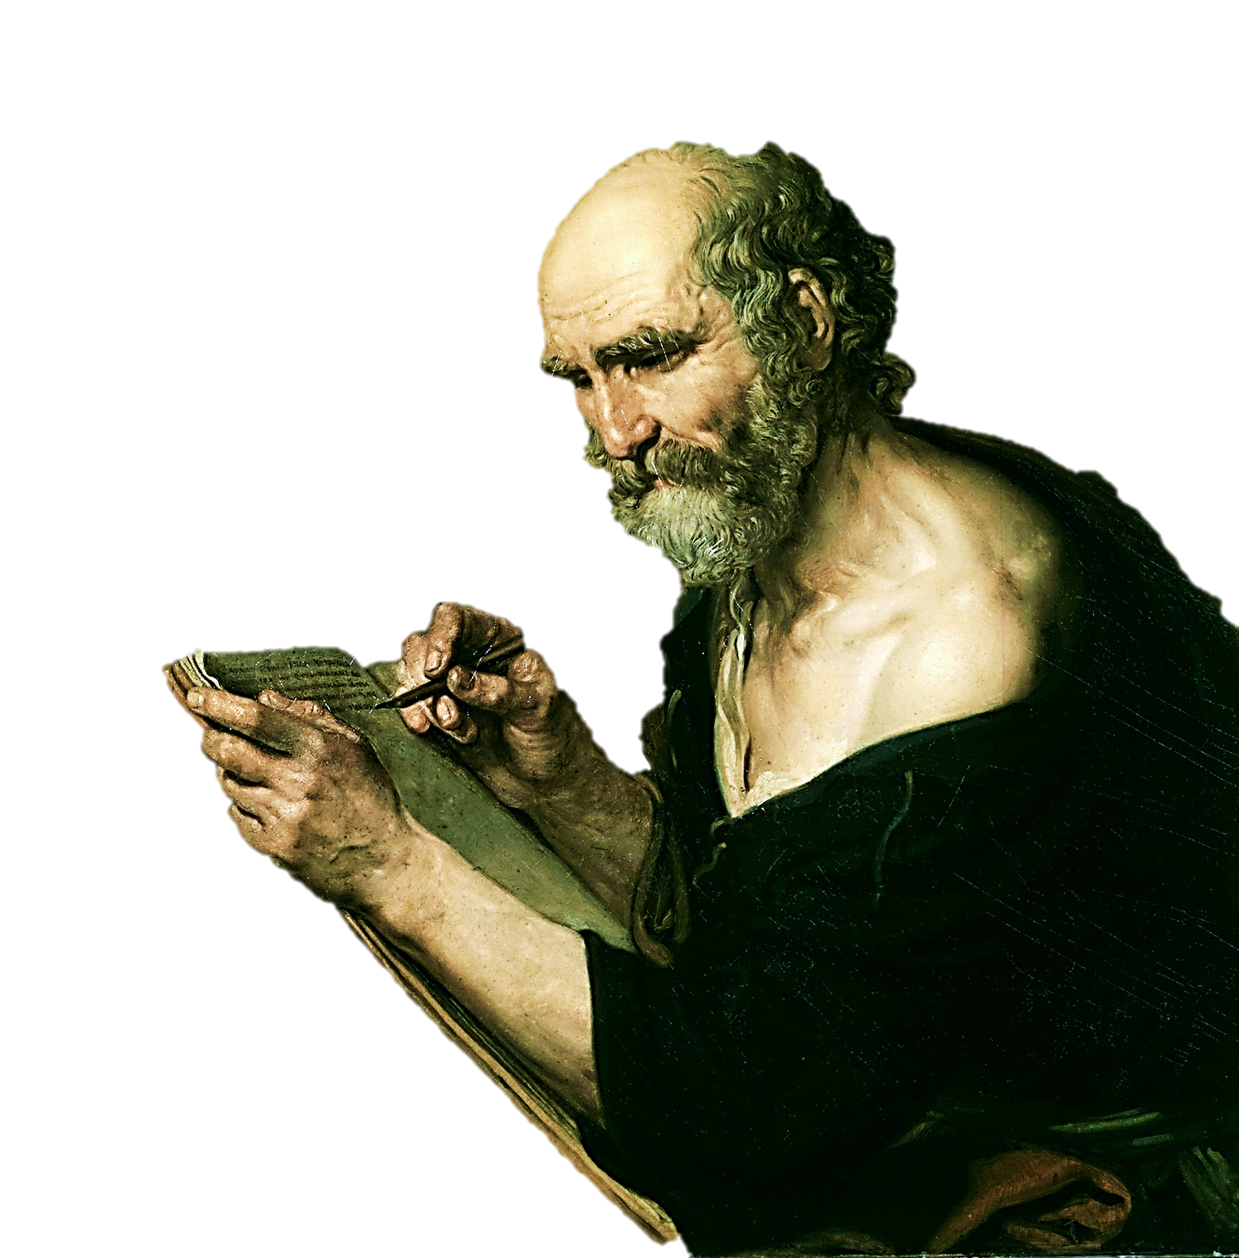
It was customary for Paul to have an amanuensis to write for him. He placed the signature himself and thereby conveyed a salutation written by his own hand.
This endorsement is followed by a request sad and abrupt- “Remember my bonds.”
Wikimedia / Over 100 yrs. Old USA / Public Domain

Slide 48
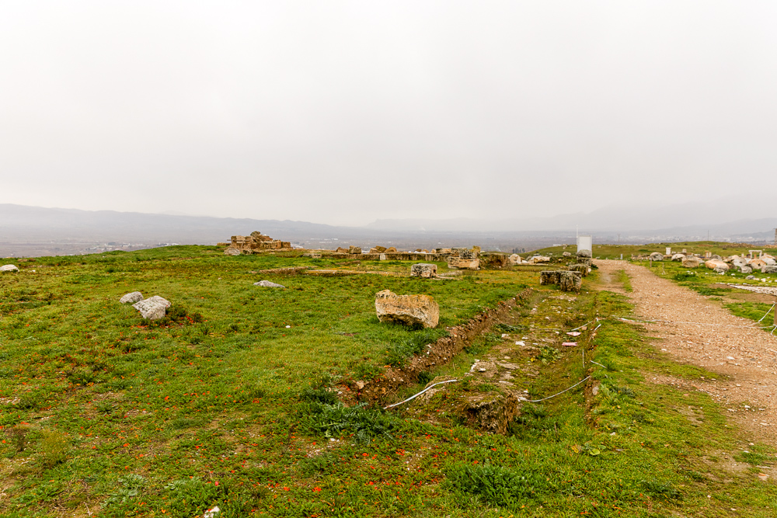
Greet the brothers who are in Laodicea
Col 4:15 Greet the brethren who are in Laodicea, and Nymphas and the church that is in his house. 16 Now when this epistle is read among you, see that it is read also in the church of the Laodiceans, and that you likewise read the epistle from Laodicea. 17 And say to Archippus, "Take heed to the ministry which you have received in the Lord, that you may fulfill it." 18 This salutation by my own hand--Paul. Remember my chains. Grace be with you. Amen.
Excavations at Laodicea with a view to Colossae
Notes:
This photo provides a view from Laodicea eastward along the Lycus River Valley toward Colossae. The distance between the two cities is about 9 miles (15 km), so the two cities would have been well acquainted with each other and likely were quite active in business and trade with each other.
jc1231149760

