Slide 1
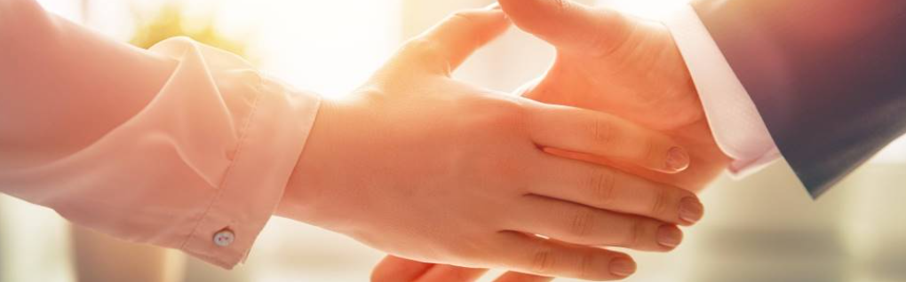
Welcome to our services
New Lebanon Church of Christ
We are Simply Christians.
Our Emphasis is Spiritual, Not Material or Social.
We are striving to be The Same Church as Described in The New Testament.
Please Come Back Again

Slide 2

God’s Timing.
The Lord Will Provide
And Abraham called the name of the place, The-LORD-Will-Provide; as it is said to this day, "In the Mount of The LORD it shall be provided.“ Genesis 22:14

Slide 3
God’s Timing. The Lord Will Provide
Abraham and Isaac
Joseph & caravan
Jonah & fish
God and us
God is never early.
God is never late.
God is always on time.

Slide 4
Questions?
Want to learn more about the Bible?
We will be glad to study the Bible with you.
New Lebanon
New Lebanon
Church of Christ
Church of Christ
New Lebanon, OH
newlebanoncoc.com
newlebanoncoc@gmail.com

