Slide 1
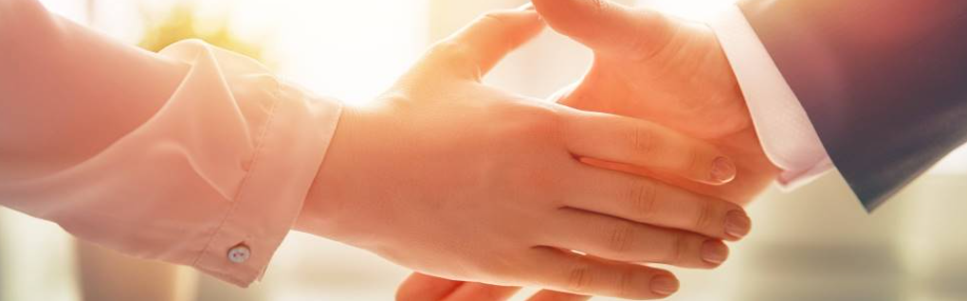
Welcome to our services
New Lebanon Church of Christ
We are Simply Christians.
Our Emphasis is Spiritual, Not Material or Social.
We are striving to be The Same Church as Described in The New Testament.
Please Come Back Again

Slide 2
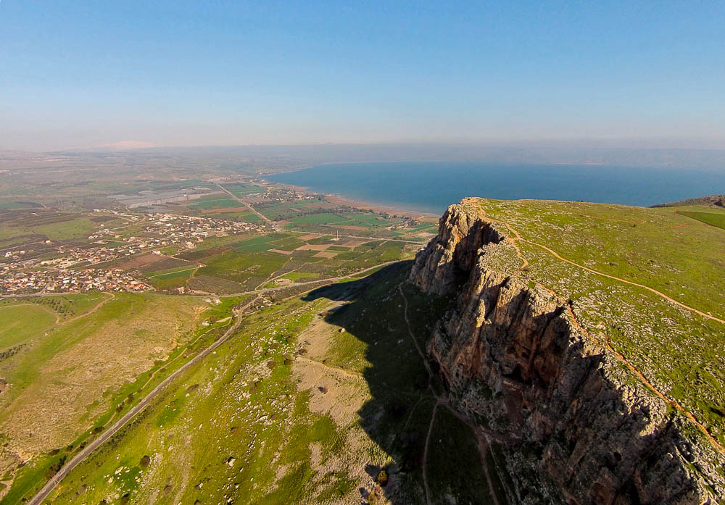
Go Into All The World
And Jesus came and spoke to them, saying, "All authority has been given to Me in heaven and on earth. "Go therefore and make disciples of all the nations, baptizing them in the name of the Father and of the Son and of the Holy Spirit, "teaching them to observe all things that I have commanded you; and lo, I am with you always, even to the end of the age." Amen.
Notes:
ws011315157

Slide 3


Slide 4
Go Into All The World
Matt. 28:18 And Jesus came and spoke to them, saying, "All authority has been given to Me in heaven and on earth.
It’s interesting that Matthew didn’t choose to conclude his Gospel by describing our Lord’s amazing ascension.
He doesn’t end with a promise of Christ’s return.
He says nothing about the coming of the Holy Spirit.
The last chapter of the first Gospel ends, abruptly and dramatically, with a command to take the news of Christ’s resurrection to the last place on earth until the last day of history.

Slide 5
Go Into All The World
In verses 6-7, the angel told the women at the tomb: “He is not here! For He has been resurrected, just as He said. Come and see.... Then go quickly and tell.”
In verse 10, Jesus Himself intercepted the women as they ran from the tomb. “Go and tell,” He commanded them.

Slide 6
Go Into All The World
Matt. 28:19 "Go therefore and make disciples of all the nations, baptizing them in the name of the Father and of the Son and of the Holy Spirit,
1. His power
2. His purpose
3. His place
4. His plan
5. His presence

Slide 7
Go Into All The World
Matt. 28:20 "teaching them to observe all things that I have commanded you; and lo, I am with you always, even to the end of the age." Amen.

Slide 8
Go Into All The World
We have the greatest work there is to do in this world and we have limited time to do it in.
The limits of time require us to make choices.
Who will we help?
Where will be go?
We can’t be everywhere at once.

Slide 9
Go Into All The World
Acts 1:8 "But you shall receive power when the Holy Spirit has come upon you; and you shall be witnesses to Me in Jerusalem, and in all Judea and Samaria, and to the end of the earth."

Slide 10
Go Into All The World
And Jesus came and spoke to them, saying, "All authority has been given to Me in heaven and on earth. "Go therefore and make disciples of all the nations, baptizing them in the name of the Father and of the Son and of the Holy Spirit, "teaching them to observe all things that I have commanded you; and lo, I am with you always, even to the end of the age." Amen.
Notes:
ws011315157

Slide 11
Questions?
Want to learn more about the Bible?
We will be glad to study the Bible with you.
New Lebanon
New Lebanon
Church of Christ
Church of Christ
New Lebanon, OH
newlebanoncoc.com
newlebanoncoc@gmail.com

Slide 12

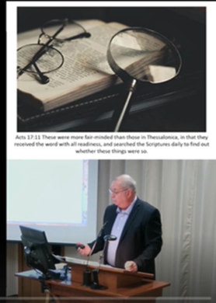


Nehemiah 2:18

