Slide 1
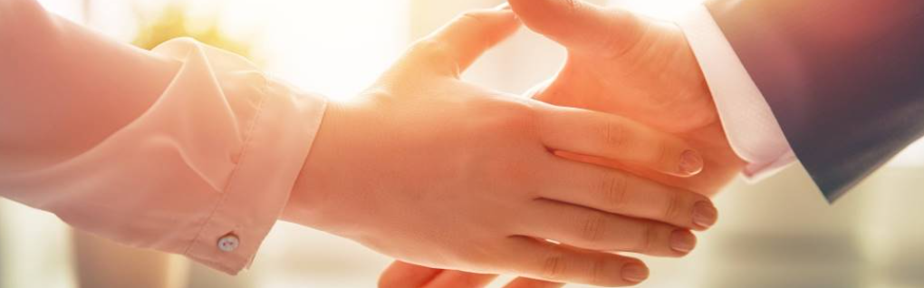
Welcome to our services
New Lebanon Church of Christ
We are Simply Christians.
Our Emphasis is Spiritual, Not Material or Social.
We are striving to be The Same Church as Described in The New Testament.
Please Come Back Again

Slide 2
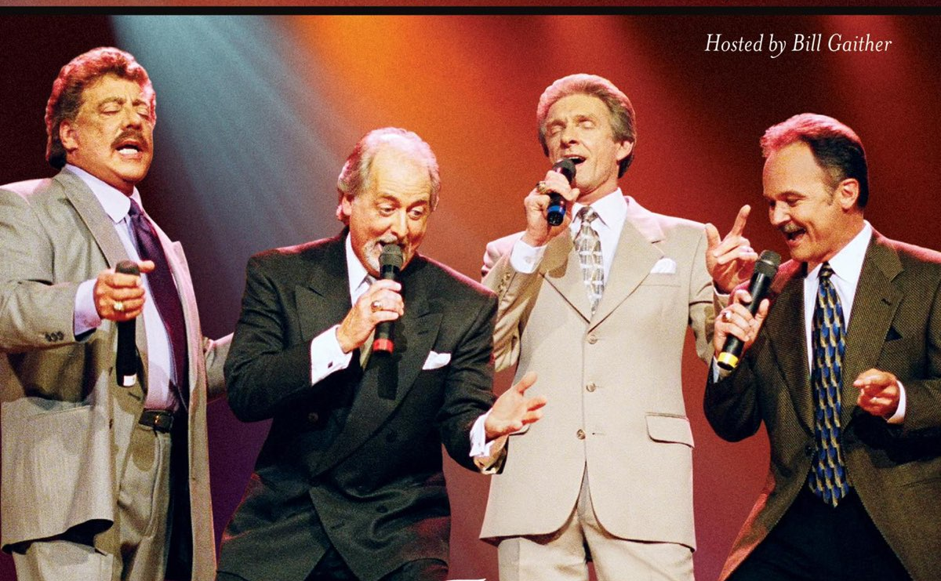
entertainmentnews.charmingflowers.com.vn

Slide 3
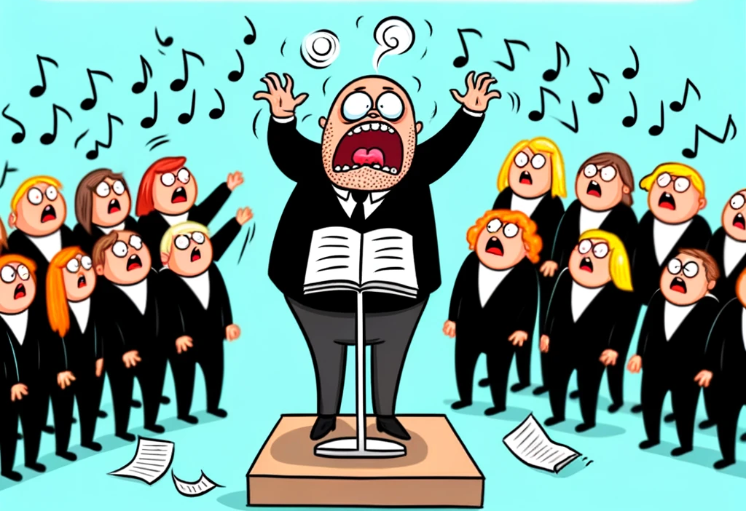
Harmony or Chaos
laughlore.com
How to we make our lives a
“pleasing sound” to the Lord?

Slide 4
In music, harmony is the concept of combining different sounds in order to create new, distinct musical ideas.
Theories of harmony seek to describe or explain the effects created by distinct pitches or tones coinciding with one another;
harmonic objects such as chords, textures and tonalities are identified, defined, and categorized in the development of these theories.

Slide 5
God’s Harmony – The Christan Graces
entertainmentnews.charmingflowers.com.vn

Slide 6
God’s Harmony – The Christan Graces
Virtue
Knowledge
Self-control
Patience
Godliness
Brotherly Kindness
Love

Slide 7
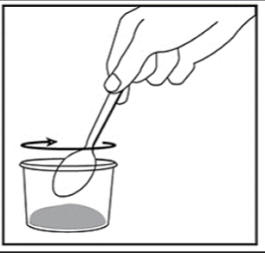
God’s Harmony – The Christan Graces
Virtue
Knowledge
Self-control
Patience
Godliness
Brotherly Kindness
Love
God’s recipe

Slide 8
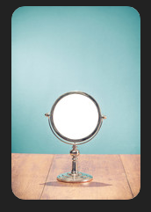
God’s Harmony – The Christan Graces
Virtue
Knowledge
Self-control
Patience
Godliness
Brotherly Kindness
Love

Slide 9
Harmony or Chaos
laughlore.com
How to we make our lives a
“pleasing sound” to the Lord?

Slide 10
Questions?
Want to learn more about the Bible?
We will be glad to study the Bible with you.
New Lebanon
New Lebanon
Church of Christ
Church of Christ
New Lebanon, OH
newlebanoncoc.com
newlebanoncoc@gmail.com

