Slide 1
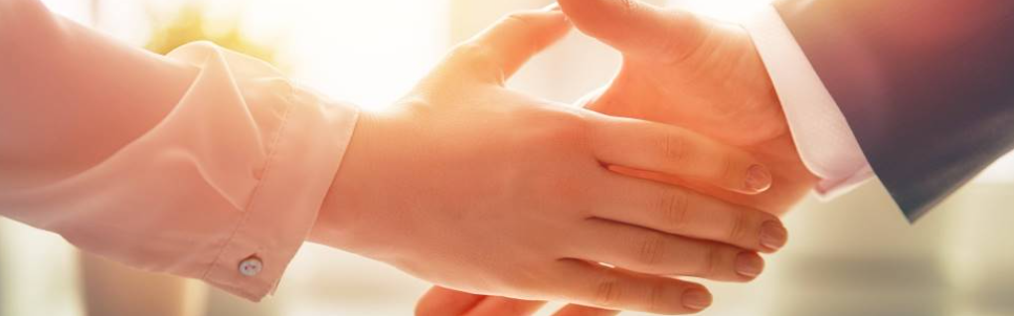
Welcome to our services
New Lebanon Church of Christ
We are Simply Christians.
Our Emphasis is Spiritual, Not Material or Social.
We are striving to be The Same Church as Described in The New Testament.
Please Come Back Again

Slide 2
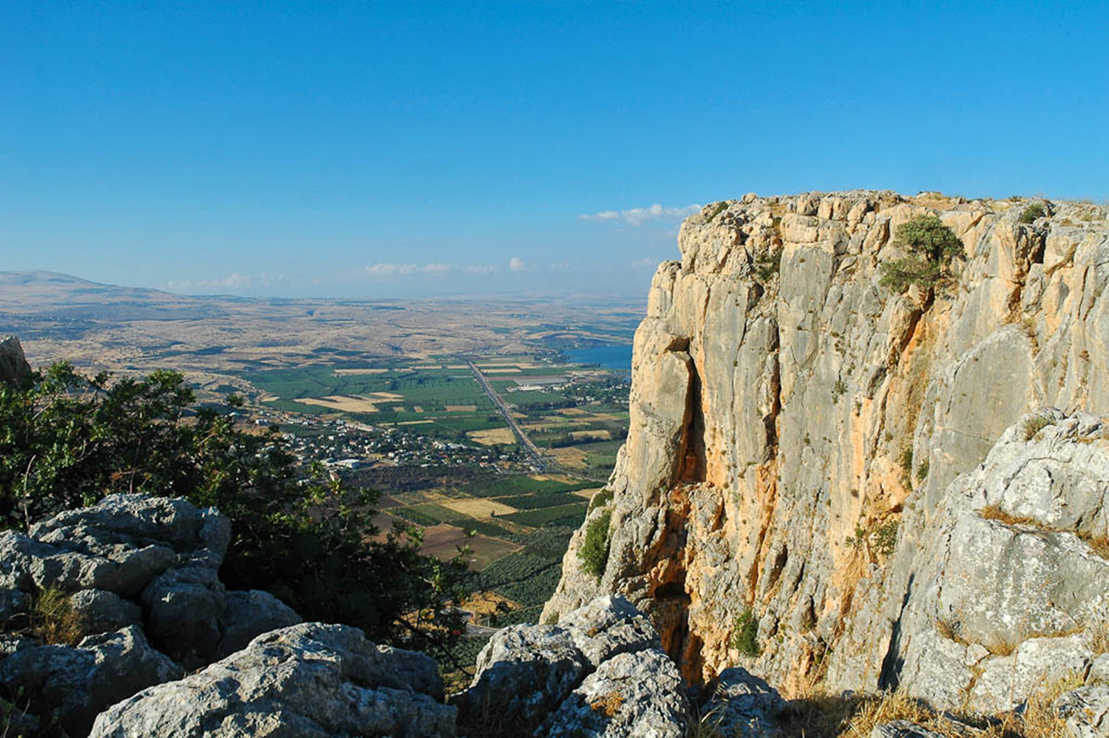
The Mighty God Whose Name Is Lord Of Hosts
'You show lovingkindness to thousands, and repay the iniquity of the fathers into the bosom of their children after them- the Great, the Mighty God, whose name is the LORD of hosts.’ Jeremiah 32:18

Slide 3
The Mighty God Whose Name Is Lord Of Hosts
Jeremiah 32:18 'You show lovingkindness to thousands, and repay the iniquity of the fathers into the bosom of their children after them-the Great, the Mighty God, whose name is the LORD of hosts.
newlebanoncoc.com

Slide 4
The Mighty God Whose Name Is Lord Of Hosts
I. What God is able to do for us:

Slide 5
The Mighty God Whose Name Is Lord Of Hosts
I. What God is able to do for us. He is—
1. Able to Save us
(Heb. 7:25). Therefore He is also able to save to the uttermost those who come to God through Him, since He always lives to make intercession for them.

Slide 6
The Mighty God Whose Name Is Lord Of Hosts
I. What God is able to do for us. He is—
2. Able to Deliver us
(Dan. 3:17). "If that is the case, our God whom we serve is able to deliver us from the burning fiery furnace, and He will deliver us from your hand, O king.

Slide 7
The Mighty God Whose Name Is Lord Of Hosts
I. What God is able to do for us. He is—
3. Able to Make us Stand
(Phil. 3:21). who will transform our lowly body that it may be conformed to His glorious body, according to the working by which He is able even to subdue all things to Himself.

Slide 8
The Mighty God Whose Name Is Lord Of Hosts
I. What God is able to do for us. He is—
4. Able to Keep us
(Jude 24). Now to Him who is able to keep you from stumbling, And to present you faultless Before the presence of His glory with exceeding joy,

Slide 9
The Mighty God Whose Name Is Lord Of Hosts
I. What God is able to do for us. He is—
5. Able to Satisfy us
(2 Cor. 9:8). And God is able to make all grace abound toward you, that you, always having all sufficiency in all things, may have an abundance for every good work.

Slide 10
The Mighty God Whose Name Is Lord Of Hosts
I. What God is able to do for us. He is—
6. Able to Raise us
(Heb. 11:19). concluding that God was able to raise him up, even from the dead, from which he also received him in a figurative sense.

Slide 11
The Mighty God Whose Name Is Lord Of Hosts
I. What God is able to do for us. He is—
7. Able to present us Faultless
(Jude 24). Now to Him who is able to keep you from stumbling, And to present you faultless Before the presence of His glory with exceeding joy,

Slide 12
The Mighty God Whose Name Is Lord Of Hosts
II. What God is able to do in us:

Slide 13
The Mighty God Whose Name Is Lord Of Hosts
II What God is able to do in us. He is—
1. Able to Dwell in us
(Eph. 3:17–20). that Christ may dwell in your hearts through faith; that you, being rooted and grounded in love, 18 may be able to comprehend with all the saints what is the width and length and depth and height-- 19 to know the love of Christ which passes knowledge; that you may be filled with all the fullness of God. 20 Now to Him who is able to do exceedingly abundantly above all that we ask or think, according to the power that works in us,

Slide 14
The Mighty God Whose Name Is Lord Of Hosts
II What God is able to do in us. He is—
2. Able to Subdue
(Phil. 3:21). who will transform our lowly body that it may be conformed to His glorious body, according to the working by which He is able even to subdue all things to Himself.

Slide 15
The Mighty God Whose Name Is Lord Of Hosts
II. What God is able to do in us. He is—
3. Able to aid us
(Heb. 2:18). For in that He Himself has suffered, being tempted, He is able to aid those who are tempted.

Slide 16
The Mighty God Whose Name Is Lord Of Hosts
II. What God is able to do in us. He is—
4. Able to Strengthen
(2 Tim. 4:17). But the Lord stood with me and strengthened me, so that the message might be preached fully through me, and that all the Gentiles might hear. And I was delivered out of the mouth of the lion.

Slide 17
The Mighty God Whose Name Is Lord Of Hosts
II. What God is able to do in us. He is—
5. Able to Build up
(Acts 20:32) So now, brethren, I commend you to God and to the word of His grace, which is able to build you up and give you an inheritance among all those who are sanctified..

Slide 18
The Mighty God Whose Name Is Lord Of Hosts
II. What God is able to do in us. He is—
6. Able to Fill
(Col. 1:9). For this reason we also, since the day we heard it, do not cease to pray for you, and to ask that you may be filled with the knowledge of His will in all wisdom and spiritual understanding;

Slide 19
The Mighty God Whose Name Is Lord Of Hosts
II. What God is able to do in us. He is—
7. Able to Work
(Heb. 13:21). make you complete in every good work to do His will, working in you what is well pleasing in His sight, through Jesus Christ, to whom be glory forever and ever. Amen.

Slide 20
The Mighty God Whose Name Is Lord Of Hosts
III. What God
is able to do through us:
newlebanoncoc.com

Slide 21
The Mighty God Whose Name Is Lord Of Hosts
III. What God is Able to Do Through Us.
He is—
1. Able to Reveal
(Gal. 1:16). to reveal His Son in me, that I might preach Him among the Gentiles, I did not immediately confer with flesh and blood,

Slide 22
The Mighty God Whose Name Is Lord Of Hosts
III. What God is Able to Do Through Us.
He is—
2. Able to Reconcile
(2 Cor. 5:18–20). Now all things are of God, who has reconciled us to Himself through Jesus Christ, and has given us the ministry of reconciliation,
19 that is, that God was in Christ reconciling the world to Himself, not imputing their trespasses to them, and has committed to us the word of reconciliation.
20 Now then, we are ambassadors for Christ, as though God were pleading through us: we implore you on Christ's behalf, be reconciled to God.

Slide 23
The Mighty God Whose Name Is Lord Of Hosts
III. What God is Able to Do Through Us.
He is—
3. Able to Overcome
(Eph. 6:11). Put on the whole armor of God, that you may be able to stand against the wiles of the devil.

Slide 24
The Mighty God Whose Name Is Lord Of Hosts
III. What God is Able to Do Through Us.
He is—
4. Able to Bear Fruit
(Col. 1:10). that you may walk worthy of the Lord, fully pleasing Him, being fruitful in every good work and increasing in the knowledge of God;

Slide 25
The Mighty God Whose Name Is Lord Of Hosts
III. What God is Able to Do Through Us.
He is—
5. Able to do His Own Pleasure
(Phil. 2:13). or it is God who works in
you both to will and to do for His good pleasure.

Slide 26
Questions?
Want to learn more about the Bible?
We will be glad to study the Bible with you.
New Lebanon
New Lebanon
Church of Christ
Church of Christ
New Lebanon, OH
newlebanoncoc.com
newlebanoncoc@gmail.com

