Slide 1
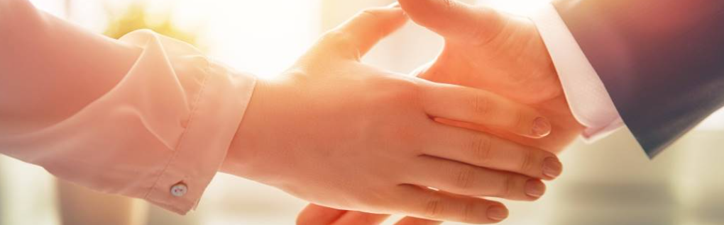
Welcome to our services
New Lebanon Church of Christ
We are Simply Christians.
Our Emphasis is Spiritual, Not Material or Social.
We are striving to be The Same Church as Described in The New Testament.
Please Come Back Again

Slide 2
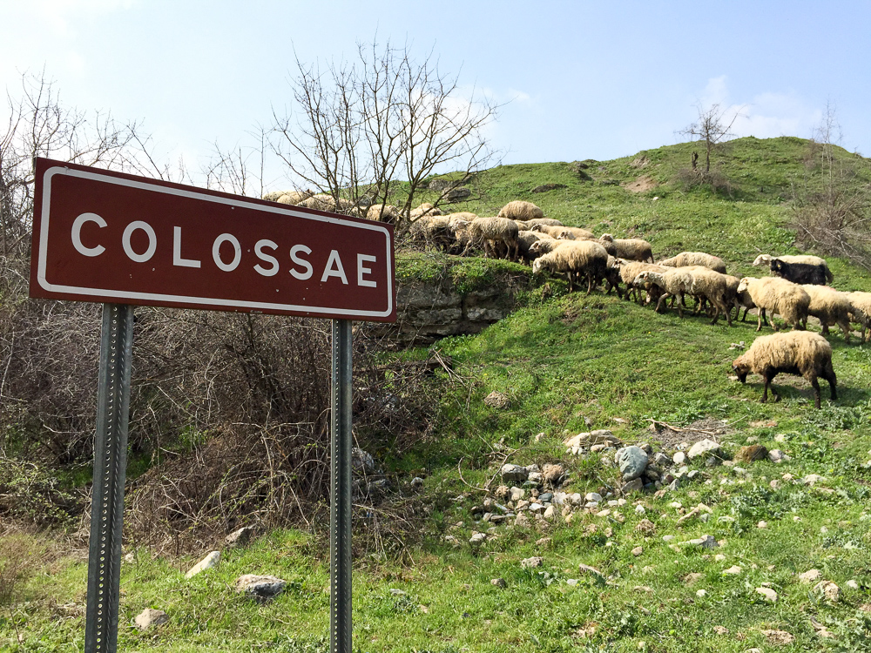
To the saints and faithful brothers in Christ who are at Colossae
Lesson One – He Is my Everything
He Is My Everything. He Is My All.
He Is My Everything, Both Great And Small.
He Gave His Life For Me, Made Everything New.
He Is My Everything. Now How About You?
Notes:
Colossae was probably severely damaged in the same earthquake that hit Laodicea and Hierapolis circa AD 61. This is about the time when Paul wrote this letter to the Colossians, and since the city was not quickly rebuilt, it is unlikely that a pseudonymous writer would have chosen Colossae as a destination for a letter “from Paul” at a later date. This history supports the traditional view that Colossians is a genuine Pauline epistle. In later history, Colossae continued to mint coins from AD 150 to 250, when many people of the city moved to nearby Chonae. Saracens filled the abandoned area in the seventh and eighth centuries. The Turks destroyed the church building in the 12th century.
shs031215355

Slide 3
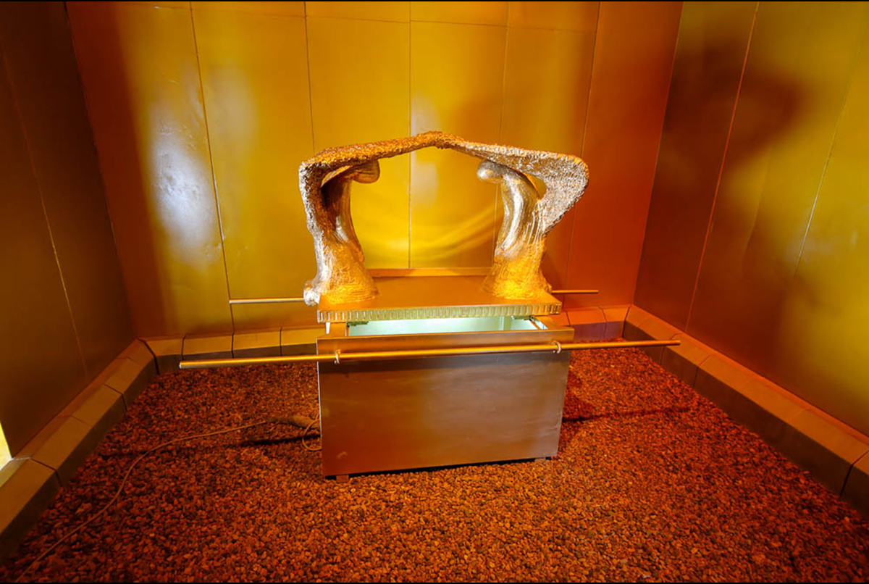
To the saints and faithful brothers in Christ who are at Colossae
Lesson Two – All The Fullness Of The Godhead
Col. 2:9-23
Paul’s language recalls God’s dwelling among His people in the Holy of Holies of the Tabernacle, and later in the Temple. As Immanuel (“God with us”), Jesus perfected this idea as God incarnate who dwelt (lit. “tabernacled”) among us. The verb “to dwell” is used to describe God dwelling in both earthly and heavenly temples. The model of the ark pictured here was photographed at Timna National Park in southern Israel.
Notes:
Colossae was probably severely damaged in the same earthquake that hit Laodicea and Hierapolis circa AD 61. This is about the time when Paul wrote this letter to the Colossians, and since the city was not quickly rebuilt, it is unlikely that a pseudonymous writer would have chosen Colossae as a destination for a letter “from Paul” at a later date. This history supports the traditional view that Colossians is a genuine Pauline epistle. In later history, Colossae continued to mint coins from AD 150 to 250, when many people of the city moved to nearby Chonae. Saracens filled the abandoned area in the seventh and eighth centuries. The Turks destroyed the church building in the 12th century.
shs031215355

Slide 4
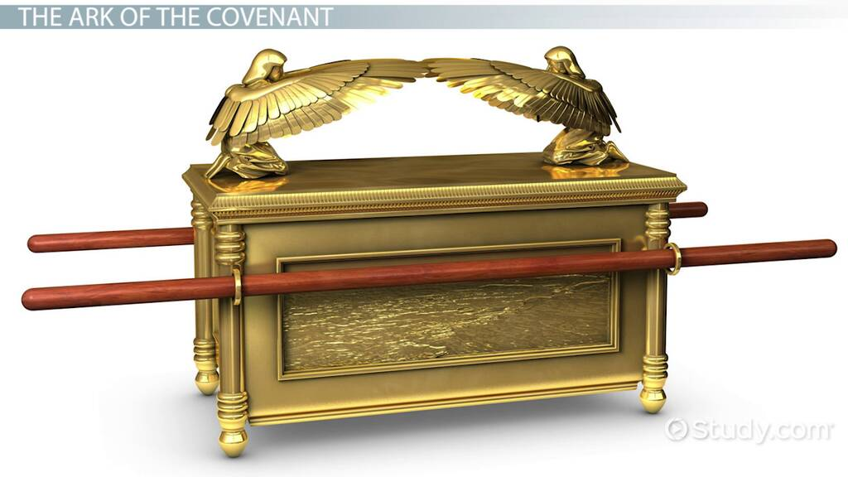
All The Fullness Of The Godhead Bodily
Col 2:9 For in Him dwells all the fullness of the Godhead bodily;
The word Godhead is used three times in the KJV (Acts 17:29; Rom.1:20; Col.2:9) and twice in the NKJV (Rom.1:20; Col.2:9).
Other versions use Deity, Divine, Divine Being, Nature or Divine Nature for Godhead in these verses.
Nearly all versions use Divine Nature in 2 Peter 1:4.
Godhead means three distinct Persons (Father, Son and Holy Spirit) in one distinct God. Each of the three Persons in the Godhead is called God.

Slide 5
All The Fullness Of The Godhead Bodily
v.10 and you are complete in Him, who is the head of all principality and power.
There is nothing lacking "in" Him (John 8:36; 4:14; Philp.4:19). "head of all principality and power" –
The preeminence of Christ (Matt.28:18; Col.1:15 27 18).
How important is it today for us to recognize that Christ is the head?
What problems will we avoid when we submit to His authority and rule?

Slide 6
All The Fullness Of The Godhead Bodily
v11 In Him you were also circumcised with the circumcision made without hands, by putting off the body of the sins of the flesh, by the circumcision of Christ,
In a spiritual sense, it refers to the separation of sins from our life by the obedience to the Gospel (Rom.6:1-6).

Slide 7
All The Fullness Of The Godhead Bodily
Col 2:12 buried with Him in baptism, in which you also were raised with Him through faith in the working of God, who raised Him from the dead.
13 And you, being dead in your trespasses and the uncircumcision of your flesh, He has made alive together with Him, having forgiven you all trespasses,
14 having wiped out the handwriting of requirements that was against us, which was contrary to us. And He has taken it out of the way, having nailed it to the cross.

Slide 8
All The Fullness Of The Godhead Bodily
Col 2:14
having wiped out - means to obliterate, erase and blot out. "handwriting of requirements" - This refers to the old law (Eph.2:15). The enforcement of the old law had been wiped out because it could not deal with man's limitations (Rom.7; Heb. 10:4).
Called "handwriting because God first wrote it with His own fingers on the stone (Ex. 31:18). The old law could point to sin, and warn against sin, but it could not provide the eternal solution for sin.
which was contrary to us- The old law clearly demonstrated the problem, but it did not contain the complete remedy (Gal. 3:19; 2 Cor. 3:6-11). "
nailed it to the cross - The sacrifice of Jesus put an end to the enforcement of the old law.
From the cross Jesus said, "It is finished“ (John 19:30; Heb. 10:10).

Slide 9
All The Fullness Of The Godhead Bodily
Col 2:15 Having disarmed principalities and powers, He made a public spectacle of them, triumphing over them in it.
(warning)
16 So let no one judge you in food or in drink, or regarding a festival or a new moon or sabbaths,
17 which are a shadow of things to come, but the substance is of Christ.

Slide 10
All The Fullness Of The Godhead Bodily
"sabbaths" - The Sabbath was not observed in the days of the Patriarchs. It was incorporated into the Mosaical system (Ex. 20:8-11). It is not a part of Christ's covenant (NT).
Notice 3 important points concerning the Sabbath:

Slide 11
All The Fullness Of The Godhead Bodily
1. The Sabbath did not apply to anyone prior to the giving of the Ten Commandments (Deut. 5:2-3). Nowhere in the Bible will you find even a hint that anyone observed the Sabbath from the time of Adam to the days of Moses.

Slide 12
All The Fullness Of The Godhead Bodily
2. The purpose of the Sabbath was a sign between God and the nation of Israel (Ex.31:16-17).
The Sabbath was FOR Israel.

Slide 13
All The Fullness Of The Godhead Bodily
3. The Sabbath was instituted to remind Israel how God delivered them from their Egyptian bondage (Deut. 5:15). This was a special observance between God and Israel. It has nothing to do with following the law of Christ today (1 Cor. 9:21).

Slide 14
All The Fullness Of The Godhead Bodily
Col 2:18 Let no one cheat you of your reward, taking delight in false humility and worship of angels, intruding into those things which he has not seen, vainly puffed up by his fleshly mind,
19 and not holding fast to the Head, from whom all the body, nourished and knit together by joints and ligaments, grows with the increase that is from God.
20 Therefore, if you died with Christ from the basic principles of the world, why, as though living in the world, do you subject yourselves to regulations--

Slide 15
All The Fullness Of The Godhead Bodily
Col 2:21 "Do not touch, do not taste, do not handle,"
22 which all concern things which perish with the using--according to the commandments and doctrines of men?
23 These things indeed have an appearance of wisdom in self-imposed religion, false humility, and neglect of the body, but are of no value against the indulgence of the flesh.

Slide 16
Questions?
Want to learn more about the Bible?
We will be glad to study the Bible with you.
New Lebanon
New Lebanon
Church of Christ
Church of Christ
New Lebanon, OH
newlebanoncoc.com
newlebanoncoc@gmail.com

