Slide 1
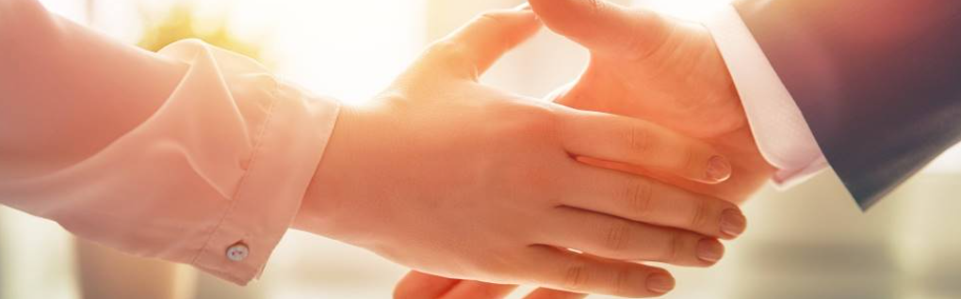
Welcome to our services
New Lebanon Church of Christ
We are Simply Christians.
Our Emphasis is Spiritual, Not Material or Social.
We are striving to be The Same Church as Described in The New Testament.
Please Come Back Again

Slide 2
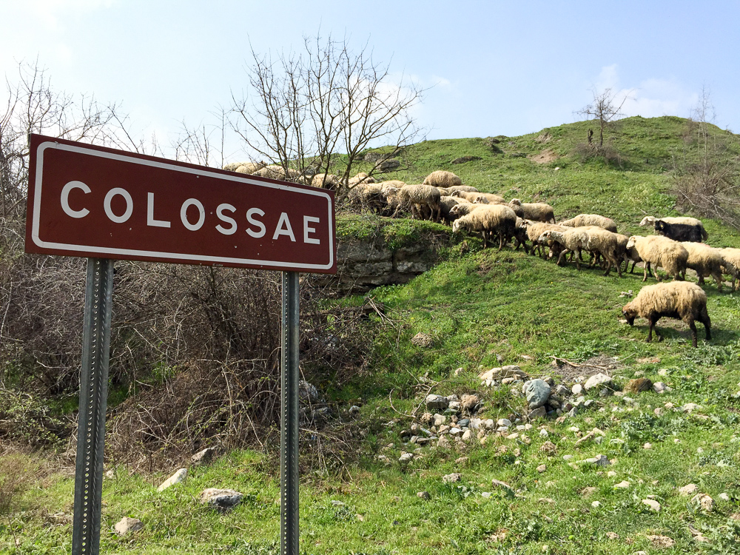
To the saints and faithful brothers in Christ who are at Colossae
Lesson One – He Is my Everything
Notes:
Colossae was probably severely damaged in the same earthquake that hit Laodicea and Hierapolis circa AD 61. This is about the time when Paul wrote this letter to the Colossians, and since the city was not quickly rebuilt, it is unlikely that a pseudonymous writer would have chosen Colossae as a destination for a letter “from Paul” at a later date. This history supports the traditional view that Colossians is a genuine Pauline epistle. In later history, Colossae continued to mint coins from AD 150 to 250, when many people of the city moved to nearby Chonae. Saracens filled the abandoned area in the seventh and eighth centuries. The Turks destroyed the church building in the 12th century.
shs031215355

Slide 3
To the saints and faithful brothers in Christ who are at Colossae
Lesson One – He Is my Everything
He Is My Everything. He Is My All.
He Is My Everything, Both Great And Small.
He Gave His Life For Me, Made Everything New.
He Is My Everything. Now How About You?
Notes:
Colossae was probably severely damaged in the same earthquake that hit Laodicea and Hierapolis circa AD 61. This is about the time when Paul wrote this letter to the Colossians, and since the city was not quickly rebuilt, it is unlikely that a pseudonymous writer would have chosen Colossae as a destination for a letter “from Paul” at a later date. This history supports the traditional view that Colossians is a genuine Pauline epistle. In later history, Colossae continued to mint coins from AD 150 to 250, when many people of the city moved to nearby Chonae. Saracens filled the abandoned area in the seventh and eighth centuries. The Turks destroyed the church building in the 12th century.
shs031215355

Slide 4
Christ In Colossians – Our All-In-All
The preeminence of Christ.
Little word all is used approximately 30 times.
above all, be for all, head of all.
Col.1:18 And He is the head of the body, the church, who is the beginning, the firstborn from the dead, that in all things He may have the preeminence.
newlebanoncoc.com

Slide 5
Christ In Colossians – Our All-In-All Col.3:11
Christ is our Lord. Col.1:2-3
To the saints and faithful brethren in Christ who are in Colosse: Grace to you and peace from God our Father and the Lord Jesus Christ.
3 We give thanks to the God and Father of our Lord Jesus Christ, praying always for you,
newlebanoncoc.com

Slide 6
Christ In Colossians – Our All-In-All
Christ is the son of God. Col.1:3
We give thanks to the God and Father of our Lord Jesus Christ, praying always for you,
newlebanoncoc.com

Slide 7
Christ In Colossians – Our All-In-All Col.3:11
"we give thanks" - Paul was thankful for these faithful brethren. Christians should always rejoice in the faithfulness of their brothers and sisters. Faithfulness has a powerful influence on others (Matthew 5:16). We must be willing to live in such a way that those around us are only influenced for good
"to the God and Father of our Lord Jesus Christ" - Christians are to be people of prayer (Matt.21:13; Isaiah 56:7) and the Bible teaches us that our prayers should be addressed to the Father through Jesus Christ. When the disciples asked Jesus to teach them to pray He said, "When you pray, say: Our Father in heaven" (Luke 11:1-2).
Our prayers are through Christ (John 14:13-14). Christians are blessed to have direct access to the Father by Jesus Christ (Heb.10:19;
John 16:20-23).
newlebanoncoc.com

Slide 8
Christ In Colossians – Our All-In-All
Christ is our king. Col. 1:13
He has delivered us from the power of darkness and conveyed us into the kingdom of the Son of His love,
newlebanoncoc.com

Slide 9
Christ In Colossians – Our All-In-All Col.3:11
"delivered us" - Christians have been rescued (Rom.3:24; Eph.6:12). God's word often speaks of redemption. Jesus paid the ransom price for our release from the captivity to sin and its consequences (Matt.20:28).
He was willing to give His life in exchange for ours. The Bible is clear that redemption is only possible through His blood (Col.1:14),
that is, by His death (1 Cor.6:20, 1 Peter 1:18-19)
newlebanoncoc.com

Slide 10
Christ In Colossians – Our All-In-All Col.3:11
"conveyed us into the kingdom" –
We see from this verse that the kingdom (church) had already been established (Mark 9:1; Acts 1:6-8; 2:38, 41 and 47).
These Colossians had been "conveyed" (transferred) into the kingdom.
This would not be possible if the kingdom did not already exist.
newlebanoncoc.com

Slide 11
Christ In Colossians – Our All-In-All
Christ is our Redeemer. Col.1:14
Col 1:14 in whom we have redemption through His blood, the forgiveness of sins.
newlebanoncoc.com

Slide 12
Christ In Colossians – Our All-In-All Col.3:11
"in whom we have redemption" - The word "redemption" is defined as a release which takes place because a ransom is paid.
Redemption is only found in Christ Jesus (Rom. 8:1; 2Tim. 2:10).
We find three points of redemption in the scriptures:
Something which was once possessed is lost (Matt.18:3)
A ransom (price) must be paid to purchase it back (1 Peter 1:18-19)
The captivity (power) is broken (Mark 3:27)
"through His blood" - (Heb. 9:22; Lev.17:11)
newlebanoncoc.com

Slide 13
Christ In Colossians – Our All-In-All Col.3:11
"through His blood" - (Heb.9:22; Lev.17:11) "the forgiveness of sins“
- Sin separates us from our God (Isaiah 59:1-2). We needed someone to solve our sin problem (Jeremiah 3:25; Romans 3:10, 23)
We are blessed to have a God who delights in mercy and is willing to forgive us (Micah 7:18-19; Isaiah 1:18 20).
newlebanoncoc.com

Slide 14
Christ In Colossians – Our All-In-All
Christ is the image
of the invisible God. Col. 1:15
He is the image of the invisible God, the firstborn over all creation.
newlebanoncoc.com

Slide 15
Christ In Colossians – Our All-In-All Col.3:11
"image of the invisible God" - In Jesus we see God (John 14:8-11; 1:1, 14 and 18)
"firstborn over all creation" - This is NOT saying that Jesus is the first created being.
The Bible clearly teaches that Jesus is God (John 1:1-3). In this passage, as well as Colossians 1:16, the Bible states that everything which was made was made through Jesus (Heb. 1:1-2).
newlebanoncoc.com

Slide 16
Christ In Colossians – Our All-In-All Col.3:11
"image of the invisible God" –
Even Jesus made it clear that He is eternal when He said, "Most assuredly, I say to you, before Abraham was, I AM." (John 8:58).
In Revelation Jesus explains, "I am the Alpha and the Omega, the Beginning and the End," says the Lord, "who is and who was and who is to come, the Almighty" (Rev.1:8).
This is the same phrase attributed to God, the Father, in Rev. 4:8 and 21:6.
newlebanoncoc.com

Slide 17
Christ In Colossians – Our All-In-All
Christ is the first born of every creature. Col. 1:15
He is the image of the invisible God, the firstborn over all creation.
newlebanoncoc.com

Slide 18
Christ In Colossians – Our All-In-All Col.3:11
The word "firstborn" is emphasizing the position of Jesus. He is above everything and in all things He has preeminence.
The emphasis is on His position, not the order of His birth. In many cultures we see the firstborn (oldest son) having special honors and privileges.
newlebanoncoc.com

Slide 19
Christ In Colossians – Our All-In-All
Christ is the agent of creation. Col. 1:16
For by Him all things were created that are in heaven and that are on earth, visible and invisible, whether thrones or dominions or principalities or powers. All things were created through Him and for Him.
newlebanoncoc.com

Slide 20
Christ In Colossians – Our All-In-All Col.3:11
"For by Him all things were created" - (Isaiah 44:24; John 1:3; Heb.1:2) "All things were created through Him and for Him"
All things were made for Him. We were created to serve and glorify Him with our bodies and souls (John 12:26; 1 Cor.6:20; 1 Cor. 10:31).
Many people today are serving the creation not the creator (Matt.6:24).
newlebanoncoc.com

Slide 21
Christ In Colossians – Our All-In-All
Christ is eternal. Col. 1:17
And He is before all things, and in Him all things consist.
newlebanoncoc.com

Slide 22
Christ In Colossians – Our All-In-All Col.3:11
"And He is before all things" - (John 1:1, 14) "in Him all things consist"
Christ upholds all things by the word of His power (Heb.1:3).
It is in Him we live and move and have our being (Acts 17:28).
newlebanoncoc.com

Slide 23
Christ In Colossians – Our All-In-All
Christ is head of the church.
Col. 1:18
And He is the head of the body, the church, who is the beginning, the firstborn from the dead, that in all things He may have the preeminence.
newlebanoncoc.com

Slide 24
Christ In Colossians – Our All-In-All Col.3:11
"He is the head of the body, the church"
(Eph. 1:21-23 Paul gives a detailed discussion of the dominion of Christ (Matt.28:18).
Notice that the word "body" is simply another way to describe the "church.“
The Bible teaches there is only one church (1 Cor. 12:20; Eph.4:4; Matt.16:15-19). Christ is the one head of the one body.
It would be a monstrosity to have a head with many bodies, or a body with many heads. (denominations)
newlebanoncoc.com

Slide 25
Christ In Colossians – Our All-In-All
Christ is the first born from the dead. Col.1:18
And He is the head of the body, the church, who is the beginning, the firstborn from the dead, that in all things He may have the preeminence.
newlebanoncoc.com

Slide 26
Christ In Colossians – Our All-In-All Col.3:11
"the firstborn from the dead“
Jesus was the first who was raised from the dead to never die again (Rom.1:4; 1 Peter 1:3-4; 1 Cor.15:1-4, 20).
Others have been raised, but they faced death again.
newlebanoncoc.com

Slide 27
Christ In Colossians – Our All-In-All
Christ is the one in whom all fulness dwells. Col. 1:19,2:9
1:19 For it pleased the Father that in Him all the fullness should dwell,
2:9 For in Him dwells all the fullness of the Godhead bodily;
newlebanoncoc.com

Slide 28
Christ In Colossians – Our All-In-All Col.3:11
"in Him all the fullness should dwell"
- (Col.2:9; John 1:1, 14; Matt.28:18-20; Phil.2:9-11).
Jesus shares fully in the divine nature.
newlebanoncoc.com

Slide 29
Christ In Colossians – Our All-In-All
Christ is our Reconciler. Col. 1:20-23
Col 1:20 and by Him to reconcile all things to Himself, by Him, whether things on earth or things in heaven, having made peace through the blood of His cross.
21 And you, who once were alienated and enemies in your mind by wicked works, yet now He has reconciled
22 in the body of His flesh through death, to present you holy, and blameless, and above reproach in His sight--
23 if indeed you continue in the faith, grounded and steadfast, and are not moved away from the hope of the gospel which you heard, which was preached to every creature under heaven, of which I, Paul, became a minister.
newlebanoncoc.com

Slide 30
Christ In Colossians – Our All-In-All Col.3:11
"reconcile" - (Matt.5:23-24; 2 Cor.5:17-21)
To reconcile the two would bring harmony between the things in heaven and earth (Eph.1:10). "having made peace through the blood of His cross"
It is sin that separates us from our heavenly Father (Isaiah 59:1-2) and it is only through the blood of the perfect sacrifice of Jesus that we can have peace with our God (Eph.1:7; 2:13; Col.1:14).It is the blood of the Savior that provided a remedy for the problem of sin.
The sacrifice of His blood took place at the cross (1 Cor.2:2). Therefore, those who were once enemies of God can now be at peace with the Father.
newlebanoncoc.com

Slide 31
Christ In Colossians – Our All-In-All Col.3:11
"once were alienated" - In the past, their wicked works had separated them from God (Eph. 2:1-3, 4:17-19; Rom. 6:17-18).
They had been shut out from fellowship with God (Rom. 11:22). "enemies in your mind by wicked works"
Notice in this verse the destructive nature of those "wicked works" which change the way we think. Those things we think in our minds will eventually be seen in our actions.
Prov. 23:7 says, "For as he thinks in his heart, so is he." "He has reconciled" - They had been reconciled to God by the sacrifice of Jesus Christ (verse 22). Christians are reconciled so they may teach others who can be reconciled as well (2 Cor. 5:18-19; Eph.2:1-7).
newlebanoncoc.com

Slide 32
Questions?
Want to learn more about the Bible?
We will be glad to study the Bible with you.
New Lebanon
New Lebanon
Church of Christ
Church of Christ
New Lebanon, OH
newlebanoncoc.com
newlebanoncoc@gmail.com

