Slide 1

Welcome to our services
New Lebanon Church of Christ
We are Simply Christians.
Our Emphasis is Spiritual, Not Material or Social.
We are striving to be The Same Church as Described in The New Testament.
Please Come Back Again

Slide 2

James 5:13 Is anyone among you suffering? Let him pray. Is anyone cheerful? Let him sing psalms. 14 Is anyone among you sick? Let him call for the elders of the church, and let them pray over him, anointing him with oil in the name of the Lord.
15 And the prayer of faith will save the sick, and the Lord will raise him up. And if he has committed sins, he will be forgiven.
16 Confess your trespasses to one another, and pray for one another, that you may be healed. The effective, fervent prayer of a righteous man avails much.

Slide 3
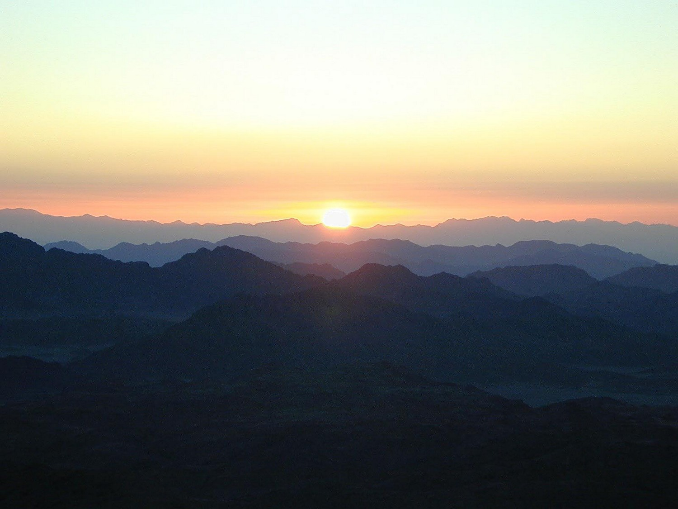
James
Lesson One – James And Jesus
Lesson Two – James And Temptations
Lesson Three - But Be Doers Of The Word
Lesson Four – Showing Partiality
Lesson Five – Relationship of Faith and Works
Lesson Six – Instructions to Teachers
Lesson Seven – Worldliness In The Church
Lesson Eight – Judging And Arrogance
Lesson Nine – Oppression By The Rich
Lesson Ten – Be Patient Brethren
Lesson Eleven – Closing Admonitions
Notes:
In his Gospel, John also connects light with God and His act of creation. “In the beginning was the Word, and the Word was with God, and the Word was God. He was with God in the beginning. Through him all things were made; without him nothing was made that has been made. In him was life, and that life was the light of all mankind. The light shines in the darkness, and the darkness has not overcome it” (John 1:1-5, NIV). This photo was taken from Jebel Musa, the traditional Mount Sinai.
tb030400500

Slide 4
Closing Admonitions. James 5:7-12
James 5:13 Is anyone among you suffering? Let him pray. Is anyone cheerful? Let him sing psalms. 14 Is anyone among you sick? Let him call for the elders of the church, and let them pray over him, anointing him with oil in the name of the Lord.
15 And the prayer of faith will save the sick, and the Lord will raise him up. And if he has committed sins, he will be forgiven. 16 Confess your trespasses to one another, and pray for one another, that you may be healed. The effective, fervent prayer of a righteous man avails much.
17 Elijah was a man with a nature like ours, and he prayed earnestly that it would not rain; and it did not rain on the land for three years and six months. 18 And he prayed again, and the heaven gave rain, and the earth produced its fruit.
19 Brethren, if anyone among you wanders from the truth, and someone turns him back, 20 let him know that he who turns a sinner from the error of his way will save a soul from death and cover a multitude of sins.

Slide 5
Closing Admonitions. James 5:7-12
In chapter 5 we see how James addressed the rich and cruel Sadducees:
V5-6 You have lived on the earth in pleasure and luxury; you have fattened your hearts as in a day of slaughter. 6 You have condemned, you have murdered the just; he does not resist you.
Because of their sin and the rich religious leaders crucifying the Christ, James tells them God is bringing judgment on them...the destruction of Jerusalem.

Slide 6
Closing Admonitions. James 5:7-12
In our last lesson we saw how James told them to be patient and he gave them 3 points to remember.
Remember the farmer and his patience
Remember the prophets and their patience
Remember Job and his patience.

Slide 7
Closing Admonitions. James 5:7-12
In this closing section we will look at James telling them some specific commands in
  Dealing with life
  The power of prayer
  Restoring an erring brother

Slide 8
Closing Admonitions. James 5:7-12
James 5:13
Is anyone among you suffering? Let him pray.
Is anyone cheerful? Let him sing psalms.
14 Is anyone among you sick? Let him call for the elders of the church, and let them pray over him, anointing him with oil in the name of the Lord.

Slide 9
Closing Admonitions. James 5:7-12
**There Are Two Possible Meanings For This Passage:
(1) That it endorses using the best available medical means for the sick (as oil was in the 1st century)
Luke 10:34; (good Samaritan, oil and wine)
Isaiah 1:6; (soothed with ointment)
Jeremiah 8:22;(is there no balm in Gilead)

Slide 10
Closing Admonitions. James 5:7-12
(2) That it was miraculous healing in the 1st century.
Oil was used in the 1st century in some cases where miracles were worked
(Mark 6:13).
Prayer was a part of the preparation both of the miracle worker and the onlookers . John 11:41 Then they took away the stone from the place where the dead man was lying. And Jesus lifted up His eyes and said, "Father, I thank You that You have heard Me. 42 "And I know that You always hear Me, but because of the people who are standing by I said this, that they may believe that You sent Me."
43 Now when He had said these things, He cried with a loud voice, "Lazarus, come forth!“ 44 And he who had died came out bound hand and foot with graveclothes, and his face was wrapped with a cloth. Jesus said to them, "Loose him, and let him go."45 Then many of the Jews who had come to Mary, and had seen the things Jesus did, believed in Him.
The anointing with oil was secondary, it was the prayer of faith that was the main thing. Just as Jesus used mud on a man's eyes, it was not the mud that returned his sight, but the man's faith in Jesus (John 9:1-7).
And they cast out many demons, and anointed with oil many who were sick, and healed them.

Slide 11
Closing Admonitions. James 5:7-12
The anointing with oil was secondary, it was the prayer of faith that was the main thing.
Just as Jesus used mud on a man's eyes, it was not the mud that returned his sight, but the man's faith in Jesus (John 9:1-7).

Slide 12
Closing Admonitions. James 5:7-12
Notice the following: The main reason for miraculous gifts was to confirm the word
Mark 16:20; And they went out and preached everywhere, the Lord working with them and confirming the word through the accompanying signs.
Hebrews 2:3-4; how shall we escape if we neglect so great a salvation, which at the first began to be spoken by the Lord, and was confirmed to us by those who heard Him, 4 God also bearing witness both with signs and wonders, with various miracles, and gifts of the Holy Spirit, according to His own will?
Miraculous gifts are not needed today because the word has already been fully given and confirmed.

Slide 13
Closing Admonitions. James 5:7-12
James 5:15
And the prayer of faith will save the sick, and the Lord will raise him up.
And if he has committed sins,
he will be forgiven.

Slide 14
Closing Admonitions. James 5:7-12
James 5:16
Confess your trespasses to one another,
and pray for one another,
that you may be healed.
The effective, fervent prayer of a righteous man avails much.

Slide 15
Closing Admonitions. James 5:7-12
Confession assumes that repentance also takes place (Acts 8:22).
The principle of confession is broader than this specific circumstance (1 John 1:9) and is in continuous action — continue to confess.
James does not just say to confess that you are a sinner, but to confess your sins.

Slide 16
Closing Admonitions. James 5:7-12
James 5:17 Elijah was a man with a nature like ours,
and he prayed earnestly that it would not rain; and it did not rain on the land for three years and six months.
18 And he prayed again, and the heaven gave rain, and the earth produced its fruit.

Slide 17
Closing Admonitions. James 5:7-12
The Jews had developed an exaggerated opinion of Elijah, making him a mysterious heavenly figure.
By thinking that Elijah was some extraordinary figure, they thought his prayer might be different from ours.
If he was like us, and if God answered his prayers, why not ours? and he prayed earnestly –

Slide 18
Closing Admonitions. James 5:7-12
James 5:19
Brethren, if anyone among you wanders from the truth,
and someone turns him back,
20 let him know that he who turns a sinner from the error of his way will save a soul from death and cover a multitude of sins.

Slide 19
Closing Admonitions. James 5:7-12
"Wanders" comes from the Greek word (PLANAŌ) meaning, "to go astray, wander, roam about."
From the many warnings given by James in this letter the people were in danger of forsaking the truth and falling into the sins which were unique to their situation. "Truth" is something that must be done!
It is not only something to be studied; but something to be done. It is not only something to which a man must submit his mind, but something to which he must submit his whole life. One cannot wander from the truth unless he has been in it. Once again, this is proof that one can fall away, fall from grace (compare Galatians 5:4). and someone turns him back –

Slide 20
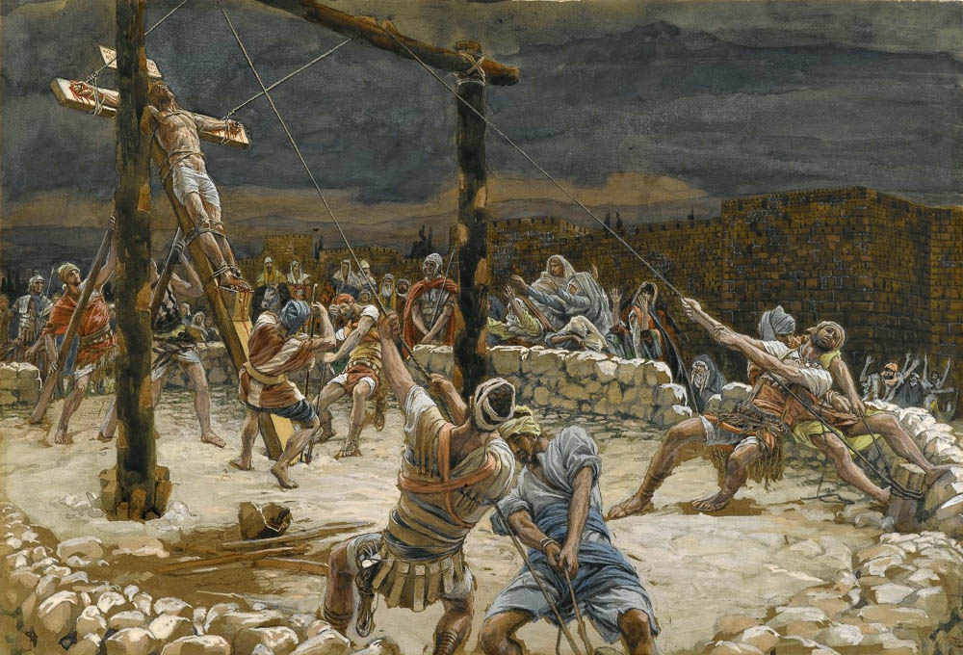
And will cover a multitude of sins
The Raising of the Cross, by James Tissot, circa 1890
5:20
Notes:
It seems likely that the death of Jesus on the cross, which provides the ultimate solution to sin, was not far from James’s mind as he penned these words. This painting by James Tissot was executed using opaque watercolor over graphite on gray wove paper. This image is in the public domain, via the Brooklyn Museum: https://www.brooklynmuseum.org/opencollection/objects/4587.
bmny001592944587

Slide 21
Questions?
Want to learn more about the Bible?
We will be glad to study the Bible with you.
New Lebanon
New Lebanon
Church of Christ
Church of Christ
New Lebanon, OH
newlebanoncoc.com
newlebanoncoc@gmail.com

