Slide 1
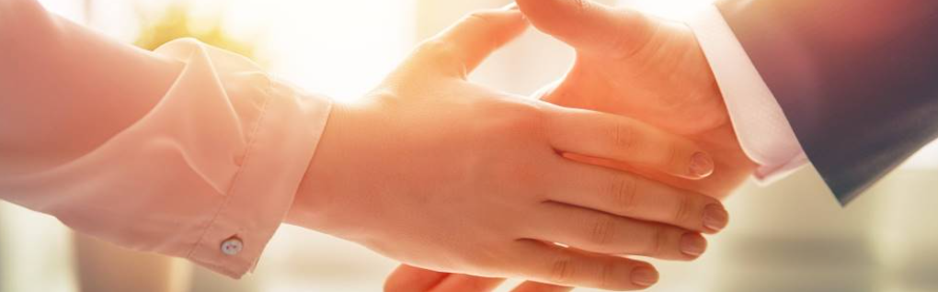
Welcome to our services
New Lebanon Church of Christ
We are Simply Christians.
Our Emphasis is Spiritual, Not Material or Social.
We are striving to be The Same Church as Described in The New Testament.
Please Come Back Again

Slide 2
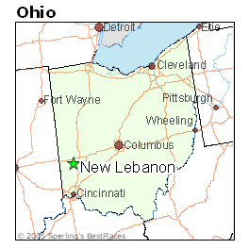

Do You Know Your Way Home?
Thomas said to Him, "Lord, we do not know where You are going, and how can we know the way?“ John 14:5

Slide 3

vecteezy.com

Slide 4
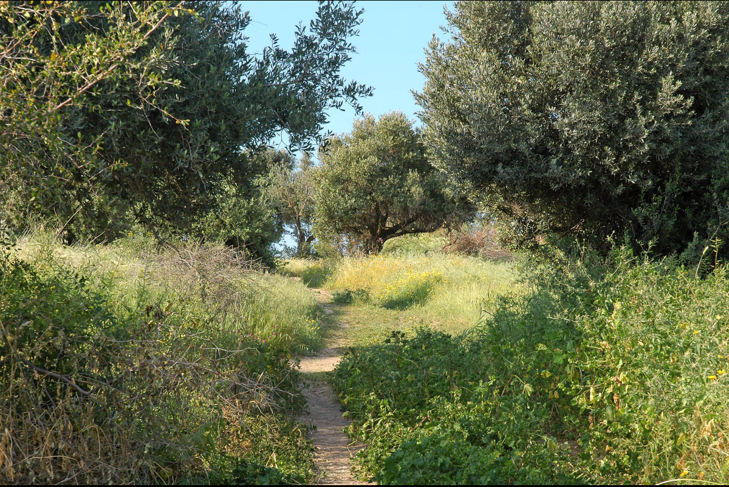
Do You Know Your Way Home?
Matthew 7:14 "Because narrow is the gate and difficult is the way which leads to life, and there are few who find it.
There are many narrow paths in Israel, but this one is located very near the traditional place where Jesus gave this sermon. - Dirt path through olive grove on the Mount of Beatitudes

Slide 5

Do You Know Your Way Home?
John 14:1 "Let not your heart be troubled; you believe in God, believe also in Me. 2 "In My Father's house are many mansions; if it were not so, I would have told you. I go to prepare a place for you. 3 "And if I go and prepare a place for you, I will come again and receive you to Myself; that where I am, there you may be also. 4 "And where I go you know, and the way you know."
5 Thomas said to Him, "Lord, we do not know where You are going, and how can we know the way?" 6 Jesus said to him, "I am the way, the truth, and the life. No one comes to the Father except through Me.
newlebanoncoc.com

Slide 6
Do You Know Your Way Home?
Matt. 7:13 "Enter by the narrow gate; for wide is the gate and broad is the way that leads to destruction, and there are many who go in by it.
14 "Because narrow is the gate and difficult is the way which leads to life, and there are few who find it.
newlebanoncoc.com

Slide 7
Do You Know Your Way Home?
Matt. 7:21 "Not everyone who says to Me, 'Lord, Lord,' shall enter the kingdom of heaven, but he who does the will of My Father in heaven.
22 "Many will say to Me in that day, 'Lord, Lord, have we not prophesied in Your name, cast out demons in Your name, and done many wonders in Your name?’ 23 "And then I will declare to them, 'I never knew you; depart from Me, you
who practice lawlessness!'
newlebanoncoc.com

Slide 8
Do You Know Your Way Home?
Philp. 1:21 For to me, to live is Christ, and to die is gain. 22 But if I live on in the flesh, this will mean fruit from my labor; yet what I shall choose I cannot tell. 23 For I am hard pressed between the two, having a desire to depart and be with Christ, which is far better. 24 Nevertheless to remain in the flesh is more needful for you.
newlebanoncoc.com

Slide 9
Do You Know Your Way Home?
Heb. 11:10 for he waited for the city which has foundations, whose builder and maker is God.
newlebanoncoc.com

Slide 10
Do You Know Your Way Home?
Joshua 24:15 "And if it seems evil to you to serve the LORD, choose for yourselves this day whom you will serve, whether the gods which your fathers served that were on the other side of the River, or the gods of the Amorites, in whose land you dwell. But as for me and my house, we will serve the LORD."
newlebanoncoc.com

Slide 11
Do You Know Your Way Home?
Philp.1:21 For to me, to live is Christ, and to die is gain. 22 But if I live on in the flesh, this will mean fruit from my labor; yet what I shall choose I cannot tell. 23 For I am hard pressed between the two, having a desire to depart and be with Christ, which is far better. 24 Nevertheless to remain in the flesh is more needful for you.
newlebanoncoc.com

Slide 12
Do You Know Your Way Home?
Proverbs 16:25 There is a way that seems right to a man, But its end is the way of death.
newlebanoncoc.com

Slide 14
Questions?
Want to learn more about the Bible?
We will be glad to study the Bible with you.
New Lebanon
New Lebanon
Church of Christ
Church of Christ
New Lebanon, OH
newlebanoncoc.com
newlebanoncoc@gmail.com

