Slide 1

Welcome to our services
New Lebanon Church of Christ
We are Simply Christians.
Our Emphasis is Spiritual, Not Material or Social.
We are striving to be The Same Church as Described in The New Testament.
Please Come Back Again

Slide 2
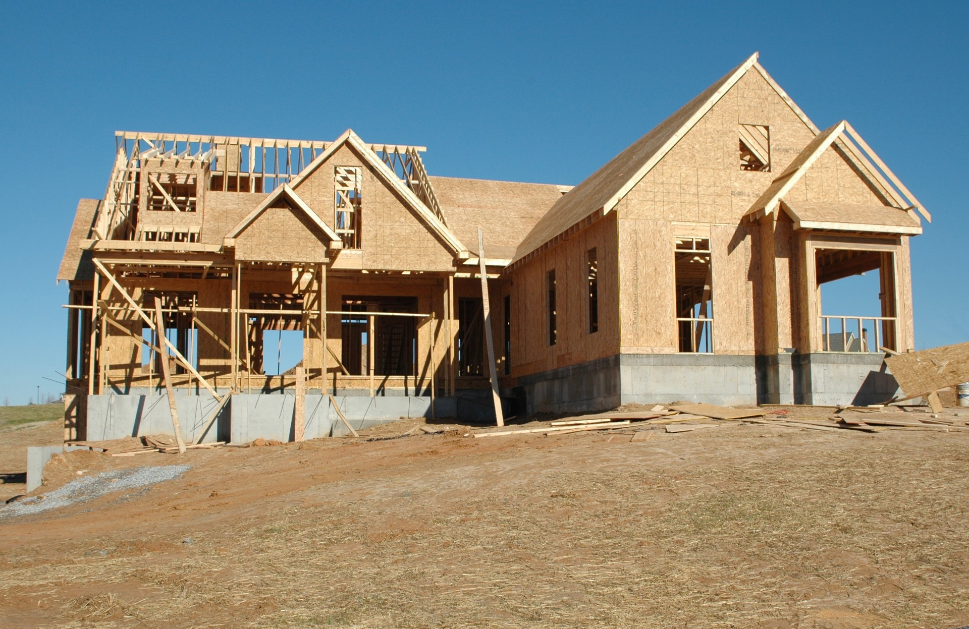
Where There Is No Vision
publicdomainpictures.net
Proverbs 29:18 Where there is no vision, the people perish: but he that keepeth the law, happy is he. KJV
newlebanoncoc.com

Slide 3

Looking To The Future
salesxceleration.com

Slide 4
Where There Is No Vision
A vision to have this house here perpetually
1Kings 9:3 And the LORD said to him: "I have heard your prayer and your supplication that you have made before Me; I have consecrated this house which you have built to put My name there forever, and My eyes and My heart will be there perpetually.
newlebanoncoc.com

Slide 5
Where There Is No Vision
2. A Vision to save people, to insure the next generation continues in the Lord.
Brethren, my heart's desire and prayer to God for Israel is that they may be saved. Rom. 10:1
newlebanoncoc.com

Slide 6
Where There Is No Vision
3. A vision for this house to be a house of prayer.
Isaiah 56:7 Even them I will bring to My holy mountain, And make them joyful in My house of prayer. Their burnt offerings and their sacrifices Will be accepted on My altar; For My house shall be called a house of prayer for all nations."
Matt. 21:13 And He said to them, "It is written, 'My house shall be called a house of prayer,' but you have made it a 'den of thieves.'"
newlebanoncoc.com

Slide 7
Where There Is No Vision
4. A vision to spend more time together with each other.
Acts 2:41 Then those who gladly received his word were baptized; and that day about three thousand souls were added to them. 42 And they continued steadfastly in the apostles' doctrine and fellowship, in the breaking of bread, and in prayers. 43 Then fear came upon every soul, and many wonders and signs were done through the apostles.
44 Now all who believed were together, and had all things in common, 45 and sold their possessions and goods, and divided them among all, as anyone had need.
46 So continuing daily with one accord in the temple, and breaking bread from house to house, they ate their food with gladness and simplicity of heart,
newlebanoncoc.com

Slide 8
Where There Is No Vision
5. A vision for this church to grow.
Acts 2:47 praising God and having favor with all the people. And the Lord added to the church daily those who were being saved.
newlebanoncoc.com

Slide 9
Where There Is No Vision
6. A vision to be here at every service.
(And if not, let everyone know why not!)
Heb.10:25 not forsaking our own assembling together
newlebanoncoc.com

Slide 10
Where There Is No Vision
7. We need to have a vision for our visitors.
We need to get the visitor’s address so you can write them a thank you card for coming.
If possible, we need to invite them out to eat.
Is there anybody here that became a member here without visiting here? No, we were all visitors here first.
And what visitors see and hear
determines if they come back again.
newlebanoncoc.com

Slide 11
Where There Is No Vision
Jer. 29:11 For I know the thoughts that I think toward you, says the LORD, thoughts of peace and not of evil, to give you a future and a hope.
Psalm 32:8 I will instruct you and teach you in the way you should go; I will guide you with My eye.
newlebanoncoc.com

Slide 12
Where There Is No Vision
Proverbs 16:3 Commit your works to the LORD, And your thoughts will be established.
Isaiah 26:3 You will keep him in perfect peace, Whose mind is stayed on You, Because he trusts in You.
newlebanoncoc.com

Slide 13
Where There Is No Vision
Isaiah 55:8 "For My thoughts are not your thoughts, Nor are your ways My ways," says the LORD.
9 "For as the heavens are higher than the earth, So are My ways higher than your ways, And My thoughts than your thoughts
newlebanoncoc.com

Slide 14
Where There Is No Vision
Matt. 6:31 "Therefore do not worry, saying, 'What shall we eat?' or 'What shall we drink?' or 'What shall we wear?'
32 "For after all these things the Gentiles seek. For your heavenly Father knows that you need all these things.
33 "But seek first the kingdom of God and His righteousness, and all these things shall be added to you.
newlebanoncoc.com

Slide 15
Where There Is No Vision
Luke 12:32 "Do not fear, little flock, for it is your Father's good pleasure to give you the kingdom.
Rom. 8:32 He who did not spare His own Son, but delivered Him up for us all, how shall He not with Him also freely give us all things?
Eph. 2:10 For we are His workmanship, created in Christ Jesus for good works, which God prepared beforehand that we should walk in them.
newlebanoncoc.com

Slide 16
Where There Is No Vision
Heb 13:5 Let your conduct be without covetousness; be content with such things as you have. For He Himself has said, "I will never leave you nor forsake you."
newlebanoncoc.com

Slide 17
Where There Is No Vision
What is your vision for the Lord’s church,
its perpetuity,
its work,
its growth?
newlebanoncoc.com

Slide 18
Looking To The Future
salesxceleration.com
Let us be known for our stand for the truth. Let us be known for our good works. Let us be known for our love for one another.
Let us be known as a shining light in the greater Dayton area. Let us give all honor and glory to God almighty.

Slide 19
Questions?
Want to learn more about the Bible?
We will be glad to study the Bible with you.
New Lebanon
New Lebanon
Church of Christ
Church of Christ
New Lebanon, OH
newlebanoncoc.com
newlebanoncoc@gmail.com

