Slide 1

Welcome to our services
New Lebanon Church of Christ
We are Simply Christians.
Our Emphasis is Spiritual, Not Material or Social.
We are striving to be The Same Church as Described in The New Testament.
Please Come Back Again

Slide 2
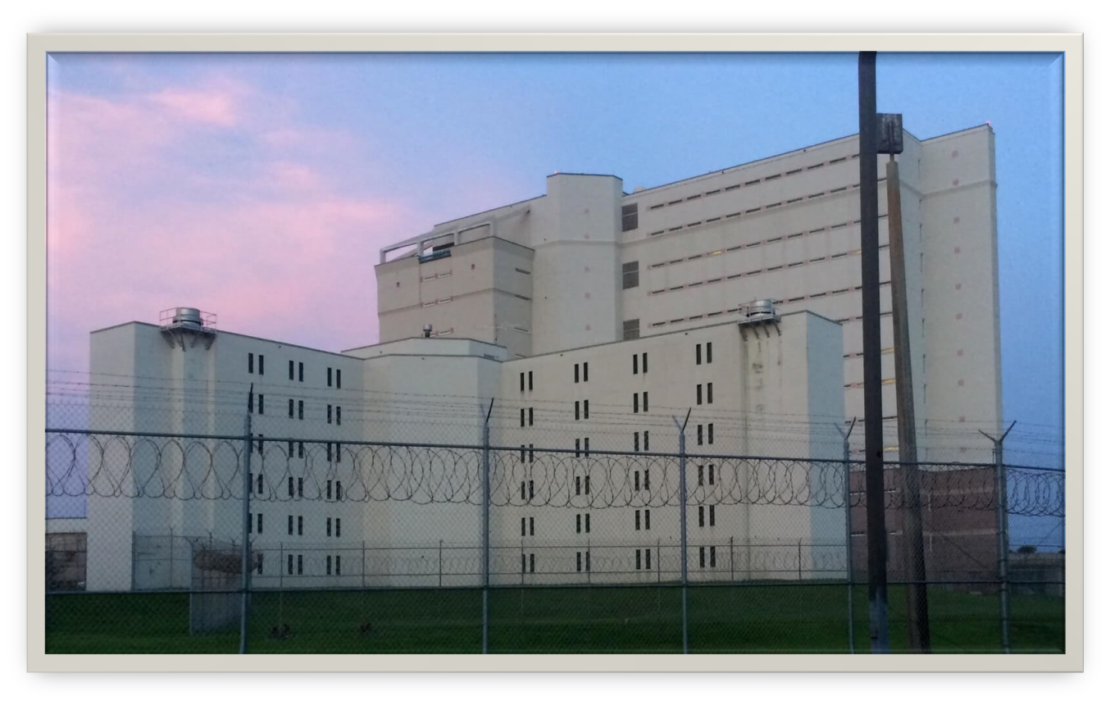
Self Made Prisons
Luke 4:16 So He came to Nazareth, where He had been brought up. And as His custom was, He went into the synagogue on the Sabbath day, and stood up to read. 17 And He was handed the book of the prophet Isaiah. And when He had opened the book, He found the place where it was written: 18 "The Spirit of the LORD is upon Me, Because He has anointed Me To preach the gospel to the poor; He has sent Me to heal the brokenhearted, To proclaim liberty to the captives And recovery of sight to the blind, To set at liberty those who are oppressed;

Slide 3
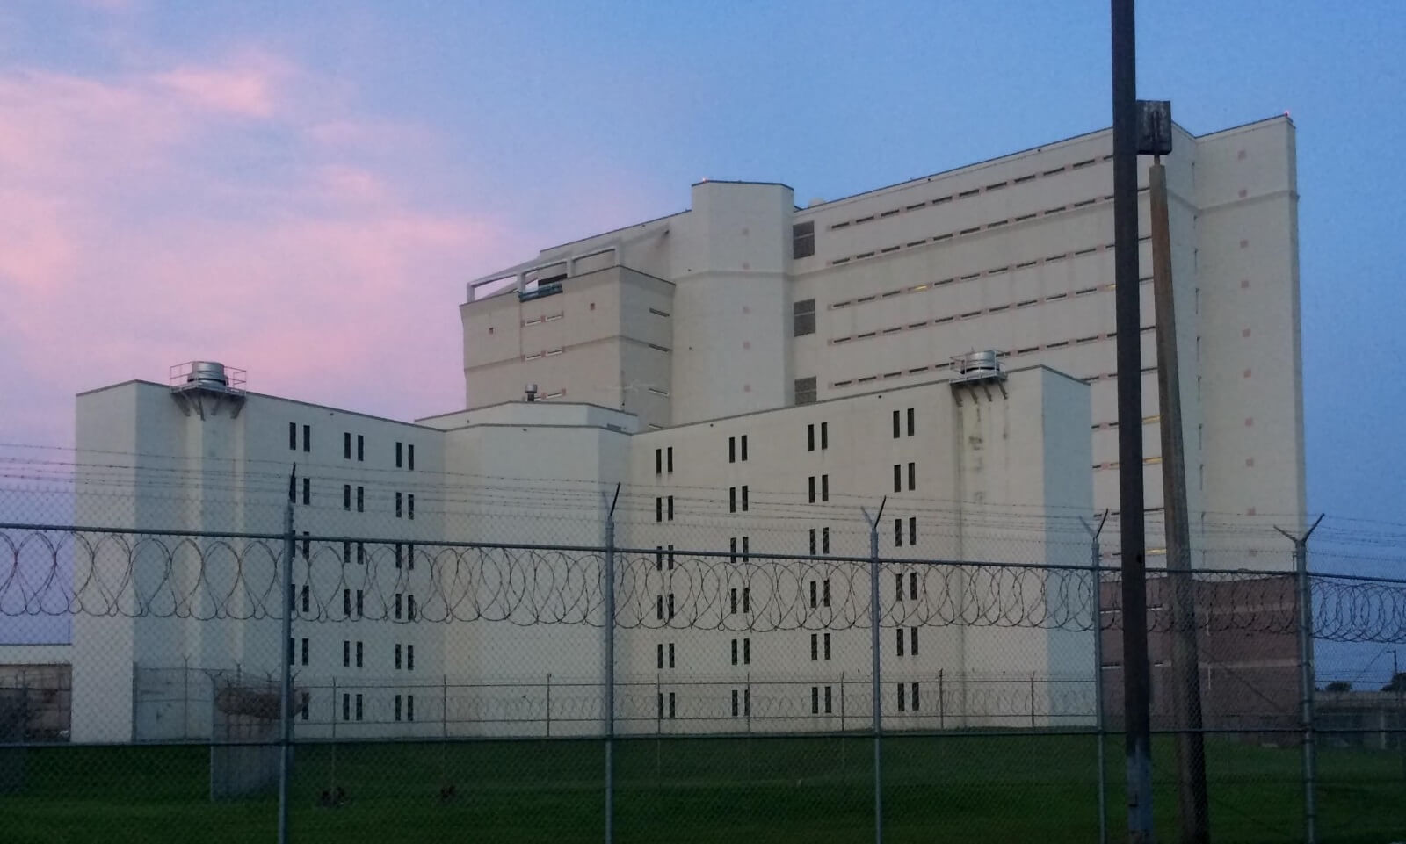
To set at liberty those who are oppressed
Northeast Ohio Correctional Center Prisoner Search | Visitation, Mail ... jailexchange.com

Slide 4

To set at liberty those who are oppressed
Self-Made Prisons

Slide 5
To set at liberty those who are oppressed
1. A self-made prison of self indulgence.
Col. 3:5 Therefore put to death your members which are on the earth: fornication, uncleanness, passion, evil desire, and covetousness, which is idolatry.
6 Because of these things the wrath of God is coming upon the sons of disobedience,
7 in which you yourselves once walked when you lived in them.
8 But now you yourselves are to put off all these: anger, wrath, malice, blasphemy, filthy language out of your mouth.
9 Do not lie to one another, since you have put off the old man with his deeds,
newlebanoncoc.com

Slide 6
To set at liberty those who are oppressed
2. A self-made prison of superstition.
Gal. 5:19 Now the works of the flesh are evident, which are: adultery, fornication, uncleanness, lewdness,
20 idolatry, sorcery, (witchcraft KJV) hatred, contentions, jealousies, outbursts of wrath, selfish ambitions, dissensions, heresies,
21 envy, murders, drunkenness, revelries, and the like; of which I tell you beforehand, just as I also told you in time past, that those who practice such things will not inherit the kingdom of God.
newlebanoncoc.com

Slide 7
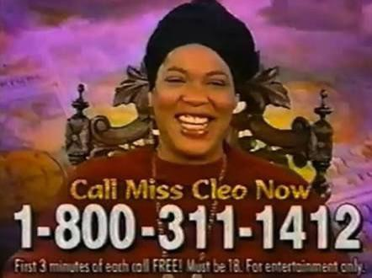
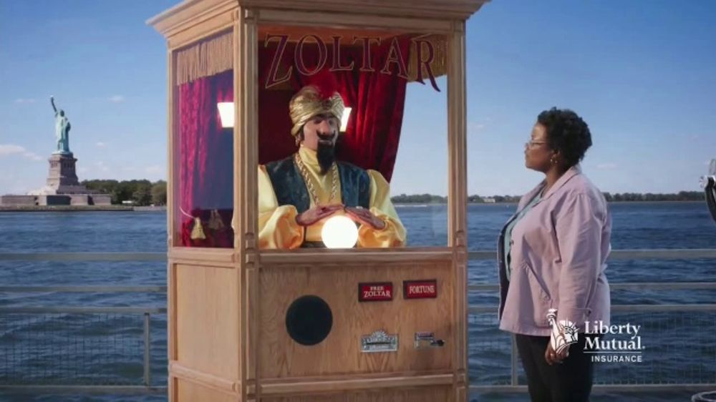


Miss Cleo fortune teller commercials : r/nostalgia
reddit.com
Liberty Mutual TV Commercial, 'Zoltar' - iSpot.tv
ispot.tv
Harry Potter: Wizards Unite News, Trailer, Guides, and More
gamerant.com
Gravity Falls | Disney Shows shows.disney.com

Slide 8
To set at liberty those who are oppressed
3. A self-made prison of hate.
1John 2:9 He who says he is in the light, and hates his brother, is in darkness until now.
1John 2:11 But he who hates his brother is in darkness and walks in darkness, and does not know where he is going, because the darkness has blinded his eyes.
1John 3:15 Whoever hates his brother is a murderer, and you know that no murderer has eternal life abiding in him.
1John 4:20 If someone says, "I love God," and hates his brother, he is a liar; for he who does not love his brother whom he has seen, how can he love God whom he has not seen?
newlebanoncoc.com

Slide 9
To set at liberty those who are oppressed
4. A self-made prison of unrest.
2Tim. 3:1 But know this, that in the last days perilous times will come:
2 For men will be lovers of themselves, lovers of money, boasters, proud, blasphemers, disobedient to parents, unthankful, unholy,
3 unloving, unforgiving, slanderers, without self-control, brutal, despisers of good,
4 traitors, headstrong, haughty, lovers of pleasure rather than lovers of God,
…. And from such people turn away!
…7 always learning and never able to come to the knowledge of the truth.
newlebanoncoc.com

Slide 10
To set at liberty those who are oppressed
5. A self-made prison of indecision.
Joshua 24:15 "And if it seems evil to you to serve the LORD, choose for yourselves this day whom you will serve, whether the gods which your fathers served that were on the other side of the River, or the gods of the Amorites, in whose land you dwell. But as for me and my house, we will serve the LORD."
newlebanoncoc.com

Slide 11
To set at liberty those who are oppressed
6. A self-made prison of unbelief.
Heb. 3:12 Beware, brethren, lest there be in any of you an evil heart of unbelief in departing from the living God;
13 but exhort one another daily, while it is called "Today," lest any of you be hardened through the deceitfulness of sin.
…
18 And to whom did He swear that they would not enter His rest, but to those who did not obey?
19 So we see that they could not enter in because of unbelief.
newlebanoncoc.com

Slide 12
To set at liberty those who are oppressed
7. A self-made prison of sin.
Rom. 6:20 For when you were slaves of sin, you were free in regard to righteousness.
21 What fruit did you have then in the things of which you are now ashamed? For the end of those things is death.
22 But now having been set free from sin, and having become slaves of God, you have your fruit to holiness, and the end, everlasting life.
23 For the wages of sin is death, but the gift of God is eternal life in Christ Jesus our Lord.
newlebanoncoc.com

Slide 13

To set at liberty those who are oppressed
hate
superstition
self-indulgence
unrest
sin
indecision

Slide 14
To set at liberty those who are oppressed
Self-Made Prisons
Jesus Can Set You Free

Slide 15
Questions?
Want to learn more about the Bible?
We will be glad to study the Bible with you.
New Lebanon
New Lebanon
Church of Christ
Church of Christ
New Lebanon, OH
newlebanoncoc.com
newlebanoncoc@gmail.com

