Slide 1

Welcome to our services
New Lebanon Church of Christ
We are Simply Christians.
Our Emphasis is Spiritual, Not Material or Social.
We are striving to be The Same Church as Described in The New Testament.
Please Come Back Again

Slide 2

Preach The Word. 2Timothy 4:2
2Timothy 4:1 I charge you therefore before God and the Lord Jesus Christ, who will judge the living and the dead at His appearing and His kingdom: 2 Preach the word! Be ready in season and out of season. Convince, rebuke, exhort, with all longsuffering and teaching.
newlebanoncoc.com

Slide 3
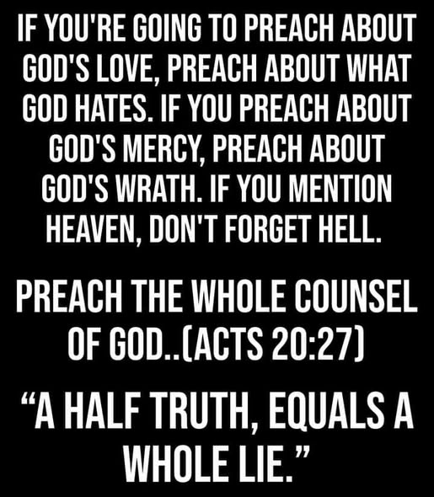

Slide 4
Preach The Word. 2Timothy 4:2
2Tim. 3:16 All Scripture is given by inspiration of God, and is profitable for doctrine, for reproof, for correction, for instruction in righteousness, 17 that the man of God may be complete, thoroughly equipped for every good work.
newlebanoncoc.com

Slide 5
Preach The Word. 2Timothy 4:2
1Tim 4:16 Take heed to yourself and to the doctrine. Continue in them, for in doing this you will save both yourself and those who hear you.
2John 1:9 Whoever transgresses and does not abide in the doctrine of Christ does not have God. He who abides in the doctrine of Christ has both the Father and the Son. 10 If anyone comes to you and does not bring this doctrine, do not receive him into your house nor greet him; 11 for he who greets him shares in his evil deeds.
newlebanoncoc.com

Slide 6
Preach The Word. 2Timothy 4:2
Jude 3; Beloved, while I was very diligent to write to you concerning our common salvation, I found it necessary to write to you exhorting you to contend earnestly for the faith which was once for all delivered to the saints.
Phil. 1:17; Some indeed preach Christ even from envy and strife, and some also from good will: 16 The former preach Christ from selfish ambition, not sincerely, supposing to add affliction to my chains;
17 but the latter out of love, knowing that I am appointed for the defense of the gospel.
newlebanoncoc.com

Slide 7
Preach The Word. 2Timothy 4:2
Eph. 4:1 I, therefore, the prisoner of the Lord, beseech you to walk worthy of the calling with which you were called, 2 with all lowliness and gentleness, with longsuffering, bearing with one another in love, 3 endeavoring to keep the unity of the Spirit in the bond of peace. 4 There is one body and one Spirit, just as you were called in one hope of your calling; 5 one Lord, one faith, one baptism; 6 one God and Father of all, who is above all, and through all, and in you all.
newlebanoncoc.com

Slide 8
Preach The Word. 2Timothy 4:2
Gal. 1:8 But even if we, or an angel from heaven, preach any other gospel to you than what we have preached to you, let him be accursed.
9 As we have said before, so now I say again, if anyone preaches any other gospel to you than what you have received, let him be accursed.
newlebanoncoc.com

Slide 9
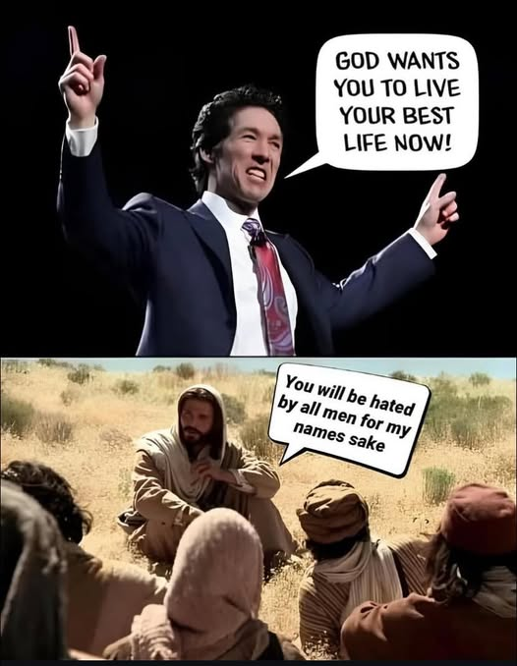

Slide 10
Preach The Word. 2Timothy 4:2
Truth is fixed, unchangeable. The truth in these passages is everlasting and cannot be altered to fit a changing world:
James 4:4 Adulterers and adulteresses! Do you not know that friendship with the world is enmity with God? Whoever therefore wants to be a friend of the world makes himself an enemy of God. 5 Or do you think that the Scripture says in vain, "The Spirit who dwells in us yearns jealously"?
6 But He gives more grace. Therefore He says: "God resists the proud, But gives grace to the humble."
7 Therefore submit to God. Resist the devil and he will flee from you. 8 Draw near to God and He will draw near to you. Cleanse your hands, you sinners; and purify your hearts, you double-minded.
newlebanoncoc.com

Slide 11
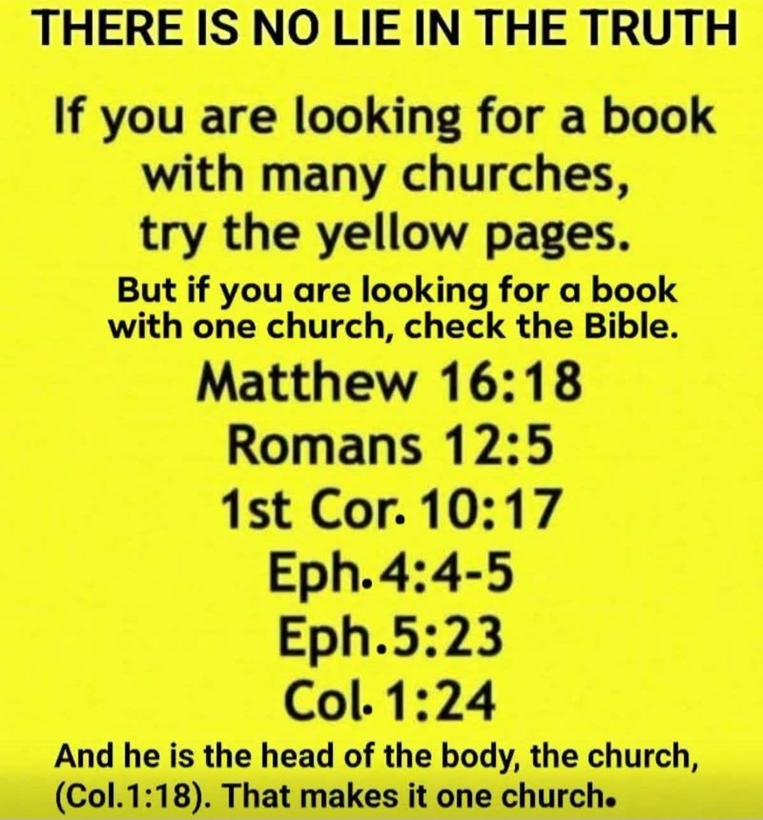

Slide 12
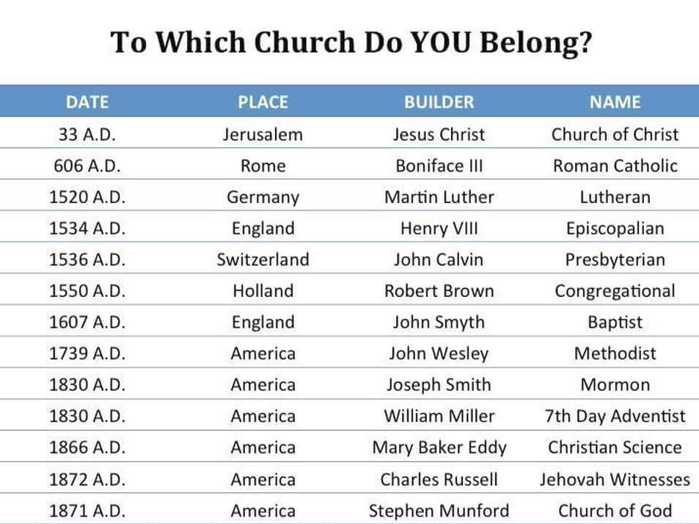
Christ and the church He built.
Acts 2:47 praising God and having favor with all the people. And the Lord added to the church daily those who were being saved.
These churches are too late to be the Lord’s church.
These churches are not the Bride of Christ (Eph.5) Christ has ONE Bride.
Which church were those in Acts 2:47 added to?

Slide 13
Preach The Word. 2Timothy 4:2
Rev. 20:12 And I saw the dead, small and great, standing before God, and books were opened. And another book was opened, which is the Book of Life. And the dead were judged according to their works, by the things which were written in the books.
13 The sea gave up the dead who were in it, and Death and Hades delivered up the dead who were in them. And they were judged, each one according to his works.
14 Then Death and Hades were cast into the lake of fire. This is the second death.
15 And anyone not found written in the Book of Life was cast into the lake of fire.
newlebanoncoc.com

Slide 14
Preach The Word. 2Timothy 4:2
"Don't preach a negative gospel.'
But Eight of ten commandments from God did are negative. (Ex. 20)!
Paul told Timothy to reprove and rebuke (2Tim. 4:2)
We cannot stand for something without standing against something (Psalm 97 :10).
Apostasy soon came as prophesied
(1Tim. 4 :1-3)
newlebanoncoc.com

Slide 15
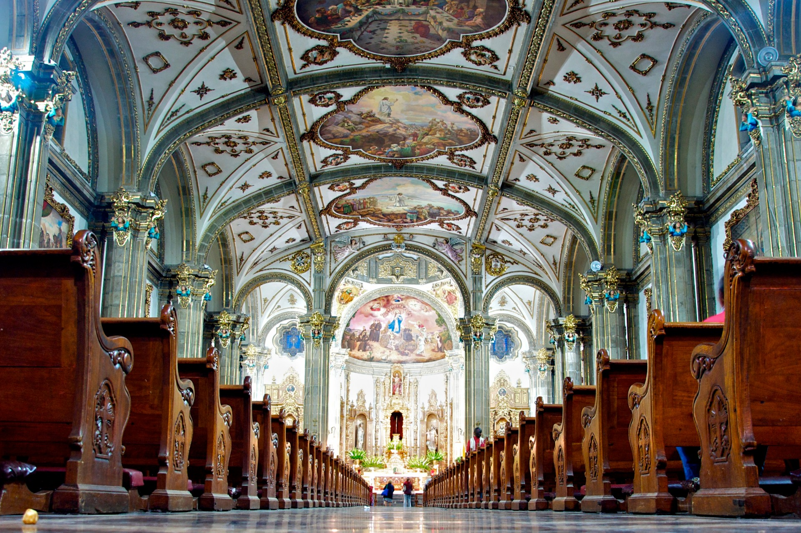
Preach The Word. 2Timothy 4:2
1Tim. 4:1 Now the Spirit expressly says that in latter times some will depart from the faith, giving heed to deceiving spirits and doctrines of demons,
2 speaking lies in hypocrisy, having their own conscience seared with a hot iron,
3 forbidding to marry, and commanding to abstain from foods which God created to be received with thanksgiving by those who believe and know the truth.
newlebanoncoc.com

Slide 16
Preach The Word. 2Timothy 4:2
2Tim. 3:16
All Scripture
is given by inspiration of God,
and is profitable for doctrine,
for reproof,
for correction,
for instruction in righteousness,
17 that the man of God may be complete,
thoroughly equipped for every good work.
newlebanoncoc.com

Slide 17

storage.googleapis.com

Slide 18
Supporting Illustrations
Bible Verses
storage.googleapis.com

Slide 19
Bible verses
Stories
Illustrations
emotions

Slide 20


Slide 21
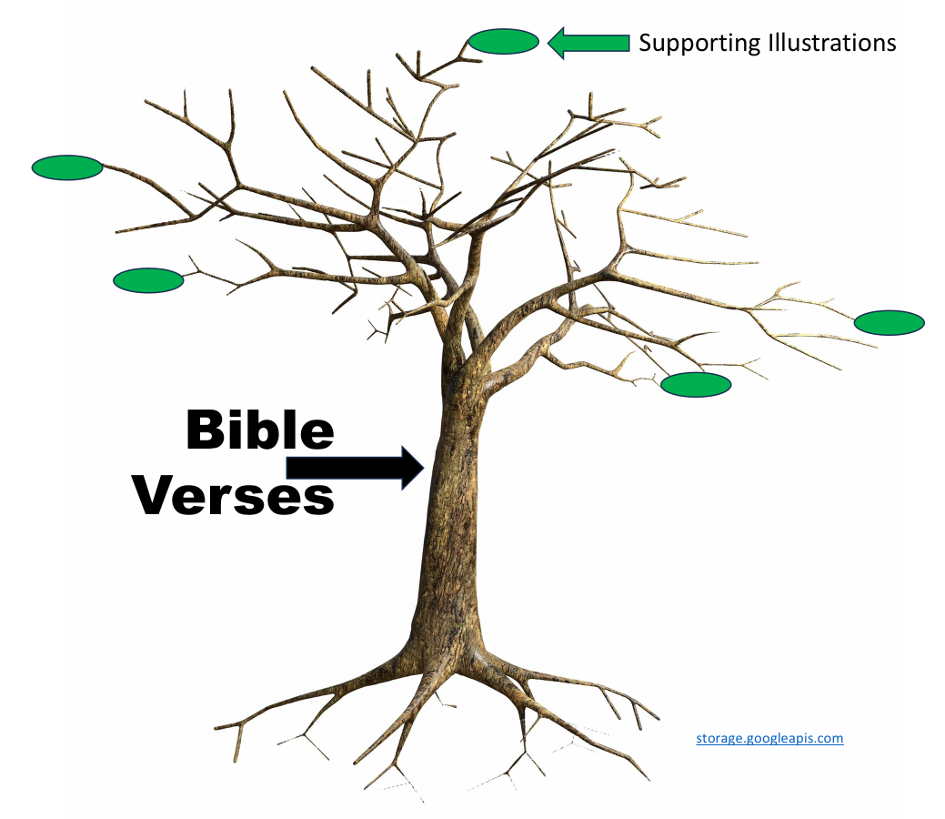

Preach The Word. 2Timothy 4:2

Slide 22
Preach The Word. 2Timothy 4:2
2Peter 1:20 knowing this first, that no prophecy of Scripture is of any private interpretation,
21 for prophecy never came by the will of man, but holy men of God spoke as they were moved by the Holy Spirit.
2:1 But there were also false prophets among the people, even as there will be false teachers among you, who will secretly bring in destructive heresies, even denying the Lord who bought them, and bring on themselves swift destruction.
newlebanoncoc.com

Slide 23
Preach The Word. 2Timothy 4:2
2Tim. 4:1 I charge you therefore before God and the Lord Jesus Christ, who will judge the living and the dead at His appearing and His kingdom:
2 Preach the word! Be ready in season and out of season. Convince, rebuke, exhort, with all longsuffering and teaching.
3 For the time will come when they will not endure sound doctrine, but according to their own desires, because they have itching ears, they will heap up for themselves teachers;
4 and they will turn their ears away from the truth, and be turned aside to fables.
5 But you be watchful in all things, endure afflictions, do the work of an evangelist, fulfill your ministry.
newlebanoncoc.com

Slide 24
Questions?
Want to learn more about the Bible?
We will be glad to study the Bible with you.
New Lebanon
New Lebanon
Church of Christ
Church of Christ
New Lebanon, OH
newlebanoncoc.com
newlebanoncoc@gmail.com

