Slide 1

Welcome to our services
New Lebanon Church of Christ
We are Simply Christians.
Our Emphasis is Spiritual, Not Material or Social.
We are striving to be The Same Church as Described in The New Testament.
Please Come Back Again

Slide 2
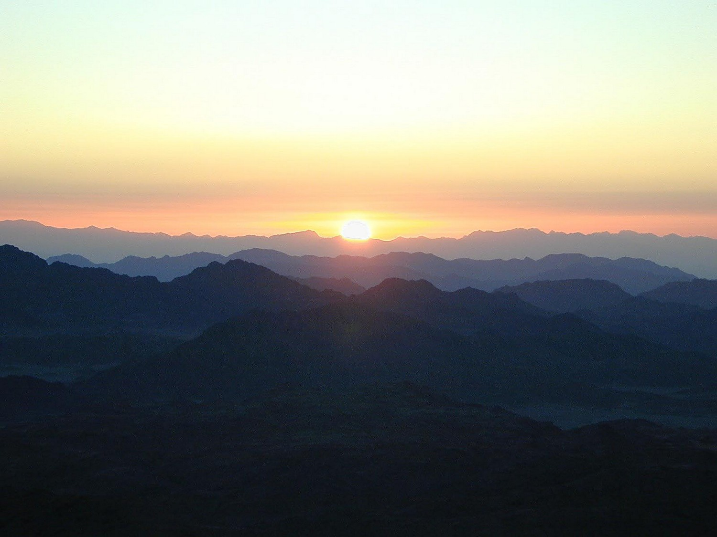
James
Lesson Nine – Oppression By The Rich
James 5:1 Come now, you rich, weep and howl for your miseries that are coming upon you! 2 Your riches are corrupted, and your garments are moth-eaten. 3 Your gold and silver are corroded, and their corrosion will be a witness against you and will eat your flesh like fire. You have heaped up treasure in the last days.
Notes:
In his Gospel, John also connects light with God and His act of creation. “In the beginning was the Word, and the Word was with God, and the Word was God. He was with God in the beginning. Through him all things were made; without him nothing was made that has been made. In him was life, and that life was the light of all mankind. The light shines in the darkness, and the darkness has not overcome it” (John 1:1-5, NIV). This photo was taken from Jebel Musa, the traditional Mount Sinai.
tb030400500

Slide 3
James
Lesson One – James And Jesus
Lesson Two – James And Temptations
Lesson Three - But Be Doers Of The Word
Lesson Four – Showing Partiality
Lesson Five – Relationship of Faith and Works
Lesson Six – Instructions to Teachers
Lesson Seven – Worldliness In The Church
Lesson Eight – Judging And Arrogance
Lesson Nine – Oppression By The Rich
Notes:
In his Gospel, John also connects light with God and His act of creation. “In the beginning was the Word, and the Word was with God, and the Word was God. He was with God in the beginning. Through him all things were made; without him nothing was made that has been made. In him was life, and that life was the light of all mankind. The light shines in the darkness, and the darkness has not overcome it” (John 1:1-5, NIV). This photo was taken from Jebel Musa, the traditional Mount Sinai.
tb030400500

Slide 4
Oppression By The Rich. James 5:1-6
James 5:1 Come now, you rich, weep and howl for your miseries that are coming upon you! 2 Your riches are corrupted, and your garments are moth-eaten.
3 Your gold and silver are corroded, and their corrosion will be a witness against you and will eat your flesh like fire. You have heaped up treasure in the last days. 4 Indeed the wages of the laborers who mowed your fields, which you kept back by fraud, cry out; and the cries of the reapers have reached the ears of the Lord of Sabaoth.
5 You have lived on the earth in pleasure and luxury; you have fattened your hearts as in a day of slaughter. 6 You have condemned, you have murdered the just; he does not resist you.
newlebanoncoc.com

Slide 5
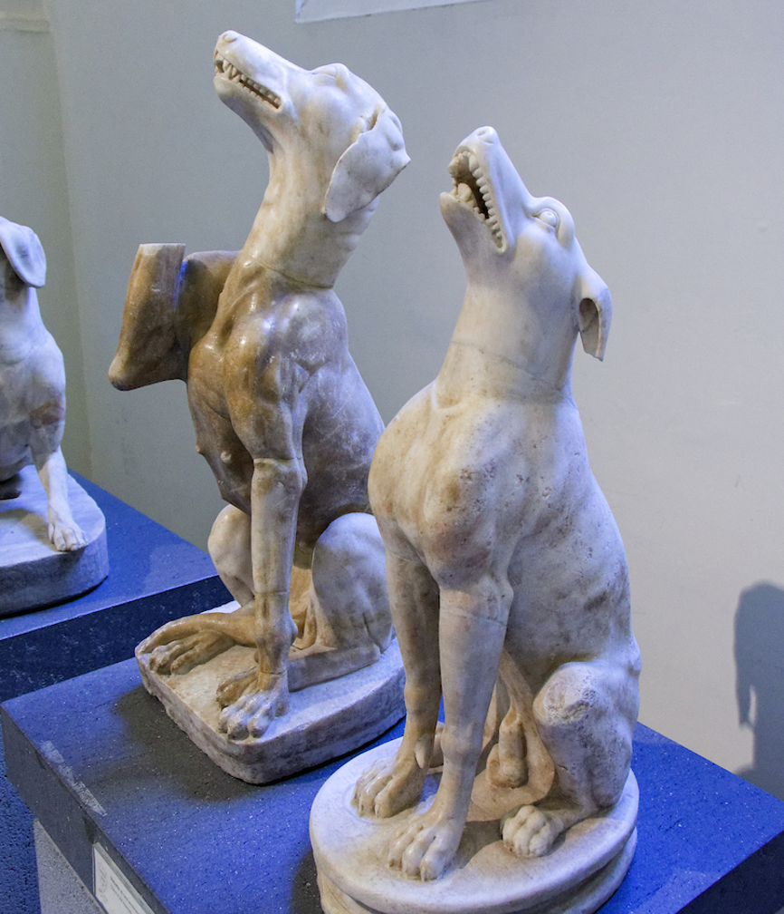
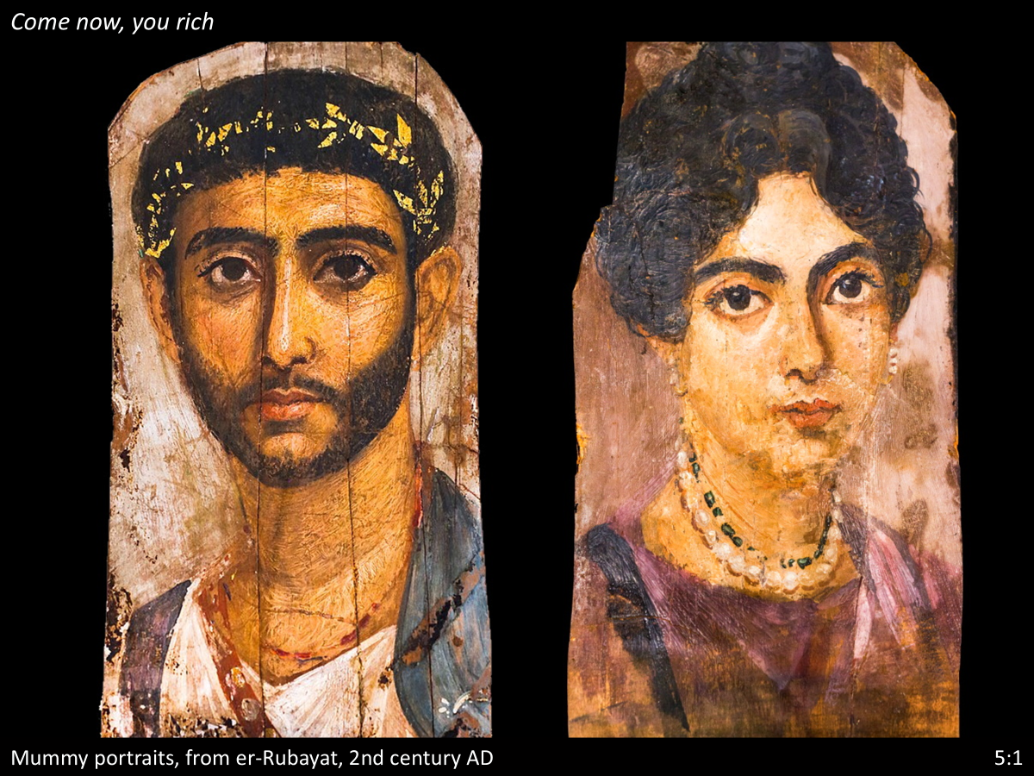
Oppression By The Rich. James 5:1-6
James 5:1 Come now, you rich, weep and howl for your miseries that are coming upon you!
newlebanoncoc.com

Slide 6
Oppression By The Rich. James 5:1-6
1Tim. 6:8 And having food and clothing, with these we shall be content.
9 But those who desire to be rich fall into temptation and a snare, and into many foolish and harmful lusts which drown men in destruction and perdition.
10 For the love of money is a root of all kinds of evil, for which some have strayed from the faith in their greediness, and pierced themselves through with many sorrows.
newlebanoncoc.com

Slide 7
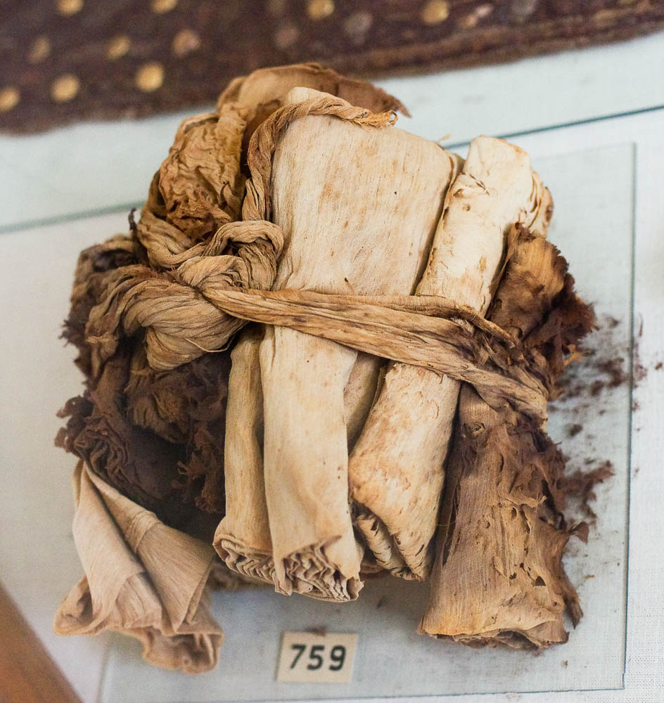
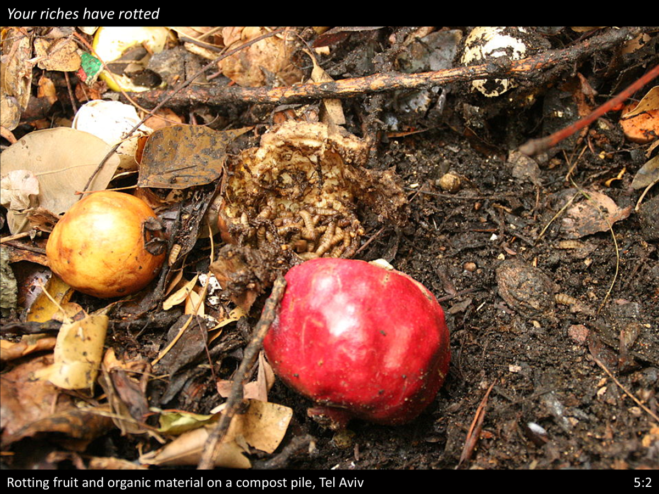
Oppression By The Rich. James 5:1-6
v.2 Your riches are corrupted, and your garments are moth-eaten.
newlebanoncoc.com

Slide 8
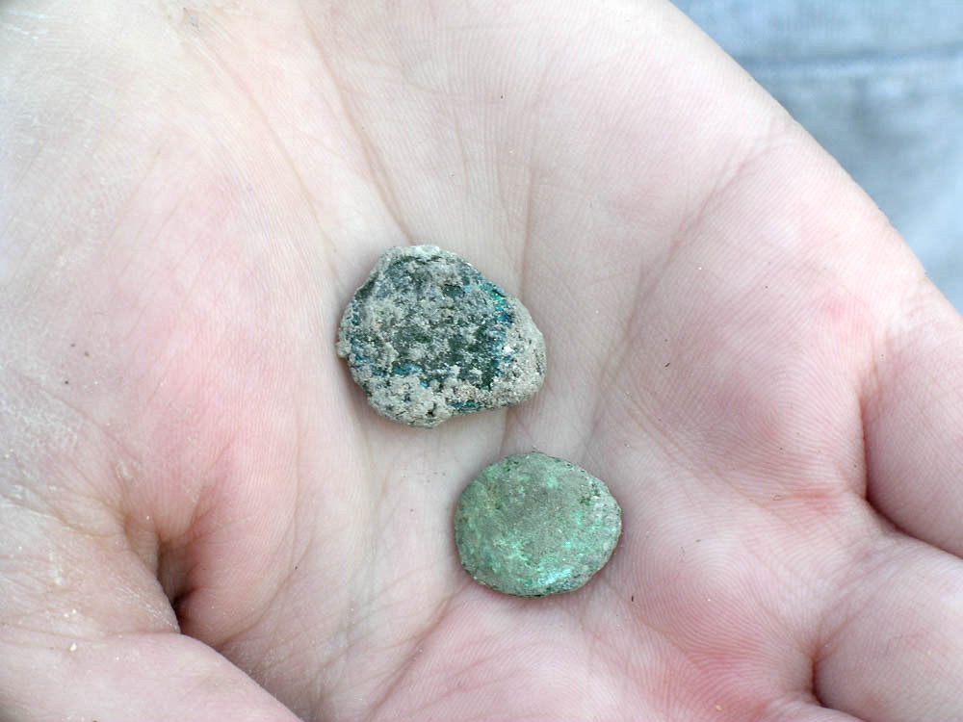
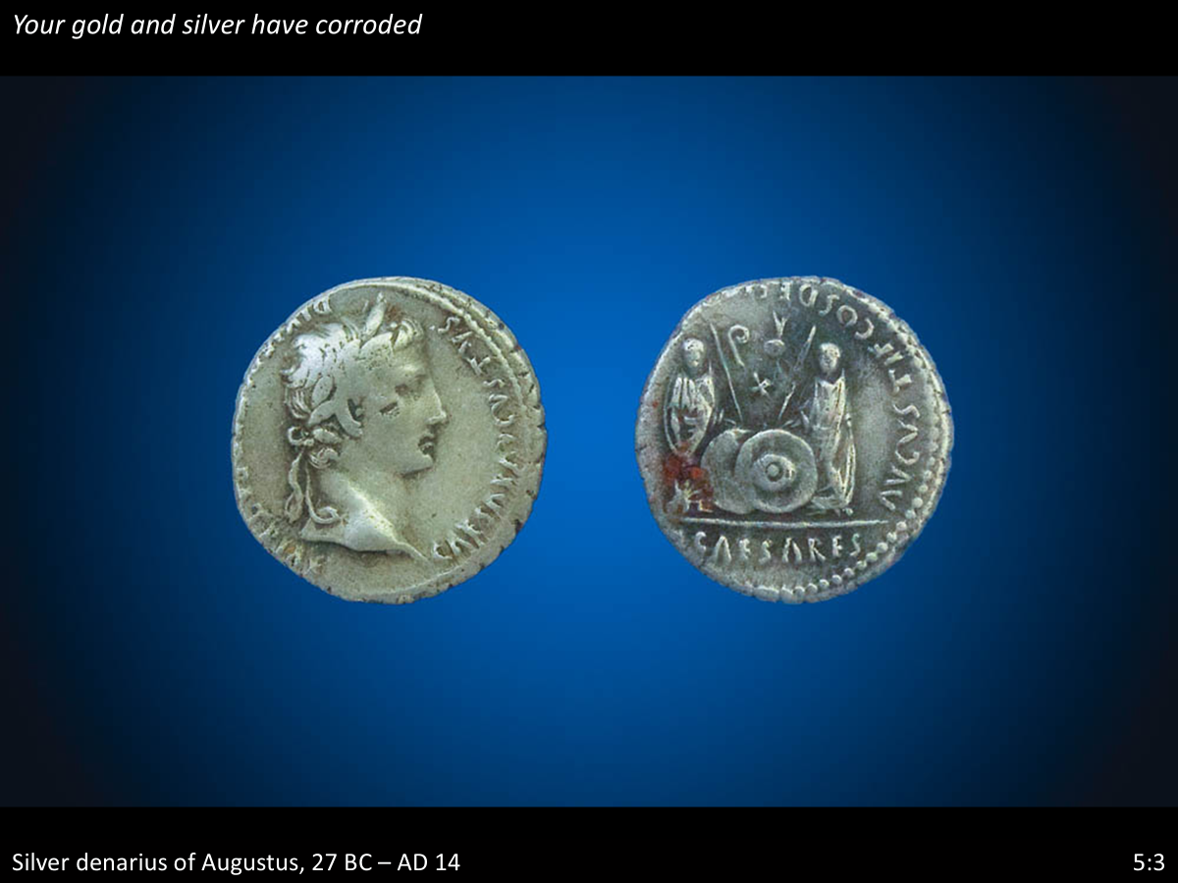
Oppression By The Rich. James 5:1-6
5:3 Your gold and silver are corroded, and their corrosion will be a witness against you and will eat your flesh like fire. You have heaped up treasure in the last days.
newlebanoncoc.com

Slide 9
Oppression By The Rich. James 5:1-6
“The wages of the traitor,
the spoil of the thief,
and the wealth of the oppressor burn the hands that clasp them. Memories of the wrongs shiver through each guilty soul like fire.”
newlebanoncoc.com

Slide 10
Oppression By The Rich. James 5:1-6
James 5:2 Your riches are corrupted, and your garments are motheaten.
Matthew 6:20 But lay up for yourselves treasures in heaven, where neither moth nor rust doth corrupt, and where thieves do not break through nor steal: 21 For where your treasure is, there will your heart be also.
newlebanoncoc.com

Slide 11
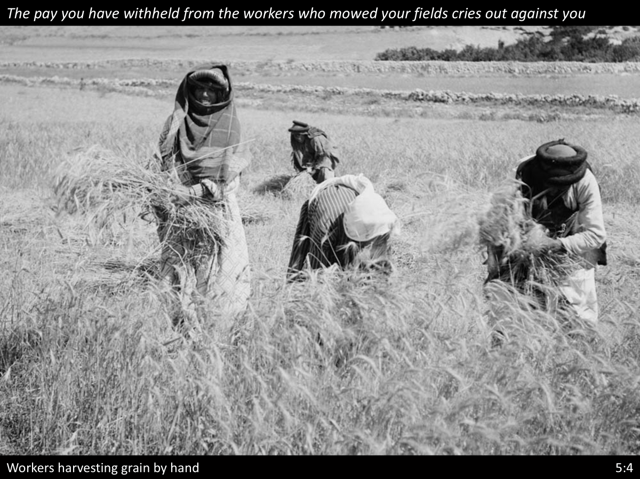
Oppression By The Rich. James 5:1-6
v.4 Indeed the wages of the laborers who mowed your fields, which you kept back by fraud, cry out; and the cries of the reapers have reached the ears of the
Lord of Sabaoth.
newlebanoncoc.com

Slide 12
Oppression By The Rich. James 5:1-6
Lord of Sabaoth - The expression means “The Lord of Hosts,” “The God of the heavenly armies,” “God of the heavenly hosts (such as the sun, moon and stars),” “God of all the armies of angels arranged in an orderly host,” etc., etc. It speaks of the omnipotence, glory and eternity of Almighty God.
newlebanoncoc.com

Slide 13
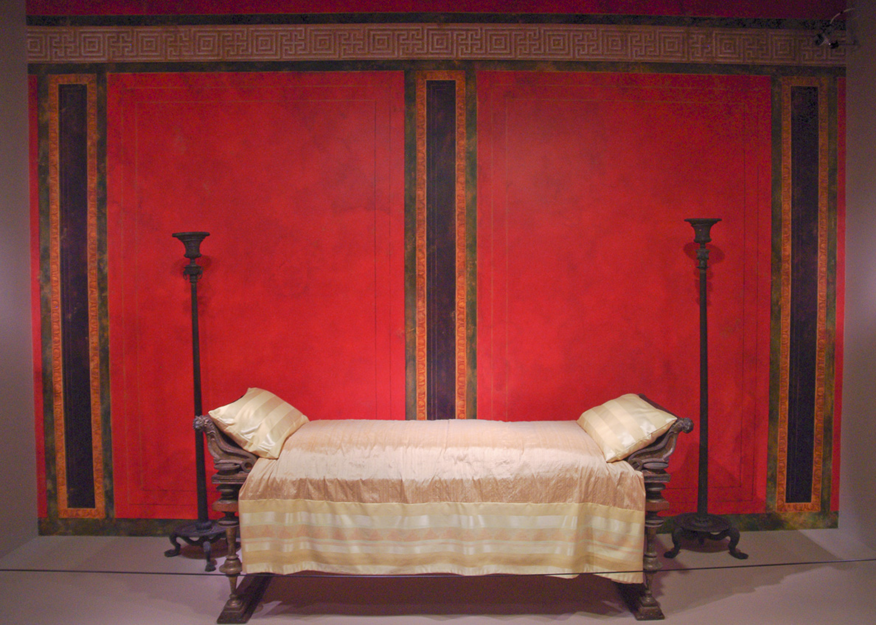
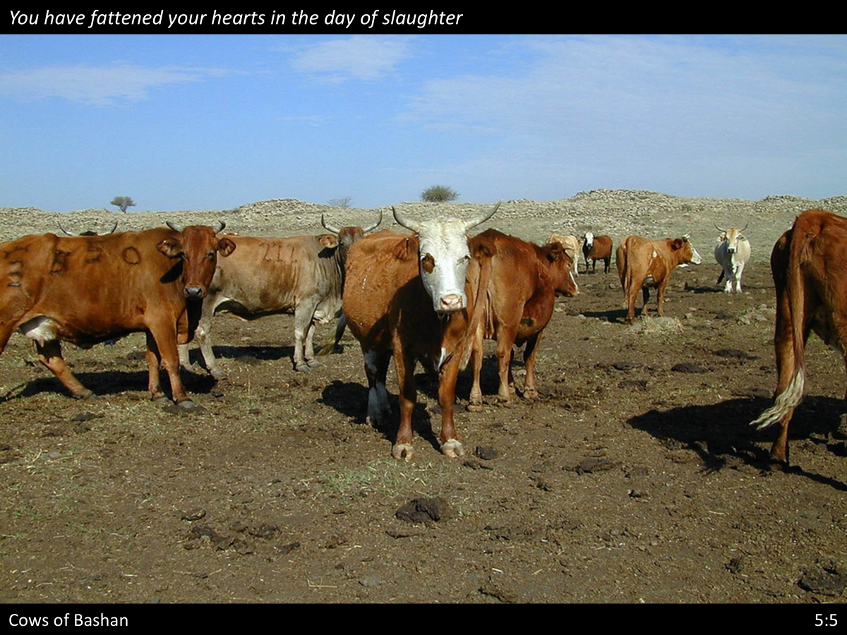
Oppression By The Rich. James 5:1-6
v.5 You have lived on the earth in pleasure and luxury; you have fattened your hearts as in a day of slaughter.
newlebanoncoc.com

Slide 14
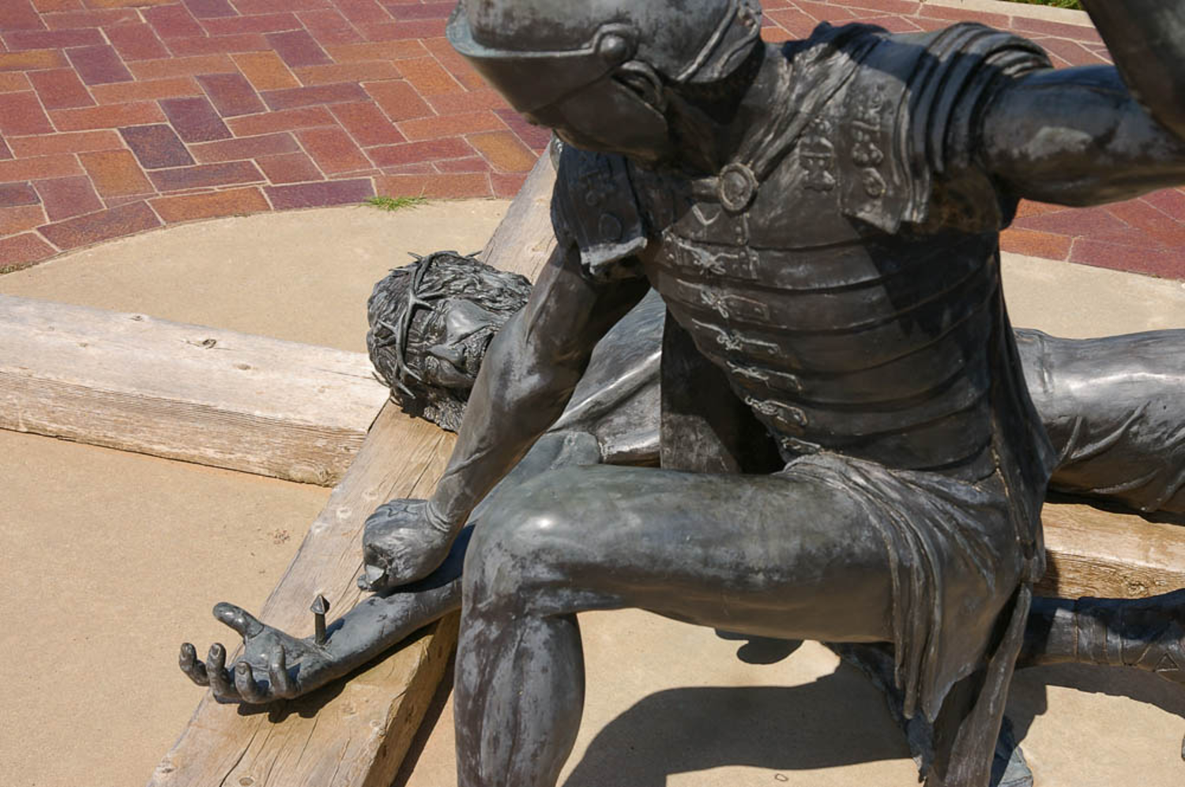
Oppression By The Rich. James 5:1-6
v.6 You have condemned, you have murdered the just; he does not resist you.
newlebanoncoc.com

Slide 15
Oppression By The Rich. James 5:1-6
The oppression of the poor,
the persecution of the church,
the cruel and heartless crucifixion of the Messiah,
inspired James in this letter to announce the coming judgment of God to fall upon those who carried out such wickedness.
newlebanoncoc.com

Slide 16
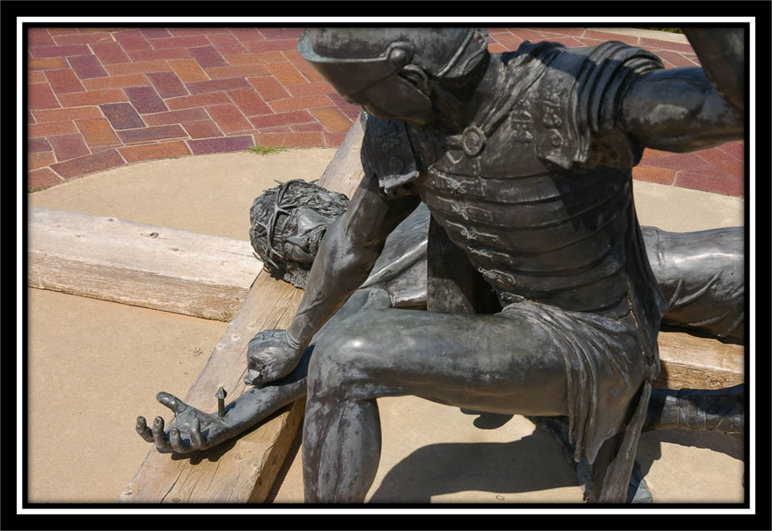

Slide 17
Questions?
Want to learn more about the Bible?
We will be glad to study the Bible with you.
New Lebanon
New Lebanon
Church of Christ
Church of Christ
New Lebanon, OH
newlebanoncoc.com
newlebanoncoc@gmail.com

