Slide 1

Welcome to our services
New Lebanon Church of Christ
We are Simply Christians.
Our Emphasis is Spiritual, Not Material or Social.
We are striving to be The Same Church as Described in The New Testament.
Please Come Back Again

Slide 2

James
Lesson Eight – Judging And Arrogance
James 4:14 whereas you do not know what will happen tomorrow. For what is your life? It is even a vapor that appears for a little time and then vanishes away. 15 Instead you ought to say, "If the Lord wills, we shall live and do this or that." 16 But now you boast in your arrogance. All such boasting is evil. 17 Therefore, to him who knows to do good and does not do it, to him it is sin.
Notes:
In his Gospel, John also connects light with God and His act of creation. “In the beginning was the Word, and the Word was with God, and the Word was God. He was with God in the beginning. Through him all things were made; without him nothing was made that has been made. In him was life, and that life was the light of all mankind. The light shines in the darkness, and the darkness has not overcome it” (John 1:1-5, NIV). This photo was taken from Jebel Musa, the traditional Mount Sinai.
tb030400500

Slide 3
James
Lesson One – James And Jesus
Lesson Two – James And Temptations
Lesson Three - But Be Doers Of The Word
Lesson Four – Showing Partiality
Lesson Five – Relationship of Faith and Works
Lesson Six – Instructions to Teachers
Lesson Seven – Worldliness In The Church
Lesson Eight – Judging And Arrogance
Notes:
In his Gospel, John also connects light with God and His act of creation. “In the beginning was the Word, and the Word was with God, and the Word was God. He was with God in the beginning. Through him all things were made; without him nothing was made that has been made. In him was life, and that life was the light of all mankind. The light shines in the darkness, and the darkness has not overcome it” (John 1:1-5, NIV). This photo was taken from Jebel Musa, the traditional Mount Sinai.
tb030400500

Slide 4
Judging And Arrogance - James 4:11-17
James 4:11 Do not speak evil of one another, brethren. He who speaks evil of a brother and judges his brother, speaks evil of the law and judges the law. But if you judge the law, you are not a doer of the law but a judge.
12 There is one Lawgiver, who is able to save and to destroy. Who are you to judge another?
newlebanoncoc.com

Slide 5
Judging And Arrogance - James 4:11-17
Matthew 7:1 "Judge not, that you be not judged. 2 "For with what judgment you judge, you will be judged; and with the measure you use, it will be measured back to you.
3 "And why do you look at the speck in your brother's eye, but do not consider the plank in your own eye?
4 "Or how can you say to your brother, 'Let me remove the speck from your eye'; and look, a plank is in your own eye? 5 "Hypocrite! First remove the plank from your own eye, and then you will see clearly to remove the speck from your brother's eye
newlebanoncoc.com

Slide 6
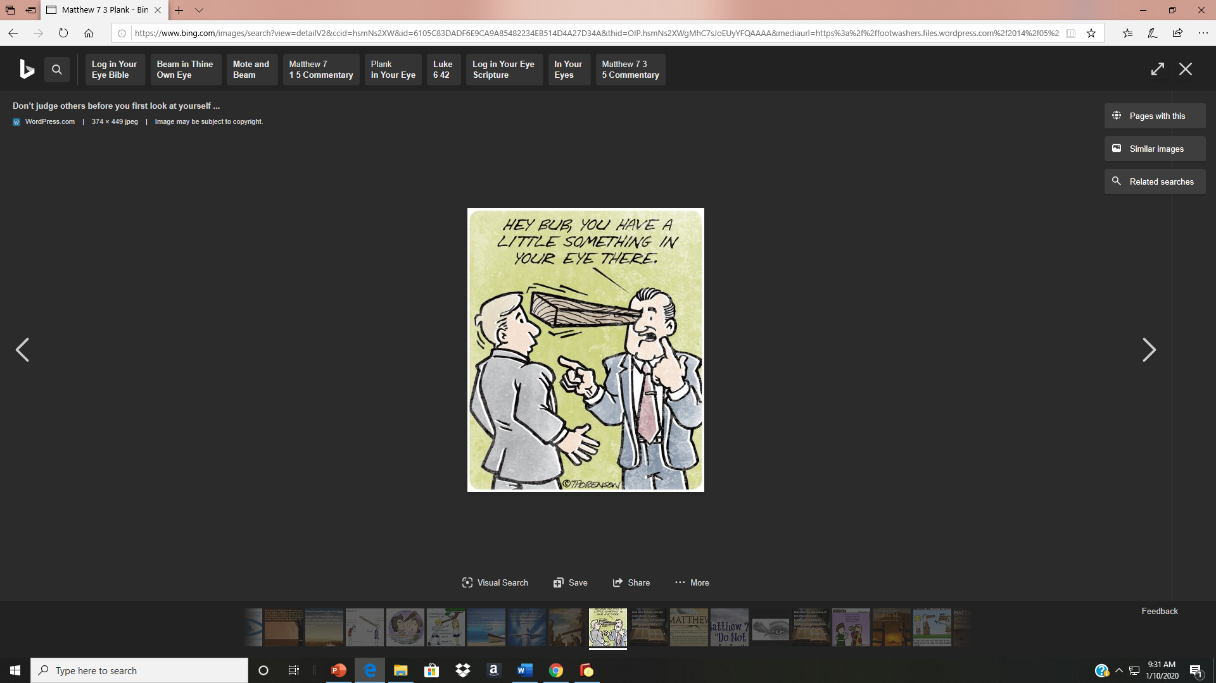
Judging And Arrogance - James 4:11-17
James 4:11 Do not speak evil of one another, brethren. He who speaks evil of a brother and judges his brother, speaks evil of the law and judges the law. But if you judge the law, you are not a doer of the law but a judge.
12 There is one Lawgiver, who is able to save and to destroy. Who are you to judge another?
newlebanoncoc.com

Slide 7
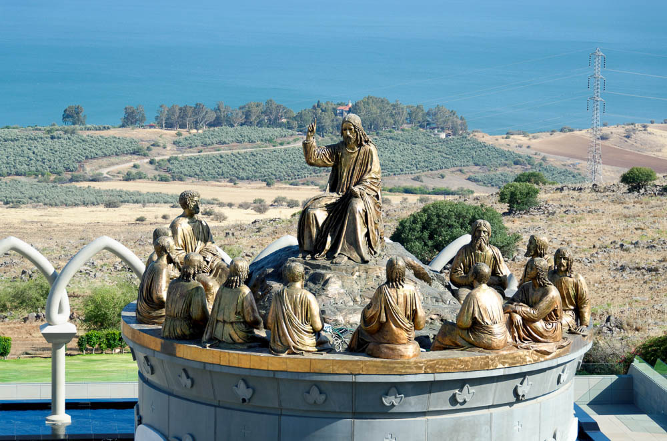
There is only one Lawgiver and Judge, One who is able to save and to destroy
Sculptures of Jesus teaching the twelve apostles overlooking the Mount of Beatitudes
4:12
Notes:
In the Sermon on the Mount (Matt 5–7), which is echoed throughout much of the Book of James, Jesus is portrayed as a new lawgiver. This can be observed from the geographical parallels with Moses ascending Sinai to receive the Law to deliver it to the people and the prelude to the Sermon on the Mount with Jesus on a “mountain” delivering “words of mine” to the disciples and the multitude.
“Seeing the crowds, he went up on the mountain, and when he sat down, his disciples came to him” (Matt 5:1, ESV).
Jesus did not give a new law, but instead presented the heart motivation of the original law by giving specific examples where tradition had crept in and nullified the underlying morale of the Law. He also claimed that he would fulfill the Law.
“Do not think that I have come to abolish the Law or the Prophets; I have not come to abolish them but to fulfill them. For truly, I say to you, until heaven and earth pass away, not an iota, not a dot, will pass from the Law until all is accomplished” (Matt 5:17-18, ESV).
These details indicate that Jesus is certainly a greater lawgiver than Moses (a major point of another Jewish-Christian text—Heb 3). Yet, they also point to the greater truth that Jesus Himself was and is the lawgiver and judge along with God the Father. This is, of course, true from a theological standpoint (e.g., Matt 19:28; John 5:19-24), but can it be substantiated in the context of James’s use of the Sermon on the Mount? James refers to Jesus’s teaching “You shall love your neighbor as yourself” (Matt 22:37-40, quoting Lev 19:18) as the ”royal law” (Jas 2:8). As we noted in James 2, referring to this law as “royal” connects it directly with Jesus’s statement during Passion Week, as well as his role as the messianic king. The fact that James mentions “judging your neighbor” again in 4:12 further underscores the idea that Jesus is being understood as the “lawgiver and judge” alongside the Father. Finally, the penultimate teaching to the conclusion of the Sermon on the Mount also presents Jesus as the judge and destroyer of those who do not follow “His words” (Matt 7:24; cf. also Matt 10:33; 13:42; 25:41).
“Not everyone who says to me, ‘Lord, Lord,’ will enter the kingdom of heaven, but the one who does the will of my Father who is in heaven. On that day many will say to me, ‘Lord, Lord, did we not prophesy in your name, and cast out demons in your name, and do many mighty works in your name?’ And then will I declare to them, ‘I never knew you; depart from me, you workers of lawlessness’” (Matt 7:21-23, ESV).
These sculptures are located at Domus Galilaeae.
tb053016334

Slide 8

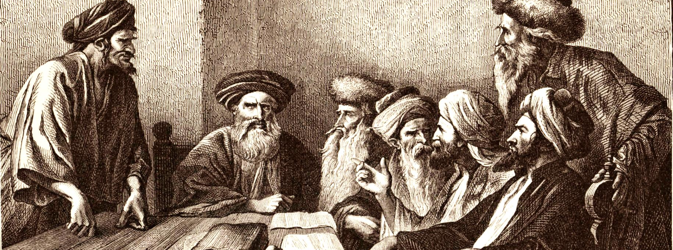
JAMES
Chapter 4
11 Speak not evil one of another, brethren. He that speaketh evil of his brother, and judgeth his brother, speaketh evil of the law, and judgeth the law: but if thou judge the law, thou art not a doer of the law, but a judge.
12 There is one lawgiver, who is able to save and to destroy: who art thou that judgest another?
To judge a brother in the sense here intended is to form unfavorable opinions, impute unworthy motives, or put the worst possible interpretation on their words and actions.
To speak evil of a brother is a sin against the brother and against the law, for you are refusing to do what the law commands—to love one’s neighbor as oneself.
Christ is our lawgiver and judge. When man legislates where God has not it brings about division, and it is rebellion against God.
Throughout history when men have enacted legislation apart from the law of Christ it has resulted in man-made creeds, synods, councils, confessions of faith, and church manuals which add to and take away from the Word of God.

Slide 9
Judging And Arrogance - James 4:11-17
13 Come now, you who say, "Today or tomorrow we will go to such and such a city, spend a year there, buy and sell, and make a profit" 14 whereas you do not know what will happen tomorrow. For what is your life? It is even a vapor that appears for a little time and then vanishes away.
15 Instead you ought to say, "If the Lord wills, we shall live and do this or that.“
16 But now you boast in your arrogance. All such boasting is evil.17 Therefore, to him who knows to do good and does not do it, to him it is sin.
newlebanoncoc.com

Slide 10
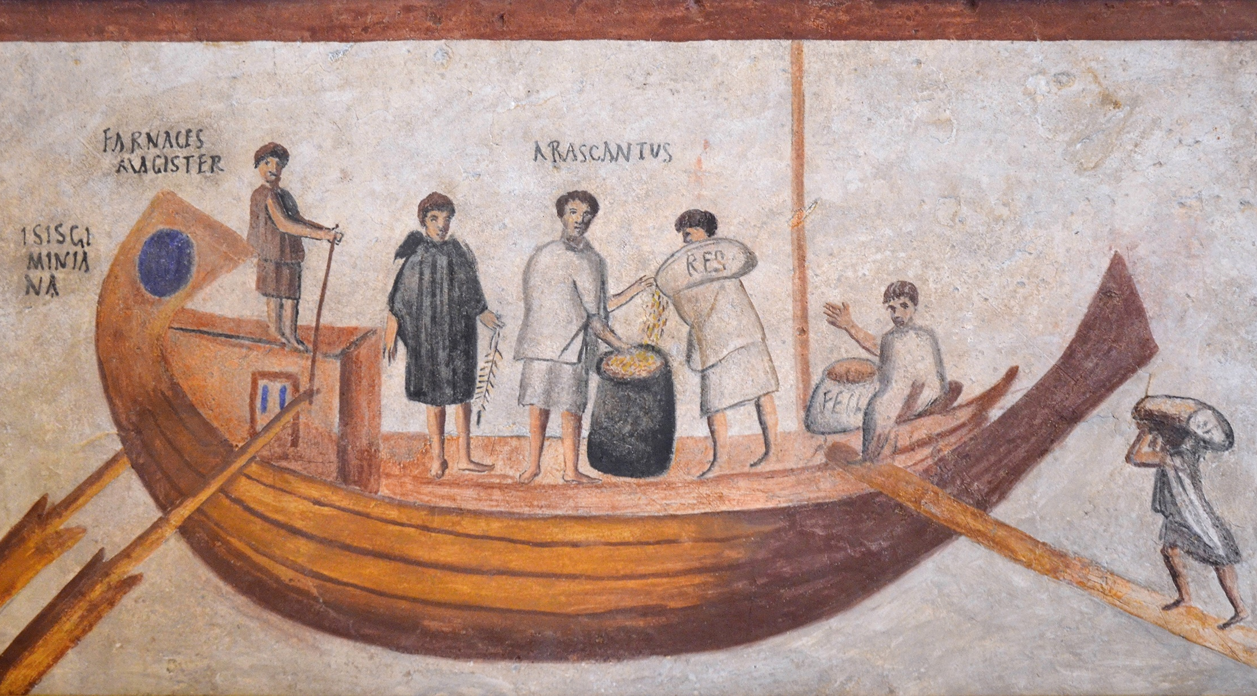
Today or tomorrow we will go to this or that city and spend a year there and trade
Fresco of a river boat embarking for grain transport, from Ostia, 3rd century AD
4:13
Notes:
This fresco fragment shows the river boat Isis Geminiana embarking grain for transportation. The workmen appear to be carrying grain in bags (one is labeled RES, “stuff,” while another is labeled FECI, “done”), and dumping them into a measuring container. While this may have been a useful method for river transport, it seems unlikely that grain would have been transported in bags or loose when crossing the sea because of the risk of it getting wet. On the other hand, it is possible that an additional layer of planking forming a second “skin” inside the hull may have been sufficient to keep the grain dry and allow it to be transported loose, as is seen in some 16th and 17th century ships. The fresco comes from the first half of the 3rd century AD, from the Columbarium No. 31 of the Necropolis in Ostia. It was photographed in the Vatican Museums. This image comes from Carole Raddato and is licensed under CC BY-SA 2.0, via Wikimedia Commons: https://www.flickr.com/photos/carolemage/28993017561
wiki28993017561

Slide 11
Judging And Arrogance - James 4:11-17
4:13 Come now,
Today or tomorrow
we will go
to such and such a city,
spend a year there,
buy
sell,
and make a profit
newlebanoncoc.com

Slide 12
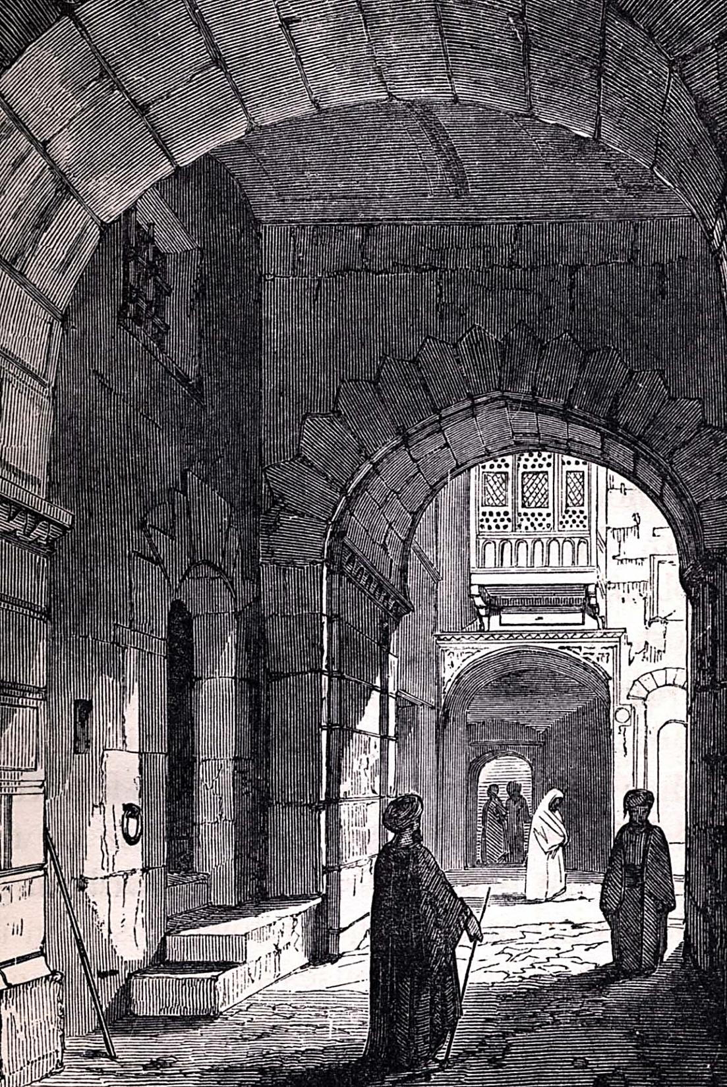
Proverbs 27:1
“Boast not thyself of to morrow; for thou knowest not what a day may bring forth.”
Paul was keenly conscious of the Lord’s hand in his affairs and frequently made mention of it.
C
Acts 18:21
“. . . If God will. . . .”
1 Corinthians 4:19
“. . . If the Lord will. . . .”
1 Corinthians 16:7
“. . . If the Lord permit.”
n
JAMES
Chapter 4
Those who make plans from which God has been excluded and who glory in such do that which is evil.
We must ever remember that God is the superintendent of the universe, we are the creatures of his hand, and we should conduct ourselves accordingly.—
13 Go to now, ye that say, To day or to morrow we will go into such a city, and continue there a year, and buy and sell, and get gain:
14 Whereas ye know not what shall be on the morrow. For what is your life? It is even a vapour, that appeareth for a little time, and then vanisheth away.
15 For that ye ought to say, If the Lord will, we shall live, and do this, or that.
16 But now ye rejoice in your boastings: all such rejoicing is evil.

Slide 13
Judging And Arrogance - James 4:11-17
4:14 whereas you do not know what will happen tomorrow. For what is your life? It is even a vapor that appears for a little time and then vanishes away.
The uncertainty of tomorrow was stressed by Jesus who said of the grass of the field, “It today is, and tomorrow is cast into the oven” (Matt. 6:30)
Both Peter and James stated the spiritual overtones of the teaching, Peter saying, “All flesh is as grass” (1 Pet. 1:24), an idea certainly included in what James said here.
newlebanoncoc.com

Slide 14
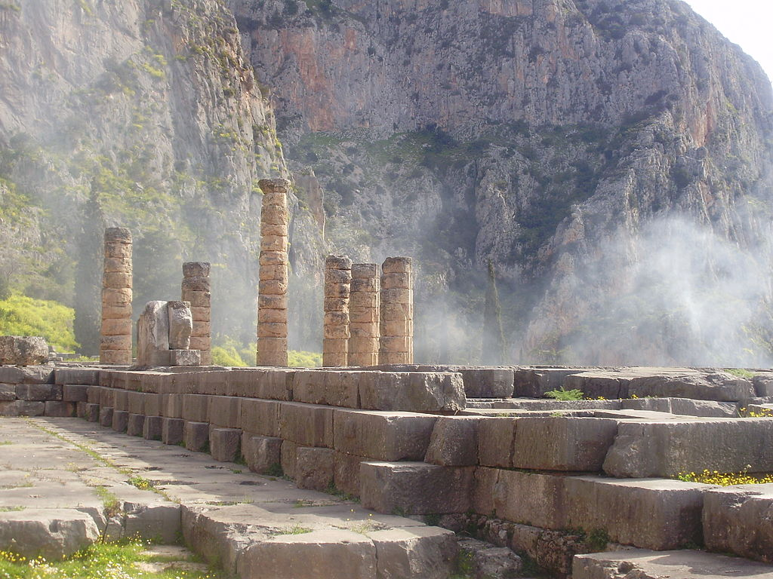
You are just a mist that appears for a short time and then vanishes away
Wispy fog at the ruins of the Temple of Apollo at Delphi
4:14
Notes:
This image comes from Laslovarga and is licensed under CC BY-SA 3.0, via Wikimedia Commons: https://commons.wikimedia.org/wiki/File:A_Delphi_magic_mist.JPG.
wiki012120092448

Slide 15
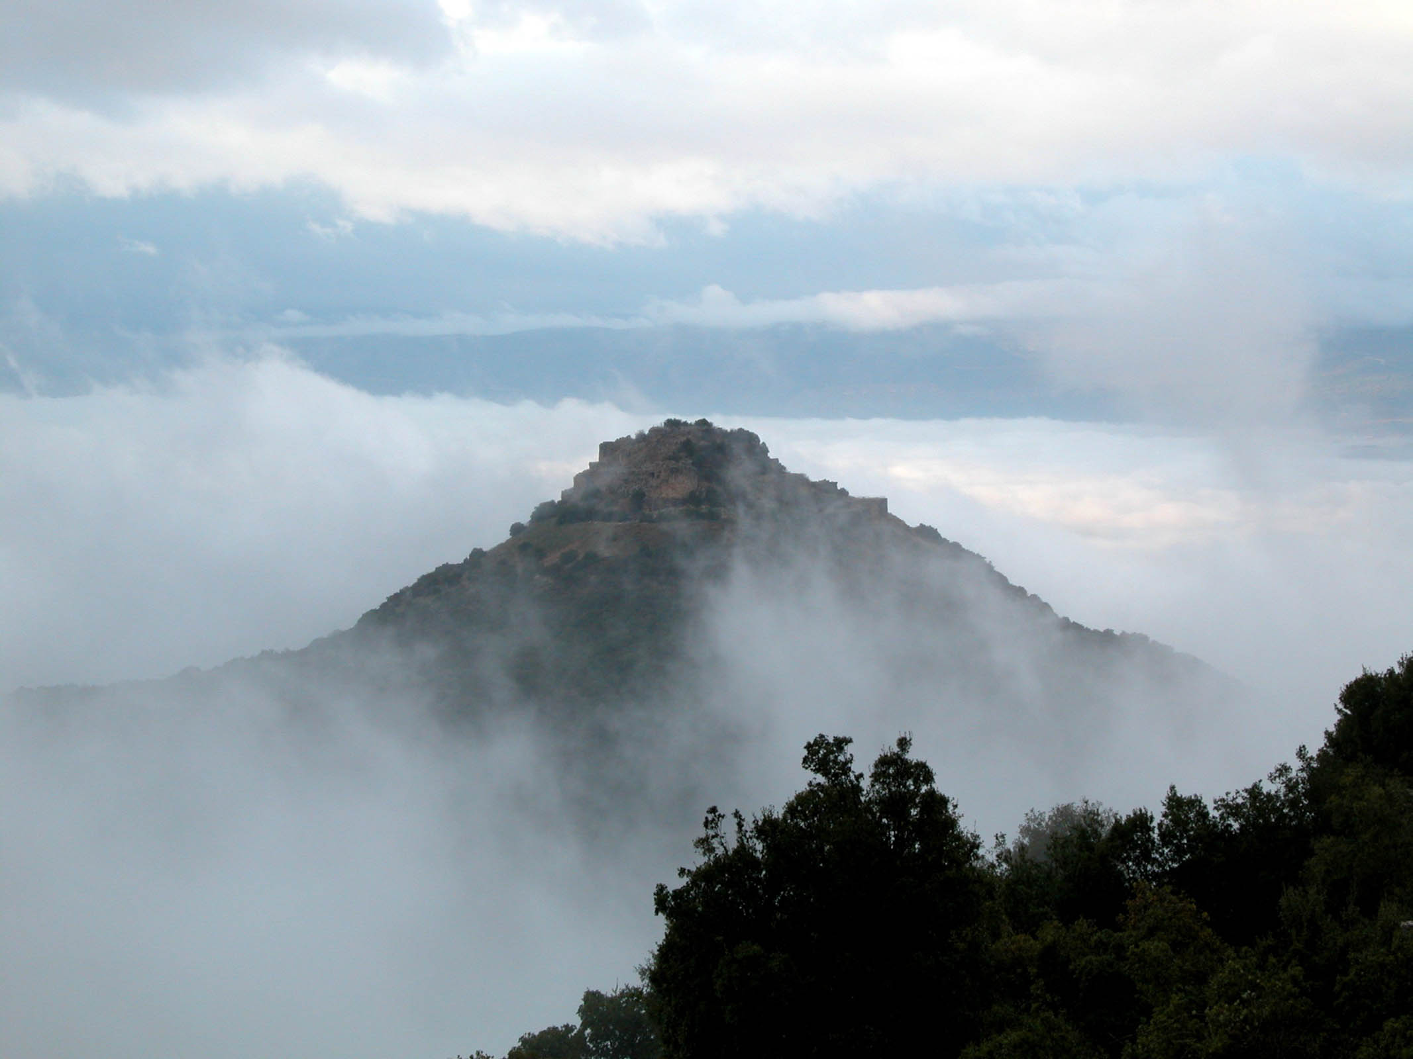
You are just a mist that appears for a short time and then vanishes away
Nimrod’s Fortress in fog
4:14
Notes:
“Oh, remember that my life is a breath! My eye will never again see good. The eye of him who sees me will see me no more; While your eyes are upon me, I shall no longer be” (Job 7:7-8, NKJV).
tb121802201

Slide 16
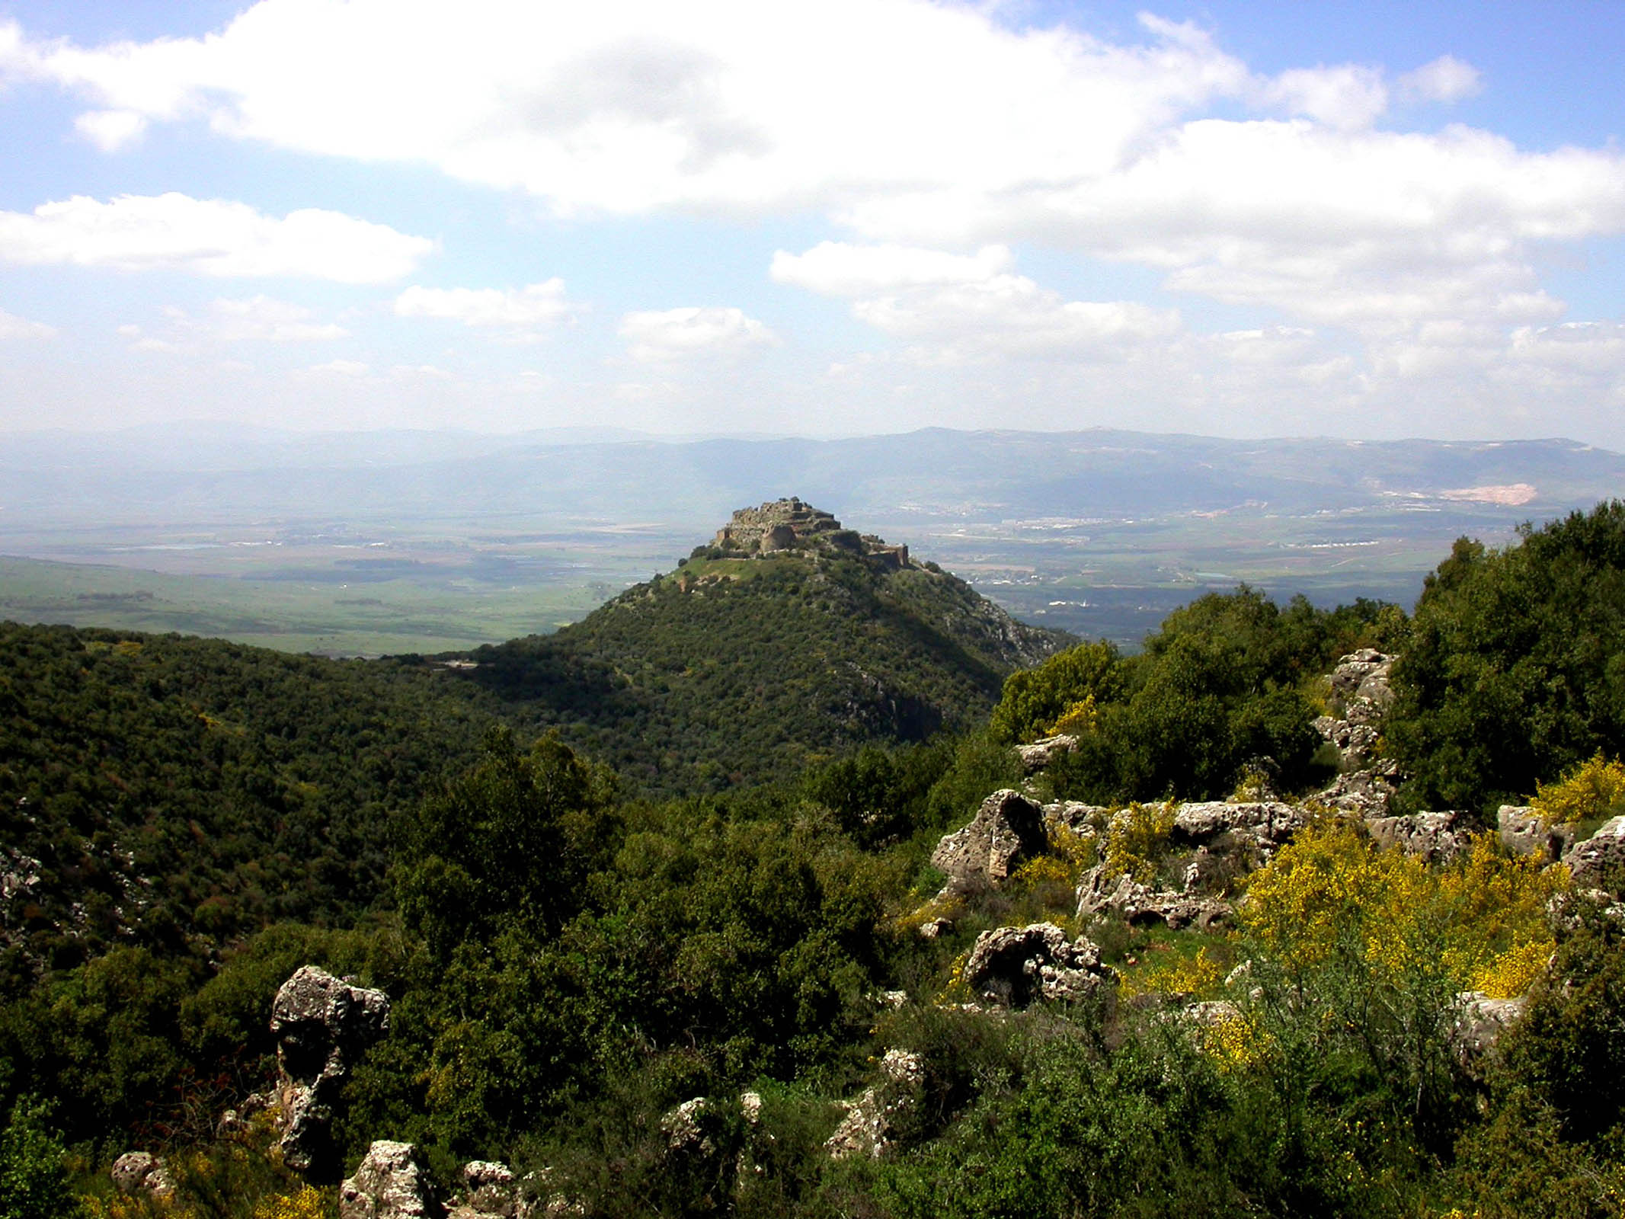
You are just a mist that appears for a short time and then vanishes away
Nimrod’s Fortress with fog gone
4:14
Notes:
“As the cloud disappears and vanishes away, So he who goes down to the grave does not come up” (Job 7:9, NKJV).
tb040903258

Slide 17
Judging And Arrogance - James 4:11-17
4:15 Instead you ought to say, "If the Lord wills, we shall live and do this or that."
Here James explains the proper attitude. "If the Lord wills, we shall live and do this or that." - Literally, this is saying, "If the Lord has so determined it in His wisdom."
It is important that our attitude always reflects this idea rather than just saying the words, "If the Lord wills.“
We should not just say it as an idle phrase, as some people do.
newlebanoncoc.com

Slide 18
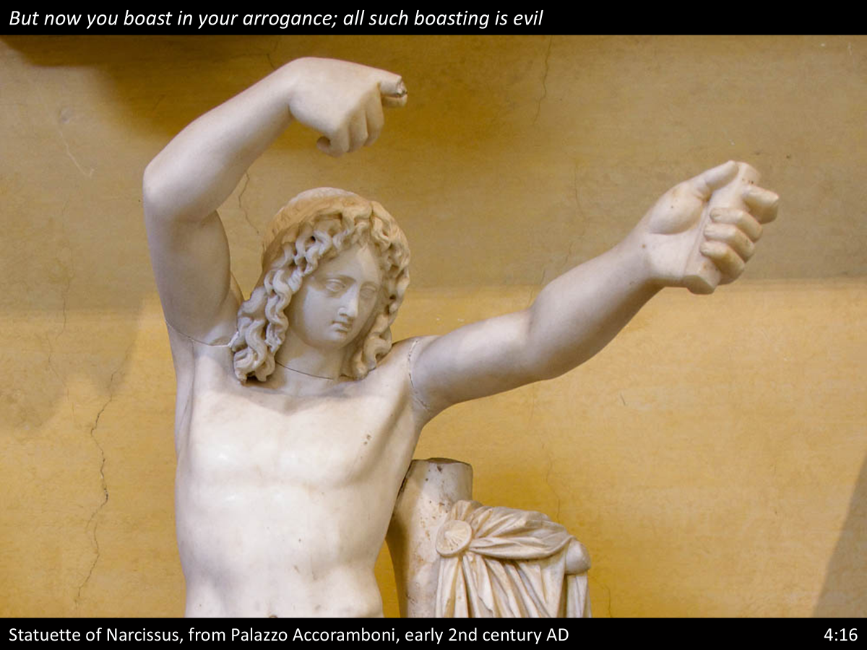
The verb “boast” (Gk. kauchaomai, καυχάομαι) means to take pride in something, often in the negative sense of bragging.
Narcissus was a figure in Greco-Roman mythology who was completely self-absorbed. Such behavior fits well with both boasting (related to self) and arrogance. This statuette of Narcisuss was photographed at the Vatican Museums.

Slide 19
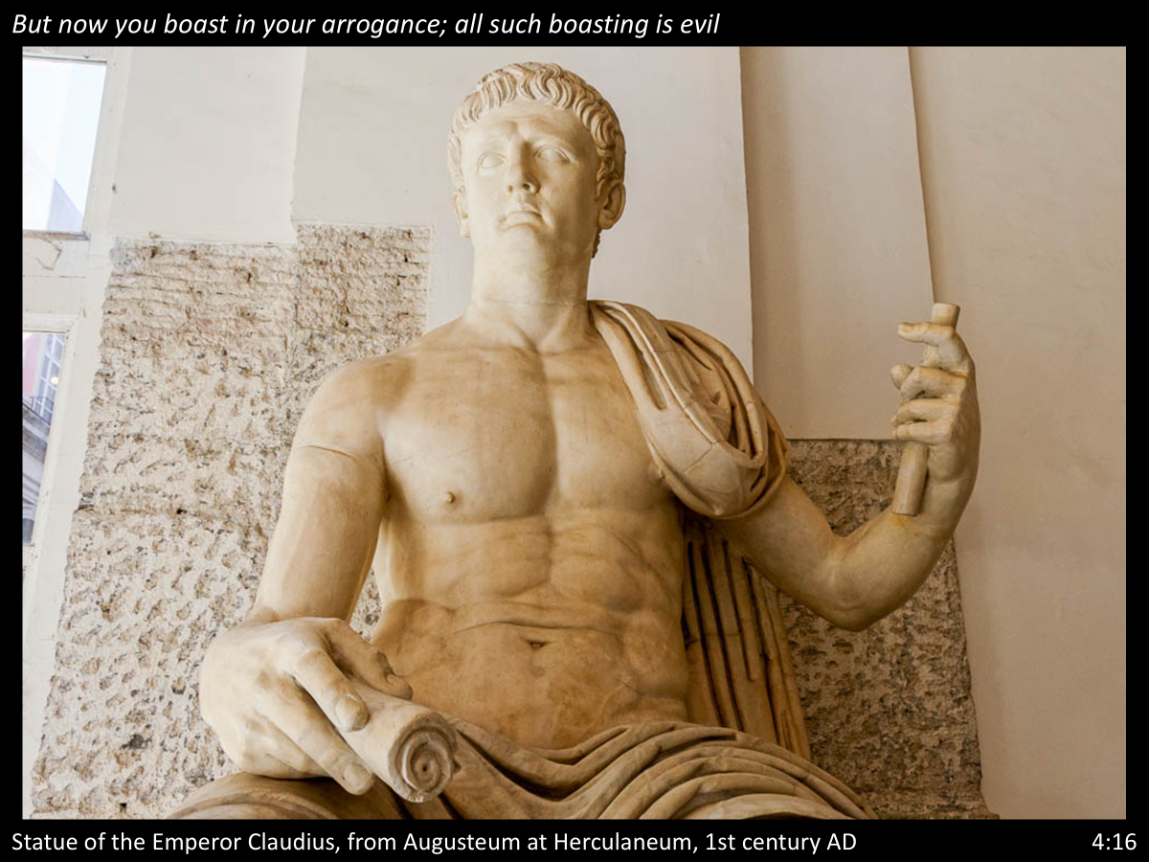
The word “arrogance” (Gk. alazoneia, ἀλαζονεία) refers to pretension and thinking highly of oneself. The Roman emperors were known for their arrogance. The emperor who was on the throne at the time when James wrote this letter was Claudius. This statue portrays him seated on a throne, holding a spear in one hand and a scroll in the other. His body is portrayed like the chiseled body of a model athlete, with his royal robe throne over one shoulder. This statue was photographed at the Naples Archaeological Museum.

Slide 20
Judging And Arrogance - James 4:11-17
"Arrogance" is from the same Greek word as is used for the "pride" of life (ALAZONEIA)
in 1 John 2:16. This phrase indicates that the real problem was they were actually making it a point to leave out God — almost defying Him. They put their trust in their own abilities. All such boasting is evil –
"Boasting" is from the Greek word (KAUCHĒSIS) meaning, "the act of glorying." This word originally referred to a traveling fake doctor, who offered cures that were not cures and boasted of things he was not actually able to do.
newlebanoncoc.com

Slide 21
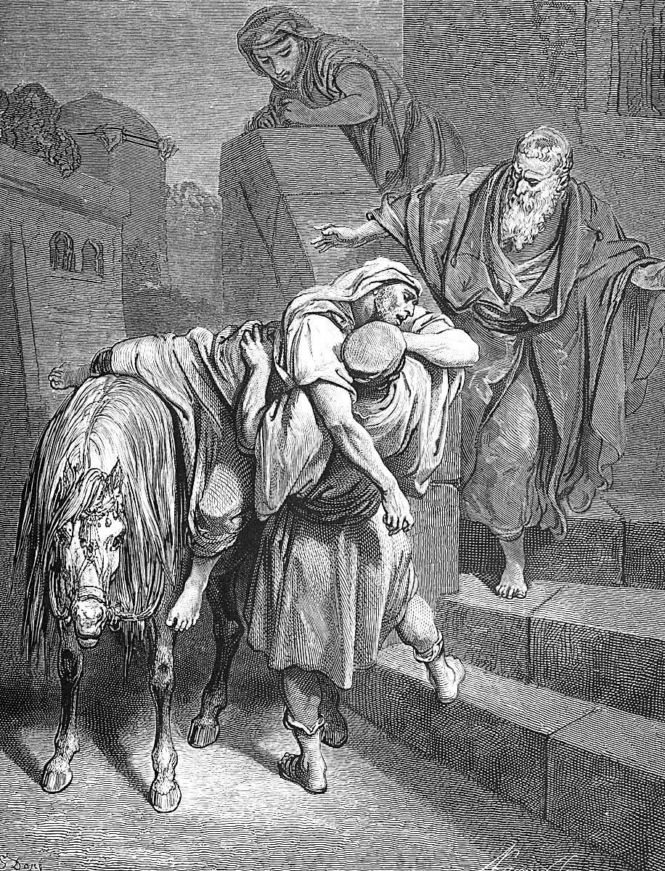
JAMES
Chapter 4
There are sins of omission as well as commission. Again we refer you to Christ’s parable in Luke 10. It is a vivid example of the sin of omission, for the priest and the Levite omit their duty to their fellow man, while the good Samaritan was a loving neighbor to the injured stranger.
17 Therefore to him that knoweth to do good, and doeth it not, to him it is sin.

Slide 22
Judging And Arrogance - James 4:11-17
God has taught us what is right and if we fail to do it, it is sin.
The danger is that we agree to the truth about the brevity of life and the uncertainty of the future.
BUT we go on living, as we did before, with our far-reaching plans and without any reference to the will of God.
Such an attitude is the very essence of sin! Sin is not only doing evil, but failing to do the good we know to do.
newlebanoncoc.com

