Slide 1

Welcome to our services
New Lebanon Church of Christ
We are Simply Christians.
Our Emphasis is Spiritual, Not Material or Social.
We are striving to be The Same Church as Described in The New Testament.
Please Come Back Again

Slide 2
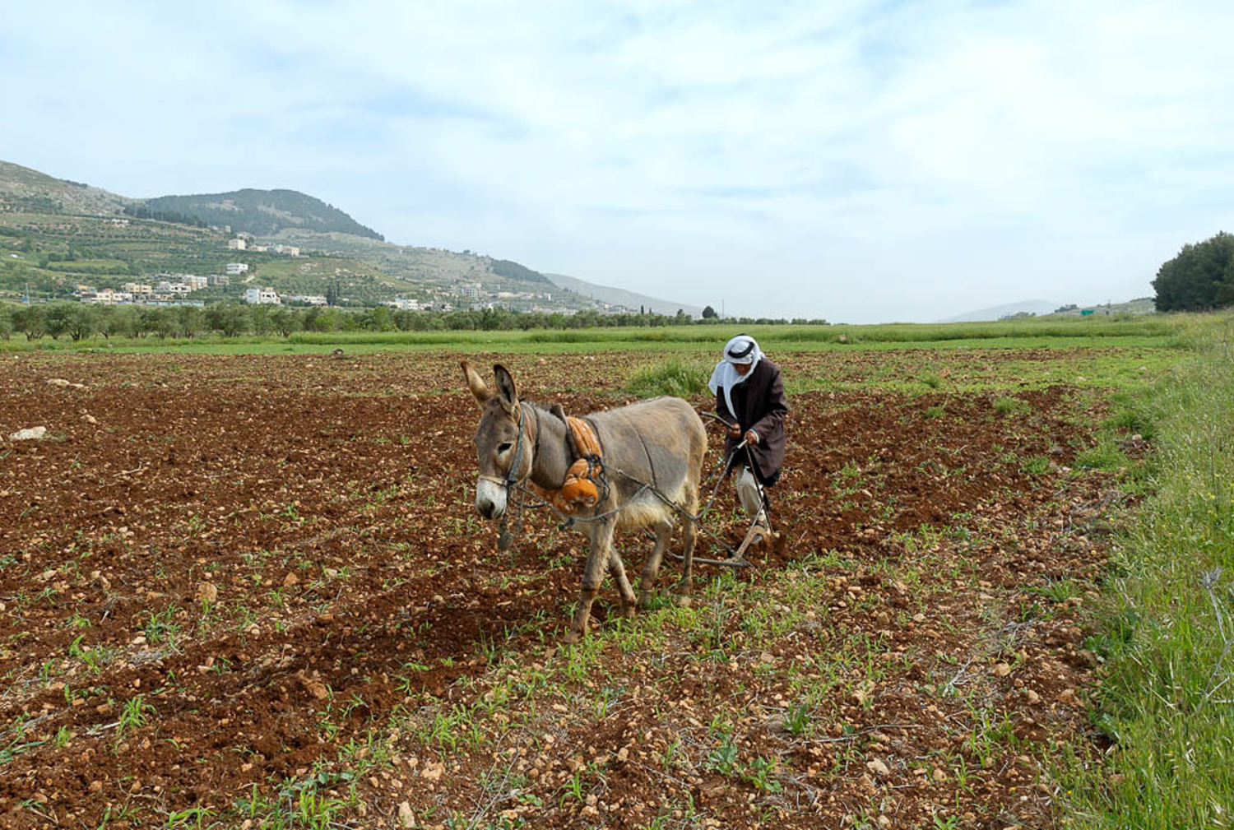
Be Patient Brethren. James 5:7-12
Therefore, be patient, brethren, until the coming of the Lord. See how the farmer waits for the precious fruit of the earth, waiting patiently for it until it receives the early and latter rain.

Slide 3
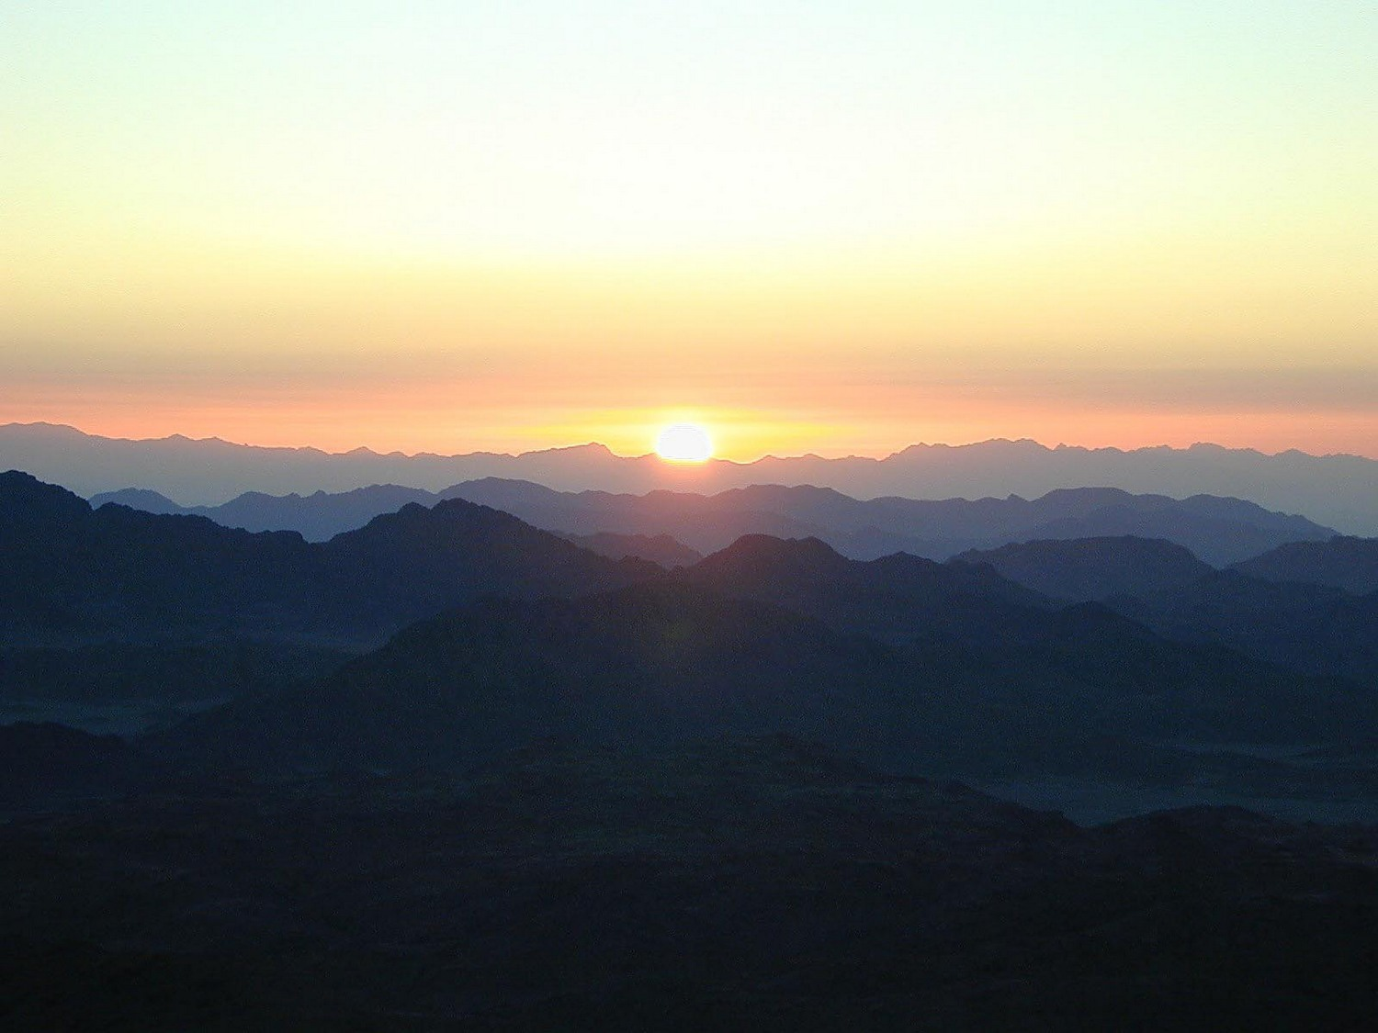
James
Lesson One – James And Jesus
Lesson Two – James And Temptations
Lesson Three - But Be Doers Of The Word
Lesson Four – Showing Partiality
Lesson Five – Relationship of Faith and Works
Lesson Six – Instructions to Teachers
Lesson Seven – Worldliness In The Church
Lesson Eight – Judging And Arrogance
Lesson Nine – Oppression By The Rich
Lesson Ten – Be Patient Brethren
Notes:
In his Gospel, John also connects light with God and His act of creation. “In the beginning was the Word, and the Word was with God, and the Word was God. He was with God in the beginning. Through him all things were made; without him nothing was made that has been made. In him was life, and that life was the light of all mankind. The light shines in the darkness, and the darkness has not overcome it” (John 1:1-5, NIV). This photo was taken from Jebel Musa, the traditional Mount Sinai.
tb030400500

Slide 4
Be Patient Brethren. James 5:7-12
James 5:7 Therefore be patient, brethren, until the coming of the Lord. See how the farmer waits for the precious fruit of the earth, waiting patiently for it until it receives the early and latter rain. 8 You also be patient. Establish your hearts, for the coming of the Lord is at hand. 9 Do not grumble against one another, brethren, lest you be condemned. Behold, the Judge is standing at the door!
10 My brethren, take the prophets, who spoke in the name of the Lord, as an example of suffering and patience. 11 Indeed we count them blessed who endure. You have heard of the perseverance of Job and seen the end intended by the Lord--that the Lord is very compassionate and merciful.
12 But above all, my brethren, do not swear, either by heaven or by earth or with any other oath. But let your "Yes," be "Yes," and your "No," "No," lest you fall into judgment.

Slide 5
Be Patient Brethren. James 5:7-12
5:8 You also be patient. Establish your hearts, for the coming of the Lord is at hand.
The farmer is patient – you also be patient
Be patient
Establish your hearts
Prepare yourselves
newlebanoncoc.com

Slide 6
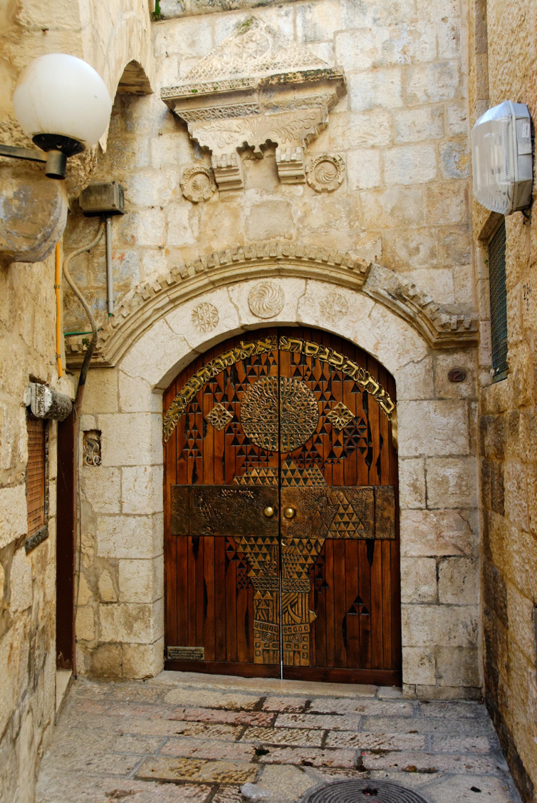
Be Patient Brethren. James 5:7-12
James 5:9 Do not grumble against one another, brethren, lest you be condemned. Behold, the Judge is standing at the door!
newlebanoncoc.com

Slide 7
Be Patient Brethren. James 5:7-12
5:10 My brethren, take the prophets, who spoke in the name of the Lord, as an example of suffering and patience.
Take the farmer
Take the prophets
newlebanoncoc.com

Slide 8
Be Patient Brethren. James 5:7-12
Heb. 11:33-38; faith subdued kingdoms, worked righteousness, stopped the mouths of lions, quenched the violence of fire, escaped the edge of the sword, out of weakness were made strong, became valiant in battle, turned to flight the armies of the aliens. Women received their dead raised to life again. And others were tortured, not accepting deliverance, that they might obtain a better resurrection. Still others had trial of mockings and scourgings, and chains and imprisonment. They were stoned, they were sawn in two, were tempted, were slain with the sword. They wandered about in sheepskins and goatskins, being destitute, afflicted, tormented--of whom the world was not worthy. They wandered in deserts and mountains, in dens and caves
newlebanoncoc.com

Slide 9
Be Patient Brethren. James 5:7-12
2 Chron. 36:16; But they mocked the messengers of God, despised His words, and scoffed at His prophets, until the wrath of the LORD arose against His people, till there was no remedy
1 Thess. 2:15; who killed both the Lord Jesus and their own prophets, and have persecuted us; and they do not please God and are contrary to all men,
Matt. 5:12; "Rejoice and be exceedingly glad, for great is your reward in heaven, for so they persecuted the prophets who were before you.
newlebanoncoc.com

Slide 10
Be Patient Brethren. James 5:7-12
5:11 Indeed we count them blessed who endure. You have heard of the perseverance of Job and seen the end intended by the Lord—that the Lord is very compassionate and merciful.
Take the farmer
Take the prophets
Take Job
James 1:12 Blessed is the man who endures temptation; for when he has been approved, he will receive the crown of life which the Lord has promised to those who love Him.
newlebanoncoc.com

Slide 11
Be Patient Brethren. James 5:7-12
Heb. 12:5 And you have forgotten the exhortation which speaks to you as to sons: "My son, do not despise the chastening of the LORD, Nor be discouraged when you are rebuked by Him;
6 For whom the LORD loves He chastens, And scourges every son whom He receives." 7 If you endure chastening, God deals with you as with sons; for what son is there whom a father does not chasten?
8 But if you are without chastening, of which all have become partakers, then you are illegitimate and not sons.
9 Furthermore, we have had human fathers who corrected us, and we paid them respect. Shall we not much more readily be in subjection to the Father of spirits and live?
10 For they indeed for a few days chastened us as seemed best to them, but He for our profit, that we may be partakers of His holiness

Slide 12
Be Patient Brethren. James 5:7-12
The Lord uses trials to produce steadfastness and to make better Christians (James 1:2-4).
James 1:2 My brethren, count it all joy when you fall into various trials, 3 knowing that the testing of your faith produces patience. 4 But let patience have its perfect work, that you may be perfect and complete, lacking nothing.
newlebanoncoc.com

Slide 13
Be Patient Brethren. James 5:7-12
Someone once said, "You cannot persevere unless there is a trial in your life.
There can be no victories without battles; there can be no peaks without valleys.
If you want the blessing, you must be prepared to carry the burden and fight the battle."
newlebanoncoc.com

Slide 14
Be Patient Brethren. James 5:7-12
1 Peter 2:20-23. For what credit is it if, when you are beaten for your faults, you take it patiently? But when you do good and suffer, if you take it patiently, this is commendable before God.
21 For to this you were called, because Christ also suffered for us, leaving us an example, that you should follow His steps:
22 "Who committed no sin, Nor was deceit found in His mouth"; 23 who, when He was reviled, did not revile in return; when He suffered, He did not threaten, but committed Himself to Him who judges righteously;
newlebanoncoc.com

Slide 15
Be Patient Brethren. James 5:7-12
5:12 But above all, my brethren, do not swear, either by heaven or by earth or with any other oath. But let your "Yes" be "Yes," and your "No," "No," lest you fall into judgment.
The phrase "above all" is another way of saying, "The most important thing to be aware of under these circumstances is…" do not swear –
This section is not talking about profanity. That was already discussed and condemned in James 3:9-12. In this section James is condemning the making of oaths.

Slide 16
Be Patient Brethren. James 5:7-12
People who are honest and truthful do not need any more than a simple "yes" or "no" to express the truth to others.
The best guarantee of any statement is not an oath, but the good character of the man who makes it.
If we are Christians no one should ever demand an oath from us because they would know that we always tell the truth.
newlebanoncoc.com

Slide 17
Be Patient Brethren. James 5:7-12
Take the farmer
Take the prophets
Take Job
newlebanoncoc.com

Slide 18
Questions?
Want to learn more about the Bible?
We will be glad to study the Bible with you.
New Lebanon
New Lebanon
Church of Christ
Church of Christ
New Lebanon, OH
newlebanoncoc.com
newlebanoncoc@gmail.com

