Slide 1
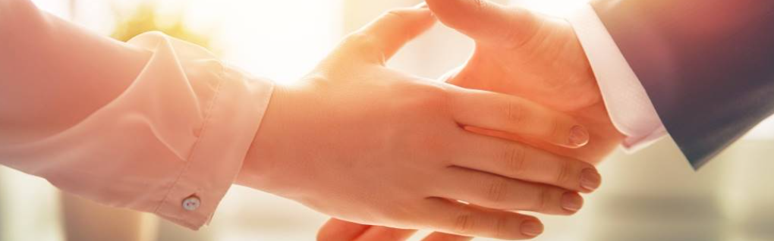
Welcome to our services
New Lebanon Church of Christ
We are Simply Christians.
Our Emphasis is Spiritual, Not Material or Social.
We are striving to be The Same Church as Described in The New Testament.
Please Come Back Again

Slide 2

James Lesson Three – Doers Of The Word
James 1:22 But be doers of the word, and not hearers only, deceiving yourselves

Slide 3

James
Lesson One – James And Jesus
Lesson Two – James And Temptations
Lesson Three - But Be Doers Of The Word
Notes:
In his Gospel, John also connects light with God and His act of creation. “In the beginning was the Word, and the Word was with God, and the Word was God. He was with God in the beginning. Through him all things were made; without him nothing was made that has been made. In him was life, and that life was the light of all mankind. The light shines in the darkness, and the darkness has not overcome it” (John 1:1-5, NIV). This photo was taken from Jebel Musa, the traditional Mount Sinai.
tb030400500

Slide 4
James – But Be Doers Of The Word
1:21 Therefore, lay aside all filthiness and overflow of wickedness, and receive with meekness the implanted word, which is able to save your souls.
newlebanoncoc.com

Slide 5
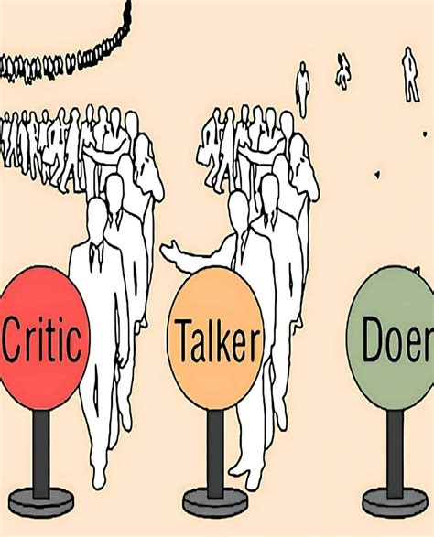
James – But Be Doers Of The Word
1:22 But be doers of the word, and not
hearers only, deceiving yourselves.
linkedin.com
newlebanoncoc.com

Slide 6
James – But Be Doers Of The Word
1:23 For if anyone is a hearer of the word and not a doer, he is like a man observing his natural face in a mirror; For if anyone is a hearer of the word and not a doer –
newlebanoncoc.com

Slide 7

James – But Be Doers Of The Word
1:24 for he observes himself, goes away, and immediately forgets what kind of man he was.
goodfreephotos.com
newlebanoncoc.com

Slide 8
James – But Be Doers Of The Word
1:25 But he who looks into the perfect law of liberty and continues in it, and is not a forgetful hearer but a doer of the work, this one will be blessed in what he does. But he who looks into the perfect law of liberty –
(perfect = complete).
1Cor. 13:10 But when that which is perfect has come, then that which is in part will be done away.
(No revelations today. No Holy Spirit speaking to us today. Study to show yourself approved…Don’t wait for the H.S. to tell you something. )
newlebanoncoc.com

Slide 9
James – But Be Doers Of The Word
The good hearer:
1. Looks deeply and with much thought into the Scriptures.
2. Remains with the Scriptures, not allowing the world to distract him from the "perfect law." The perfecting of character, and thus our salvation, depends upon both a continual contemplation of the word and translating the word into fruit in our lives.
Eph.2:10 tells us our purpose as Christians here on this earth (good works).
newlebanoncoc.com

Slide 10
James – But Be Doers Of The Word
James now selects three things which illustrate how a man may be a hearer of the word and still be a forgetful hearer whose religion is vain.
The three areas of control are:
The tongue
Benevolence
Purity of life
newlebanoncoc.com

Slide 11

James – But Be Doers Of The Word
1:26 If anyone among you thinks he is religious, and does not bridle his tongue but deceives his own heart, this one's religion is useless.
(The tongue)
lifehopeandtruth.com
newlebanoncoc.com

Slide 12

James – But Be Doers Of The Word
1:27 Pure and undefiled religion before God and the Father is this: to visit orphans and widows in their trouble, and to keep oneself unspotted from the world.
(Benevolence)
vecteezy.com
newlebanoncoc.com

Slide 13

James – But Be Doers Of The Word
1:27 Pure and undefiled religion before God and the Father is this: to visit orphans and widows in their trouble, and to keep oneself unspotted from the world.
(Purity of life)
newlebanoncoc.com

Slide 14
Questions?
Want to learn more about the Bible?
We will be glad to study the Bible with you.
New Lebanon
New Lebanon
Church of Christ
Church of Christ
New Lebanon, OH
newlebanoncoc.com
newlebanoncoc@gmail.com

