Slide 1
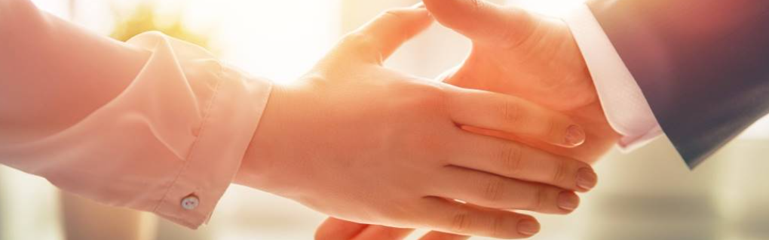
Welcome to our services
New Lebanon Church of Christ
We are Simply Christians.
Our Emphasis is Spiritual, Not Material or Social.
We are striving to be The Same Church as Described in The New Testament.
Please Come Back Again

Slide 2

James
Lesson Four – Showing Partiality
James 2:1 My brethren, do not hold the faith of our Lord Jesus Christ, the Lord of glory, with partiality.
Notes:
In his Gospel, John also connects light with God and His act of creation. “In the beginning was the Word, and the Word was with God, and the Word was God. He was with God in the beginning. Through him all things were made; without him nothing was made that has been made. In him was life, and that life was the light of all mankind. The light shines in the darkness, and the darkness has not overcome it” (John 1:1-5, NIV). This photo was taken from Jebel Musa, the traditional Mount Sinai.
tb030400500

Slide 3
James
Lesson One – James And Jesus
Lesson Two – James And Temptations
Lesson Three - But Be Doers Of The Word
Lesson Four – Showing Partiality
Notes:
In his Gospel, John also connects light with God and His act of creation. “In the beginning was the Word, and the Word was with God, and the Word was God. He was with God in the beginning. Through him all things were made; without him nothing was made that has been made. In him was life, and that life was the light of all mankind. The light shines in the darkness, and the darkness has not overcome it” (John 1:1-5, NIV). This photo was taken from Jebel Musa, the traditional Mount Sinai.
tb030400500

Slide 4
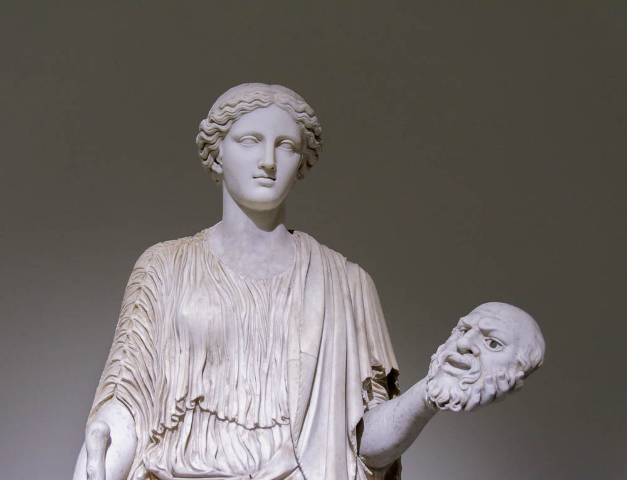
My brothers, do not hold the faith of our glorious Lord Jesus Christ with favoritism
Female holding a theatrical mask, 2nd century AD
2:1
Notes:
The word “favoritism,” (Gk. prosōpolēmpsia, προσωπολημψία) could be rendered woodenly “to receive a face.” It seems to describe the practice of giving preference to certain persons based on outward characteristics such as appearance or perceived social status. The issue was that the outward appearance is ephemeral, even unimportant, since Jesus has broken down the normal social barriers. What mattered instead was the heart or the inward man.
By way of analogy, the use of masks allowed a theatrical actor to portray someone whom they were not, as with this female holding the mask of a bearded male. In a related vein, Paul considered Peter’s actions to be hypocritical because he put on one face with the Gentiles when James was not there, but a different face when James was present (Gal 2:13).
It is thought that this 2nd century AD statue is a copy of a 5th century BC original. This statue was photographed at the Naples Archaeological Museum.
tb0515171184

Slide 5
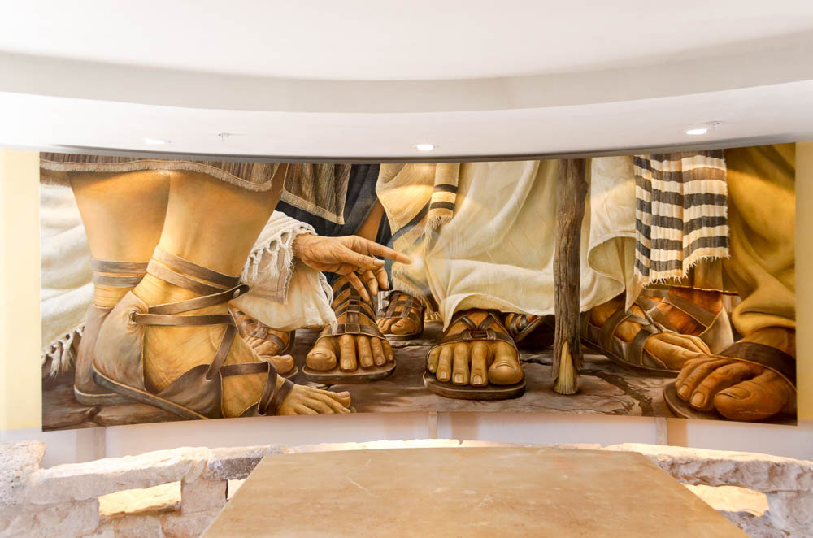
My brothers, do not hold the faith of our glorious Lord Jesus Christ with favoritism
Painting of the woman touching Jesus’s garment, in the Duc In Altum chapel at Magdala
2:1
Notes:
Jesus was notorious for His willingness to fellowship with people of low social status, including people like tax collectors, those who were diseased, and those who were considered outcasts, and non-Jews. This painting depicts the woman with the hemorrhage who touched the hem of Jesus’s garment and was healed because of her faith (Mark 5:25-34). James will go on to argue that faith makes believers equal, brothers and sisters in Christ, and that divisions based on things like social status are sinful.
tb053116468

Slide 6
2 For if there should come into your assembly a man with gold rings, in fine apparel, and there should also come in a poor man in filthy clothes, 3 and you pay attention to the one wearing the fine clothes and say to him, "You sit here in a good place," and say to the poor man, "You stand there," or, "Sit here at my footstool,"
4 have you not shown partiality among yourselves, and become judges with evil thoughts?

Slide 7
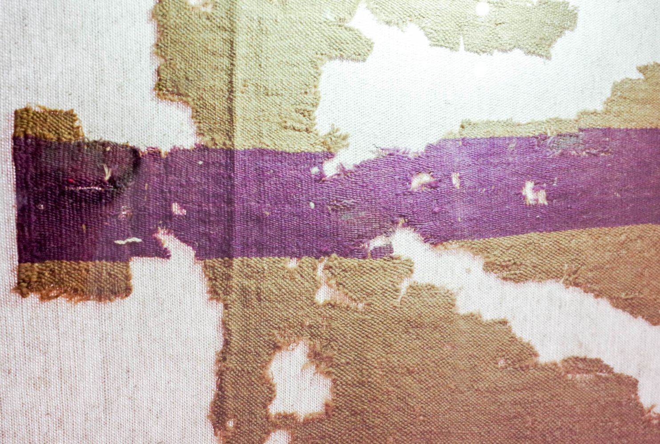
If a man comes into your assembly with a gold ring, and dressed in fine clothing
Wool tunic with purple stripes, from the Cave of the Letters in Nahal Hever, circa AD 132
2:2
Notes:
Clothing in the ancient world was a sign of status and wealth. Clothing was expensive particularly robes that were dyed with purple (from murex shells). This wool tunic, which dates to less than a century after the writing of the Book of James, was found in Nahal Hever. It was preserved due to the arid conditions of the Judean Wilderness. It was photographed at the Bible Lands Museum in Jerusalem.
adr1806274484

Slide 8
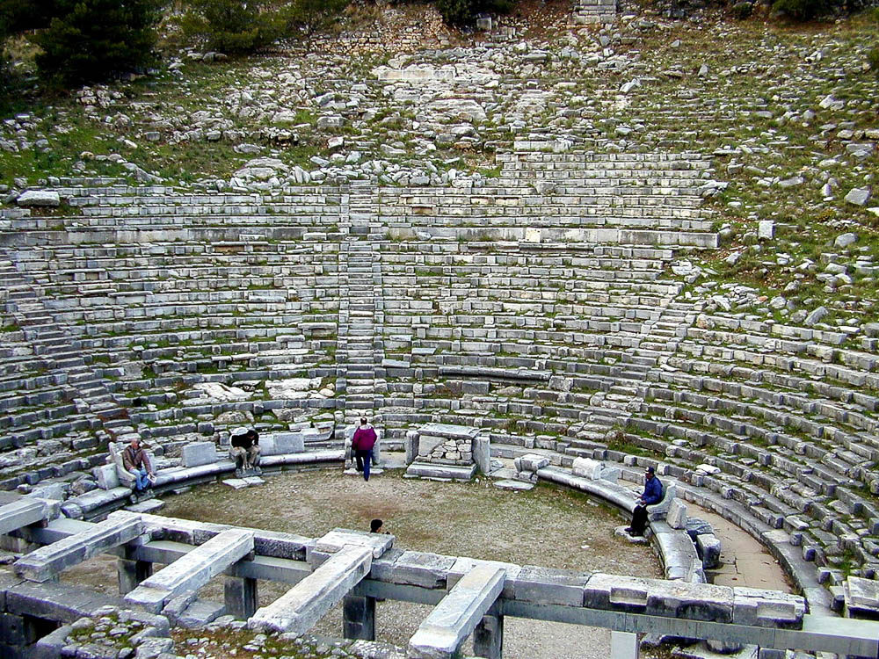
You show regard to the one wearing the fine clothes, and say, “You sit here in a good place”
Luxury seating in the theater at Priene
2:3
Notes:
In this theater at Priene, the special seats are those in the front row, and a number of seats with back and arm rests are visible.
tb010401874

Slide 9
The Sin Of Partiality
5 Listen, my beloved brethren: Has God not chosen the poor of this world to be rich in faith and heirs of the kingdom which He promised to those who love Him?
6 But you have dishonored the poor man. Do not the rich oppress you and drag you into the courts?
newlebanoncoc.com

Slide 10
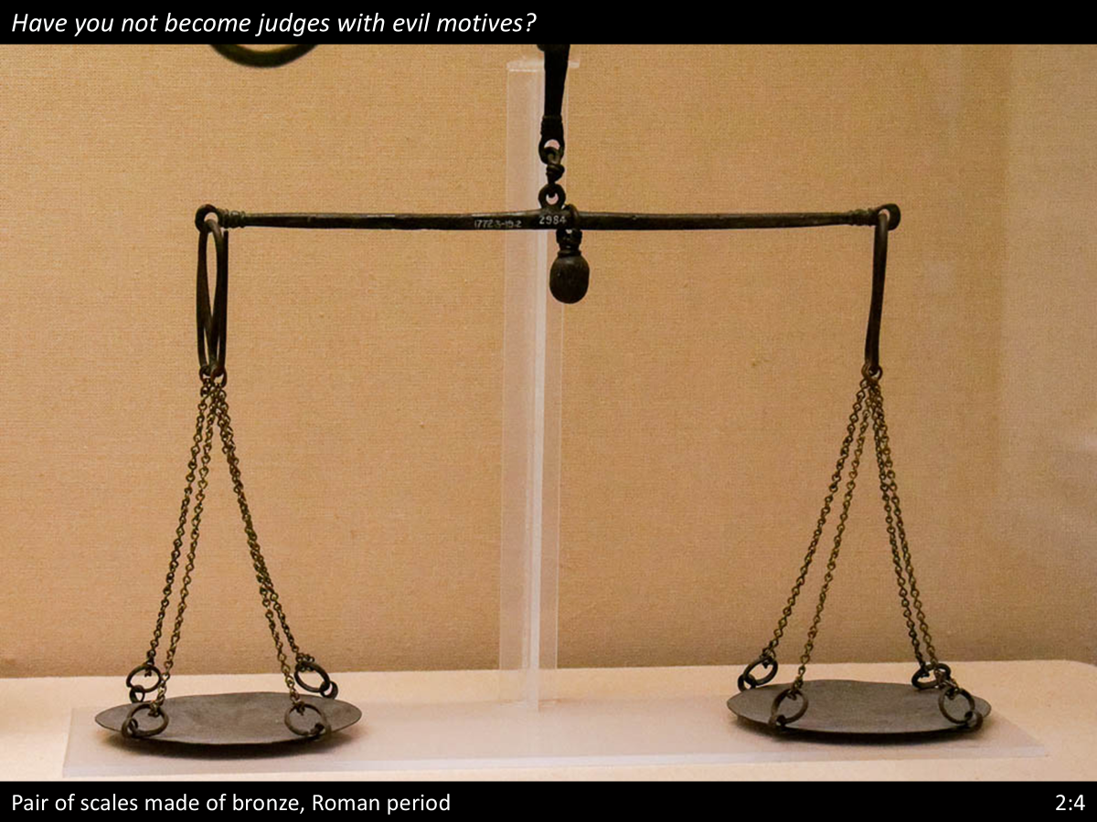
4 have you not shown partiality among yourselves, and become judges with evil thoughts?

Slide 11
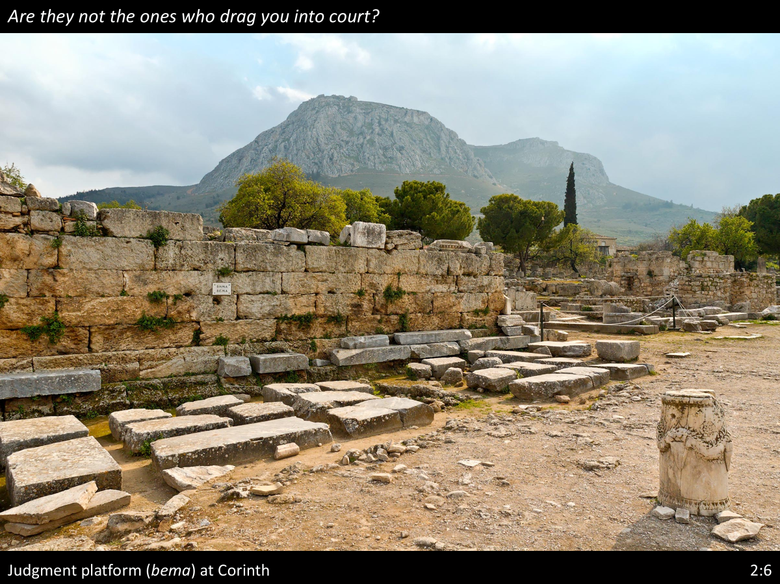
4 have you not shown partiality among yourselves, and become judges with evil thoughts?

Slide 12
The Sin Of Partiality
7 Do they not blaspheme that noble name by which you are called?
8 If you really fulfill the royal law according to the Scripture, "You shall love your neighbor as yourself," you do well;
9 but if you show partiality, you commit sin, and are convicted by the law as transgressors.
newlebanoncoc.com

Slide 13
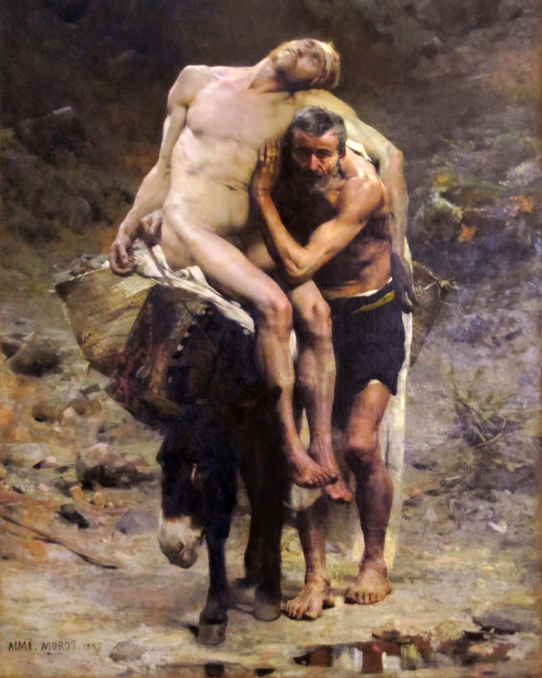
8 If you really fulfill the royal law according to the Scripture, "You shall love your neighbor as yourself," you do well; 9 but if you show partiality, you commit sin, and are convicted by the law as transgressors.

Slide 14
The Sin Of Partiality
10 For whoever shall keep the whole law, and yet stumble in one point, he is guilty of all.
11 For He who said, "Do not commit adultery," also said, "Do not murder." Now if you do not commit adultery, but you do murder, you have become a transgressor of the law.
newlebanoncoc.com

Slide 15
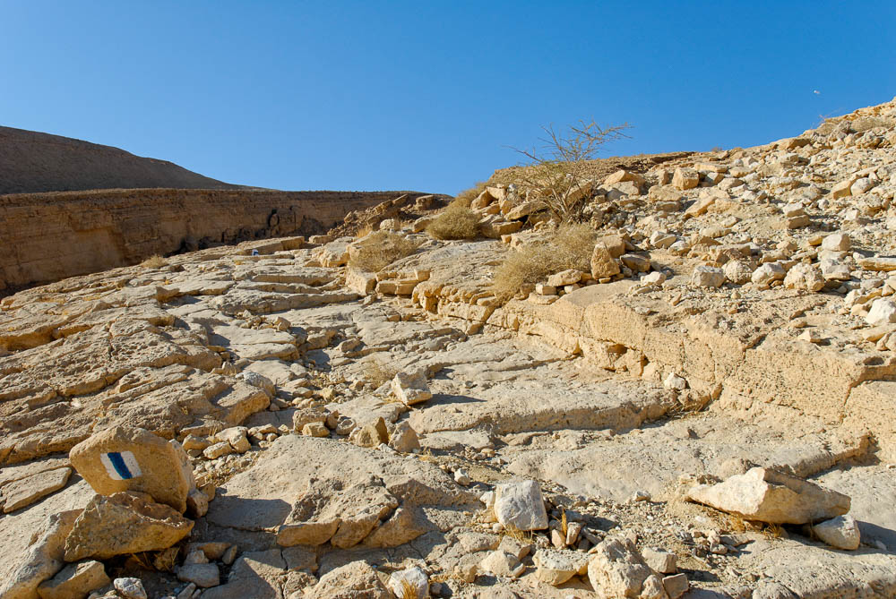
For whoever keeps the whole law, but stumbles in one point, he has become guilty of all
Roman road and steps at the Ascent of Scorpions (Maale Aqrabbim)
2:10
Notes:
This photo shows what remains of the Roman road at the Ascent of Scorpions. Steps have been cut into the path at some points to ease travel, but even these steps could cause the absent-minded traveler to stumble.
tb010712170

Slide 16
The Sin Of Partiality
12 So speak and so do as those who will be judged by the law of liberty.
13 For judgment is without mercy to the one who has shown no mercy. Mercy triumphs over judgment.
newlebanoncoc.com

Slide 17
The Sin Of Partiality
It is impossible to keep from recognizing differences in people,
It is not wrong to notice those differences,
The wrong is to respect that difference Gal. 2:6.
newlebanoncoc.com

Slide 18
The Sin Of Partiality
We are not to judge by appearance (John 7:24; Phil. 3:2).
We are not to make hypocritical judgements (Matt. 7:1-5).
We are not to be guilty of harsh judgments (Matt. 5:7).
We are not to judge falsely (Prov.19:5).
We are not to make self-righteous judgments (Luke 18:9-11).
We are not to (and not able to) judge motives.
newlebanoncoc.com

Slide 19
The Sin Of Partiality
The fact that this occurs in the meeting place for the church shows that no place is safe from temptation.
It is implied that both of these are strangers to the assembly since they have both been judged by their appearances.
newlebanoncoc.com

Slide 20
The Sin Of Partiality
If you love God,
stop showing partiality
newlebanoncoc.com

Slide 21
Questions?
Want to learn more about the Bible?
We will be glad to study the Bible with you.
New Lebanon
New Lebanon
Church of Christ
Church of Christ
New Lebanon, OH
newlebanoncoc.com
newlebanoncoc@gmail.com

