Slide 1

Welcome to our services
New Lebanon Church of Christ
We are Simply Christians.
Our Emphasis is Spiritual, Not Material or Social.
We are striving to be The Same Church as Described in The New Testament.
Please Come Back Again

Slide 2

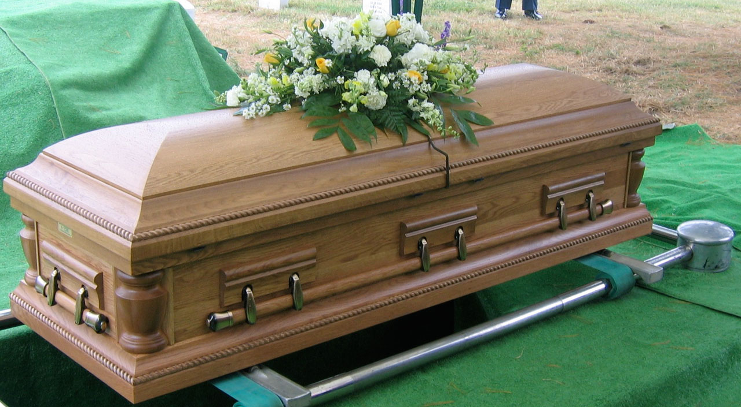
James
Lesson Five
The Relationship of Faith and Works
publicdomainpictures.net
James 2:26 For as the body without the spirit is dead, so faith without works is dead also.
Notes:
In his Gospel, John also connects light with God and His act of creation. “In the beginning was the Word, and the Word was with God, and the Word was God. He was with God in the beginning. Through him all things were made; without him nothing was made that has been made. In him was life, and that life was the light of all mankind. The light shines in the darkness, and the darkness has not overcome it” (John 1:1-5, NIV). This photo was taken from Jebel Musa, the traditional Mount Sinai.
tb030400500

Slide 3
James
Lesson One – James And Jesus
Lesson Two – James And Temptations
Lesson Three - But Be Doers Of The Word
Lesson Four – Showing Partiality
Lesson Five – Relationship of Faith and Works
Notes:
In his Gospel, John also connects light with God and His act of creation. “In the beginning was the Word, and the Word was with God, and the Word was God. He was with God in the beginning. Through him all things were made; without him nothing was made that has been made. In him was life, and that life was the light of all mankind. The light shines in the darkness, and the darkness has not overcome it” (John 1:1-5, NIV). This photo was taken from Jebel Musa, the traditional Mount Sinai.
tb030400500

Slide 4
Relationship of Faith and Works
James 2:14 What does it profit, my brethren, if someone says he has faith but does not have works? Can faith save him?
15 If a brother or sister is naked and destitute of daily food, 16 and one of you says to them, "Depart in peace, be warmed and filled," but you do not give them the things which are needed for the body, what does it profit?
17 Thus also faith by itself, if it does not have works, is dead.
newlebanoncoc.com

Slide 5
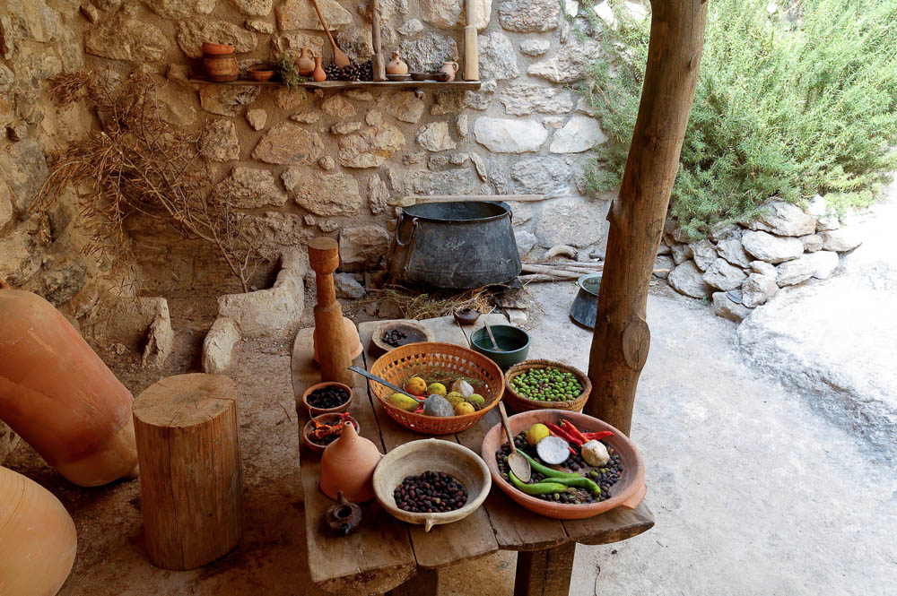
If a brother or sister is without clothing or in lack of daily food
Reconstruction of first-century table with food in Nazareth
2:15
Notes:
This picture taken at Nazareth Village illustrates the typical first-century AD diet.
tb102704380

Slide 6
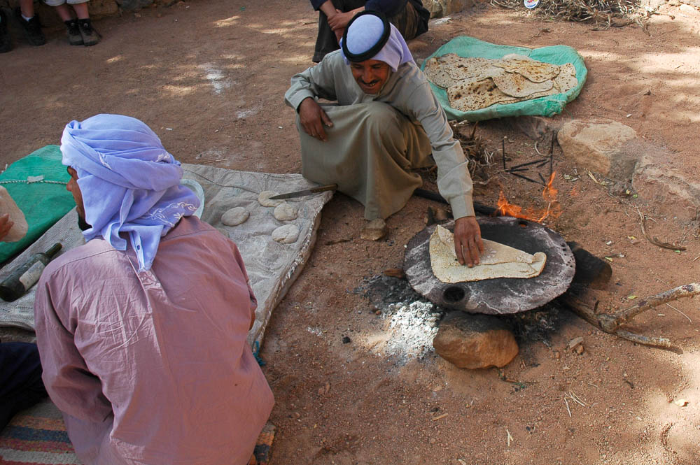
And one of you says to them, “Go in peace, be warmed and filled”
Bedouin cooking bread over a fire, near Jebel Musa
2:16
Notes:
This picture shows a Bedouin cooking bread over a fire, illustrating both warmth and having food with which to be filled.
tb062005835

Slide 7
Relationship of Faith and Works
18 But someone will say, "You have faith, and I have works." Show me your faith without your works, and I will show you my faith by my works.
19 You believe that there is one God. You do well. Even the demons believe--and tremble!
20 But do you want to know, O foolish man, that faith without works is dead?
newlebanoncoc.com

Slide 8
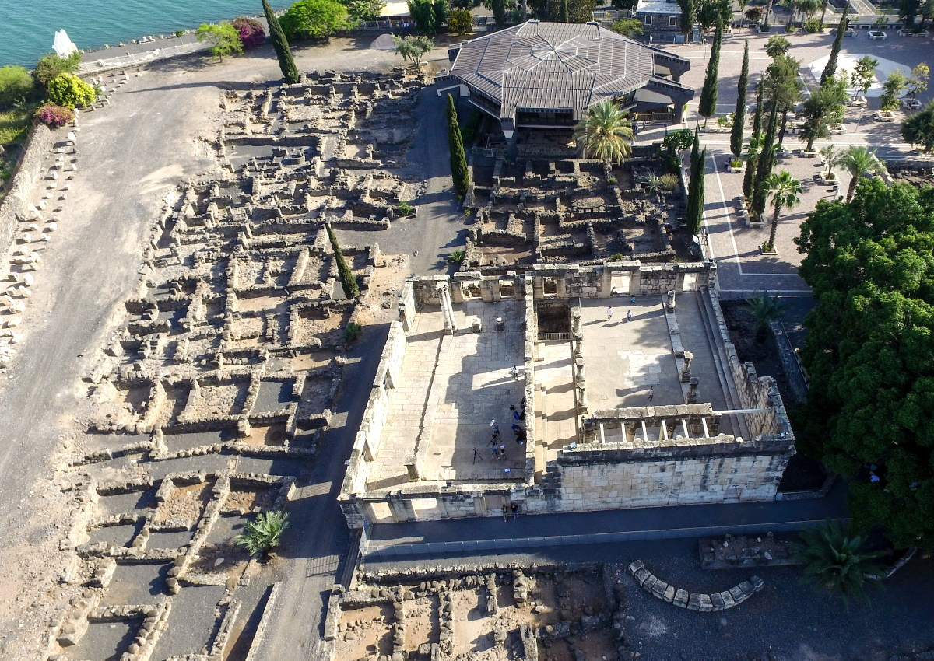
The demons also believe and shudder
Synagogue at Capernaum (aerial view from the north)
2:19
Notes:
James may have been present at the synagogue in Capernaum when a man with an unclean spirit met Jesus; the unclean spirit recognized Jesus and expressed great fear of Him (Mark 1:21-26). Thus James may have been speaking here from personal experience. The white building in the foreground of this aerial photo is a synagogue at Capernaum. Though the visible limestone synagogue is several centuries after the time of Jesus and James, it is built on the foundations of an earlier synagogue from the 1st century.
ws040416942

Slide 9
Relationship of Faith and Works
21 Was not Abraham our father justified by works when he offered Isaac his son on the altar?
22 Do you see that faith was working together with his works, and by works faith was made perfect?
23 And the Scripture was fulfilled which says, "Abraham believed God, and it was accounted to him for righteousness." And he was called the friend of God.
newlebanoncoc.com

Slide 10
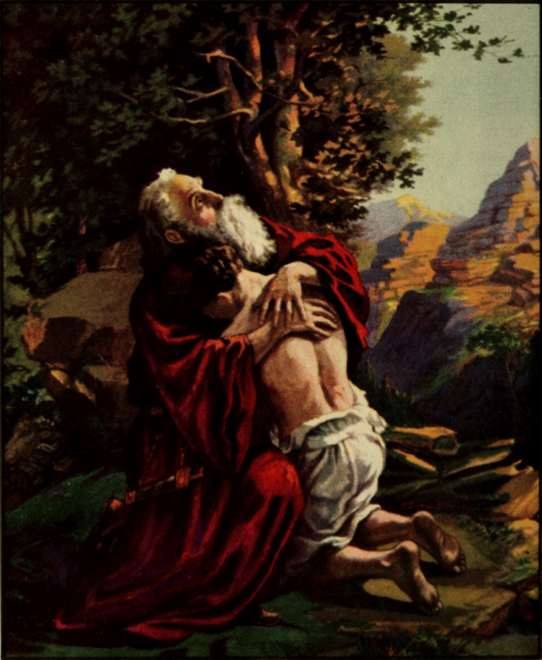
You see that faith was active with his works, and by works faith was made perfect
Abraham receiving back Isaac, from the Bible Primer, Old Testament, 1919
2:22
Notes:
The verb “to perfect” (Gk. teleioō, τελειόω) should probably be understood in the sense of bringing something (i.e., faith) to its goal or accomplishment. James does not replace faith with works as the means of justification, but argues that works perfect faith, bringing it to its fulfillment. James returns to language that is reminiscent to the opening verse of the letter. “Consider it all joy, my brothers, when you encounter various trials, knowing that the testing of your faith brings about perseverance. And let perseverance have its perfect work, so that you may be perfect and complete, lacking in nothing” (1:2-4, LSB) This depiction comes from the Bible Primer, Old Testament, for use in the primary department of Sunday schools, by Adolf Hult. This image is in the public domain, via Wikimedia Commons: https://commons.wikimedia.org/wiki/File:Bible_primer,_Old_Testament,_for_use_in_the_primary_department_of_Sunday_schools_(1919)_(14759064066).jpg.
wiki147590640661919

Slide 11
Relationship of Faith and Works
24 You see then that a man is justified by works, and not by faith only.
25 Likewise, was not Rahab the harlot also justified by works when she received the messengers and sent them out another way?
26 For as the body without the spirit is dead, so faith without works is dead also.
newlebanoncoc.com

Slide 12
Relationship of Faith and Works
James 2:17 Thus also faith by itself, if it does not have works, is dead.
James 2:20 But do you want to know, O foolish man, that faith without works is dead?
James 2:26 For as the body without the spirit is dead, so faith without works is dead also.
newlebanoncoc.com

Slide 13
Relationship of Faith and Works
Faith without works is dead.
Faith without works is dead.
Faith without works is dead.
Faith without works is dead.
Faith without works is dead.
newlebanoncoc.com

Slide 14
Relationship of Faith and Works
Some will say Paul and James taught two different things.
Paul taught saved by faith.
James taught saved by works.
newlebanoncoc.com

Slide 15
Relationship of Faith and Works
Romans 1:5 Through Him we have received grace and apostleship for obedience to the faith among all nations for His name,
Romans 6:16 Do you not know that to whom you present yourselves slaves to obey, you are that one's slaves whom you obey, whether of sin leading to death, or of obedience leading to righteousness? 17 But God be thanked that though you were slaves of sin, yet you obeyed from the heart that form of doctrine to which you were delivered.
Romans 16:25 Now to Him who is able to establish you according to my gospel and the preaching of Jesus Christ, according to the revelation of the mystery kept secret since the world began 26 but now has been made manifest, and by the prophetic Scriptures has been made known to all nations, according to the commandment of the everlasting God, for obedience to the faith-- 27 to God, alone wise, be glory through Jesus Christ forever. Amen.
newlebanoncoc.com

Slide 16
Relationship of Faith and Works
Two – Valued – Orientation
Creates a faulty premise
One answer is right and the other is wrong
Both answers could be wrong.
Both answers could be right.
newlebanoncoc.com

Slide 17
Relationship of Faith and Works
Two – Valued - Orientation
What is the capitol of Ohio?
a) Cincinnati
b) Columbus
One answer is right and the other is wrong
newlebanoncoc.com

Slide 18
Relationship of Faith and Works
Two – Valued - Orientation
How do you pronounce the capitol of Kentucky?
a) “Louis-ville”
b) “Looy-vul”
Both answers are wrong.
Frankfort is the correct pronunciation
newlebanoncoc.com

Slide 19
Relationship of Faith and Works
Two – Valued - Orientation
Are we saved by Faith or by Works?
We are saved by BOTH.
NOT one or the other
newlebanoncoc.com

Slide 20
Relationship of Faith and Works
We are justified “by both,” and it is a sin to assert that men are justified either
“by faith alone”
“by works alone”
newlebanoncoc.com

Slide 21
Relationship of Faith and Works
Many people seem to have a faith with no object.
Their faith is really faith in faith.
They believe that believing will make it so.
This is a form of wishful thinking that enables a person to live completely in a make-believe world.
(the power of positive thinking)
newlebanoncoc.com

Slide 22
Relationship of Faith and Works
Faith may be put in an idol made of stone, and the idol would still do absolutely nothing.
(dashboard idol / figurine)
Faith may be put in a god fabricated out of one’s imagination, and since this god is non-existent and is not Jehovah God, nothing will be accomplished by that god.
Faith may be put in a system of salvation or forgiveness not ordained by God and this system will promise nothing to the believer. (The teachings of men)
newlebanoncoc.com

Slide 23
Relationship of Faith and Works
What are the works under consideration?
newlebanoncoc.com

Slide 24
Relationship of Faith and Works
James 2:14 What does it profit, my brethren, if someone says he has faith but does not have works? Can faith save him?
James is speaking of works of obedience, not works of merit.
In John 6:29 - belief is called a work by Jesus. This is the same type of work as repentance and baptism. Works of obedience, not works of merit.
newlebanoncoc.com

Slide 25
Relationship of Faith and Works
Matt.7:21-23 is a good section to show works of merit versus works of obedience. Without works of obedience these are still lost.
Matthew 7:21-23, "Not everyone who says to Me, 'Lord, Lord,' shall enter the kingdom of heaven, but he who does the will of My Father in heaven. Many will say to Me in that day, 'Lord, Lord, have we not prophesied in Your name, cast out demons in Your name, and done many wonders in Your name?' And then I will declare to them, 'I never knew you; depart from Me, you who practice lawlessness!'"
newlebanoncoc.com

Slide 26
Relationship of Faith and Works
Those who are trying the teach the false doctrine of "faith only" most often point to the book of Romans as proof, but the book begins and ends with obedience to the faith.
The "works" being addressed in the book of Romans are the works of the old law. Paul was telling the Jews who had become Christians that the "works" in the law of Moses will not save.
newlebanoncoc.com

Slide 27
Relationship of Faith and Works
Faith is demonstrated only through works! One who boasts about his faith, but never does any good works must be doubted.
2:19 You believe that there is one God. You do well. Even the demons believe—and tremble!
James has selected the greatest fundamental doctrine of all religion — the Existence of One Supreme Being! James shows that even if one believed this, it is also believed by demons and cannot save you (without the required works of obedience).
newlebanoncoc.com

Slide 28
Relationship of Faith and Works
- James does not belittle faith, he encourages it. –
The right kind of faith.
In Matt.8:29 we find one account of the demons believing and crying out in fear, but their belief and fear did not bring them any benefit.
Matt.8:29, And suddenly they cried out, saying, 'What have we to do with You, Jesus, You Son of God? Have You come here to torment us before the time?
newlebanoncoc.com

Slide 29
Relationship of Faith and Works
This shows that strong belief, that could even cause trembling in fear, is not enough by itself without works of obedience.
Things Demons Do:
Pray (beseech) (Mark 5:10)
Have knowledge about God and Jesus (Matthew 8:29)
Have faith (James 2:19)
Confess their faith (Luke 4:34)
newlebanoncoc.com

Slide 30
Relationship of Faith and Works
Things Demons Do Not Do:
Show signs of repentance
Seek to do the will of God
newlebanoncoc.com

Slide 31
Relationship of Faith and Works
2:21 Was not Abraham our father justified by works when he offered Isaac his son on the altar?
- This is a rhetorical question that implies an answer of "yes." The fact that Abraham is used shows that even the father of the faithful had to obey.
It is possible that this point is being made because the Jews believed that being a descendant of Abraham was all that was needed for salvation (Matt. 3:9-10).
newlebanoncoc.com

Slide 32
Relationship of Faith and Works
The only kind of work that brings justification is a work done in obedience to a command of God. Abraham had faith in God but it was not accounted to him for righteousness until it proved itself in works.
Abraham recognized that it was his obligation to obey God and to trust God to keep His promises.
newlebanoncoc.com

Slide 33
Relationship of Faith and Works
So we see different kinds of works.
Works of law of Moses (Romans)
Works of merit (Matt 7)
Works of obedience (belief is a work)
newlebanoncoc.com

Slide 34
Relationship of Faith and Works
Gal. 2:16 "knowing that a man is not justified by the works of the law but by faith in Jesus Christ, even we have believed in Christ Jesus, that we might be justified by faith in Christ and not by the works of the law; for by the works of the law no flesh shall be justified.
Paul states that Abraham’s justification was before the law of Moses and apart from it, just as he insisted it was before circumcision (Romans 4:10-12).
Therefore, Paul and James agree that a work of obedience growing out of one's faith in God and Christ is the basis of justification.
newlebanoncoc.com

Slide 35
Relationship of Faith and Works
Abraham’s sacrifice took place in the region of Moriah (Gen 22:2), and Solomon’s temple was later built on Mount Moriah (2 Chr 3:1).
Abraham’s sacrifice foreshadowed both the ongoing temple sacrifices and the ultimate sacrifice of Jesus Christ.
The temple sacrifices took place where the Dome of the Rock stands today, while the sacrifice of Jesus took place nearby but outside the city walls.
newlebanoncoc.com

Slide 36
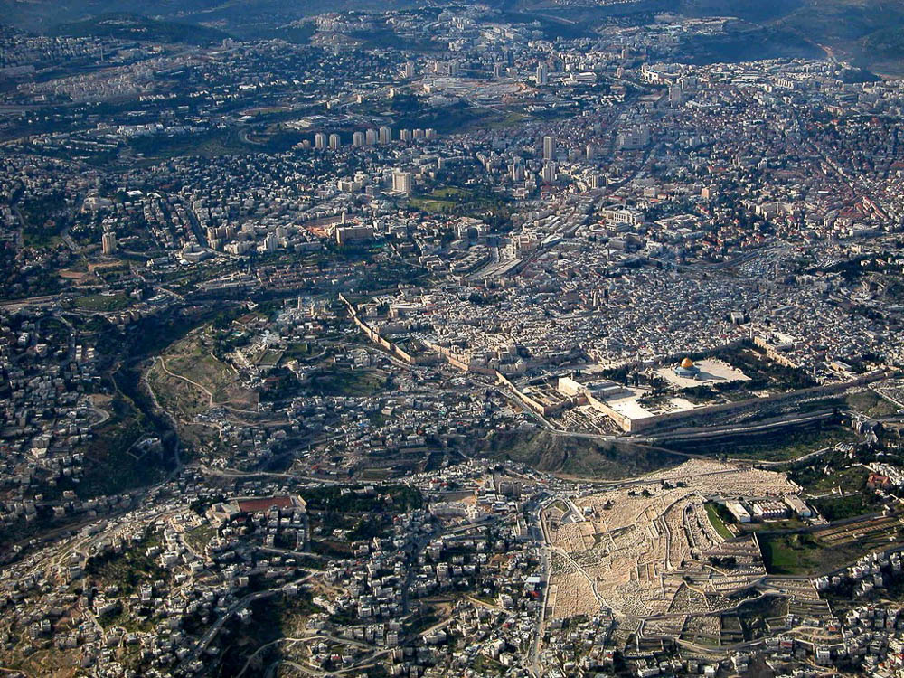
Was not Abraham our father justified by works when he offered up his son Isaac on the altar?
Holy Sepulcher
Hinnom Valley
Temple Mount
Central Valley
Kidron Valley
Jerusalem (aerial view from the east)
2:21
Notes:
Abraham’s sacrifice took place in the region of Moriah (Gen 22:2), and Solomon’s temple was later built on Mount Moriah (2 Chr 3:1). Abraham’s sacrifice foreshadowed both the ongoing temple sacrifices and the ultimate sacrifice of Jesus Christ. The temple sacrifices took place where the Dome of the Rock stands today, while the sacrifice of Jesus took place nearby but outside the city walls. The traditional location of Jesus’s crucifixion is marked by the Church of the Holy Sepulcher.
tb010703735

Slide 37
Questions?
Want to learn more about the Bible?
We will be glad to study the Bible with you.
New Lebanon
New Lebanon
Church of Christ
Church of Christ
New Lebanon, OH
newlebanoncoc.com
newlebanoncoc@gmail.com

