Slide 1

Welcome to our services
New Lebanon Church of Christ
We are Simply Christians.
Our Emphasis is Spiritual, Not Material or Social.
We are striving to be The Same Church as Described in The New Testament.
Please Come Back Again

Slide 2

James
Lesson Six – Instructions to Teachers
James 3:1 My brethren, let not many of you become teachers, knowing that we shall receive a stricter judgment. 2 For we all stumble in many things. If anyone does not stumble in word, he is a perfect man, able also to bridle the whole body.
Notes:
In his Gospel, John also connects light with God and His act of creation. “In the beginning was the Word, and the Word was with God, and the Word was God. He was with God in the beginning. Through him all things were made; without him nothing was made that has been made. In him was life, and that life was the light of all mankind. The light shines in the darkness, and the darkness has not overcome it” (John 1:1-5, NIV). This photo was taken from Jebel Musa, the traditional Mount Sinai.
tb030400500

Slide 3
James
Lesson One – James And Jesus
Lesson Two – James And Temptations
Lesson Three - But Be Doers Of The Word
Lesson Four – Showing Partiality
Lesson Five – Relationship of Faith and Works
Lesson Six – Instructions to Teachers
Notes:
In his Gospel, John also connects light with God and His act of creation. “In the beginning was the Word, and the Word was with God, and the Word was God. He was with God in the beginning. Through him all things were made; without him nothing was made that has been made. In him was life, and that life was the light of all mankind. The light shines in the darkness, and the darkness has not overcome it” (John 1:1-5, NIV). This photo was taken from Jebel Musa, the traditional Mount Sinai.
tb030400500

Slide 4

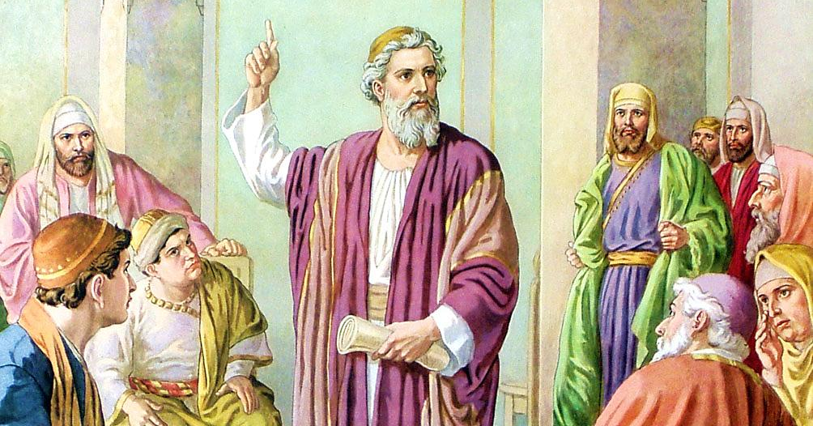
n
Teachers must answer in the judgment not only for what they know but for what they could have found out by reasonable effort. It will not suffice for us to plead ignorance of God’s will when the means by which we may become efficient teachers are readily at hand. “And the times of this ignorance God winked at; but now commands all men every where to repent:” (Acts 17:30).
JAMES
Chapter 3
1 My brethren, be not many masters [teachers], knowing that we shall receive the greater condemnation.

Slide 5
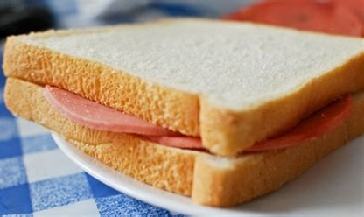
Sandwich Verses
James 3:1 My brethren, let not many of you become teachers, knowing that we shall receive a stricter judgment.
Verse 1 - teachers
Verse 13-18- teachers
V2-12 we have a “tongue sandwich”
James 3:13 Who is wise and understanding among you? Let him show by his good conduct…

Slide 6
Instructions To Teachers James 3:1-18
James 3:2 For we all stumble in many things. If anyone does not stumble in word, he is a perfect man, able also to bridle the whole body.
3 Indeed, we put bits in horses' mouths that they may obey us, and we turn their whole body.
4 Look also at ships: although they are so large and are driven by fierce winds, they are turned by a very small rudder wherever the pilot desires.
5 Even so the tongue is a little member and boasts great things. See how great a forest a little fire kindles!
6 And the tongue is a fire, a world of iniquity. The tongue is so set among our members that it defiles the whole body, and sets on fire the course of nature; and it is set on fire by hell.
newlebanoncoc.com

Slide 7
Instructions To Teachers James 3:1-18
James 3:7 For every kind of beast and bird, of reptile and creature of the sea, is tamed and has been tamed by mankind.
8 But no man can tame the tongue. It is an unruly evil, full of deadly poison.
9 With it we bless our God and Father, and with it we curse men, who have been made in the similitude of God.
10 Out of the same mouth proceed blessing and cursing. My brethren, these things ought not to be so.
11 Does a spring send forth fresh water and bitter from the same opening?
12 Can a fig tree, my brethren, bear olives, or a grapevine bear figs? Thus no spring yields both salt water and fresh.
newlebanoncoc.com

Slide 8
Instructions To Teachers James 3:1-18
When we read this letter it appears the brethren were having trouble with the tongue.
James 1:19 So then, my beloved brethren, let every man be swift to hear, slow to speak, slow to wrath;
James 1:26 If anyone among you thinks he is religious, and does not bridle his tongue but deceives his own heart, this one's religion is useless.
newlebanoncoc.com

Slide 9
Instructions To Teachers James 3:1-18
James 2:12 So speak and so do as those who will be judged by the law of liberty.
James 4:1 Where do wars and fights come from among you? Do they not come from your desires for pleasure that war in your members?
James 4:11 Do not speak evil of one another, brethren. He, who speaks evil of a brother and judges his brother, speaks evil of the law and judges the law. But if you judge the law, you are not a doer of the law but a judge.
newlebanoncoc.com

Slide 10
6 word pictures for the tongue
a horse’s mouth and
bits
v3-4
ship and a rudder
and a poisonous snake
v5-8
a fire
a fountain of water
and a fig tree
v9-12

Slide 11
Instructions To Teachers James 3:1-18
1.The tongue has the power to direct lives of others.
John 4:39 And many of the Samaritans of that city believed in Him because of the word of the woman who testified, "He told me all that I ever did.“
John 4:42 Then they said to the woman, "Now we believe, not because of what you said, for we ourselves have heard Him and we know that this is indeed the Christ, the Savior of the world.“
Peter on the day of Pentecost spoke the words of Jesus the Christ, the son of God, and those words influenced 3,000 people to change their lives.
newlebanoncoc.com

Slide 12
Instructions To Teachers James 3:1-18
1.The tongue has the power to direct lives of others.
Our tongue like a small bit or rudder has great influence over the way we and others will walk.
Prov. 15:1 A soft answer turns away wrath, But a harsh word stirs up anger.
Prov. 12:22 Lying lips are an abomination to the LORD, But those who deal truthfully are His delight.
newlebanoncoc.com

Slide 13
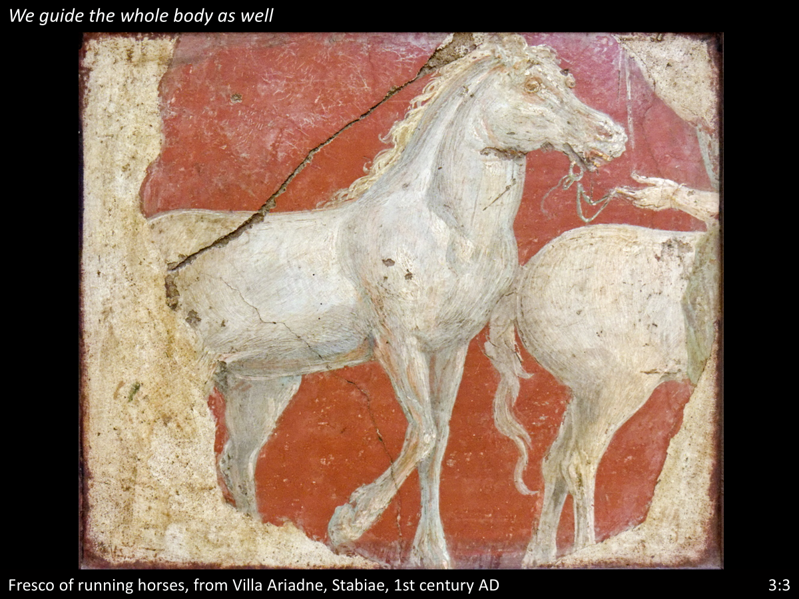
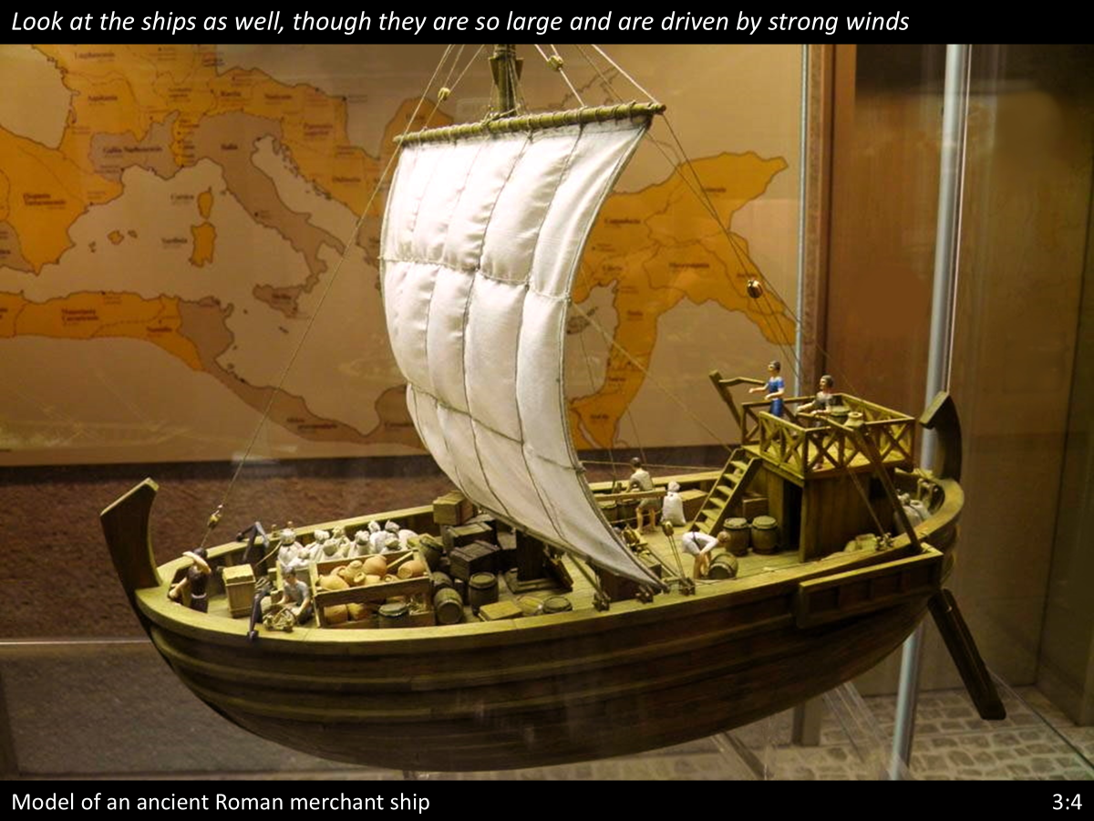
Instructions To Teachers James 3:1-18
1.The tongue has the power to direct lives of others.
newlebanoncoc.com

Slide 14
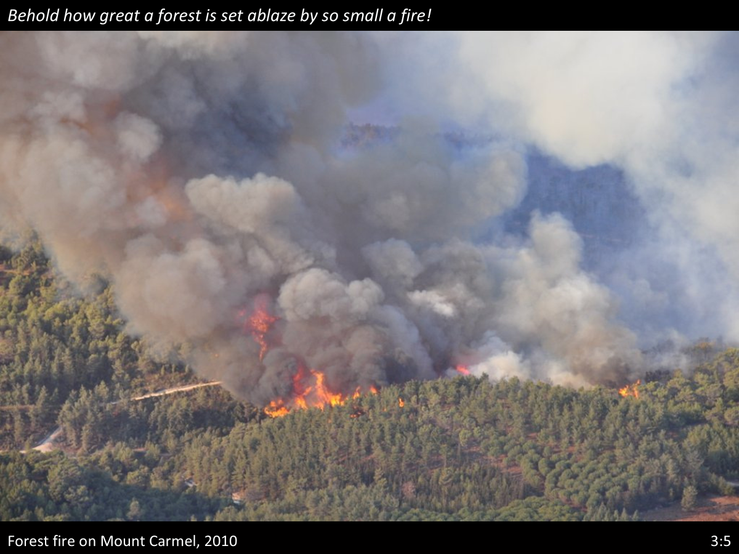
Instructions To Teachers James 3:1-18
2. The tongue has the power of destruction
James 3:6 And the tongue is a fire, a world of iniquity. The tongue is so set among our members that it defiles the whole body, and sets on fire the course of nature; and it is set on fire by hell.
newlebanoncoc.com

Slide 15
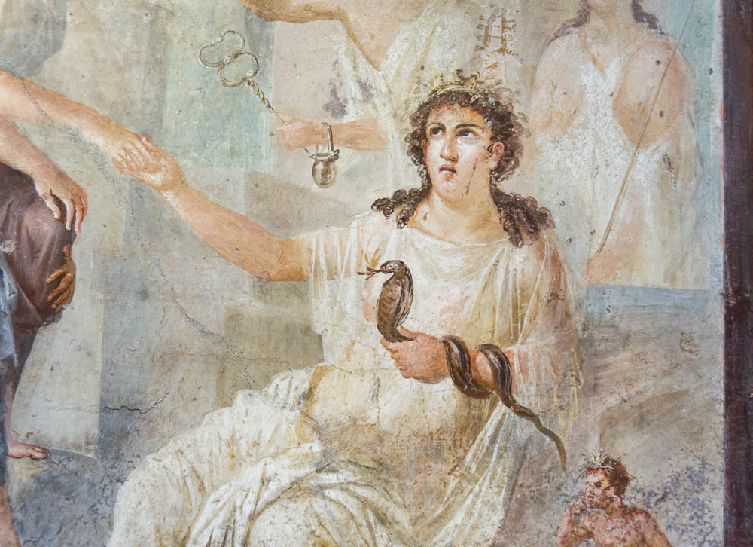
So also the tongue is full of deadly poison
Io welcomed by Isis at Canopo, from Pompeii, 1st century AD
3:5
Notes:
Other animals that were depicted with tongues were birds, fantastical beasts like griffins, and snakes. This fresco from Pompeii shows the Greco-Egyptian goddess Isis holding a snake with a forked tongue. This fresco comes from the central area of the south wall of the Ekklesiasterion of the Isis temple at Pompeii. It was photographed at the Naples Archaeological Museum.
tb0515170376

Slide 16
Instructions To Teachers James 3:1-18
3.The tongue is like a fountain or fig tree.
Proverbs 13:14 The law of the wise is a fountain of life, To turn one away from the snares of death.
Prov. 18:21 Death and life are in the power of the tongue, And those who love it will eat its fruit.
newlebanoncoc.com

Slide 17
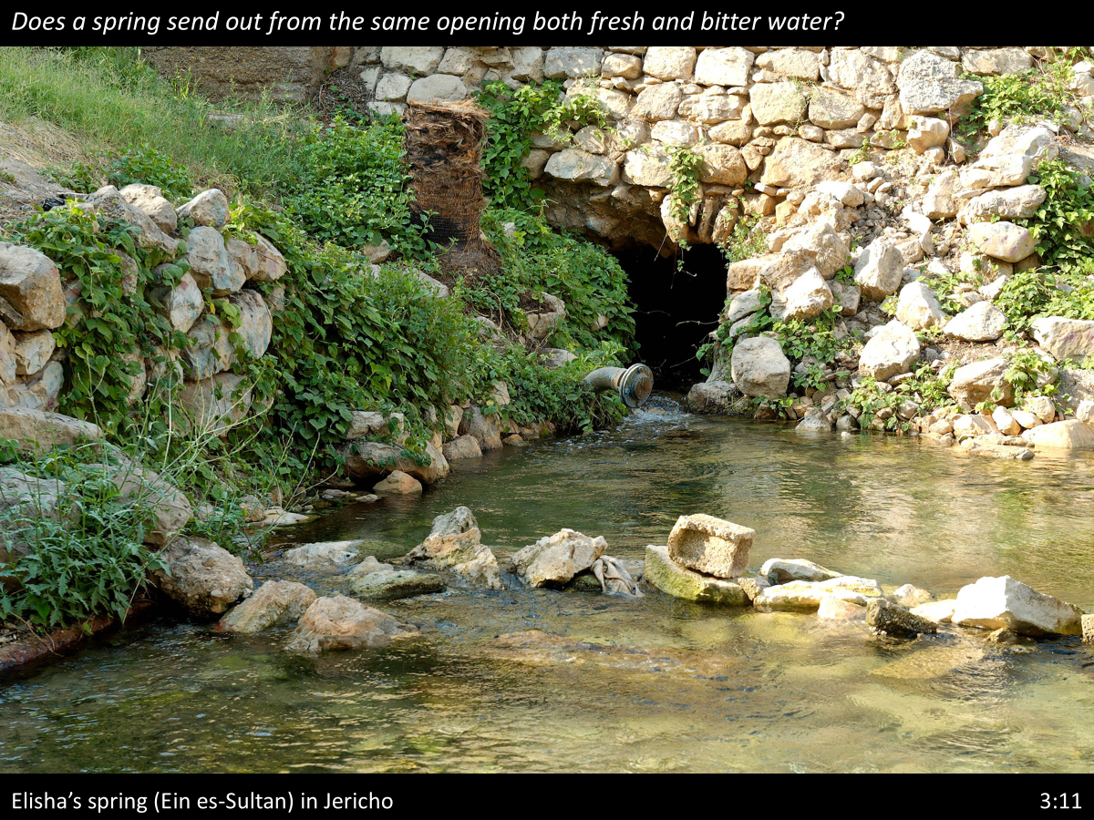
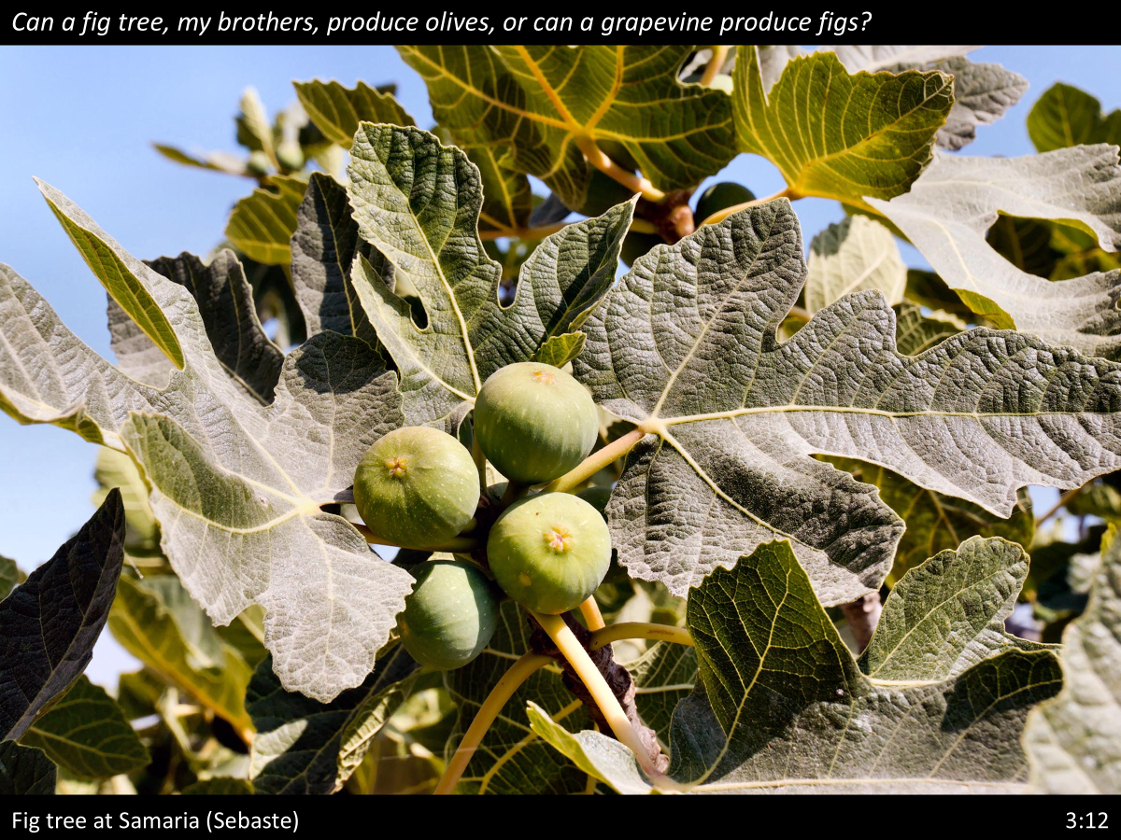
Instructions To Teachers James 3:1-18
3.The tongue is like a fountain or fig tree.
newlebanoncoc.com

Slide 18
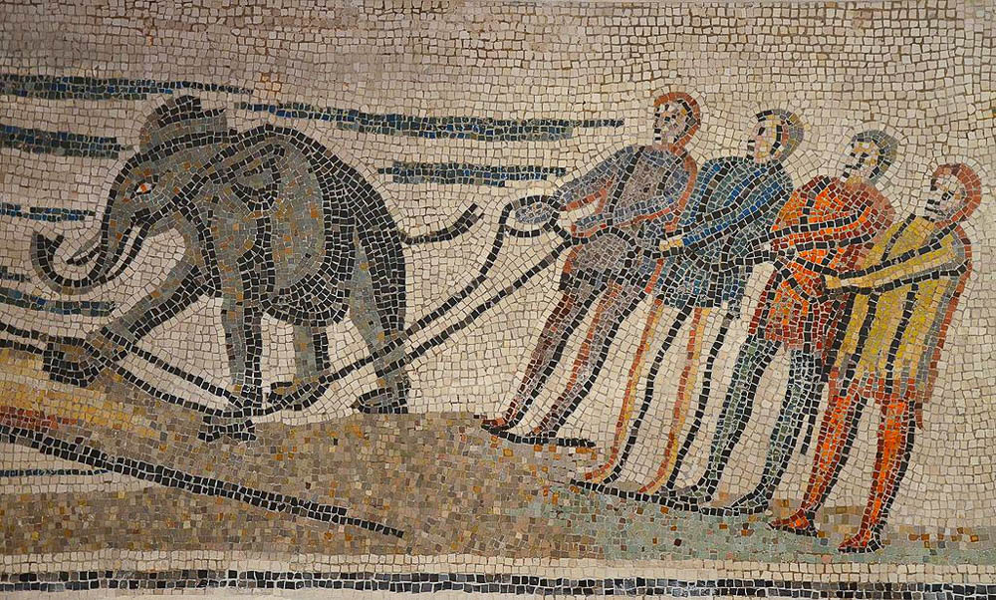
For every kind of beasts and birds, of reptiles and sea creatures . . . has been tamed by mankind
Roman mosaic depicting an African elephant being loaded onto a ship, 3rd–4th centuries AD
3:7
Notes:
The word “tamed” (Gk. damazō, δαμάζω) does not mean to domesticate, but to control or subdue. Elephants were used by the Roman army several centuries before the time of James; it was necessary to bind such animals to limit their movements, especially when travelling over bridges or on board a ship, as shown here. This mosaic comes from Veii (Isola Farnese, Italy). It was photographed at the Badisches Landesmuseum Karlsruhe, Germany. This image comes from Carole Raddato and is licensed under CC BY-SA 2.0, via Wikimedia Commons: https://commons.wikimedia.org/wiki/File:Detail_of_Roman_mosaic_from_Veii_(Isola_Farnese,_Italy)_depicting_an_African_elephant_being_loaded_onto_a_ship,_3rd-4th_century_AD,_Badisches_Landesmuseum_Karlsruhe,_Germany_(18460609338).jpg.
wiki18460609338

Slide 19
Sandwich Verses
James 3:1 My brethren, let not many of you become teachers, knowing that we shall receive a stricter judgment.
Verse 1 - teachers
Verse 13-18- teachers
V2-12 we have a “tongue sandwich”
James 3:13 Who is wise and understanding among you? Let him show by his good conduct…

Slide 20
Instructions To Teachers James 3:1-18
James 3:13 Who is wise and understanding among you? Let him show by good conduct that his works are done in the meekness of wisdom. 14 But if you have bitter envy and self-seeking in your hearts, do not boast and lie against the truth.
15 This wisdom does not descend from above, but is earthly, sensual, demonic. 16 For where envy and self-seeking exist, confusion and every evil thing are there.
17 But the wisdom that is from above is first pure, then peaceable, gentle, willing to yield, full of mercy and good fruits, without partiality and without hypocrisy. 18 Now the fruit of righteousness is sown in peace by those who make peace.
newlebanoncoc.com

Slide 21
Instructions To Teachers James 3:1-18
Who is wise and understanding among you? - The phrase "wise (man)" was often applied to a teacher. "Understanding" is from the Greek word that indicates one who has the knowledge of an expert.
"Wise" may describe the possession of wisdom as such and
"Understanding" may relate to the practical details of life.
newlebanoncoc.com

Slide 22
Instructions To Teachers James 3:1-18
If the teacher does not manifest the wisdom in his life he should not wear the title. But if he does wear that title, it becomes a lie against the truth.
This even applies to the spirit of one fighting false doctrine. What is your attitude after talking to a lost soul?
Sad because his soul is lost or
"I sure set him straight!"?
newlebanoncoc.com

Slide 23
Instructions To Teachers James 3:1-18
James now lists the characteristics of the godly teacher: James 3:17 But the wisdom that is from above is first
  pure,
  then peaceable,
  gentle,
  willing to yield,
  full of mercy
  and good fruits,
  without partiality
  and without hypocrisy.
newlebanoncoc.com

Slide 24
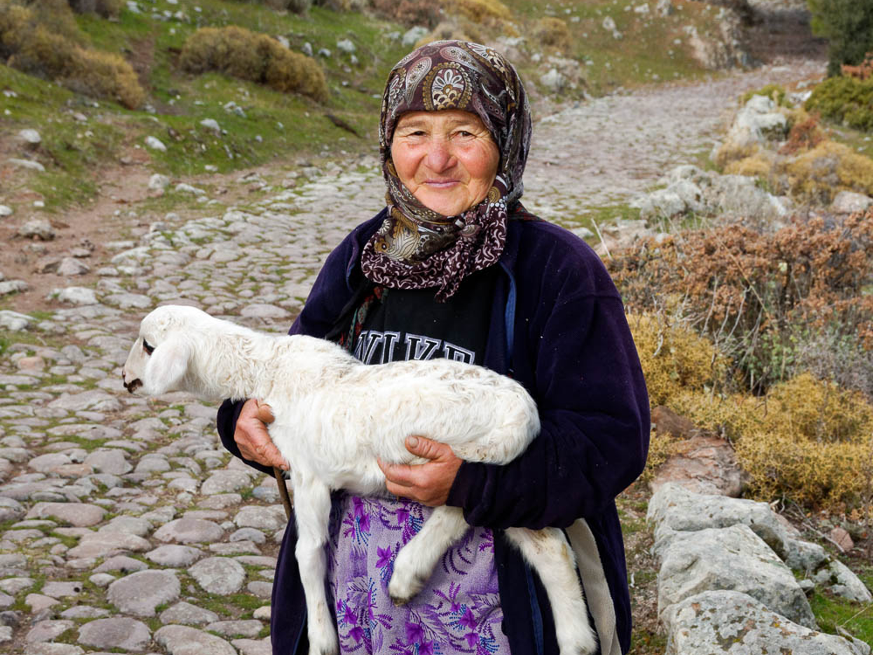
James 3:17 But the wisdom that is from above is first pure, then peaceable, gentle, willing to yield, full of mercy and good fruits, without partiality and without hypocrisy.

Slide 25
Questions?
Want to learn more about the Bible?
We will be glad to study the Bible with you.
New Lebanon
New Lebanon
Church of Christ
Church of Christ
New Lebanon, OH
newlebanoncoc.com
newlebanoncoc@gmail.com

