Slide 1

Welcome to our services
New Lebanon Church of Christ
We are Simply Christians.
Our Emphasis is Spiritual, Not Material or Social.
We are striving to be The Same Church as Described in The New Testament.
Please Come Back Again

Slide 2
Fathers and their Children. Eph.6:4
Eph 6:4 And you, fathers, do not provoke your children to wrath,
but bring them up
in the training
and admonition of the Lord.

Slide 3
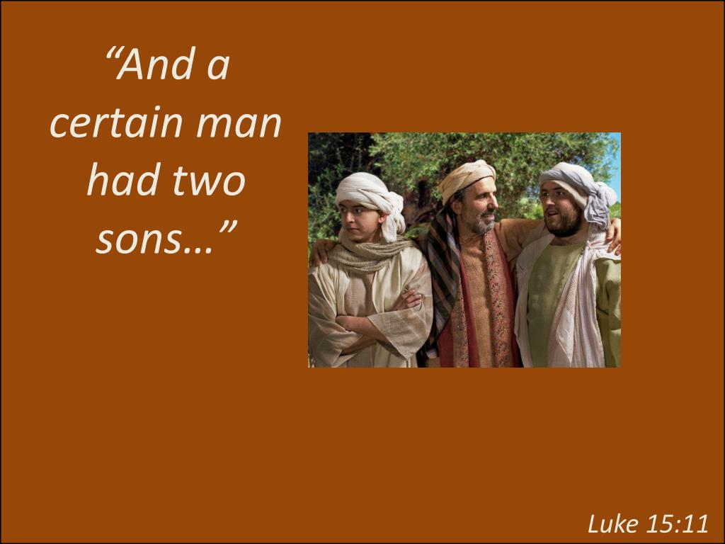

Slide 4

Holy Women Who Trusted In God
1Peter 3:5 For in this manner, in former times, the holy women who trusted in God also adorned themselves, being submissive to their own husbands,

Slide 5

The Older
And The Younger
…the older women likewise, that they be reverent in behavior, not slanderers, not given to much wine, teachers of good things-- that they admonish the young women to love their husbands, to love their children, to be discreet, chaste, homemakers, good, obedient to their own husbands, that the word of God may not be blasphemed. Likewise, exhort the young men to be sober-minded, in all things showing yourself to be a pattern of good works; in doctrine showing integrity, reverence, incorruptibility, sound speech that cannot be condemned, that one who is an opponent may be ashamed, having nothing evil to say of you. Titus 2:3-8

Slide 6
Fathers and their Children. Eph.6:4
Do you know
more about tv fathers
or
Bible fathers?

Slide 7

remindmagazine.com

Slide 8
Fathers and their Children. Eph.6:4
Adam
Noah
Abraham
Lot
Job
Isaac
Jacob
Moses
Aaron
David

Slide 9

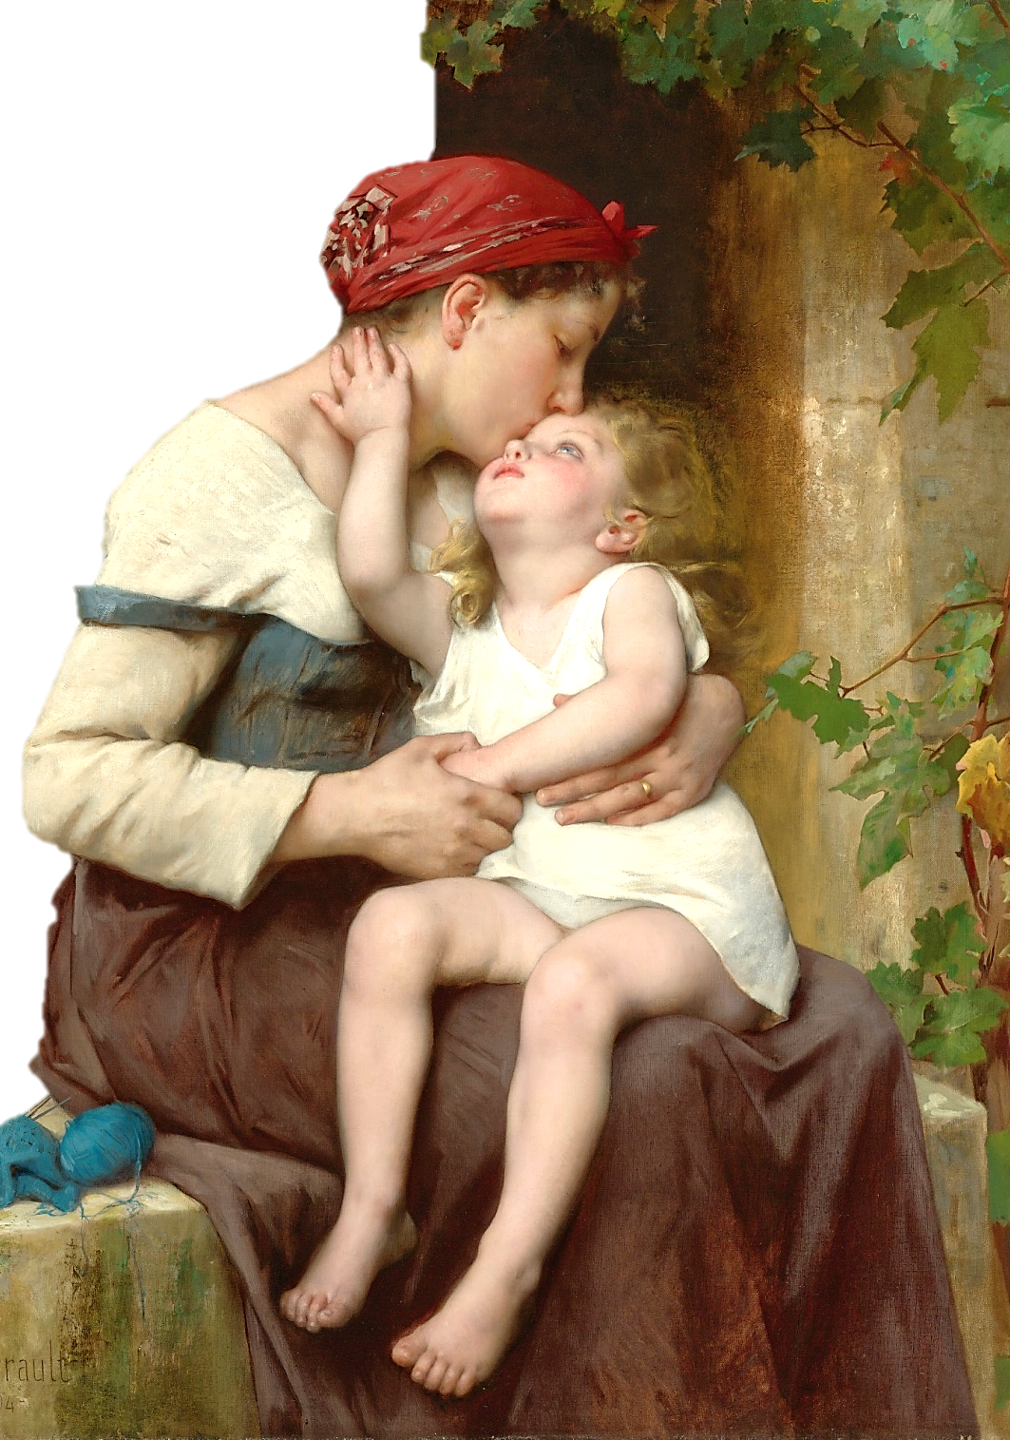
EPHESIANS
Chapter 6
1 Children, obey your parents in the Lord: for this is right.
2 Honour thy father and mother; (which is the first commandment with promise;)
3 That it may be well with thee, and thou mayest live long on the earth.
4 And, you fathers, provoke not your children to wrath: but bring them up in the nurture and admonition of the Lord.
Wikimedia: Public Domain over 100 years old, USA

Slide 10
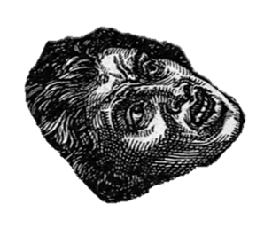

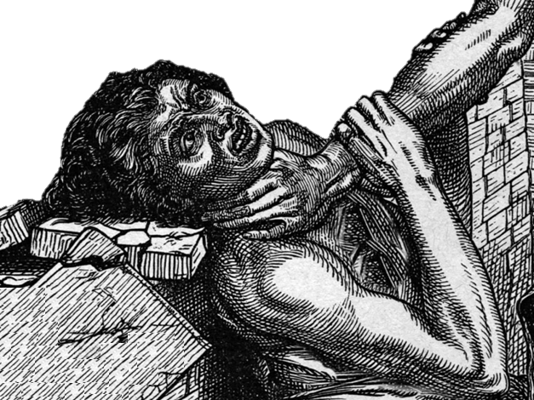
Under the old law a child that was guilty of smiting or cursing a parent, or that was stubborn or rebellious, or that was a glutton or drunkard was to be stoned to death.
References: Exodus 21:15-17, Leviticus 20:9
Deuteronomy 21:18-21

Slide 11
Ex. 21:15-17 "And he who strikes his father or his mother shall surely be put to death. 16 "He who kidnaps a man and sells him, or if he is found in his hand, shall surely be put to death. 17 "And he who curses his father or his mother shall surely be put to death.
Lev. 20:9 For everyone who curses his father or his mother shall surely be put to death. He has cursed his father or his mother. His blood shall be upon him.
Deut. 21:18-21 "If a man has a stubborn and rebellious son who will not obey the voice of his father or the voice of his mother, and who, when they have chastened him, will not heed them, 19 "then his father and his mother shall take hold of him and bring him out to the elders of his city, to the gate of his city.
20 "And they shall say to the elders of his city, 'This son of ours is stubborn and rebellious; he will not obey our voice; he is a glutton and a drunkard.' 21 "Then all the men of his city shall stone him to death with stones; so you shall put away the evil from among you, and all Israel shall hear and fear.

Slide 12
Fathers and their Children. Eph.6:4
"Children are an heritage of the Lord" (Ps. 127:3) and should be considered gifts from God who have been placed in our hands to mold and fashion into worth-while citizens in his kingdom.
So, it is our responsibility to "train up a child in the way he should go, and even when he is old he will not depart from it" (Prov. 22:6).

Slide 13
Fathers and their Children. Eph.6:4
Note the word "train." Too many times this is thought to be accomplished simply by telling how to act, etc. However, there is much more than simply telling.
Telling is important.
(Deut. 6:6-7)." "And these words which I command you today shall be in your heart. 7 "You shall teach them diligently to your children, and shall talk of them when you sit in your house, when you walk by the way, when you lie down, and when you rise up.

Slide 14
Fathers and their Children. Eph.6:4
Nurture and admonition defined.
Nurture = Train (chastise, discipline, correction) out of love.
Admonition = putting in mind by words.
To warn
To correct by discipline
To train.
Admonition. Admonish. Teach and admonish.

Slide 15
Fathers and their Children. Eph.6:4
Nurture and admonition
Love and control
Love and discipline

Slide 16
Eph. 6:4 And, ye fathers, provoke not your children to wrath: but bring them up in the nurture and admonition of the Lord. (love and control)
love
love
Lot
Eli
control
control
Jacob
Permissive children
Wild children
All love no control
All control no love
control
love
Abram
love
control
Children willingly obey
More control little love
Equal love and control

Slide 17
Fathers and their Children. Eph.6:4
Col.3:16 Let the word of Christ dwell in you richly in all wisdom; teaching and admonishing one another in psalms and hymns and spiritual songs, singing with grace in your hearts to the Lord.
Teach deals with positive truth...Reason
Admonish deals with things wrong – warning…Power
We need Balance.

Slide 18
Fathers and their Children. Eph.6:4
Sometimes we fathers leave this to mothers, but in doing so we have neglected the fact that the passage explicitly gives this command to the father!
So, it is his responsibility to do the "nurture and admonition." He can do this by reading the Bible and Bible stories to and with his children and help them to make application of its truth to various aspects of life.
He doesn't merely tell them but helps them in preparing their Bible class lessons.

Slide 19
Fathers and their Children. Eph.6:4
Nevertheless, (Eph. 5:23). "the husband is the head of the wife as Christ also is head of the church"
So, in addition to being involved in the actual teaching and training, it is his responsibility and God has given him the authority to see that all such nurturing and admonishing is done properly.

Slide 20
Fathers and their Children. Eph.6:4
A father has certain rules by to train his children, and he enforces those rules. He makes them pray and teaches them who gives us all things.
He makes them do to their lessons at home, that they may know that they have got to work and not be lazy.
He makes them be selective as to their companionships. The father knows his children may not be able to get out of evil associations.
He sets certain hours, deadlines, and curfews for the house, that they may learn order and punctuality. (all of this spills over into the church).

Slide 21
Fathers and their Children. Eph.6:4
He does not ask them if they want to go to bible class or go to worship, but he makes them go to worship with him.
That is the kind of nurture and admonition that is meant here, and when it is necessary it must be backed up by wise chastening, or punishment for good."
With admonition, It is not necessary that a parent should always explain to a child the reasons of his procedure.

Slide 22
Fathers and their Children. Eph.6:4
But it is important that, as a rule, children should have explained to them the evil of the way they are asked to avoid, and the advantages of the way they are asked to follow."
They gotta understand the WHY.
Again observe that the text places the responsibility to do this on the fathers.
The wording of this may seem somewhat harsh, but remember the same verse (Eph. 6:4) lets us know that it is to be administered in such a way as not to provoke the children to wrath. – done with love!

Slide 23
Eph. 6:4 And, ye fathers, provoke not your children to wrath: but bring them up in the nurture and admonition of the Lord. (love and control)
love
love
Lot
Eli
control
control
Jacob
Permissive children
Wild children
All love no control
All control no love
control
love
Abram
love
control
Children willingly obey
More control little love
Equal love and control

Slide 24
Fathers and their Children. Eph.6:4
Behavior is predictable.
“I’m gonna be like you dad”
“he’d grown up just like me
My boy was just like me”

Slide 25
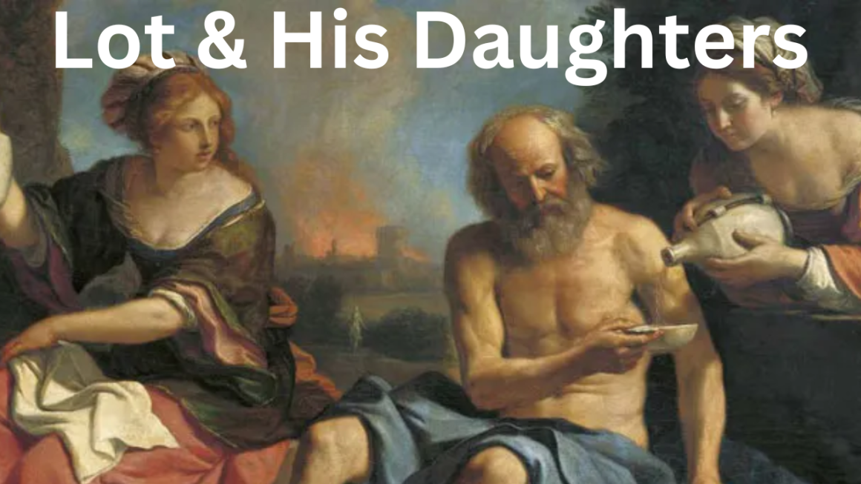

jewishdrinking.com

Slide 26
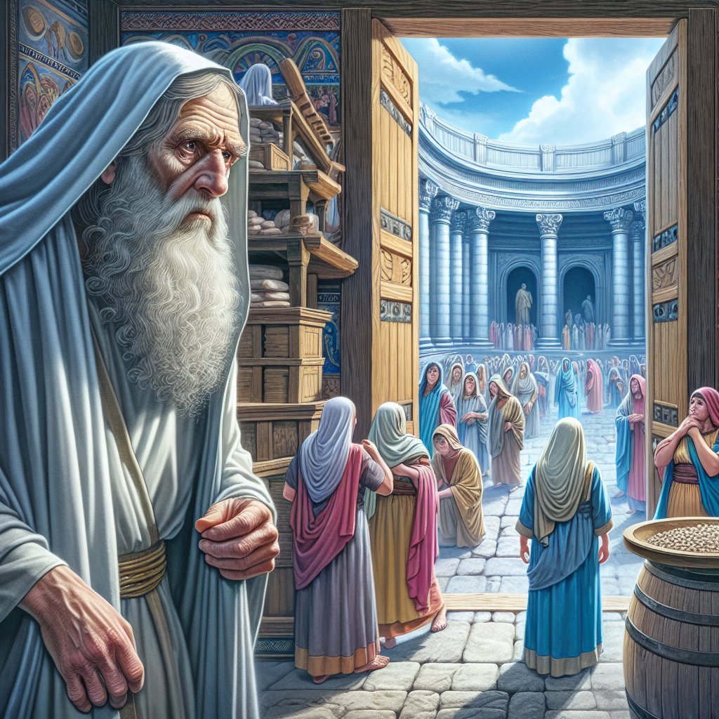

bible.art
Eli and his sons

Slide 27
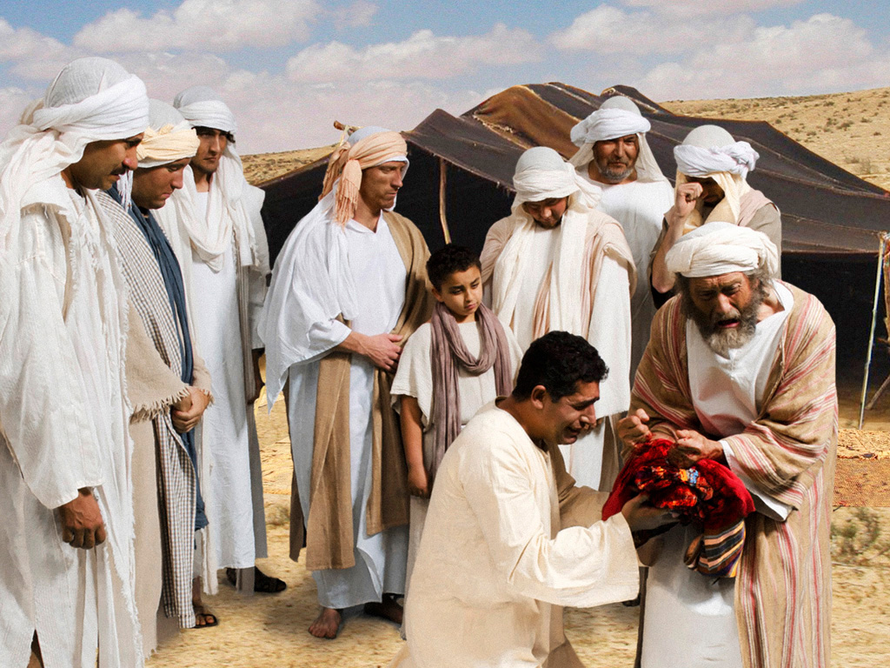

Jacob and
his sons
Notes:
They return to Jacob to show him the blood-stained robe. Jacob assumes that Joseph must have been torn to pieces by a wild animal.

Slide 28
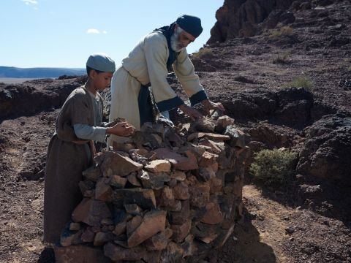

Abraham and Issac

Slide 29
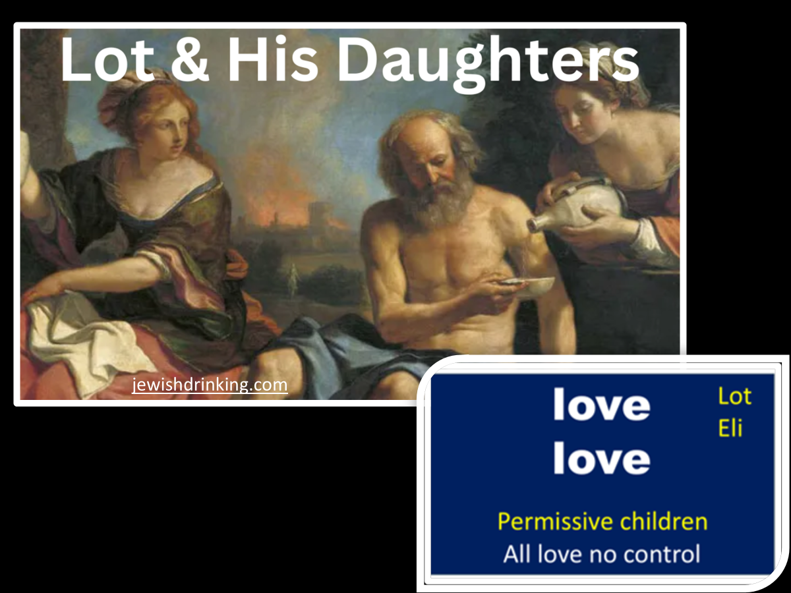
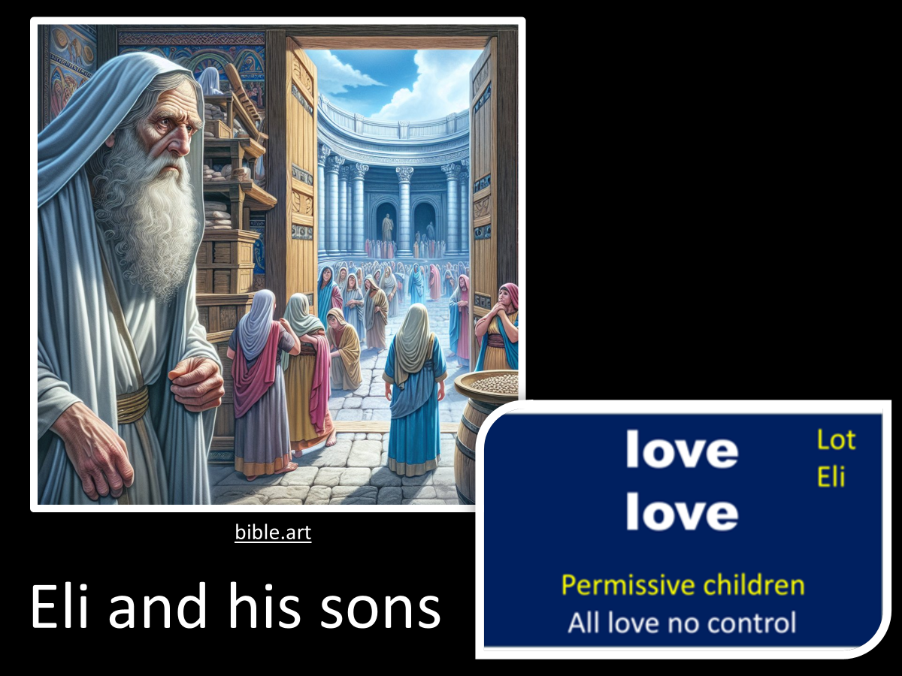
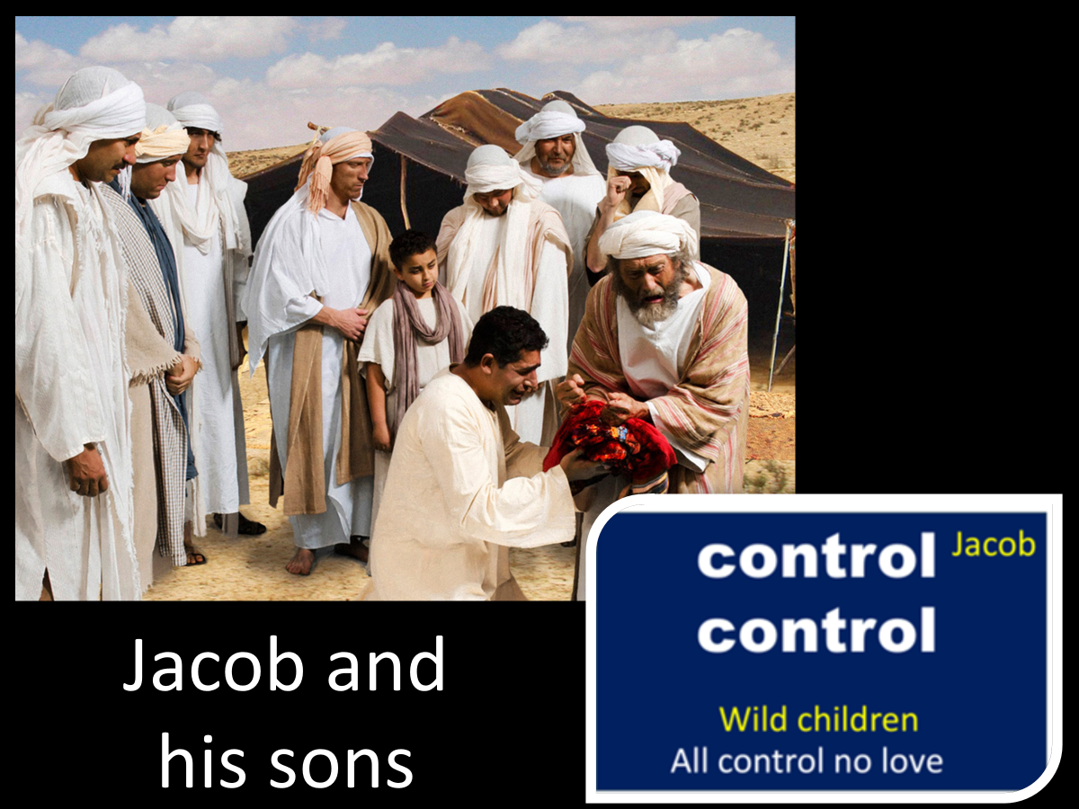
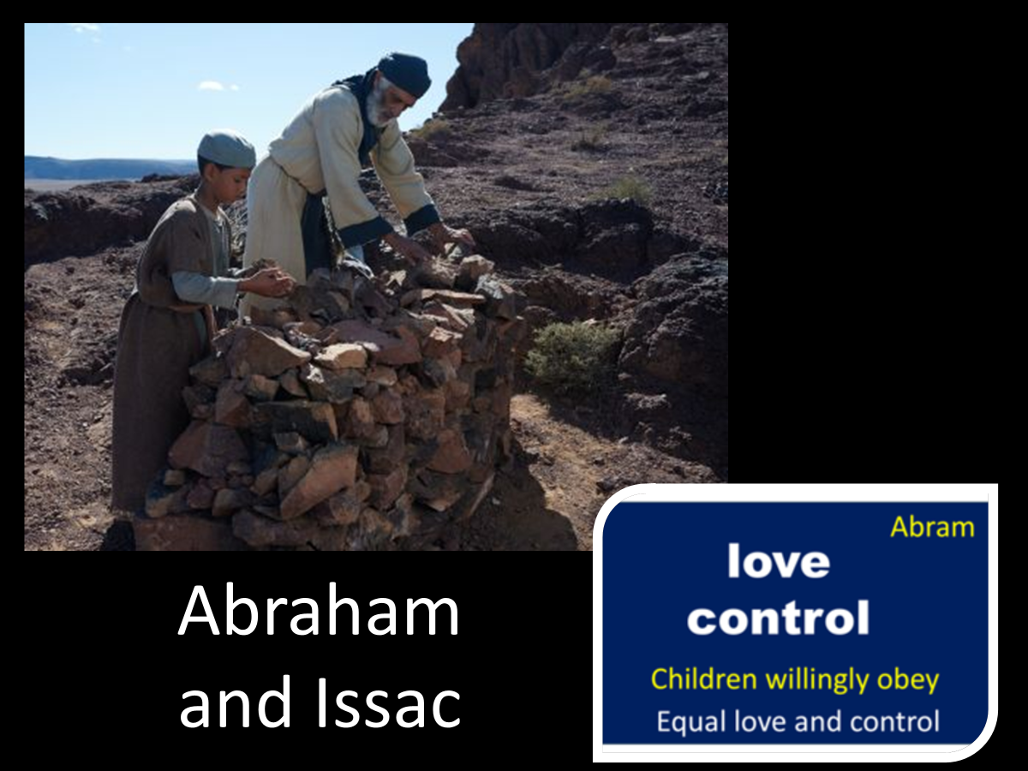

Slide 30
The Training And Admonition Of The Lord. Eph.6:4
Abraham and Issac

