Slide 1
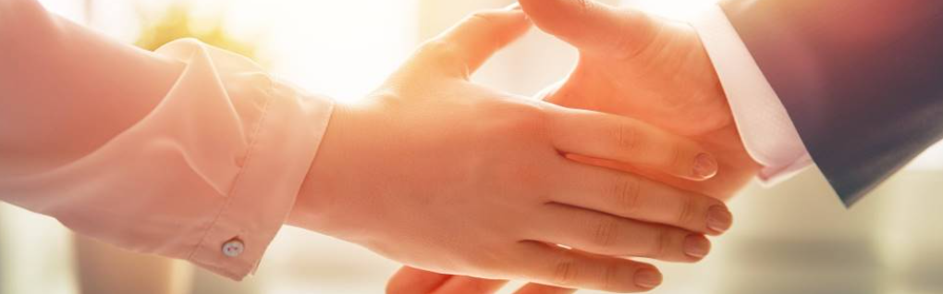
Welcome to our services
New Lebanon Church of Christ
We are Simply Christians.
Our Emphasis is Spiritual, Not Material or Social.
We are striving to be The Same Church as Described in The New Testament.
Please Come Back Again

Slide 2

Hebrews 3:1
Therefore, holy brethren,
partakers of the heavenly calling, consider the Apostle and High Priest of our confession, Christ Jesus,
2 who was faithful to Him who appointed Him, as Moses also was faithful in all His house.

Slide 3

Hebrews 3:1-6
Consider Jesus

Slide 4
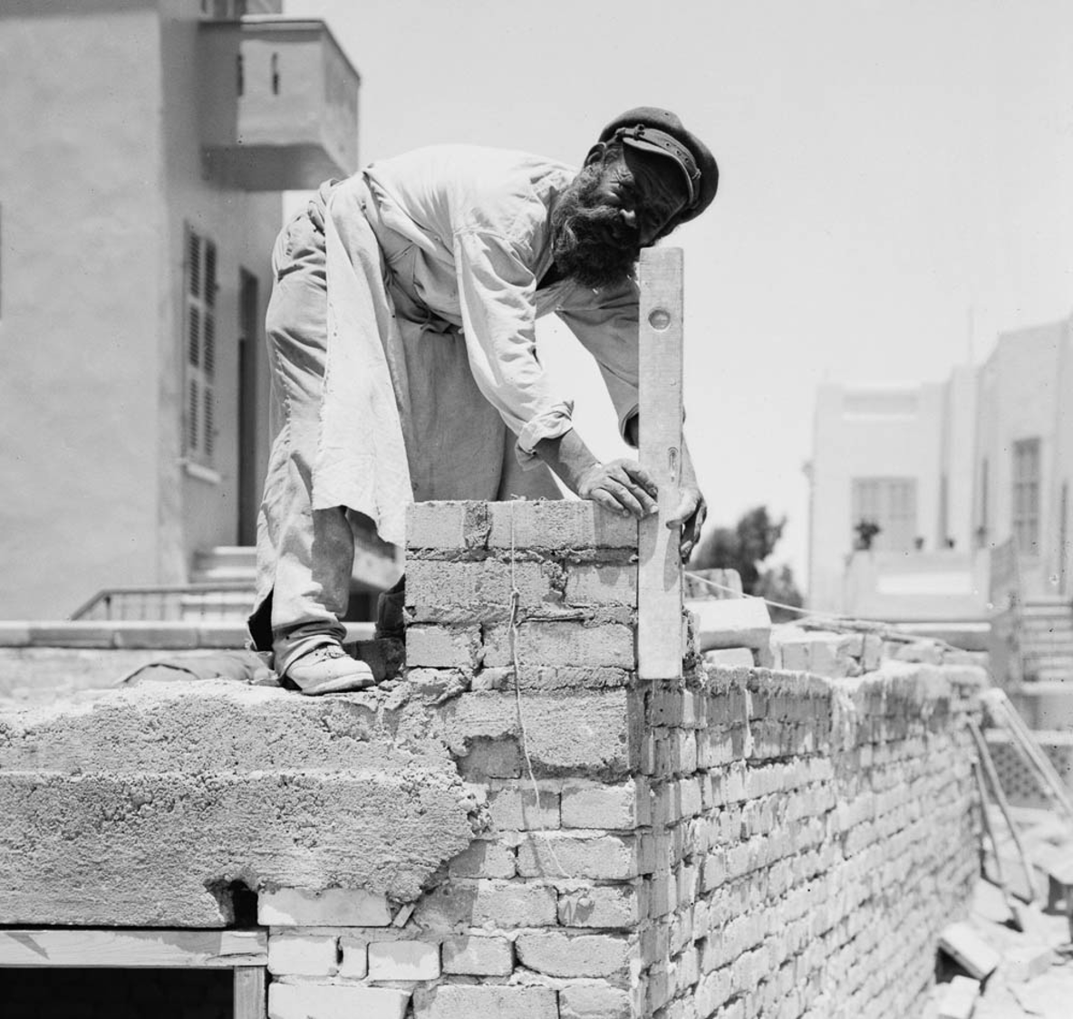
Heb 3:3 For this One has been counted worthy of more glory than Moses, inasmuch as He who built the house has more honor than the house.
4 For every house is built by someone, but He who built all things is God.

Slide 5
Heb 3:5 And Moses indeed was faithful in all His house as a servant, for a testimony of those things which would be spoken afterward,
6 but Christ as a Son over His own house, whose house we are if we hold fast the confidence and the rejoicing of the hope firm to the end.

Slide 6
Consider Jesus
As the Apostle, He Offers -
Light for the blind. John 8:12
Pardon for the guilty. Rom.8:1-2
Liberty for the slaves Rom. 6:17-18
Healing balm for the sin-sick Matt.9:12
Rest for the weary Matt.11:28-30
Life for the dead. John 1:4
newlebanoncoc.com

Slide 7
Have you a heart that's weary
Tending a load of care?
Are you a soul that's seeking
Rest from the burden you bear?
Do you know (do you know) my Jesus?
Do you know (do you know) my friend?
Have you heard He loves you?
And that He will abide til the end
Who knows your disappointments?
Who hears each time you cry?
Who understands your heartaches?
Who dries the tears from your eyes?
Do you know (do you know) my Jesus?
Do you know (do you know) my friend?
Have you heard He loves you?
And that He will abide til the end
Have you a heart that's weary
Tending a load of care
Are you a soul that's seeking rest
From the burden you bear?
Do you know (do you know) my Jesus?
Do you know (do you know) my friend?
Have you heard He loves you?
And that He will abide til the end
Have you heard He loves you?
And that He will abide til the end

Slide 8
Consider Jesus
As the High Priest, He offers us to God -
In the sin offering he made. Heb 8:3
In helping us in time of temptation. Heb 2:17-18
In bearing our petitions to the throne of grace.
newlebanoncoc.com

Slide 9
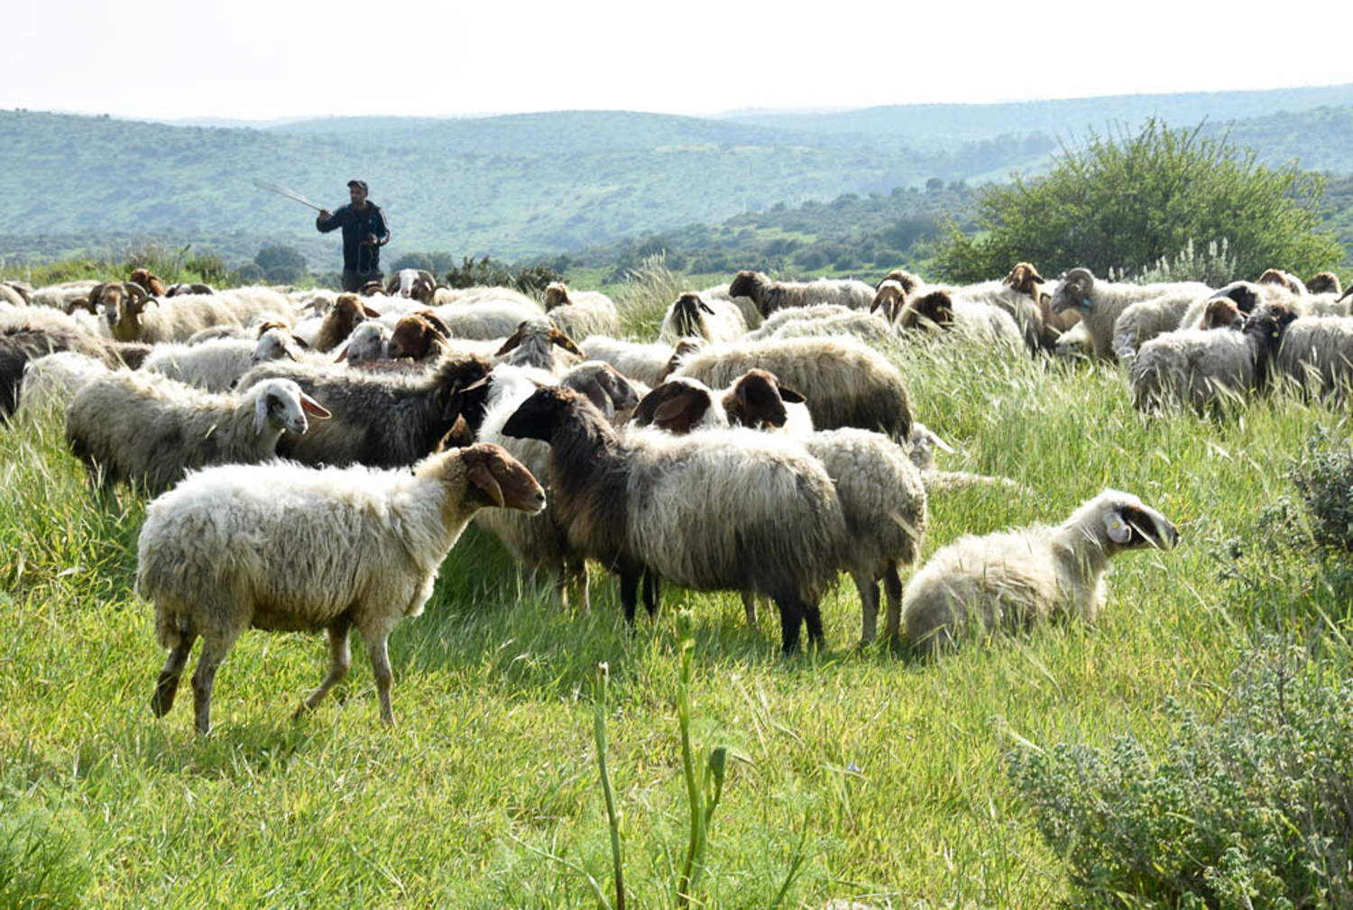
Heb 3:7 Therefore, as the Holy Spirit says: "Today, if you will hear His voice, 8 Do not harden your hearts as in the rebellion, In the day of trial in the wilderness,

Slide 10
Consider Jesus
“Consider” an earnest, fixed, prolonged attention of the mind.
1st, consider Jesus as our Apostle – the representative from heaven. His words are all-authoritative.
2nd, consider Jesus as our High Priest – our helper in heaven. We can go to him in time of trial.
3rd, consider him as our one and only mediator between God and man. This eliminates the Pope or priest .
newlebanoncoc.com

Slide 11
Consider Jesus
Heb. 2:1 Therefore we must give the more earnest heed to the things we have heard, lest we drift away. 2 For if the word spoken through angels proved steadfast, and every transgression and disobedience received a just reward,
3 how shall we escape if we neglect so great a salvation, which at the first began to be spoken by the Lord, and was confirmed to us by those who heard Him,
4 God also bearing witness both with signs and wonders, with various miracles, and gifts of the Holy Spirit, according to His own will? 5 For He has not put the world to come, of which we speak, in subjection to angels.
newlebanoncoc.com

Slide 12
Questions?
Want to learn more about the Bible?
We will be glad to study the Bible with you.
New Lebanon
New Lebanon
Church of Christ
Church of Christ
New Lebanon, OH
newlebanoncoc.com
newlebanoncoc@gmail.com

