Slide 1
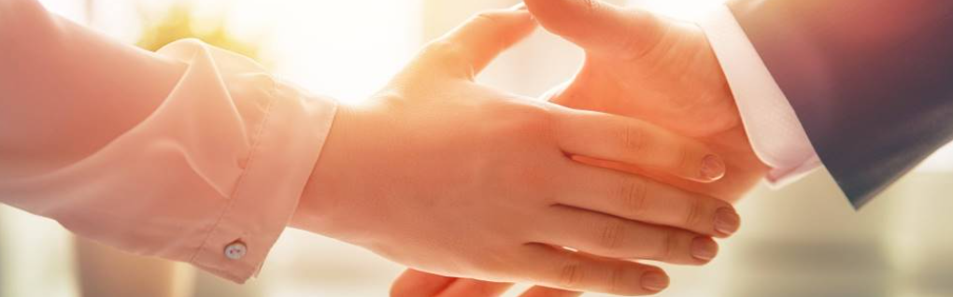
Welcome to our services
New Lebanon Church of Christ
We are Simply Christians.
Our Emphasis is Spiritual, Not Material or Social.
We are striving to be The Same Church as Described in The New Testament.
Please Come Back Again

Slide 2
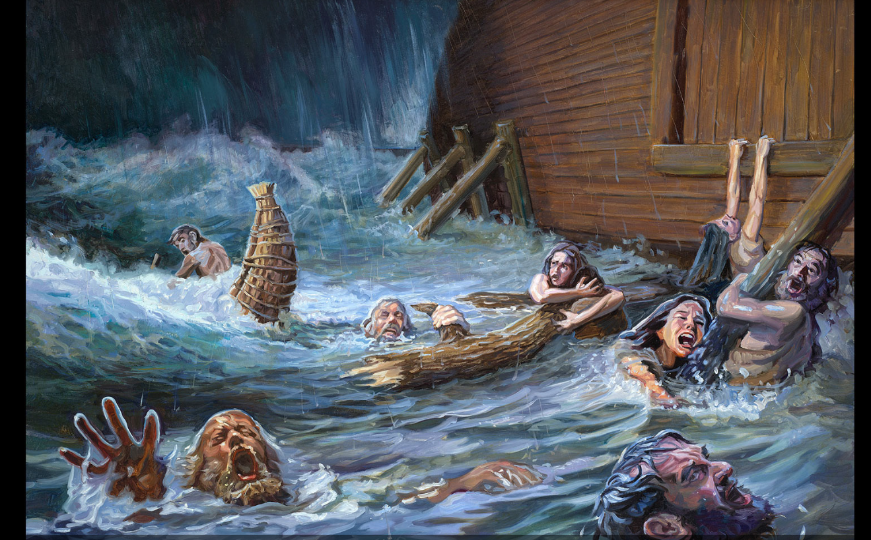
What About The People Outside Of The Ark?
What About The People Outside Of The Lord’s Church?

Slide 3
What About The People Outside Of The Ark?
All That Have Been Saved Have Been Added To the Church
newlebanoncoc.com

Slide 4
What About The People Outside Of The Ark?
All That Have Been Saved Have Been Reconciled unto God in one body - the Church
newlebanoncoc.com

Slide 5
What About The People Outside Of The Ark?
The Church is the family of God
newlebanoncoc.com

Slide 6
What About The People Outside Of The Ark?
All who have been saved have been translated into the kingdom of Christ.
newlebanoncoc.com

Slide 7
What About The People Outside Of The Ark?
In the end, Christ will deliver up to the Father, only those who are in the kingdom.
newlebanoncoc.com

Slide 8
What About The People Outside Of The Ark?
Only those in the church will have their names written in heaven.
newlebanoncoc.com

Slide 9
What About The People Outside Of The Ark?
Only those in the church are purchased with the blood of Christ.
newlebanoncoc.com

Slide 10
What About The People Outside Of The Ark?
Only those in the church have been called out of the world.
newlebanoncoc.com

Slide 11
What About The People Outside Of The Ark?
Salvation is in the church. Paul promised that Christ would save the church.
newlebanoncoc.com

Slide 12
What About The People Outside Of The Ark?
Salvation is in the church because that is the group that Christ will present unto Himself.
newlebanoncoc.com

Slide 13
What About The People Outside Of The Ark?
It is impossible to be saved out of church because the church is the “fullness of Christ.”
newlebanoncoc.com

Slide 15
What About The People Outside Of The church?
If there are saved people - Christians - in the denominations, these conclusions follow:
1. Denominationalism makes the gospel plan of salvation unnecessary. Denominations do not preach and practice the Bible plan of salvation

Slide 16
What About The People Outside Of The church?
If there are saved people - Christians - in the denominations, these conclusions follow:
2. If there are Christians in denominations then people can be saved without obeying the gospel (which is false, Matt 7:21-23).

Slide 17
What About The People Outside Of The church?
If there are saved people - Christians - in the denominations, these conclusions follow:
3. Denominationalism makes the church of Christ unnecessary. The New Testament teaches the church is essential to God's eternal purpose of redemption (Eph 3:10-11). God is glorified "in the church by Christ Jesus" (Eph 3:21).

Slide 18
What About The People Outside Of The church?
If there are saved people - Christians - in the denominations, these conclusions follow:
4. Denominationalism makes contending for the faith futile and factious. If Christians are in denominations should we not embrace them as brethren instead of contending against their error (Jude 3-4)?

Slide 19
What About The People Outside Of The church?
If there are saved people - Christians - in the denominations, these conclusions follow:
5. Denominationalism makes fellowship with error acceptable. The New Testament teaches Christians not to have fellowship with error (Eph 5:11).

Slide 20
What About The People Outside Of The church?
If there are saved people - Christians - in the denominations, these conclusions follow:
6.To suggest that false churches practicing error contain saved people (Christians) is a denial of every verse that warns against having fellowship with error (2 Jno 9-11; Gal 1:6-10; 2 Cor 6:14-18). Matt. 7:21-23

Slide 21
What About The People Outside Of The Ark?
Psalm 32:5 I acknowledged my sin to You, And my iniquity I have not hidden. I said, "I will confess my transgressions to the LORD," And You forgave the iniquity of my sin. 6 For this cause everyone who is godly shall pray to You In a time when You may be found; Surely in a flood of great waters They shall not come near him.
newlebanoncoc.com

Slide 22
Questions?
Want to learn more about the Bible?
We will be glad to study the Bible with you.
New Lebanon
New Lebanon
Church of Christ
Church of Christ
New Lebanon, OH
newlebanoncoc.com
newlebanoncoc@gmail.com

