Slide 1

Welcome to our services
New Lebanon Church of Christ
We are Simply Christians.
Our Emphasis is Spiritual, Not Material or Social.
We are striving to be The Same Church as Described in The New Testament.
Please Come Back Again

Slide 2

The Older
And The Younger
…the older women likewise, that they be reverent in behavior, not slanderers, not given to much wine, teachers of good things-- that they admonish the young women to love their husbands, to love their children, to be discreet, chaste, homemakers, good, obedient to their own husbands, that the word of God may not be blasphemed. Likewise, exhort the young men to be sober-minded, in all things showing yourself to be a pattern of good works; in doctrine showing integrity, reverence, incorruptibility, sound speech that cannot be condemned, that one who is an opponent may be ashamed, having nothing evil to say of you. Titus 2:3-8

Slide 3

The Older Women Likewise, Titus 2:3-8

Slide 4

The importance of this lesson…
-William Ross Wallace

Slide 5
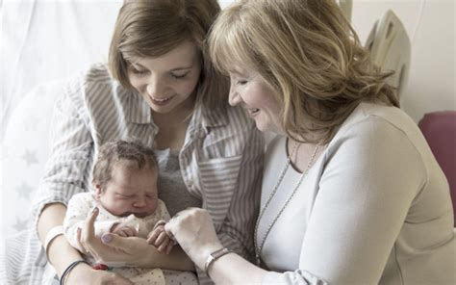
The Older Women Likewise, Titus 2:3-8
Generational teaching

Slide 6
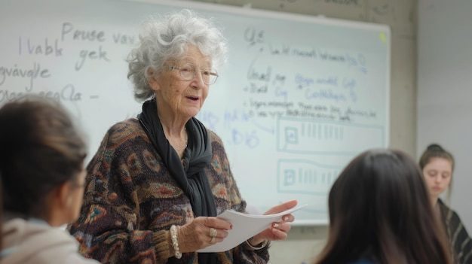
The Older Women Likewise, Titus 2:3-8
Classroom teaching.
(“I’m too old to teach!” ???)

Slide 7

The Older Women Likewise, Titus 2:3-8
Teaching one on one. (Don’t tell me, show me.)

Slide 8
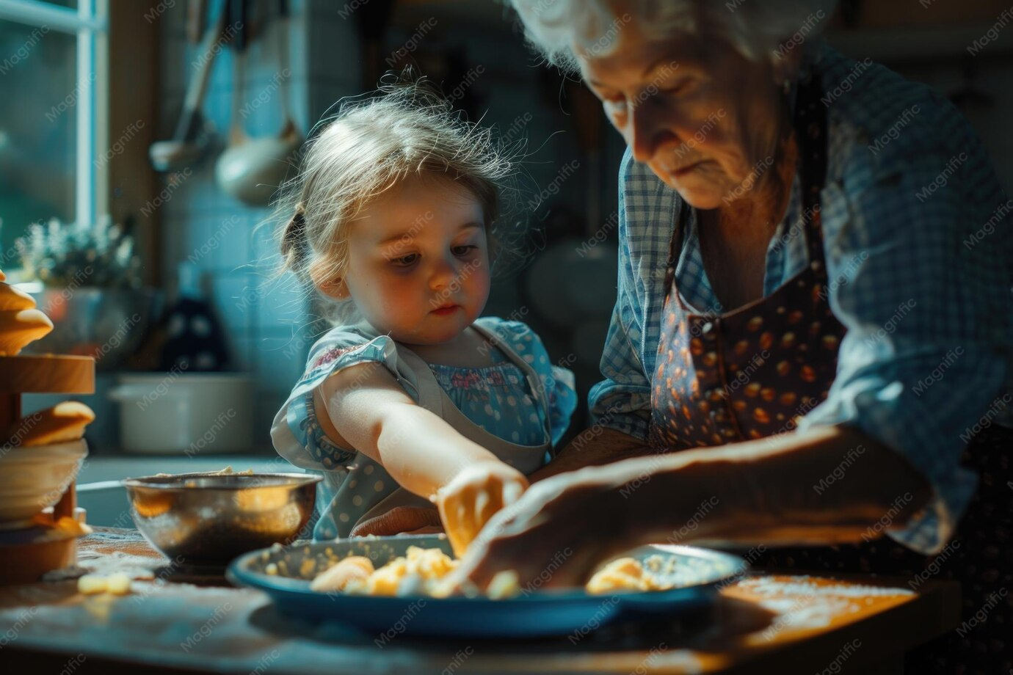
The Older Women Likewise, Titus 2:3-8
Teaching one on one. (Don’t tell me, show me.)

Slide 9
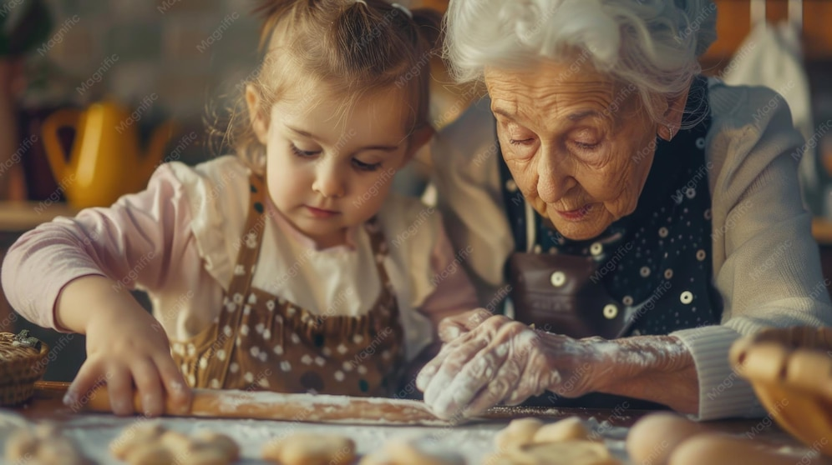
The Older Women Likewise, Titus 2:3-8
Teaching one on one. (Don’t tell me, show me.)

Slide 10
The Older Women Likewise, Titus 2:3-8
“But we proved to be gentle among you, as a nursing mother tenderly cares for her own children” (1 Thess. 2:7).
This type of personal, nurturing affection and attention is what the older women were to teach the young women to practice. The young women must be taught to avoid the characteristics of the ostrich who abandons and neglects her young and treats them “as if they were not hers,” because she is too concerned with other matters that she believes to be important (Job 39:13-18).

Slide 11
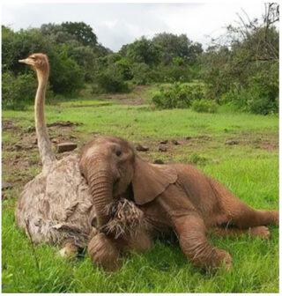
The Older Women Likewise, Titus 2:3-8
Job 39:13 "The wings of the ostrich wave proudly, But are her wings and pinions like the kindly stork's?
14 For she leaves her eggs on the ground, And warms them in the dust;
15 She forgets that a foot may crush them, Or that a wild beast may break them.
16 She treats her young harshly, as though they were not hers; Her labor is in vain, without concern,
17 Because God deprived her of wisdom, And did not endow her with understanding.
18 When she lifts herself on high, She scorns the horse and its rider.
(NKJV)

Slide 12
The Older Women Likewise, Titus 2:3-8
Be Kind – Tabitha is an example of a woman who was “abounding with deeds of kindness and charity which she continually did” (Acts 9:36). Kindness involves showing love and doing good toward others. When Paul discussed the care of certain widows, he described the character of one who would be worthy of help:
“Having a reputation for good works… if she has shown hospitality to strangers, if she has washed the saints’ feet, if she has assisted those in distress, and if she has devoted herself to every good work” (1 Timothy 5:10).
Humility is involved in this because in order to show kindness, a woman must “regard others as more important” than herself, and not “look out for her own personal interest, but also for the interests of others” (Philippians 2:3-4). The older women must teach the young women to show kindness and do good to others.
(Show by doing with them)

Slide 13
The Older
And The Younger
…the older women likewise, that they be reverent in behavior, not slanderers, not given to much wine, teachers of good things-- that they admonish the young women to love their husbands, to love their children, to be discreet, chaste, homemakers, good, obedient to their own husbands, that the word of God may not be blasphemed. Likewise, exhort the young men to be sober-minded, in all things showing yourself to be a pattern of good works; in doctrine showing integrity, reverence, incorruptibility, sound speech that cannot be condemned, that one who is an opponent may be ashamed, having nothing evil to say of you. Titus 2:3-8

Slide 14
The Older Women Likewise, Titus 2:3-8
Husband-lovers
Children-lovers
Sober minded
Pure
Workers at home
Kind
In subjection to their own husband

Slide 15
…And has an enormous influence on the future of the church!

Slide 16
Questions?
Want to learn more about the Bible?
We will be glad to study the Bible with you.
New Lebanon
New Lebanon
Church of Christ
Church of Christ
New Lebanon, OH
newlebanoncoc.com
newlebanoncoc@gmail.com

