Slide 1
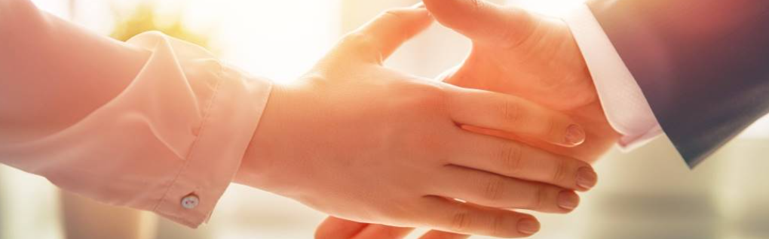
Welcome to our services
New Lebanon Church of Christ
We are Simply Christians.
Our Emphasis is Spiritual, Not Material or Social.
We are striving to be The Same Church as Described in The New Testament.
Please Come Back Again

Slide 2
CAUTION
"And now, Israel, what does the LORD your God require of you, but to fear the LORD your God, to walk in all His ways and to love Him, to serve the LORD your God with all your heart and with all your soul,
DEUT. 10:12
Universally Required

Slide 3
CAUTION
He has shown you, O man, what is good; And what does the LORD require of you But to do justly, To love mercy, And to walk humbly with your God?
He has shown you, O man,
what is good; And what does the LORD require of you But to do justly, To love mercy, And to walk humbly with your God?
Micah 6:8
Universally Required

Slide 4

The Lord’s Requirements. Deut. 10:12-22
The Lord has Requirements.
As our Creator,
As our Redeemer

Slide 5
The Lord’s Requirements. Deut. 10:12-22
So What Does the Lord require?
  A Family Fear
  An Obedient Walk
  An Affectionate Heart
  A Whole-hearted Service
  A Submissive Will
  A Loving Spirit
  A Tenacious Faith

Slide 6
Questions?
Want to learn more about the Bible?
We will be glad to study the Bible with you.
New Lebanon
New Lebanon
Church of Christ
Church of Christ
New Lebanon, OH
newlebanoncoc.com
newlebanoncoc@gmail.com

