Slide 1
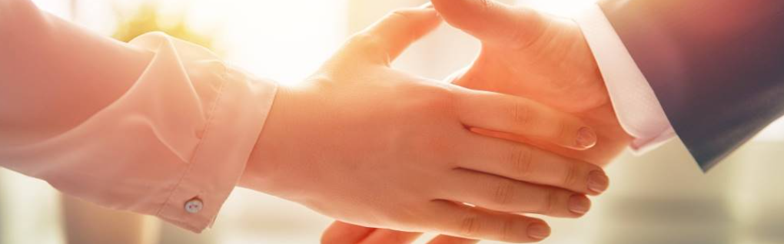
Welcome to our services
New Lebanon Church of Christ
We are Simply Christians.
Our Emphasis is Spiritual, Not Material or Social.
We are striving to be The Same Church as Described in The New Testament.
Please Come Back Again

Slide 2
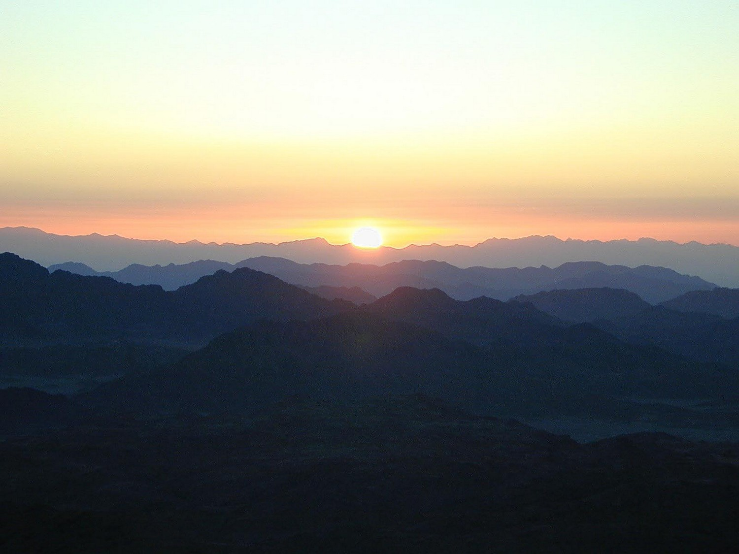
Every good gift and every perfect gift is from above, coming down from the Father of lights. James 1:17
The letter of James
Lesson one
James and Jesus
Notes:
In his Gospel, John also connects light with God and His act of creation. “In the beginning was the Word, and the Word was with God, and the Word was God. He was with God in the beginning. Through him all things were made; without him nothing was made that has been made. In him was life, and that life was the light of all mankind. The light shines in the darkness, and the darkness has not overcome it” (John 1:1-5, NIV). This photo was taken from Jebel Musa, the traditional Mount Sinai.
tb030400500

Slide 3
The letter of James
Lesson two
Temptations
James 1:13-14, "Let no one say when he is tempted, 'I am tempted by God'; for God cannot be tempted by evil, nor does He Himself tempt anyone. But each one is tempted when he is drawn away by his own desires and enticed."
Notes:
In his Gospel, John also connects light with God and His act of creation. “In the beginning was the Word, and the Word was with God, and the Word was God. He was with God in the beginning. Through him all things were made; without him nothing was made that has been made. In him was life, and that life was the light of all mankind. The light shines in the darkness, and the darkness has not overcome it” (John 1:1-5, NIV). This photo was taken from Jebel Musa, the traditional Mount Sinai.
tb030400500

Slide 4
We are bondservants, slaves of God. We are bought with a price.
There are at least 3 implications-
*It implies absolute obedience. A slave has no rights and he is owned.
*It implies absolute humility. This is a person who loses himself in service to his master.
*It implies absolute loyalty. This person is one who does not consider his own preferences, only his loyalty to his master.
Notes:
In his Gospel, John also connects light with God and His act of creation. “In the beginning was the Word, and the Word was with God, and the Word was God. He was with God in the beginning. Through him all things were made; without him nothing was made that has been made. In him was life, and that life was the light of all mankind. The light shines in the darkness, and the darkness has not overcome it” (John 1:1-5, NIV). This photo was taken from Jebel Musa, the traditional Mount Sinai.
tb030400500

Slide 5
Temptations
James 1:13-14
"Let no one say when he is tempted, 'I am tempted by God'; for God cannot be tempted by evil, nor does He Himself tempt anyone. But each one is tempted when he is drawn away by his own desires and enticed."
Notes:
In his Gospel, John also connects light with God and His act of creation. “In the beginning was the Word, and the Word was with God, and the Word was God. He was with God in the beginning. Through him all things were made; without him nothing was made that has been made. In him was life, and that life was the light of all mankind. The light shines in the darkness, and the darkness has not overcome it” (John 1:1-5, NIV). This photo was taken from Jebel Musa, the traditional Mount Sinai.
tb030400500

Slide 6
Temptations
Trials represent an outward opportunity to sin.
Temptations refer to the inward desire to sin.
James 1:13 Let no one say when he is tempted, "I am tempted by God"; for God cannot be tempted by evil, nor does He Himself tempt anyone. 14 But each one is tempted when he is drawn away by his own desires and enticed.
Notes:
In his Gospel, John also connects light with God and His act of creation. “In the beginning was the Word, and the Word was with God, and the Word was God. He was with God in the beginning. Through him all things were made; without him nothing was made that has been made. In him was life, and that life was the light of all mankind. The light shines in the darkness, and the darkness has not overcome it” (John 1:1-5, NIV). This photo was taken from Jebel Musa, the traditional Mount Sinai.
tb030400500

Slide 7
Temptations
James 1:3 knowing that the testing of your faith produces patience.
4 But let patience have its perfect work, that you may be perfect and complete, lacking nothing.
"Perfect" does NOT mean sinless. "Perfect" comes from the Greek word (TELEIOS) meaning, "brought to its end, finished, wanting nothing necessary to completeness, full grown, mature" (Eph.3:19; 4:13).
Notes:
In his Gospel, John also connects light with God and His act of creation. “In the beginning was the Word, and the Word was with God, and the Word was God. He was with God in the beginning. Through him all things were made; without him nothing was made that has been made. In him was life, and that life was the light of all mankind. The light shines in the darkness, and the darkness has not overcome it” (John 1:1-5, NIV). This photo was taken from Jebel Musa, the traditional Mount Sinai.
tb030400500

Slide 8
Temptations
1Cor.10:13 No temptation has overtaken you except such as is common to man; but God is faithful, who will not allow you to be tempted beyond what you are able, but with the temptation will also make the way of escape, that you may be able to bear it.
Notes:
In his Gospel, John also connects light with God and His act of creation. “In the beginning was the Word, and the Word was with God, and the Word was God. He was with God in the beginning. Through him all things were made; without him nothing was made that has been made. In him was life, and that life was the light of all mankind. The light shines in the darkness, and the darkness has not overcome it” (John 1:1-5, NIV). This photo was taken from Jebel Musa, the traditional Mount Sinai.
tb030400500

Slide 9
Temptations
1Peter 1:6 In this you greatly rejoice, though now for a little while, if need be, you have been grieved by various trials,
7 that the genuineness of your faith, being much more precious than gold that perishes, though it is tested by fire, may be found to praise, honor, and glory at the revelation of Jesus Christ,
Notes:
In his Gospel, John also connects light with God and His act of creation. “In the beginning was the Word, and the Word was with God, and the Word was God. He was with God in the beginning. Through him all things were made; without him nothing was made that has been made. In him was life, and that life was the light of all mankind. The light shines in the darkness, and the darkness has not overcome it” (John 1:1-5, NIV). This photo was taken from Jebel Musa, the traditional Mount Sinai.
tb030400500

Slide 10
Temptations
"Perfect" does NOT mean sinless. "Perfect" comes from the Greek word (TELEIOS) meaning, "brought to its end, finished, wanting nothing necessary to completeness, full grown, mature" (Eph.3:19; 4:13).
Notes:
In his Gospel, John also connects light with God and His act of creation. “In the beginning was the Word, and the Word was with God, and the Word was God. He was with God in the beginning. Through him all things were made; without him nothing was made that has been made. In him was life, and that life was the light of all mankind. The light shines in the darkness, and the darkness has not overcome it” (John 1:1-5, NIV). This photo was taken from Jebel Musa, the traditional Mount Sinai.
tb030400500

Slide 11
Temptations
James 1:12 Blessed is the man who endures temptation; for when he has been approved, he will receive the crown of life which the Lord has promised to those who love Him.
13 Let no one say when he is tempted, "I am tempted by God"; for God cannot be tempted by evil, nor does He Himself tempt anyone.
14 But each one is tempted when he is drawn away by his own desires and enticed. 15 Then, when desire has conceived, it gives birth to sin; and sin, when it is full-grown, brings forth death.
Notes:
In his Gospel, John also connects light with God and His act of creation. “In the beginning was the Word, and the Word was with God, and the Word was God. He was with God in the beginning. Through him all things were made; without him nothing was made that has been made. In him was life, and that life was the light of all mankind. The light shines in the darkness, and the darkness has not overcome it” (John 1:1-5, NIV). This photo was taken from Jebel Musa, the traditional Mount Sinai.
tb030400500

Slide 12
Temptations
1). Nature (v13).
2). Origin (v14).
3). Form. (v2).
4). Estimation. (v2).
Notes:
In his Gospel, John also connects light with God and His act of creation. “In the beginning was the Word, and the Word was with God, and the Word was God. He was with God in the beginning. Through him all things were made; without him nothing was made that has been made. In him was life, and that life was the light of all mankind. The light shines in the darkness, and the darkness has not overcome it” (John 1:1-5, NIV). This photo was taken from Jebel Musa, the traditional Mount Sinai.
tb030400500

Slide 13
Temptations
Notes:
In his Gospel, John also connects light with God and His act of creation. “In the beginning was the Word, and the Word was with God, and the Word was God. He was with God in the beginning. Through him all things were made; without him nothing was made that has been made. In him was life, and that life was the light of all mankind. The light shines in the darkness, and the darkness has not overcome it” (John 1:1-5, NIV). This photo was taken from Jebel Musa, the traditional Mount Sinai.
tb030400500

Slide 14
Questions?
Want to learn more about the Bible?
We will be glad to study the Bible with you.
New Lebanon
New Lebanon
Church of Christ
Church of Christ
New Lebanon, OH
newlebanoncoc.com
newlebanoncoc@gmail.com

