Slide 1
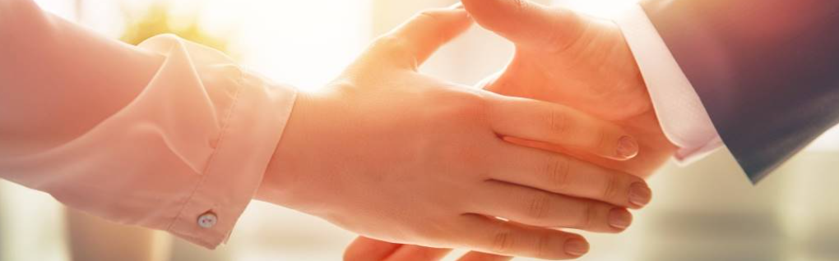
Welcome to our services
New Lebanon Church of Christ
We are Simply Christians.
Our Emphasis is Spiritual, Not Material or Social.
We are striving to be The Same Church as Described in The New Testament.
Please Come Back Again

Slide 2
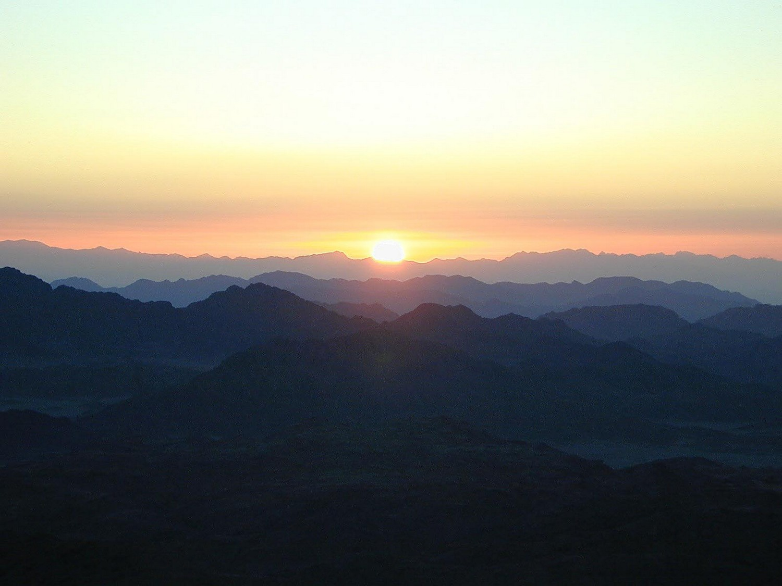
Every good gift and every perfect gift is from above, coming down from the Father of lights. James 1:17
The letter of James
Lesson one
James and Jesus
Notes:
In his Gospel, John also connects light with God and His act of creation. “In the beginning was the Word, and the Word was with God, and the Word was God. He was with God in the beginning. Through him all things were made; without him nothing was made that has been made. In him was life, and that life was the light of all mankind. The light shines in the darkness, and the darkness has not overcome it” (John 1:1-5, NIV). This photo was taken from Jebel Musa, the traditional Mount Sinai.
tb030400500

Slide 3
James and Jesus
1. There was a James who was the father of Judas (not Judas Iscariot) (Luke 6:16).
2. There was James, the brother of Jude (sometimes called Joses), the son of Alphaeus (Matthew 10:3).
3. James, son of Zebedee and Salome, brother of John and one of the apostles of the Lord (Matthew 4:21; Mark 1:19; Luke 5:10). In the year A.D. 44, he was put to death by Herod Agrippa I A.D.44 (Acts 12:1-2).
4. James, a half-brother in the flesh of Christ.
newlebanoncoc.com

Slide 4
James and Jesus
James, a half-brother in the flesh of Christ
Matt. 13:55 "Is this not the carpenter's son? Is not His mother called Mary? And His brothers James, Joses, Simon, and Judas?
Mark 6:3 "Is this not the carpenter, the Son of Mary, and brother of James, Joses, Judas, and Simon? And are not His sisters here with us?" And they were offended at Him.
Gal. 1:18 Then after three years I went up to Jerusalem to see Peter, and remained with him fifteen days. 19 But I saw none of the other apostles except James, the Lord's brother.
newlebanoncoc.com

Slide 5
Christ began the Sermon on the Mount with the special blessing of the poor, the meek and the mournful (Matt. 5:3–9)
James began with
“My brethren, count it all joy when you fall into various trials,” (James 1:2)
Notes:
In his Gospel, John also connects light with God and His act of creation. “In the beginning was the Word, and the Word was with God, and the Word was God. He was with God in the beginning. Through him all things were made; without him nothing was made that has been made. In him was life, and that life was the light of all mankind. The light shines in the darkness, and the darkness has not overcome it” (John 1:1-5, NIV). This photo was taken from Jebel Musa, the traditional Mount Sinai.
tb030400500

Slide 6
Christ made “perfection” the theme of the Sermon on the Mount.
"Therefore you shall be perfect, just as your Father in heaven is perfect. (Matt. 5:48)
same theme is in James: But let patience have its perfect work, that you may be perfect and complete, lacking nothing. (James 1:4); and (James 3:2). For we all stumble in many things. If anyone does not stumble in word, he is a perfect man, able also to bridle the whole body.
Notes:
In his Gospel, John also connects light with God and His act of creation. “In the beginning was the Word, and the Word was with God, and the Word was God. He was with God in the beginning. Through him all things were made; without him nothing was made that has been made. In him was life, and that life was the light of all mankind. The light shines in the darkness, and the darkness has not overcome it” (John 1:1-5, NIV). This photo was taken from Jebel Musa, the traditional Mount Sinai.
tb030400500

Slide 7
Christ said in (Luke 6:20); "Blessed are you poor, For yours is the kingdom of God.
James wrote: Listen, my beloved brethren: Has God not chosen the poor of this world to be rich in faith and heirs of the kingdom which He promised to those who love Him? (James 2:5).
Notes:
In his Gospel, John also connects light with God and His act of creation. “In the beginning was the Word, and the Word was with God, and the Word was God. He was with God in the beginning. Through him all things were made; without him nothing was made that has been made. In him was life, and that life was the light of all mankind. The light shines in the darkness, and the darkness has not overcome it” (John 1:1-5, NIV). This photo was taken from Jebel Musa, the traditional Mount Sinai.
tb030400500

Slide 8
Christ said, “Every one that asks will receive” (Matt. 7:8)
James wrote, If any of you lacks wisdom, let him ask of God, who gives to all liberally and without reproach, and it will be given to him. (James 1:5)
Notes:
In his Gospel, John also connects light with God and His act of creation. “In the beginning was the Word, and the Word was with God, and the Word was God. He was with God in the beginning. Through him all things were made; without him nothing was made that has been made. In him was life, and that life was the light of all mankind. The light shines in the darkness, and the darkness has not overcome it” (John 1:1-5, NIV). This photo was taken from Jebel Musa, the traditional Mount Sinai.
tb030400500

Slide 9
Christ said, "By your patience possess your souls. (Luke 21:19);
James admonished, James 1:4 But let patience have its perfect work, that you may be perfect and complete, lacking nothing.
James 5:7 Therefore be patient, brethren, until the coming of the Lord. See how the farmer waits for the precious fruit of the earth, waiting patiently for it until it receives the early and latter rain.
James 5:11 Indeed we count them blessed who endure. You have heard of the perseverance of Job and seen the end intended by the Lord--that the Lord is very compassionate and merciful.
Notes:
In his Gospel, John also connects light with God and His act of creation. “In the beginning was the Word, and the Word was with God, and the Word was God. He was with God in the beginning. Through him all things were made; without him nothing was made that has been made. In him was life, and that life was the light of all mankind. The light shines in the darkness, and the darkness has not overcome it” (John 1:1-5, NIV). This photo was taken from Jebel Musa, the traditional Mount Sinai.
tb030400500

Slide 10
Christ said, Matt. 21:21 "Assuredly, I say to you, if you have faith and do not doubt, you will not only do what was done to the fig tree, but also if you say to this mountain, 'Be removed and be cast into the sea,' it will be done. 22 "And whatever things you ask in prayer, believing, you will receive."
James stressed the same promise: James 1:6 But let him ask in faith, with no doubting, for he who doubts is like a wave of the sea driven and tossed by the wind. 7 For let not that man suppose that he will receive anything from the Lord; 8 he is a double-minded man, unstable in all his ways.
Notes:
In his Gospel, John also connects light with God and His act of creation. “In the beginning was the Word, and the Word was with God, and the Word was God. He was with God in the beginning. Through him all things were made; without him nothing was made that has been made. In him was life, and that life was the light of all mankind. The light shines in the darkness, and the darkness has not overcome it” (John 1:1-5, NIV). This photo was taken from Jebel Musa, the traditional Mount Sinai.
tb030400500

Slide 11
Christ said, "If you then, being evil, know how to give good gifts to your children, how much more will your Father who is in heaven give good things to those who ask Him! (Matt. 7:11).
James declared that “Every good gift and every perfect gift is from above, and comes down from the Father of lights, with whom there is no variation or shadow of turning.” (James 1:17)
Notes:
In his Gospel, John also connects light with God and His act of creation. “In the beginning was the Word, and the Word was with God, and the Word was God. He was with God in the beginning. Through him all things were made; without him nothing was made that has been made. In him was life, and that life was the light of all mankind. The light shines in the darkness, and the darkness has not overcome it” (John 1:1-5, NIV). This photo was taken from Jebel Musa, the traditional Mount Sinai.
tb030400500

Slide 12
Christ said (Matt. 6:20). but lay up for yourselves treasures in heaven, where neither moth nor rust destroys and where thieves do not break in and steal.
James also spoke of short-lived riches, “For no sooner has the sun risen with a burning heat than it withers the grass; its flower falls, and its beautiful appearance perishes. So the rich man also will fade away in his pursuits.” (James 1:11)
Notes:
In his Gospel, John also connects light with God and His act of creation. “In the beginning was the Word, and the Word was with God, and the Word was God. He was with God in the beginning. Through him all things were made; without him nothing was made that has been made. In him was life, and that life was the light of all mankind. The light shines in the darkness, and the darkness has not overcome it” (John 1:1-5, NIV). This photo was taken from Jebel Musa, the traditional Mount Sinai.
tb030400500

Slide 13
Christ said, Blessed are the meek, For they shall inherit the earth.
(Matt. 5:5).
James wrote, “ Therefore lay aside all filthiness and overflow of wickedness, and receive with meekness the implanted word, which is able to save your souls. (James 1:21)
Notes:
In his Gospel, John also connects light with God and His act of creation. “In the beginning was the Word, and the Word was with God, and the Word was God. He was with God in the beginning. Through him all things were made; without him nothing was made that has been made. In him was life, and that life was the light of all mankind. The light shines in the darkness, and the darkness has not overcome it” (John 1:1-5, NIV). This photo was taken from Jebel Musa, the traditional Mount Sinai.
tb030400500

Slide 14
Christ said, (Luke 6:46). But why do you call Me 'Lord, Lord,' and do not do the things which I say?
James said, “For if anyone is a hearer of the word and not a doer, he is like a man observing his natural face in a mirror; 24 for he observes himself, goes away, and immediately forgets what kind of man he was. 25 But he who looks into the perfect law of liberty and continues in it, and is not a forgetful hearer but a doer of the work, this one will be blessed in what he does. (James 1:23–25)
Notes:
In his Gospel, John also connects light with God and His act of creation. “In the beginning was the Word, and the Word was with God, and the Word was God. He was with God in the beginning. Through him all things were made; without him nothing was made that has been made. In him was life, and that life was the light of all mankind. The light shines in the darkness, and the darkness has not overcome it” (John 1:1-5, NIV). This photo was taken from Jebel Musa, the traditional Mount Sinai.
tb030400500

Slide 15
Christ said, "But if you do not forgive men their trespasses, neither will your Father forgive your trespasses. (Matt. 6:15).
James put the same principle in these words James 2:13. For judgment is without mercy to the one who has shown no mercy. Mercy triumphs over judgment.
Notes:
In his Gospel, John also connects light with God and His act of creation. “In the beginning was the Word, and the Word was with God, and the Word was God. He was with God in the beginning. Through him all things were made; without him nothing was made that has been made. In him was life, and that life was the light of all mankind. The light shines in the darkness, and the darkness has not overcome it” (John 1:1-5, NIV). This photo was taken from Jebel Musa, the traditional Mount Sinai.
tb030400500

Slide 16
Christ said, Luke 12:32 "Do not fear, little flock, for it is your Father's good pleasure to give you the kingdom.
33 "Sell what you have and give alms; provide yourselves money bags which do not grow old, a treasure in the heavens that does not fail, where no thief approaches nor moth destroys.34 "For where your treasure is, there your heart will be also.
James asked in James 2:15 If a brother or sister is naked and destitute of daily food,
16 and one of you says to them, "Depart in peace, be warmed and filled," but you do not give them the things which are needed for the body, what does it profit?
Notes:
In his Gospel, John also connects light with God and His act of creation. “In the beginning was the Word, and the Word was with God, and the Word was God. He was with God in the beginning. Through him all things were made; without him nothing was made that has been made. In him was life, and that life was the light of all mankind. The light shines in the darkness, and the darkness has not overcome it” (John 1:1-5, NIV). This photo was taken from Jebel Musa, the traditional Mount Sinai.
tb030400500

Slide 17
Christ asked, You will know them by their fruits. Do men gather grapes from thornbushes or figs from thistles? (Matt. 7:16).
James said Can a fig tree, my brethren, bear olives, or a grapevine bear figs? Thus no spring yields both salt water and fresh. (James 3:12).
Notes:
In his Gospel, John also connects light with God and His act of creation. “In the beginning was the Word, and the Word was with God, and the Word was God. He was with God in the beginning. Through him all things were made; without him nothing was made that has been made. In him was life, and that life was the light of all mankind. The light shines in the darkness, and the darkness has not overcome it” (John 1:1-5, NIV). This photo was taken from Jebel Musa, the traditional Mount Sinai.
tb030400500

Slide 18
Christ said, Blessed are the peacemakers, For they shall be called sons of God. (Matt. 5:9).
James also praised the peacemakers - Now the fruit of righteousness is sown in peace by those who make peace. (James 3:18).
Notes:
In his Gospel, John also connects light with God and His act of creation. “In the beginning was the Word, and the Word was with God, and the Word was God. He was with God in the beginning. Through him all things were made; without him nothing was made that has been made. In him was life, and that life was the light of all mankind. The light shines in the darkness, and the darkness has not overcome it” (John 1:1-5, NIV). This photo was taken from Jebel Musa, the traditional Mount Sinai.
tb030400500

Slide 19
Christ promised, Ask, and it will be given to you; seek, and you will find; knock, and it will be opened to you.8 "For everyone who asks receives, and he who seeks finds, and to him who knocks it will be opened. (Matt. 7:7, 8);
and James stated the same thing negatively, You lust and do not have. You murder and covet and cannot obtain. You fight and war. Yet you do not have because you do not ask. (James 4:2)
Notes:
In his Gospel, John also connects light with God and His act of creation. “In the beginning was the Word, and the Word was with God, and the Word was God. He was with God in the beginning. Through him all things were made; without him nothing was made that has been made. In him was life, and that life was the light of all mankind. The light shines in the darkness, and the darkness has not overcome it” (John 1:1-5, NIV). This photo was taken from Jebel Musa, the traditional Mount Sinai.
tb030400500

Slide 20
Christ said, And whoever exalts himself will be humbled, and he who humbles himself will be exalted. (Matt. 23:12).
James said, Humble yourselves in the sight of the Lord, and He will lift you up. (James 4:10)
Notes:
In his Gospel, John also connects light with God and His act of creation. “In the beginning was the Word, and the Word was with God, and the Word was God. He was with God in the beginning. Through him all things were made; without him nothing was made that has been made. In him was life, and that life was the light of all mankind. The light shines in the darkness, and the darkness has not overcome it” (John 1:1-5, NIV). This photo was taken from Jebel Musa, the traditional Mount Sinai.
tb030400500

Slide 21
Christ said, "Judge not, that you be not judged.” (Matt. 7:1).
James asked the question, There is one Lawgiver, who is able to save and to destroy. Who are you to judge another? (James 4:12)
Notes:
In his Gospel, John also connects light with God and His act of creation. “In the beginning was the Word, and the Word was with God, and the Word was God. He was with God in the beginning. Through him all things were made; without him nothing was made that has been made. In him was life, and that life was the light of all mankind. The light shines in the darkness, and the darkness has not overcome it” (John 1:1-5, NIV). This photo was taken from Jebel Musa, the traditional Mount Sinai.
tb030400500

Slide 22
Christ commanded, Therefore do not worry about tomorrow, for tomorrow will worry about its own things. Sufficient for the day is its own trouble. (Matt. 6:34).
James reprimanded those who were making plans for tomorrow, saying, whereas you do not know what will happen tomorrow. For what is your life? It is even a vapor that appears for a little time and then vanishes away. (James 4:14)
Notes:
In his Gospel, John also connects light with God and His act of creation. “In the beginning was the Word, and the Word was with God, and the Word was God. He was with God in the beginning. Through him all things were made; without him nothing was made that has been made. In him was life, and that life was the light of all mankind. The light shines in the darkness, and the darkness has not overcome it” (John 1:1-5, NIV). This photo was taken from Jebel Musa, the traditional Mount Sinai.
tb030400500

Slide 23
Christ admonished the rich, (Luke 6:24, 25). But woe to you who are rich, For you have received your consolation. 25 Woe to you who are full, For you shall hunger. Woe to you who laugh now, For you shall mourn and weep.
In exactly this line of thought, James wrote: Come now, you rich, weep and howl for your miseries that are coming upon you! (James 5:1).
Notes:
In his Gospel, John also connects light with God and His act of creation. “In the beginning was the Word, and the Word was with God, and the Word was God. He was with God in the beginning. Through him all things were made; without him nothing was made that has been made. In him was life, and that life was the light of all mankind. The light shines in the darkness, and the darkness has not overcome it” (John 1:1-5, NIV). This photo was taken from Jebel Musa, the traditional Mount Sinai.
tb030400500

Slide 24
Christ but lay up for yourselves treasures in heaven, where neither moth nor rust destroys and where thieves do not break in and steal. (Matt. 6:20).
James described what had happened to the rich who he mentioned: Your riches are corrupted, and your garments are moth-eaten. 3 Your gold and silver are corroded, and their corrosion will be a witness against you and will eat your flesh like fire. You have heaped up treasure in the last days. (James 5:2, 3)
Notes:
In his Gospel, John also connects light with God and His act of creation. “In the beginning was the Word, and the Word was with God, and the Word was God. He was with God in the beginning. Through him all things were made; without him nothing was made that has been made. In him was life, and that life was the light of all mankind. The light shines in the darkness, and the darkness has not overcome it” (John 1:1-5, NIV). This photo was taken from Jebel Musa, the traditional Mount Sinai.
tb030400500

Slide 25
Christ pointed out that pleasures are capable of choking out the word of God (Luke 8:14). "Now the ones that fell among thorns are those who, when they have heard, go out and are choked with cares, riches, and pleasures of life, and bring no fruit to maturity.
In James’ condemnation of the rich, he said, “ You have lived on the earth in pleasure and luxury; you have fattened your hearts as in a day of slaughter.
(James 5:5)
Notes:
In his Gospel, John also connects light with God and His act of creation. “In the beginning was the Word, and the Word was with God, and the Word was God. He was with God in the beginning. Through him all things were made; without him nothing was made that has been made. In him was life, and that life was the light of all mankind. The light shines in the darkness, and the darkness has not overcome it” (John 1:1-5, NIV). This photo was taken from Jebel Musa, the traditional Mount Sinai.
tb030400500

Slide 26
Christ said, But I say to you, do not swear at all: neither by heaven, for it is God's throne; (Matt. 5:34).
James wrote, But above all, my brethren, do not swear, either by heaven or by earth or with any other oath. But let your "Yes," be "Yes," and your "No," "No," lest you fall into judgment. (James 5:12).
Notes:
In his Gospel, John also connects light with God and His act of creation. “In the beginning was the Word, and the Word was with God, and the Word was God. He was with God in the beginning. Through him all things were made; without him nothing was made that has been made. In him was life, and that life was the light of all mankind. The light shines in the darkness, and the darkness has not overcome it” (John 1:1-5, NIV). This photo was taken from Jebel Musa, the traditional Mount Sinai.
tb030400500

Slide 27
Questions?
Want to learn more about the Bible?
We will be glad to study the Bible with you.
New Lebanon
New Lebanon
Church of Christ
Church of Christ
New Lebanon, OH
newlebanoncoc.com
newlebanoncoc@gmail.com

