Slide 1
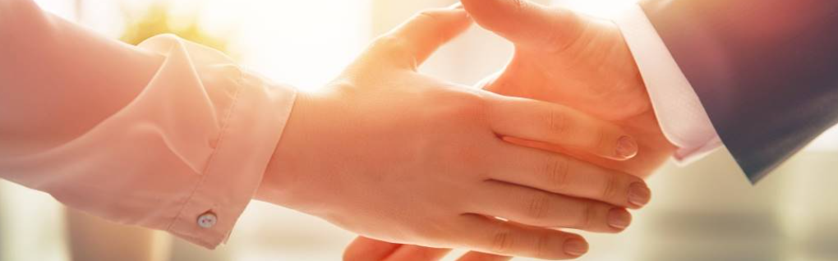
Welcome to our services
New Lebanon Church of Christ
We are Simply Christians.
Our Emphasis is Spiritual, Not Material or Social.
We are striving to be The Same Church as Described in The New Testament.
Please Come Back Again

Slide 2
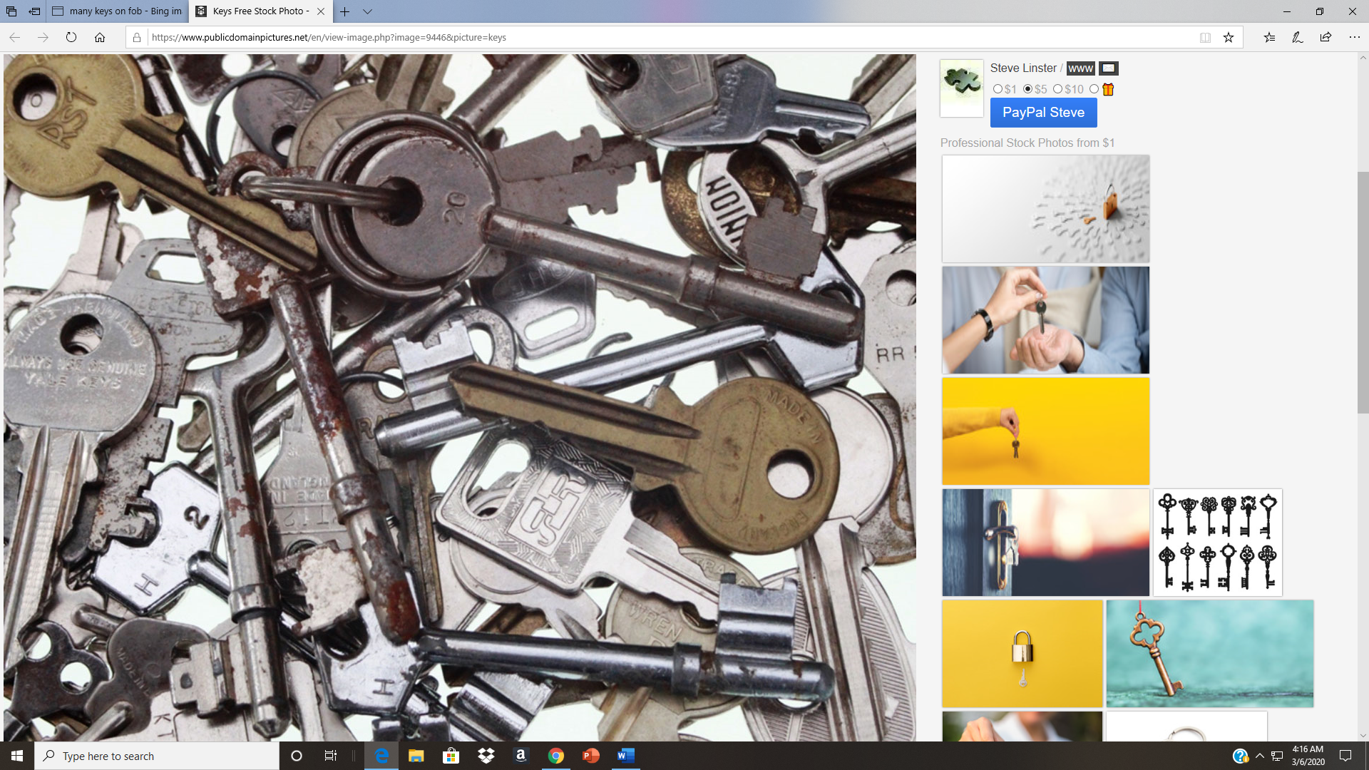
Acts
Chapter 2.
One of
the keys
to understanding
the Bible.

Slide 3
1. The establishment of the Church.
2. The descent of the Holy Spirit, and the gospel that came with it.
3. The beginning of the reign of Christ on David's spiritual throne, the only throne he will occupy.
4. The first complete divine answer to the question, "What must I do to be saved?"

Slide 4
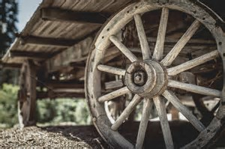
Psalm 2:1-12
Daniel 2:31-35
Isaiah 2:1-4
Acts 2. Hub of the Bible
Joel 2:28-32
Col. 1:13

Slide 5
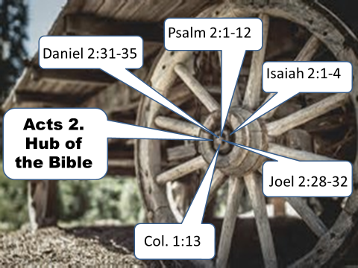
(Daniel 2:31-35) "You, O king, were watching; and behold, a great image! This great image, whose splendor was excellent, stood before you; and its form was awesome. 32 "This image's head was of fine gold, its chest and arms of silver, its belly and thighs of bronze,
33 "its legs of iron, its feet partly of iron and partly of clay. 34 "You watched while a stone was cut out without hands, which struck the image on its feet of iron and clay, and broke them in pieces.
35 "Then the iron, the clay, the bronze, the silver, and the gold were crushed together, and became like chaff from the summer threshing floors; the wind carried them away so that no trace of them was found. And the stone that struck the image became a great mountain and filled the whole earth.

Slide 6
Psalm 2:1-12 Why do the nations rage, And the people plot a vain thing? 2 The kings of the earth set themselves, And the rulers take counsel together, Against the LORD and against His Anointed, saying, 3 "Let us break Their bonds in pieces And cast away Their cords from us."
4 He who sits in the heavens shall laugh; The Lord shall hold them in derision.5 Then He shall speak to them in His wrath, And distress them in His deep displeasure: 6 "Yet I have set My King On My holy hill of Zion."
7 "I will declare the decree: The LORD has said to Me, 'You are My Son, Today I have begotten You. 8 Ask of Me, and I will give You The nations for Your inheritance, And the ends of the earth for Your possession.9 You shall break them with a rod of iron; You shall dash them to pieces like a potter's vessel.'"
10 Now therefore, be wise, O kings; Be instructed, you judges of the earth.11 Serve the LORD with fear, And rejoice with trembling. 12 Kiss the Son, lest He be angry, And you perish in the way, When His wrath is kindled but a little. Blessed are all those who put their trust in Him.

Slide 7
Isaiah 2:1-4 The word that Isaiah the son of Amoz saw concerning Judah and Jerusalem. 2 Now it shall come to pass in the latter days That the mountain of the LORD'S house Shall be established on the top of the mountains, And shall be exalted above the hills; And all nations shall flow to it.
3 Many people shall come and say, "Come, and let us go up to the mountain of the LORD, To the house of the God of Jacob; He will teach us His ways, And we shall walk in His paths." For out of Zion shall go forth the law, And the word of the LORD from Jerusalem. 4 He shall judge between the nations, And rebuke many people; They shall beat their swords into plowshares, And their spears into pruning hooks; Nation shall not lift up sword against nation, Neither shall they learn war anymore.

Slide 8
Joel 2:28-32 "And it shall come to pass afterward That I will pour out My Spirit on all flesh; Your sons and your daughters shall prophesy, Your old men shall dream dreams, Your young men shall see visions.
29 And also on My menservants and on My maidservants I will pour out My Spirit in those days.30 "And I will show wonders in the heavens and in the earth: Blood and fire and pillars of smoke.
31 The sun shall be turned into darkness, And the moon into blood, Before the coming of the great and awesome day of the LORD. 32 And it shall come to pass That whoever calls on the name of the LORD Shall be saved. For in Mount Zion and in Jerusalem there shall be deliverance, As the LORD has said, Among the remnant whom the LORD calls.

Slide 9
Col. 1:13 He has delivered us from the power of darkness and
conveyed us into
the kingdom of the Son of His love,

Slide 10
Daniel 2:44 "And in the days of these kings the God of heaven will set up
a kingdom which shall never be destroyed; and the kingdom shall not be left to other people; it shall break in pieces and consume all these kingdoms, and it shall stand forever.
Mark 9:1 And He said to them, "Assuredly, I say to you that there are
some standing here who will not taste death till they see the kingdom of God present with power."

Slide 11
Matt. 16:16 Simon Peter answered and said, "You are the Christ, the Son of the living God." 17 Jesus answered and said to him, "Blessed are you, Simon Bar-Jonah, for flesh and blood has not revealed this to you, but My Father who is in heaven.
18 "And I also say to you that you are Peter, and on this rock I will build My church, and the gates of Hades shall not prevail against it.
19 "And I will give you the keys of the kingdom of heaven, and whatever you bind on earth will be bound in heaven, and whatever you loose on earth will be loosed in heaven."

Slide 12

Acts 1:8 "But you shall receive power when the Holy Spirit has come upon you;
and you shall be witnesses to Me in Jerusalem, and in all Judea and Samaria, and to the end of the earth."

Slide 13

The KINGDOM would come with POWER.
The POWER would come when the HOLY SPIRIT came.
Therefore, the KINGDOM came when the HOLY SPIRIT came.
HOW WE KNOW WHEN
THE KINGDOM CAME
Mark 9:1
“And he said unto them, Verily I say unto you, That there be some of them that stand here, which shall not taste of death, till they have seen the kingdom of God come with power. “
Mark 9:1
“And he said unto them, Verily I say unto you, That there be some of them that stand here, which shall not taste of death, till they have seen the kingdom of God come with power. “
Acts 1:8
“But ye shall receive power, after that the Holy Ghost is come upon you: and ye shall be witnesses unto me both in Jerusalem, and in all Judaea, and in Samaria, and unto the uttermost part of the earth.”
Acts 2:1-4
“¹And when the day of Pentecost was fully come, they were all with one accord in one place. ² And suddenly there came a sound from heaven as of a rushing mighty wind, and it filled all the house where they were sitting. ³ And there appeared unto them cloven tongues like as of fire, and it sat upon each of them. ⁴And they were all filled with the Holy Ghost, and began to speak with other tongues, as the Spirit gave them utterance.”

Slide 14
The KINGDOM would come with POWER.
The POWER would come when the HOLY SPIRIT came.
Therefore, the KINGDOM came when the HOLY SPIRIT came.
HOW WE KNOW WHEN
THE KINGDOM CAME
Acts 1:8
“But ye shall receive power, after that the Holy Ghost is come upon you: and ye shall be witnesses unto me both in Jerusalem, and in all Judaea, and in Samaria, and unto the uttermost part of the earth.”
Mark 9:1
“And he said unto them, Verily I say unto you, That there be some of them that stand here, which shall not taste of death, till they have seen the kingdom of God come with power. “
Acts 1:8
“But ye shall receive power, after that the Holy Ghost is come upon you: and ye shall be witnesses unto me both in Jerusalem, and in all Judaea, and in Samaria, and unto the uttermost part of the earth.”
Acts 2:1-4
“¹And when the day of Pentecost was fully come, they were all with one accord in one place. ² And suddenly there came a sound from heaven as of a rushing mighty wind, and it filled all the house where they were sitting. ³ And there appeared unto them cloven tongues like as of fire, and it sat upon each of them. ⁴And they were all filled with the Holy Ghost, and began to speak with other tongues, as the Spirit gave them utterance.”

Slide 15
The KINGDOM would come with POWER.
The POWER would come when the HOLY SPIRIT came.
Therefore, the KINGDOM came when the HOLY SPIRIT came.
Acts 2:1-4
“¹And when the day of Pentecost was fully come, they were all with one accord in one place. ²And suddenly there came a sound from heaven as of a rushing mighty wind, and it filled all the house where they were sitting. ³And there appeared unto them cloven tongues like as of fire, and it sat upon each of them. ⁴And they were all filled with the Holy Ghost, and began to speak with other tongues, as the Spirit gave them utterance.”
HOW WE KNOW WHEN
THE KINGDOM CAME
Mark 9:1
“And he said unto them, Verily I say unto you, That there be some of them that stand here, which shall not taste of death, till they have seen the kingdom of God come with power. “
Acts 1:8
“But ye shall receive power, after that the Holy Ghost is come upon you: and ye shall be witnesses unto me both in Jerusalem, and in all Judaea, and in Samaria, and unto the uttermost part of the earth.”
Acts 2:1-4
“¹And when the day of Pentecost was fully come, they were all with one accord in one place. ² And suddenly there came a sound from heaven as of a rushing mighty wind, and it filled all the house where they were sitting. ³ And there appeared unto them cloven tongues like as of fire, and it sat upon each of them. ⁴And they were all filled with the Holy Ghost, and began to speak with other tongues, as the Spirit gave them utterance.”

Slide 16
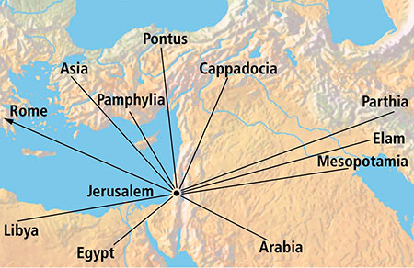
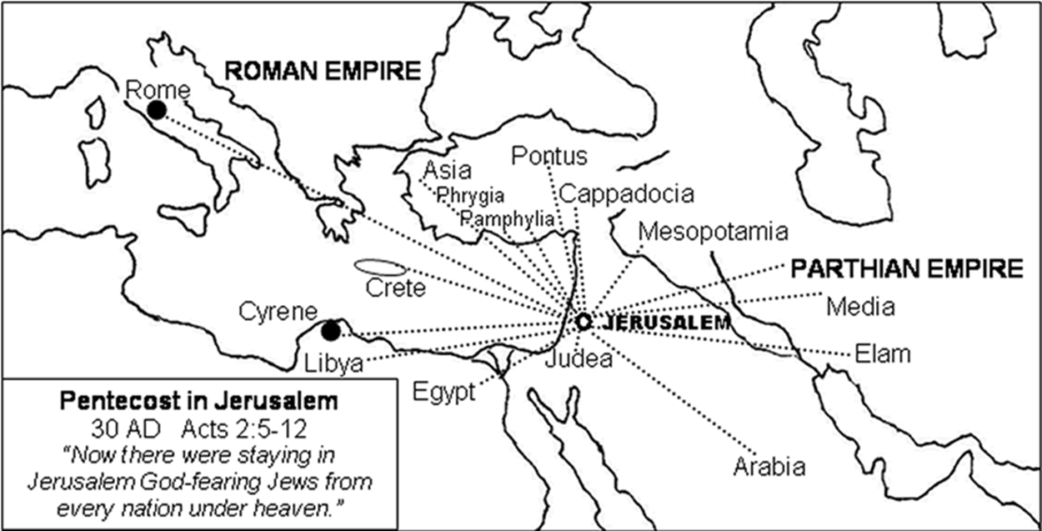
From every nation under heaven.

Slide 17
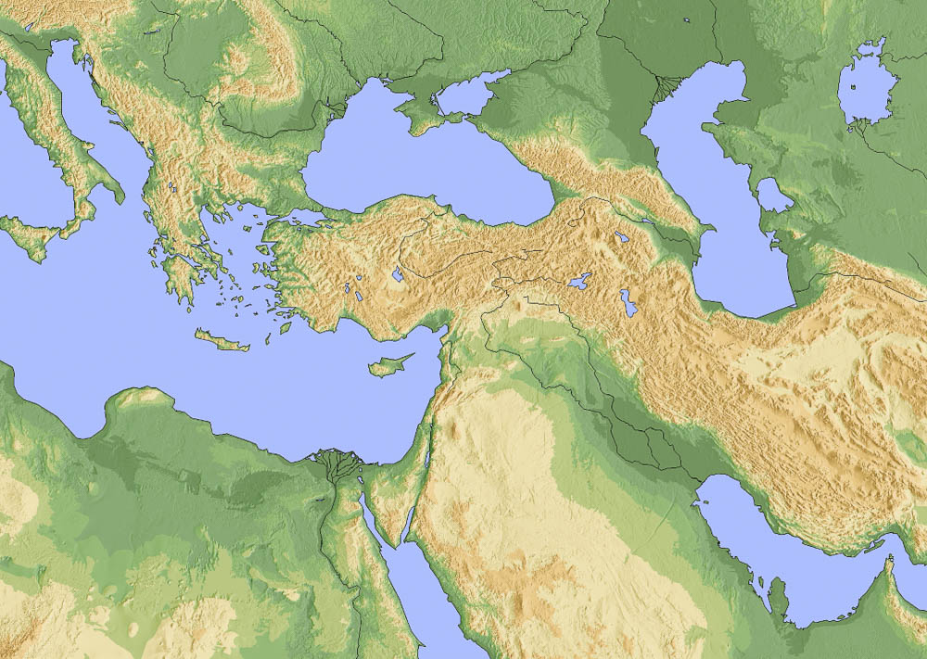
And how is it that we each hear them in our own native language? Parthians . . .
Rome
Pontus
Asia
Cappadocia
Phrygia
Pamphylia
Crete
Parthia
Media
Cyrene
Libya
Mesopotamia
Judea
Elam
Egypt
Arabia
Map of the regions mentioned in Acts 2:9-11
2:8-9
Notes:
This image was created with Generic Mapping Tools and is licensed under CC-BY-SA-3.0, via Wikimedia Commons: https://commons.wikimedia.org/wiki/File:Hellenistic_world_323BC_blank.jpg.
wiki030120061958

Slide 18
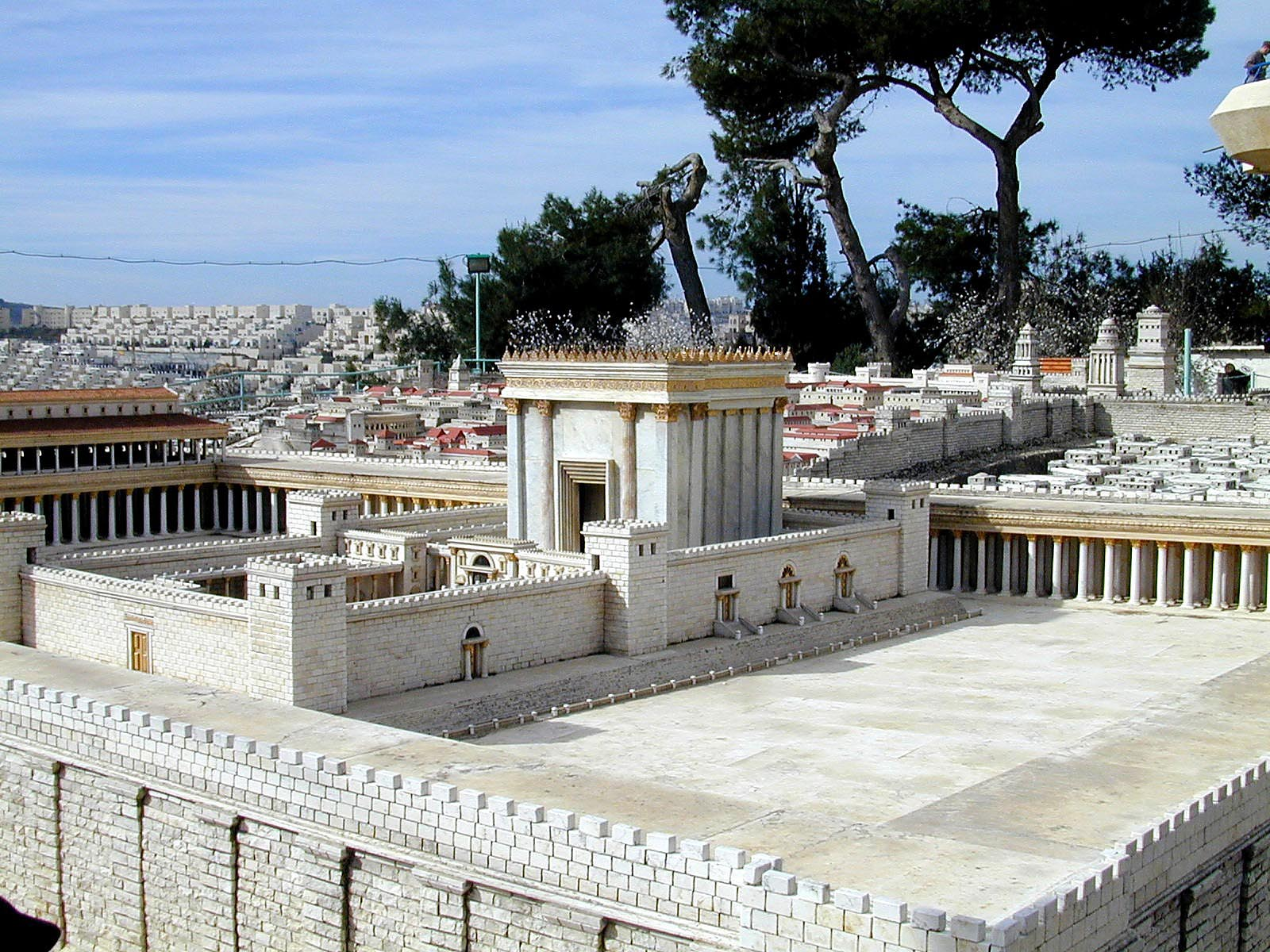
But Peter, standing up with the Eleven, lifted up his voice and declared to them:
Herod’s Temple on a model of 1st century AD Jerusalem (from the northeast)
2:14
Notes:
F. F. Bruce writes, “Whatever account may be given of the geography of verses 1-4, it is difficult to think of a more appropriate or probable setting for Peter’s address than the outer court of the temple” (Acts of the Apostles, rev. ed., NICNT [Grand Rapids: Eerdmans, 1988], 60). Some reasons for this:
Thousands of people were addressed, and the temple was the main public gathering place in Jerusalem (Acts 2:41).
The first church subsequently gathered in the temple to hear the apostles teach (Acts 2:46; 5:20-21).
The third hour (Acts 2:15) was a customary prayer hour, when many Jews would have gathered in the temple.
tb020101209

Slide 19
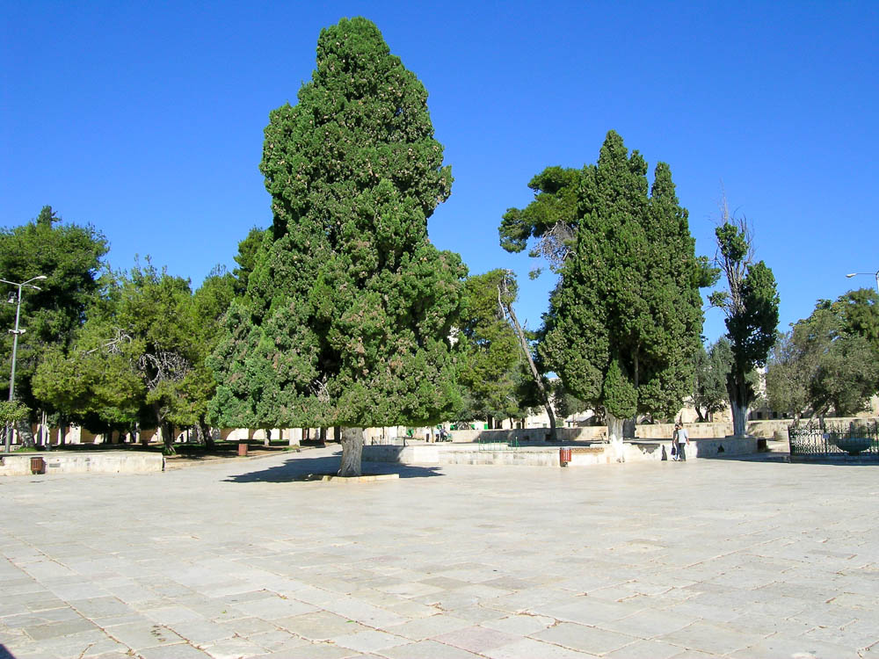
But Peter, standing up with the Eleven, lifted up his voice and declared to them:
Platform of the Temple Mount
2:14
Notes:
tb092103149

Slide 20
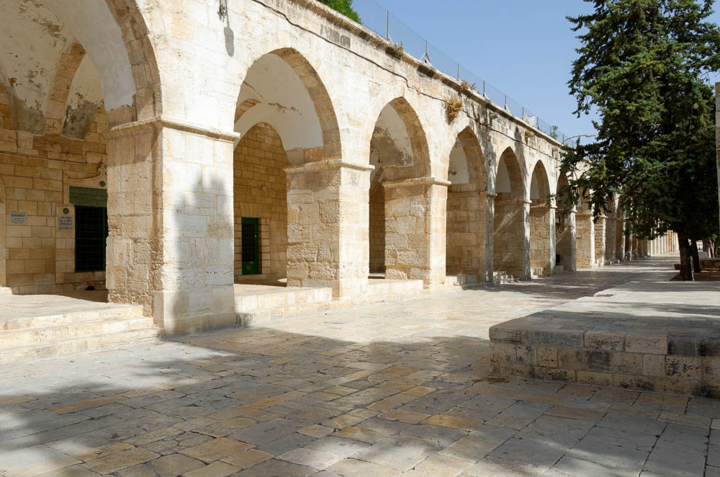
But Peter, standing up with the Eleven, lifted up his voice and declared to them:
Western portico of the Temple Mount
2:14
Notes:
tb060516800

Slide 21
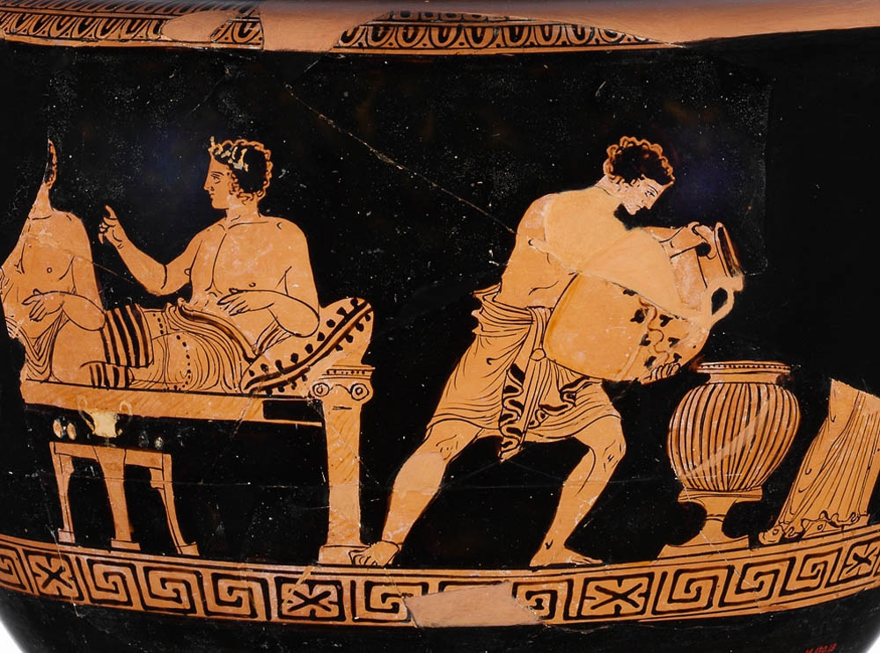
I will pour forth of My Spirit on all mankind
Terracotta dinos with male guests on couches and slave attending, circa 375–350 BC
2:17
Notes:
The verb “pour out” (Gk. ekcheō, ἐκχέω), when used literally means to emit something in quantity (cf. Luke 5:37; Acts 1:18). Here it is used metaphorically in the sense of causing someone to fully experience something (cf. Acts 10:45; Rom 5:5; Titus 3:6). The more literal sense is illustrated here by a scene that shows a servant mixing wine for the guests reclining on couches behind him, pouring a liquid from one jar into another. Interestingly, this scene was painted on a jar made for mixing wine, known as a dinos. This image comes from The Metropolitan Museum of Art, public domain, Rogers Fund, 1914, accession number 14.130.13, http://metmuseum.org/art/collection/search/248903.
met248903

Slide 22
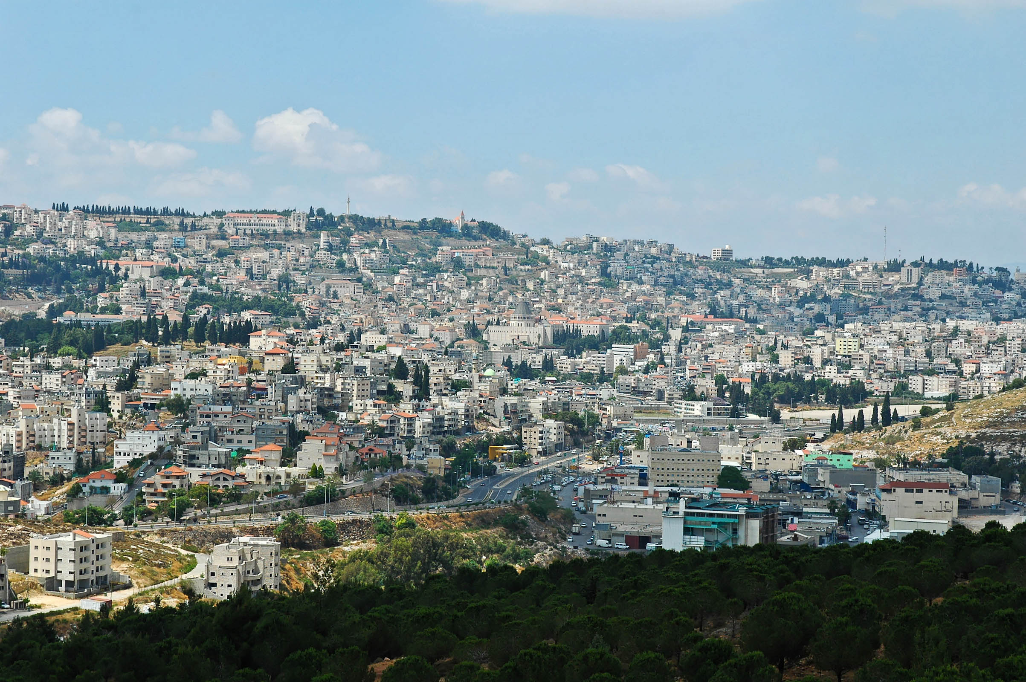
Men of Israel, hear these words: Jesus of Nazareth . . .
Nazareth (from the south)
2:22
Notes:
Nazareth today is much larger than it was 100 years ago. This photo looks the opposite direction than the previous photochrom image.
tb053005460

Slide 23
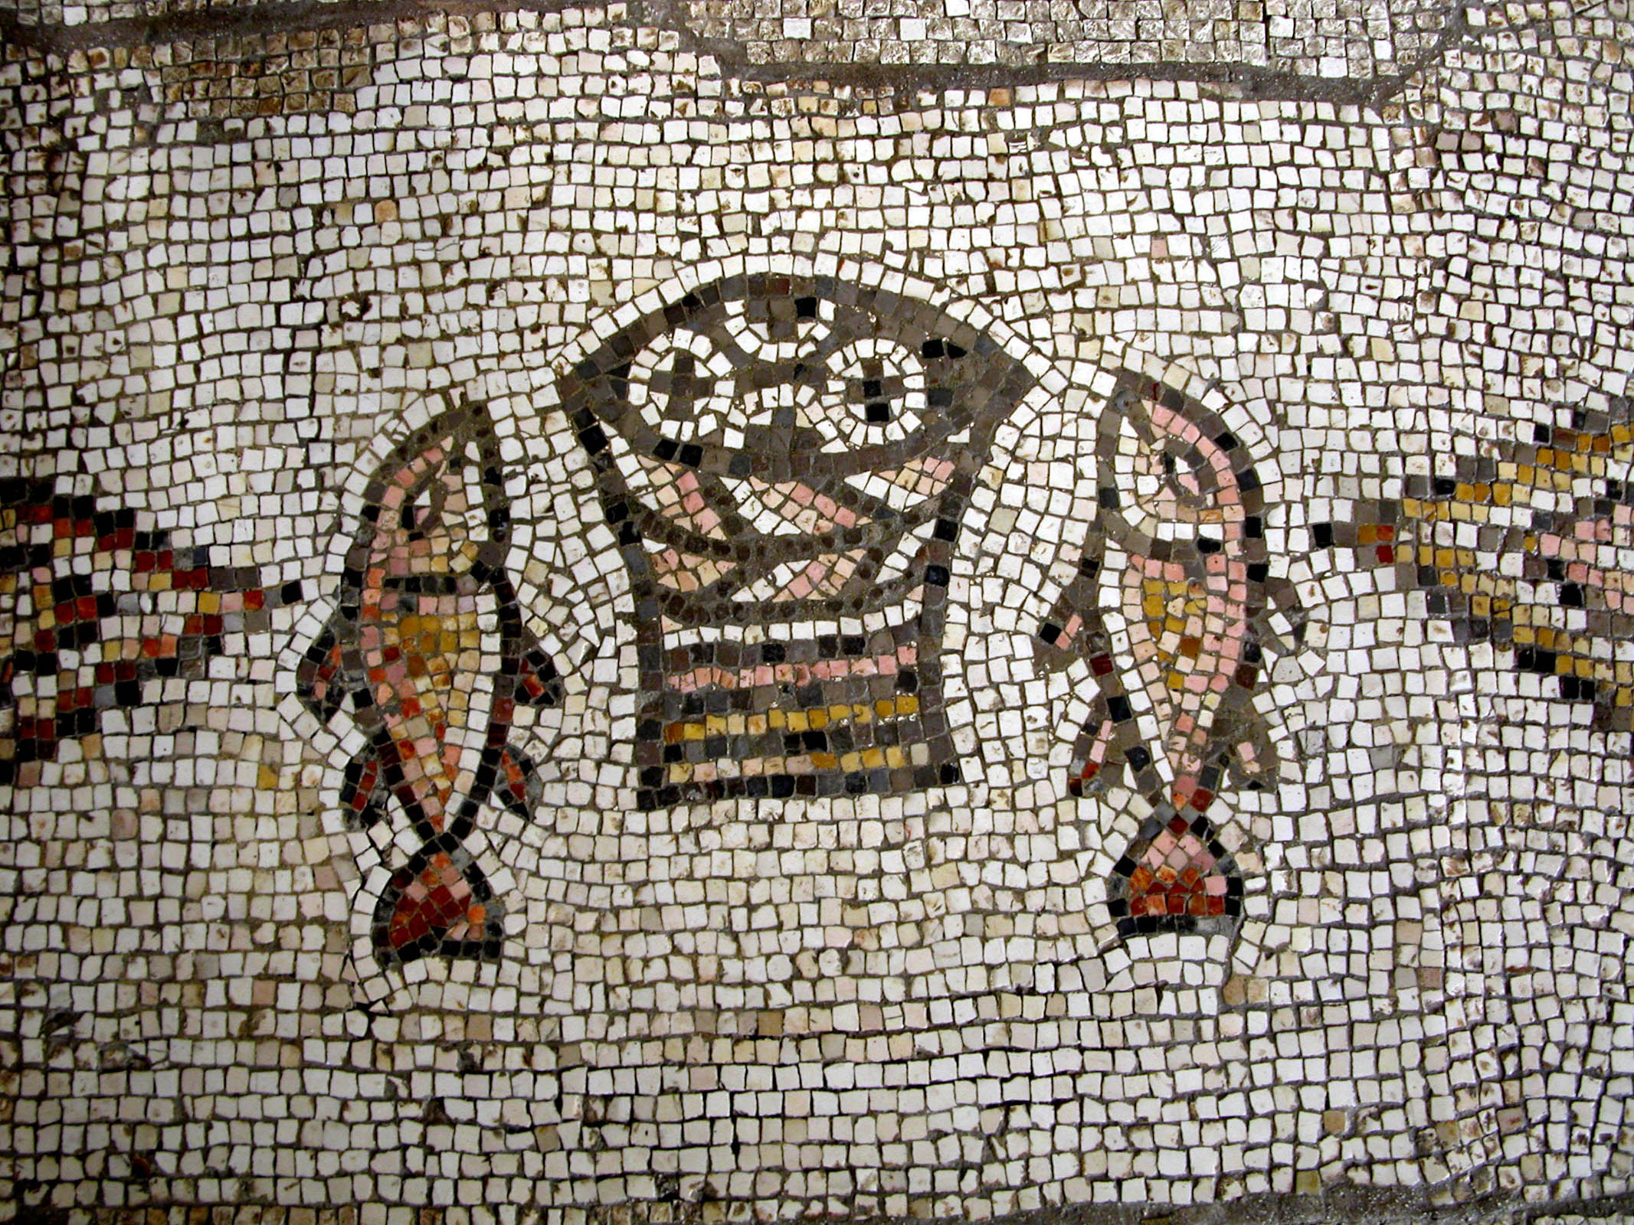
By mighty works and wonders and signs which God did by Him in your midst
Mosaic with fish and loaves from Tabgha
2:22
Notes:
This mosaic from a Byzantine church at Tabgha (ancient Heptapegon) recalls Jesus’s feeding of the 5,000 (Matt 14:13-21).
tb102702024

Slide 24
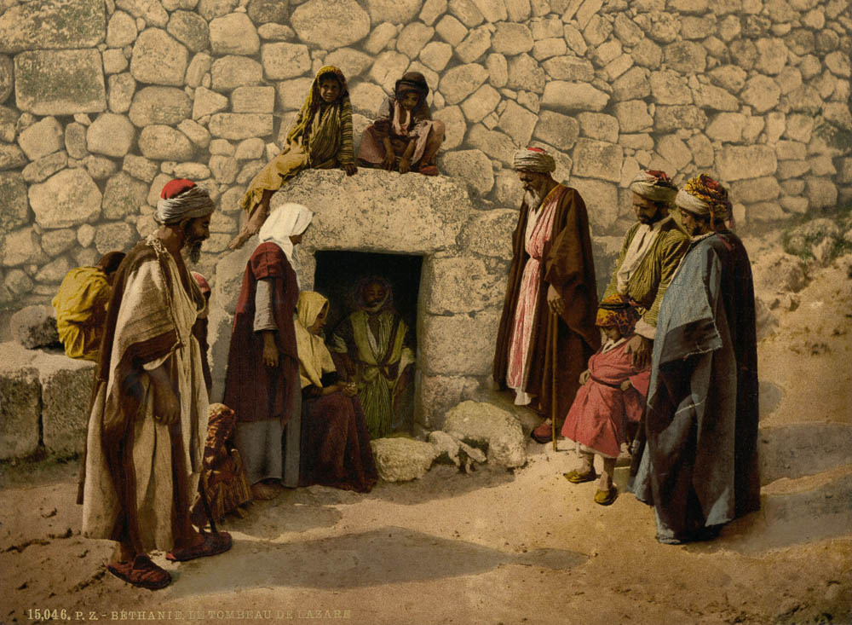
By mighty works and wonders and signs which God did by Him in your midst
Traditional tomb of Lazarus in Bethany
2:22
Notes:
One of Jesus’s most spectacular miracles, both in terms of its nature as well as its timing, was the raising of Lazarus from the dead shortly before His public presentation in the triumphal entry in Jerusalem. This photochrom image was taken in the 1890s.
pcm02655

Slide 25
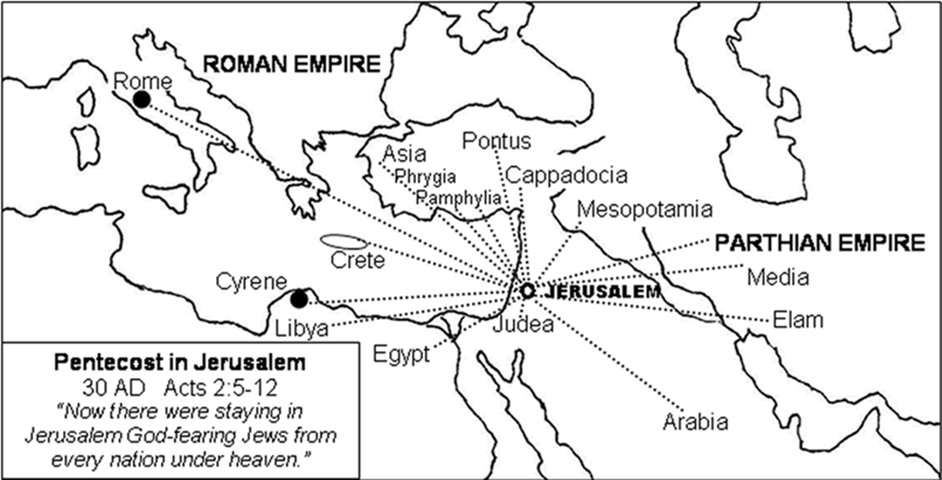
1. Jesus said “Go and make disciples of all nations.” Matt28:19
2. Men came from every nation under heaven to Jerusalem.
Acts 2:5-12
3. They were all scattered from Jerusalem, except the apostles.
Acts 8:1
4. Gospel was preached to every creature under heaven.
Col. 1:23

Slide 26
1. The establishment of the Church.
2. The descent of the Holy Spirit, and the gospel that came with it.
3. The beginning of the reign of Christ on David's spiritual throne, the only throne he will occupy.
4. The first complete divine answer to the question, "What must I do to be saved?"

Slide 27
Acts 2. A three point sermon.
The Sermon
1.Jesus is the messiah
2.You killed Him.
3.God raised Him up. (not stolen)
The Evidence:
1.David. (respected prophet and king)
2.We are witnesses. (Happened right here in Jerusalem)
3.The Holy Spirit (you both see and hear)
4.God made Jesus both Lord and Christ.
The Results
Those that gladly received the word were baptized.
Matt.27:50-53

Slide 28
Acts 4:12 "Nor is there salvation in any other, for there is no other name under heaven given among men by which we must be saved."
John 14:6 Jesus said to him, "I am the way, the truth, and the life. No one comes to the Father except through Me.
Rom. 6:3 Or do you not know that as many of us as were baptized into Christ Jesus were baptized into His death?
Matt. 26:28 "For this is My blood of the new covenant, which is shed for many for the remission of sins.
Eph. 5:23 For the husband is head of the wife, as also Christ is head of the church; and He is the Savior of the body.
John 3:5 Jesus answered, "Most assuredly, I say to you, unless one is born of water and the Spirit, he cannot enter the kingdom of God.
6 "That which is born of the flesh is flesh, and that which is born of the Spirit is spirit.
7 "Do not marvel that I said to you, 'You must be born again.'

Slide 29
CASE STUDIES OF CONVERSION
Acts | Preaching | Believed | Repented | Confessed | Baptized | Saved
2:22-41 | Pentecost |  | vv. 37-38 |  | vv. 38-41 | Remission Of Sins
8:12 | Samaritans | v. 12 |  |  | v. 12 | Believed
8:13 | Simon | v. 13 |  |  | v. 13
8:35-39 | Eunuch | vv. 36-37 |  | v. 37 | v. 38 | Rejoiced
9:17-18 | Saul |  |  |  | v. 18 | Sins Washed Away
10:34-48 | Cornelius | v. 43 |  |  | v. 48 | Remission Of Sins
16:13 | Lydia | v. 14 |  |  | v. 15
16:31-34 | The Jailer | v. 31 |  |  | v. 33 | Rejoiced
18:8 | Corinthians | v. 8 |  |  | v. 8
19:5 | Ephesians |  |  |  | v. 5
Baptized

Slide 30
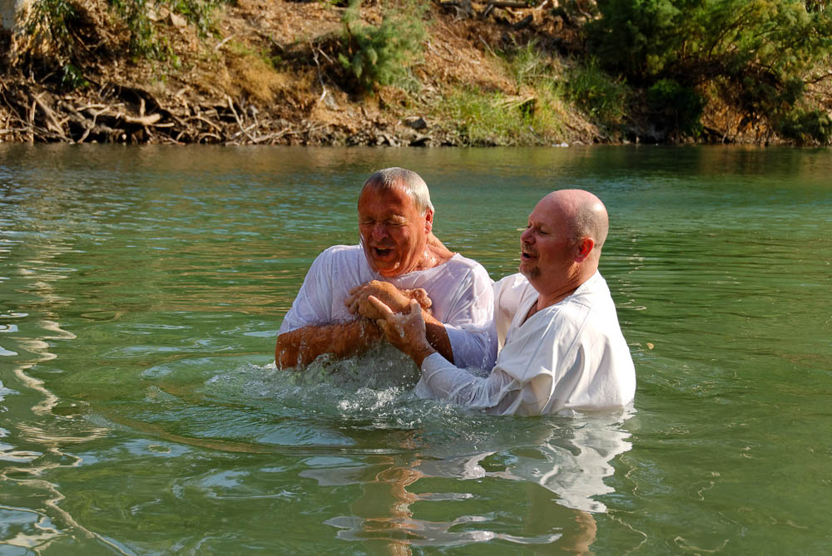
Then Peter said to them, “Repent and be baptized”
Baptism in the Jordan River at the Yardenit baptismal site
2:38
Notes:
Yardenit is a popular place for Christian pilgrims to be baptized in the Jordan River. It is located just south of the Sea of Galilee.
cd081002001

Slide 31
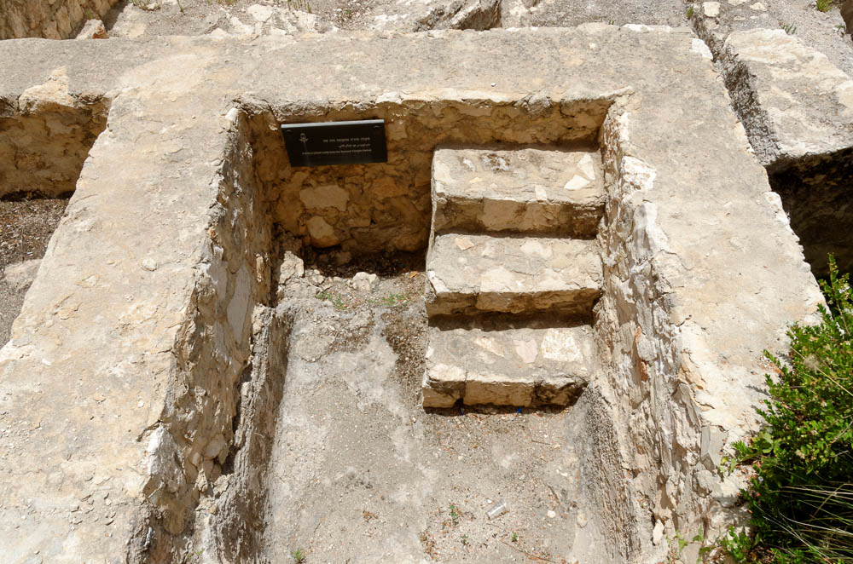
Then Peter said to them, “Repent and be baptized”
Mikveh to the south of the Temple Mount
2:38
Notes:
tb060516874

Slide 32
1. The establishment of the Church.
2. The descent of the Holy Spirit, and the gospel that came with it.
3. The beginning of the reign of Christ on David's spiritual throne, the only throne he will occupy.
4. The first complete divine answer to the question, "What must I do to be saved?"

