Slide 1
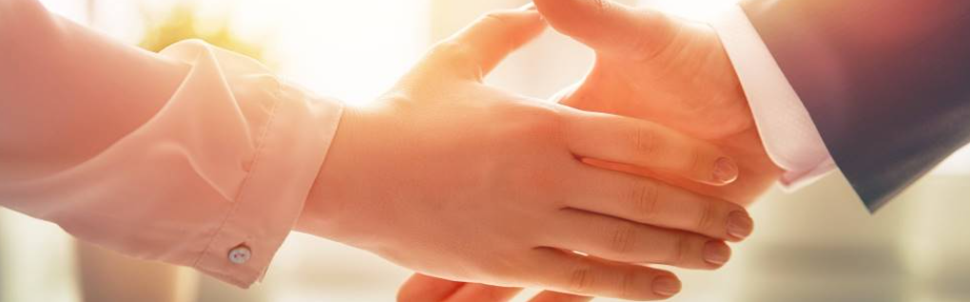
Welcome to our services
New Lebanon Church of Christ
We are Simply Christians.
Our Emphasis is Spiritual, Not Material or Social.
We are striving to be The Same Church as Described in The New Testament.
Please Come Back Again

Slide 2

Oh, give thanks to the LORD, for He is good! For His mercy endures forever.
1 Chronicles 16:34

Slide 3

A song Of Thanksgiving. 1Chronicles 16:7-36
1. What we Should Seek.
Seek the Lord
Seek His strength for service
Seek His face continually for fellowship
newlebanoncoc.com

Slide 4
A song Of Thanksgiving. 1Chronicles 16:7-36
2. What we should Sing.
Sing psalms to Him; Talk of all His wondrous works!
Proclaim the good news of His salvation from day to day.
newlebanoncoc.com

Slide 5
A song Of Thanksgiving. 1Chronicles 16:7-36
3. What we should Give.
Give thanks to the LORD!
Glory and strength.
Give to the LORD the glory due His name
newlebanoncoc.com

Slide 6
A song Of Thanksgiving. 1Chronicles 16:7-36
4. What we should Remember.
Remember His marvelous works
Remember the judgments of His mouth
Remember His faithfulness.
newlebanoncoc.com

Slide 7
A song Of Thanksgiving. 1Chronicles 16:7-36
5. What we should Speak.
Of all His wondrous works
Declare His glory among the nations
Speak of His glory among the heathen
newlebanoncoc.com

Slide 8
Questions?
Want to learn more about the Bible?
We will be glad to study the Bible with you.
New Lebanon
New Lebanon
Church of Christ
Church of Christ
New Lebanon, OH
newlebanoncoc.com
newlebanoncoc@gmail.com

Slide 9
A song Of Thanksgiving. 1Chronicles 16:7-36
newlebanoncoc.com

Slide 10
A song Of Thanksgiving. 1Chronicles 16:7-36
newlebanoncoc.com

