Slide 1

Welcome to our services
New Lebanon Church of Christ
We are Simply Christians.
Our Emphasis is Spiritual, Not Material or Social.
We are striving to be The Same Church as Described in The New Testament.
Please Come Back Again

Slide 2
True Heartfelt Religion 1 Peter 3
1 Peter 3:10–17 10 For "He who would love life And see good days, Let him refrain his tongue from evil, And his lips from speaking deceit.11 Let him turn away from evil and do good; Let him seek peace and pursue it. 12 For the eyes of the LORD are on the righteous, And His ears are open to their prayers; But the face of the LORD is against those who do evil."13 And who is he who will harm you if you become followers of what is good?
4 But even if you should suffer for righteousness' sake, you are blessed. "And do not be afraid of their threats, nor be troubled."15 But sanctify the Lord God in your hearts, and always be ready to give a defense to everyone who asks you a reason for the hope that is in you, with meekness and fear;
16 having a good conscience, that when they defame you as evildoers, those who revile your good conduct in Christ may be ashamed.17 For it is better, if it is the will of God, to suffer for doing good than for doing evil.

Slide 3
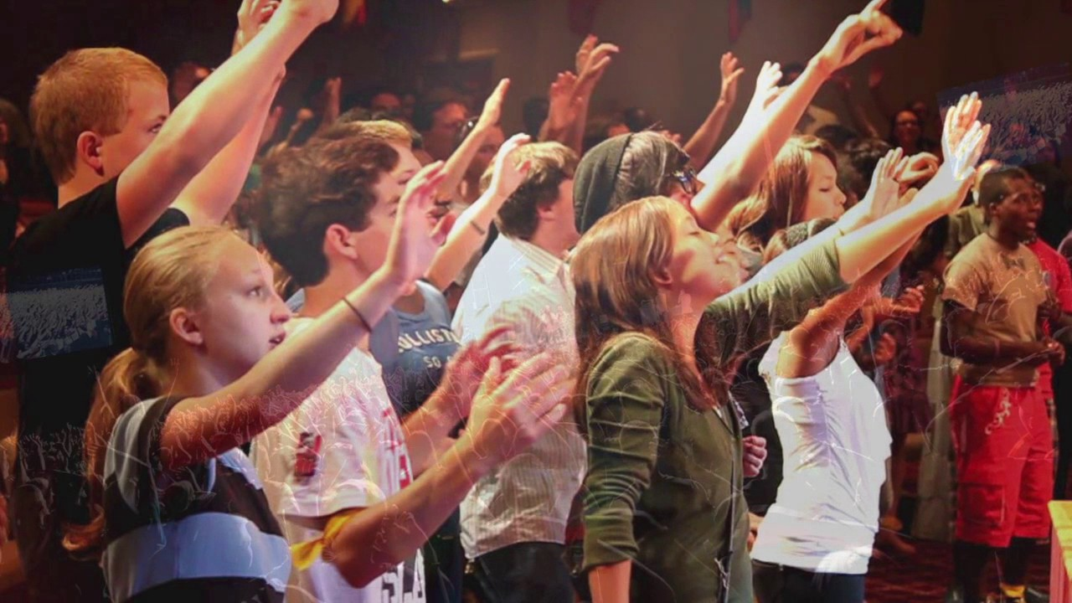

Slide 4
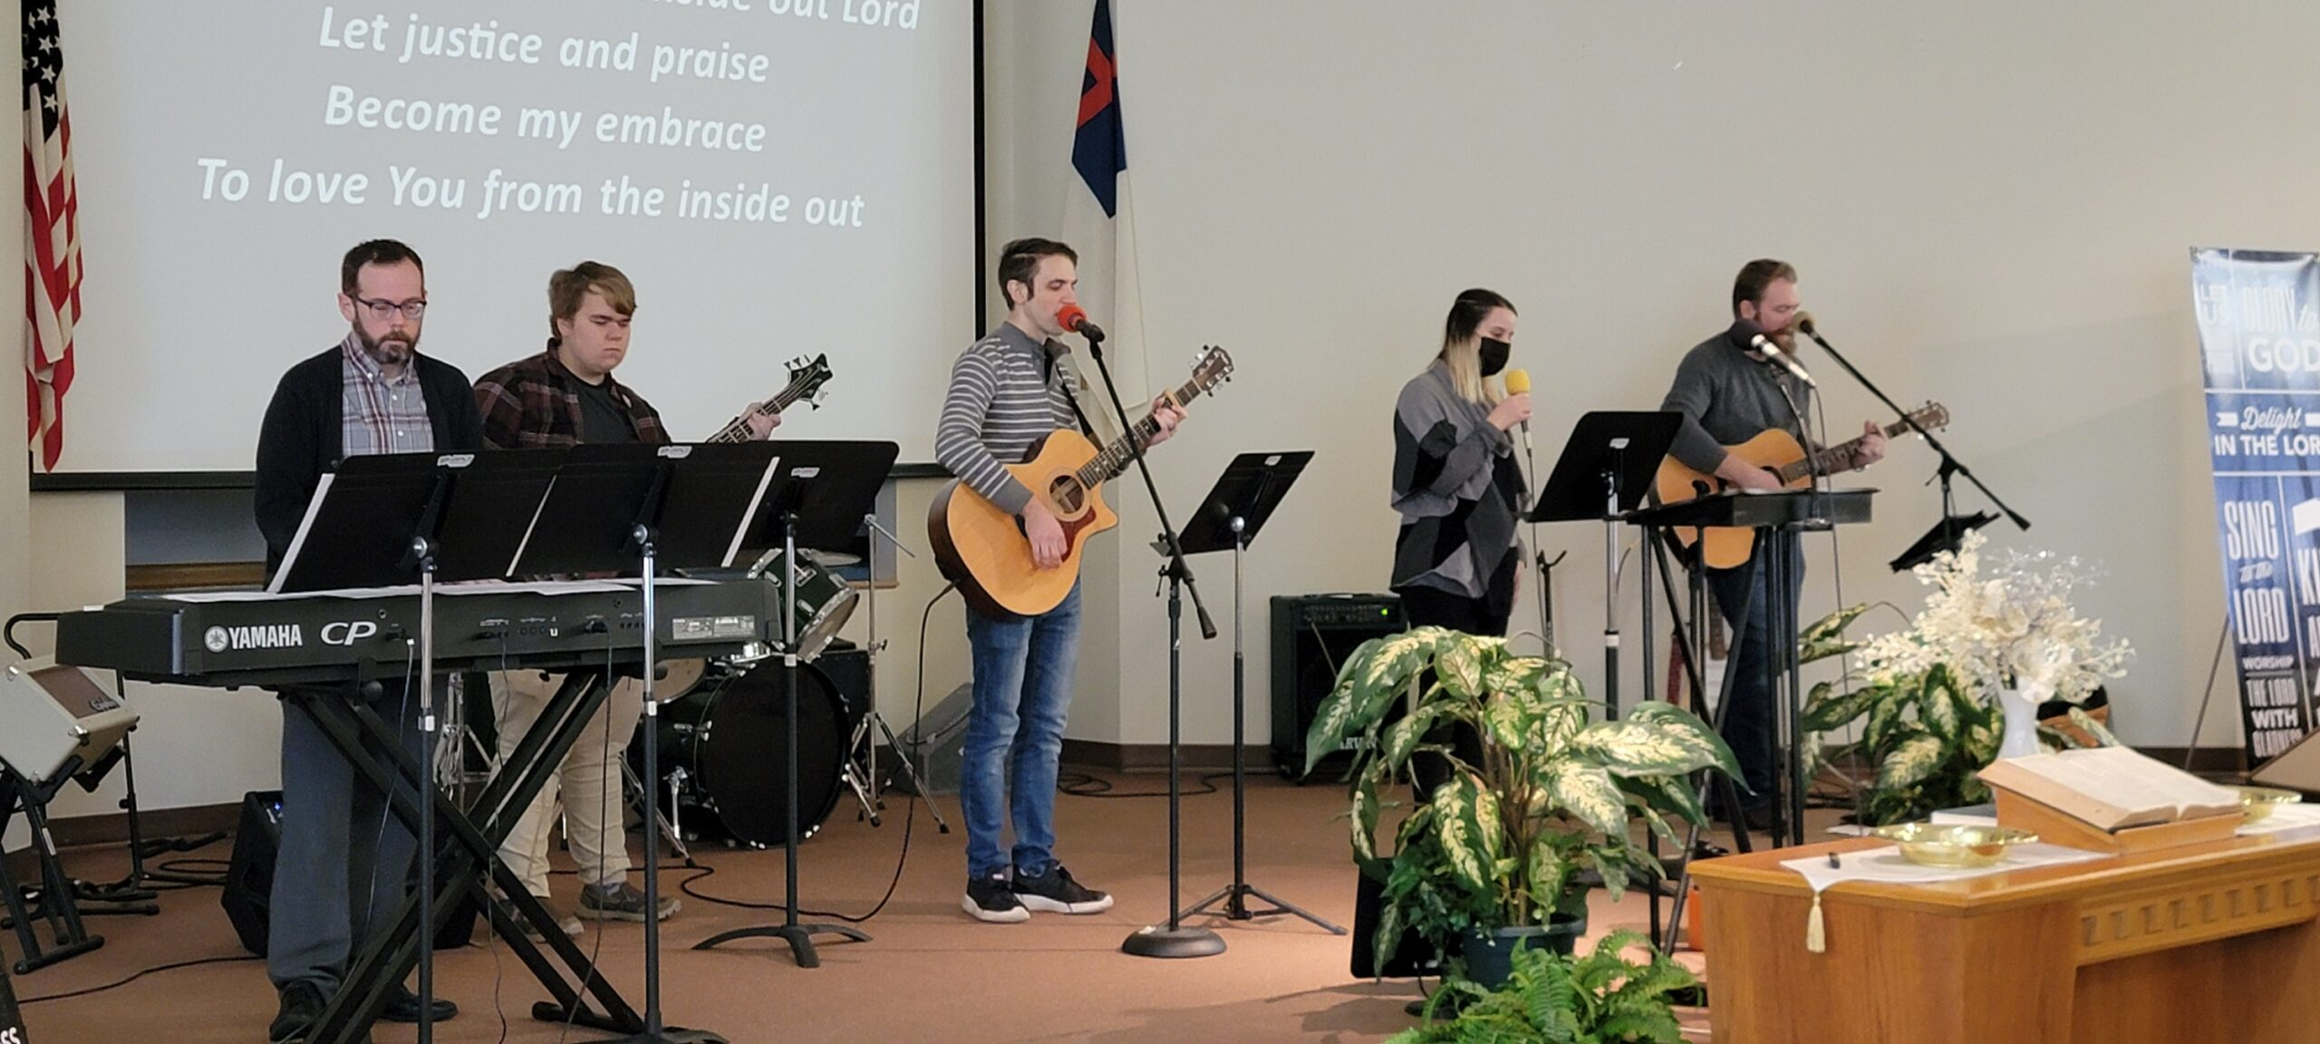
Praise Band - mygracebaptist.church

Slide 5
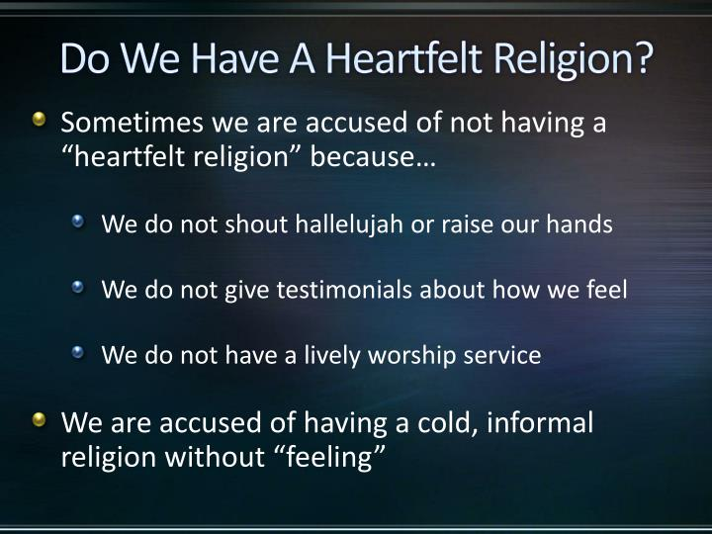

Slide 6
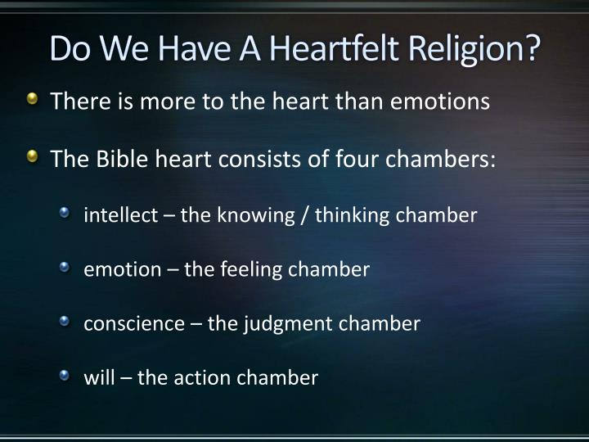

Slide 7
True Heartfelt Religion 1 Peter 3
True “Heartfelt” Religion is a religion of the heart…as described IN THE BIBLE
Note the emphasis here upon a heart religion. This is something that has to take place in the hearts of God’s people. “Reverence Christ as Lord in your own hearts”
“In your hearts consecrate Christ as Lord”
“But love the Lord Christ in your hearts”

Slide 8
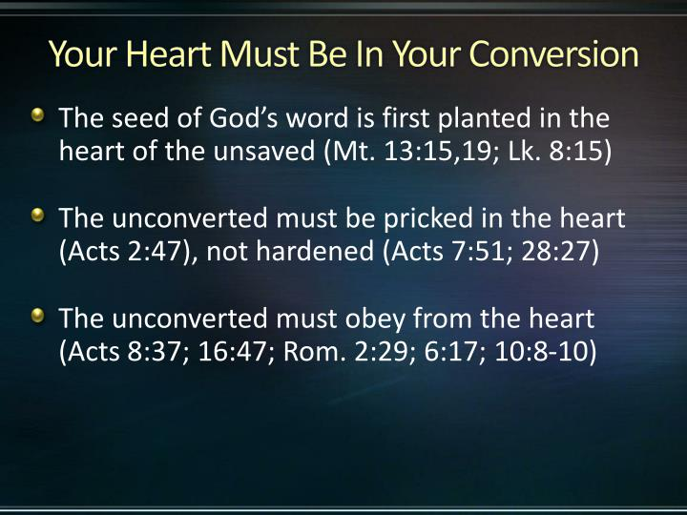

Slide 9
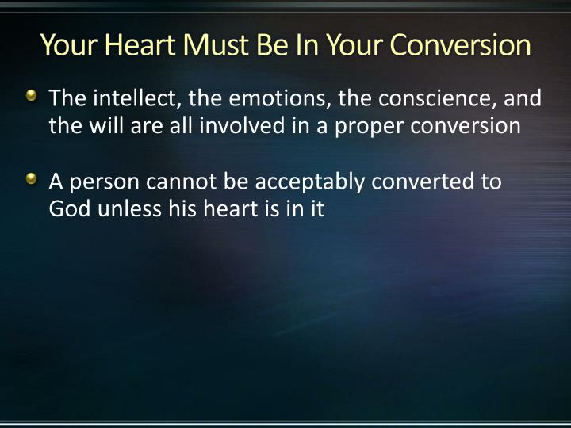

Slide 10
True Heartfelt Religion 1 Peter 3
Shrine - naos (ναός, 3485), “the innermost part of a temple, a shrine,” is used in the plural in Acts 19:24, of the silver models of the pagan “shrine” in which the image of Diana (Greek Artemis) was preserved.
The models were large or small, and were signs of wealth and devotion on the part of purchasers. The variety of forms connected with the embellishment of the image provided “no little business” for the silversmiths. See temple.

Slide 11
True Heartfelt Religion 1 Peter 3
Man is a Shrine. - The heart of a Christian man or woman is a shrine. It is a place of worship. There is a large congregation there, consisting of wishes, motives, ambitions, desires, likes, dislikes, passions, and wishes,. And Christ also is there.
God must be the one in command. He first comes as Guest, but ought to become supreme Master—Lord, in every sense of that word. This should be our deliberate act—place the God on the throne of our being, ask God to take command of the vessel. Ask God to take supreme command

Slide 12
True Heartfelt Religion 1 Peter 3
What it does it means to Sanctify Christ?
1. SET Him apart from the common and ordinary to special use.
To sanctify in the Bible means to “set apart,” and in consequence to view in a different light, ceasing to use or treat as formerly.
Sanctify B. Verb.
hagiazo (ἁγιάζω, 37), “to sanctify,” “is used of (a) the gold adorning the Temple and of the gift laid on the altar, Matt. 23:17, 19; (b) food, ……….

Slide 13
True Heartfelt Religion 1 Peter 3
What is the common use made of our Lord? A Fire Escape.
We first begin to think of Him as Savior from sin and the wrath to come. He is a Fire Escape.
He is much more. He should become everything to us. Thank God that He has saved you from Hell, but also find out what He has saved you to! If a believer, He is already in your heart as Christ. Now make Him your Lord, Master, Sovereign.

Slide 14
True Heartfelt Religion 1 Peter 3
2. Worship.
To sanctify the Christ in your heart as Lord means that you do set Him on the pedestal and pinnacle of your being, and that you bow down before Him with adoring love and wonder, and with reverence and submission, worshipping Him.

Slide 15
True Heartfelt Religion 1 Peter 3
3. Hallow.
Sanctify is the same word in the Lord’s Prayer rendered “hallowed be Thy Name.” We sanctify or hallow One who is holy already, when we recognize that holiness, and honor in speech, thought and act, what we recognize. It means to hallow Him by thought, word, and service

Slide 16
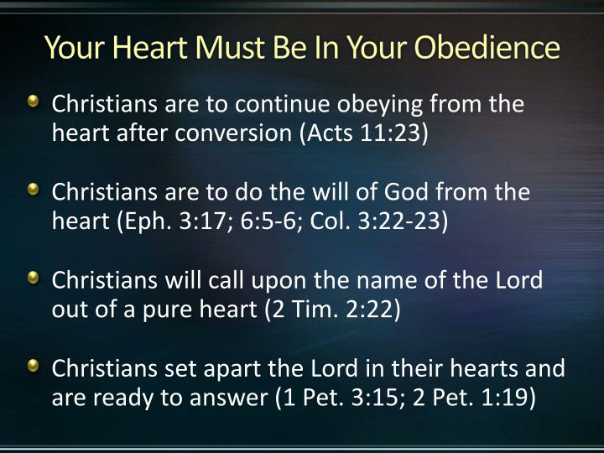

Slide 17
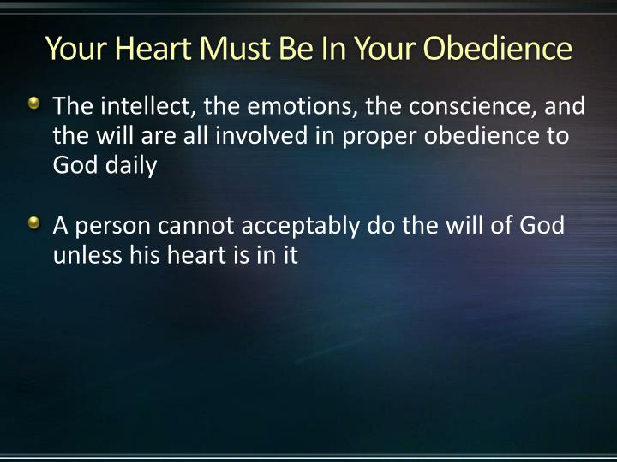

Slide 18
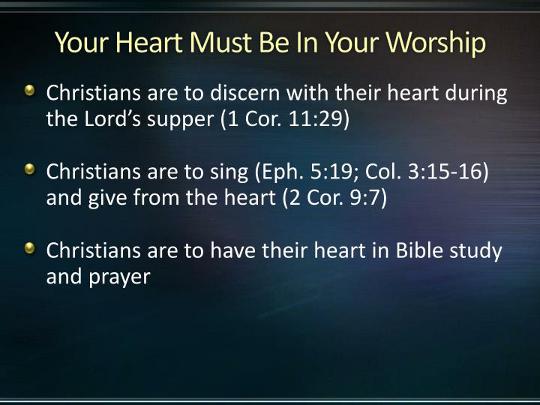

Slide 19
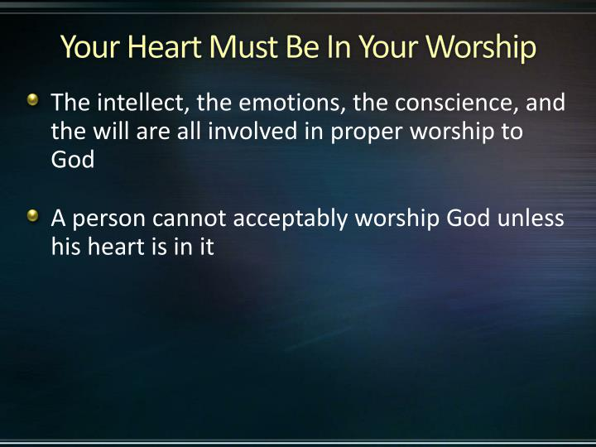

Slide 20
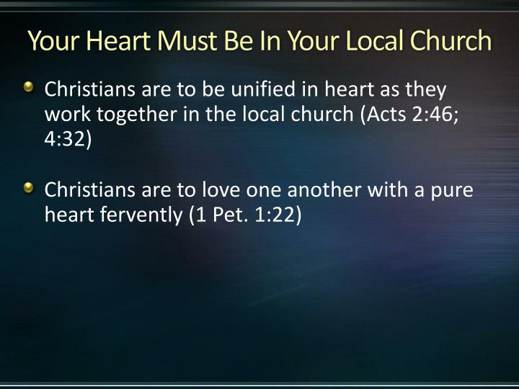

Slide 21
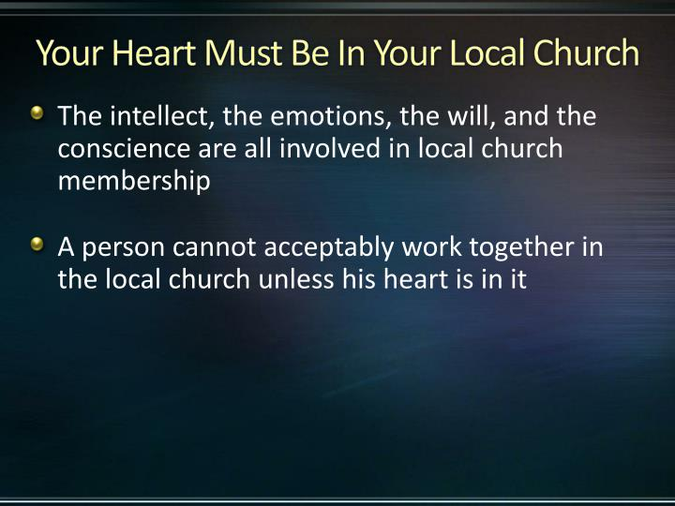

Slide 22
True Heartfelt Religion 1 Peter 3
What will be the result of such a heart?
1. Fearlessness and Calmness (14). “Be not afraid of their terror, neither be troubled.” When Christ is Master within our hearts, He calms and steadies, and gives us calmness and courage.
2. Mental Alertness (15). “And be ready” of the A.V. is in R.V. “Being ready,” that is to say, mental alertness follows the setting apart of Christ as Lord.

Slide 23
True Heartfelt Religion 1 Peter 3
What will be the result of such a heart?
3. Gentleness. (15) Being ready always to “answer gently and with reverence.”
Another wonderful and impressive result of sanctifying Christ as Lord.

Slide 24
True Heartfelt Religion 1 Peter 3
What will be the result of such an act on our part?
4. A Good Conscience (16). What a blessing. A conscience void of offence toward God and man.
5. Purity (16). Purity of heart and thought and life, so patent to our persecutors, “they may be ashamed that falsely accuse your good conversation (or life) in Christ.”

Slide 25
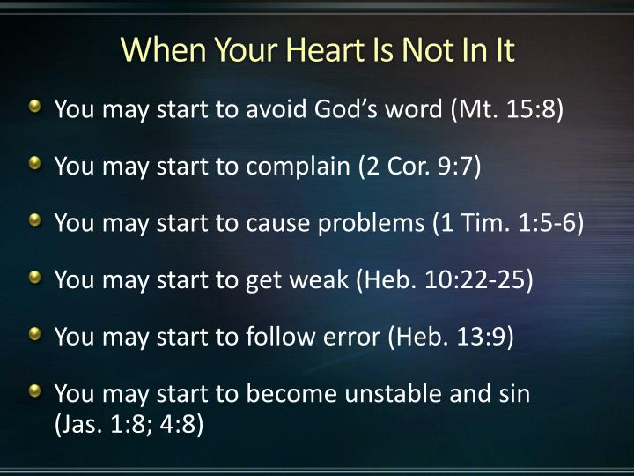

Slide 26
True Heartfelt Religion 1 Peter 3
To have a heartfelt religion, we must-
Have our heart in our conversion
Have our heart in our obedience
Have our heart in our worship
Have our heart in our local church

Slide 27
