Slide 1
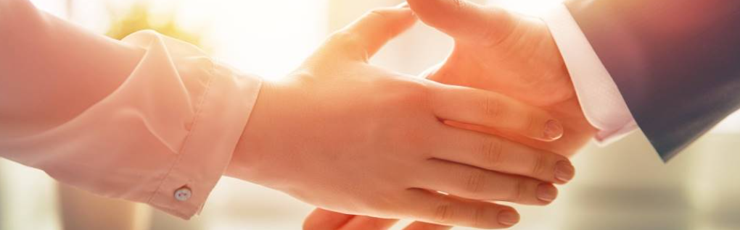
Welcome to our services
New Lebanon Church of Christ
We are Simply Christians.
Our Emphasis is Spiritual, Not Material or Social.
We are striving to be The Same Church as Described in The New Testament.
Please Come Back Again

Slide 2

Luke 16:22-25 So it was that the beggar died, and was carried by the angels to Abraham's bosom. The rich man also died and was buried. 23 And being in torments in Hades, he lifted up his eyes and saw Abraham afar off, and Lazarus in his bosom.
24 Then he cried and said, Father Abraham, have mercy on me, and send Lazarus that he may dip the tip of his finger in water and cool my tongue; for I am tormented in this flame. 25 But Abraham said, Son, remember that in your lifetime you received your good things, and likewise Lazarus evil things; but now he is comforted and you are tormented.

Slide 3

Some Things For Every Christian To Remember.
nobaproject.com

Slide 4
Some Things For Every Christian To Remember.
1.Remember: we may be our own worst enemies by opposing ourselves.
2Timothy 2:22-26 Flee also youthful lusts; but pursue righteousness, faith, love, peace with those who call on the Lord out of a pure heart. 23 But avoid foolish and ignorant disputes, knowing that they generate strife. 24 And a servant of the Lord must not quarrel but be gentle to all, able to teach, patient,
25 in humility correcting those who are in opposition, if God perhaps will grant them repentance, so that they may know the truth, 26 and that they may come to their senses and escape the snare of the devil, having been taken captive by him to do his will

Slide 5
Some Things For Every Christian To Remember.
2.Remember: We should change our minds if we are wrong.
Some people will never admit they are wrong about anything; however, to admit that we were wrong is to prove that we are wiser today than we were yesterday.
Acts 22:1-6
Acts 26:9-11

Slide 6
Some Things For Every Christian To Remember.
3.Remember: return good for evil.
Matt. 5:43-44 You have heard that it was said, You shall love your neighbor and hate your enemy. 44 But I say to you, love your enemies, bless those who curse you, do good to those who hate you, and pray for those who spitefully use you and persecute you,
Rom 12:20-21 Therefore If your enemy is hungry, feed him; If he is thirsty, give him a drink; For in so doing you will heap coals of fire on his head. 21 Do not be overcome by evil, but overcome evil with good.

Slide 7
Some Things For Every Christian To Remember.
4. Remember: do not blindly follow another.
Matt. 15:14 Let them alone. They are blind leaders of the blind. And if the blind leads the blind, both will fall into a ditch.
Matt. 7:13-14 Enter by the narrow gate; for wide is the gate and broad is the way that leads to destruction, and there are many who go in by it. 14 Because narrow is the gate and difficult is the way which leads to life, and there are few who find it.
1 Cor. 11:1

Slide 8
Some Things For Every Christian To Remember.
5. Remember: Satan is trying to get your soul.
He tempts (Matt. 4:1)
Satan lies (John 8:44)
Satan steals the word (Luke 8:12)
Satan persecutes (Rev. 2:10)
Satan fashions himself into an angel of light (2 Cor. 11:14,15)
Satan seeks to destroy (1 Pet. 5:8)

Slide 9
Some Things For Every Christian To Remember.
6. Remember: staying away from the services and fellowship of God's people will cause you to become cold.
Rev. 3:15-16 I know thy works, that thou art neither cold nor hot: I would thou wert cold or hot. 16 So then because thou art lukewarm, and neither cold nor hot, I will vomit you out of my mouth.

Slide 10
Some Things For Every Christian To Remember.
7. Remember: YOU must be joined to Christ.
Paul was joined to Christ.
Phil. 4:13 I can do all things through Christ which strengths me.
Phil. 1:21 For to me to live is Christ, and to die is gain.

Slide 11
Questions?
Want to learn more about the Bible?
We will be glad to study the Bible with you.
New Lebanon
New Lebanon
Church of Christ
Church of Christ
New Lebanon, OH
newlebanoncoc.com
newlebanoncoc@gmail.com

