Slide 1
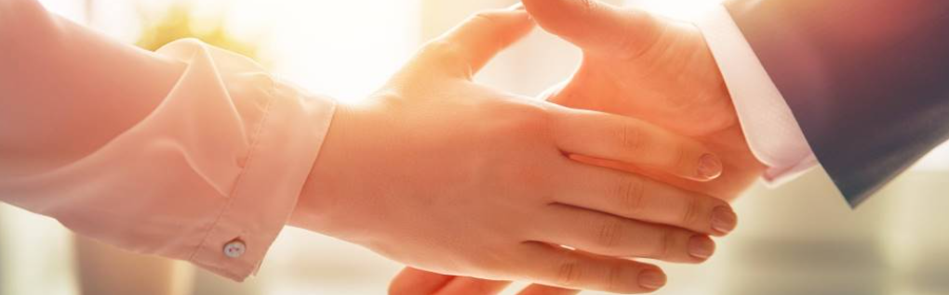
Welcome to our services
New Lebanon Church of Christ
We are Simply Christians.
Our Emphasis is Spiritual, Not Material or Social.
We are striving to be The Same Church as Described in The New Testament.
Please Come Back Again

Slide 2
Christ and the church He built.
So Great A Salvation. Hebrews 2:1-4
Hebrews 2:1-4 Therefore we must give the more earnest heed to the things we have heard, lest we drift away. 2 For if the word spoken through angels proved steadfast, and every transgression and disobedience received a just reward,
3 how shall we escape if we neglect so great a salvation, which at the first began to be spoken by the Lord, and was confirmed to us by those who heard Him, 4 God also bearing witness both with signs and wonders, with various miracles, and gifts of the Holy Spirit, according to His own will?
1

Slide 3
Questions?
Want to learn more about the Bible?
We will be glad to study the Bible with you.
New Lebanon
New Lebanon
Church of Christ
Church of Christ
New Lebanon, OH
newlebanoncoc.com
newlebanoncoc@gmail.com

Slide 4
So Great A Salvation. Hebrews 2:1-4
We must go back to Genesis to understand the story of Salvation.
Genesis
Creation
Fall of man – chapter 3. Sin enters the world.
Promise of a savior – chapter 3:14-15
We learn the importance of blood cover man’s sin.
Genesis 3:7 fig leaves could not cover sin
Genesis 3:21 tunics of skin (the shedding of blood)
Cain and Abel
3

Slide 5
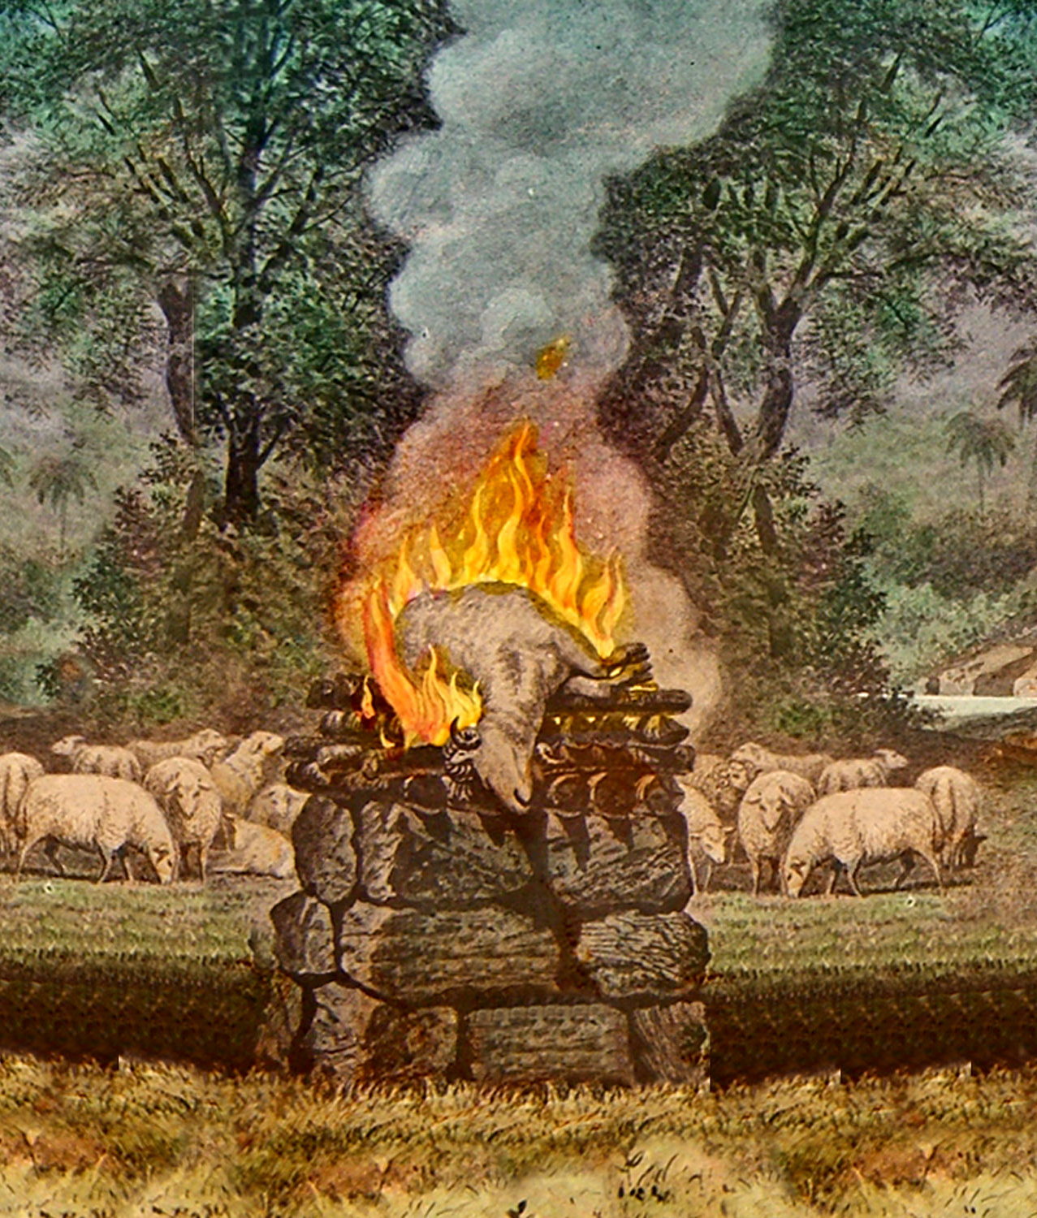
God commanded them that they must shed blood by making an animal sacrifice
for the forgiveness of sins.
Romans 10:17
“So then faith cometh by hearing, and hearing by the word of God.”
[Therefore, God had obviously instructed Abel and Cain regarding making a sacrifice.]
Hebrews 11:4
“By faith Abel offered unto God a more excellent sacrifice than Cain, by which he obtained witness that he was righteous, God testifying of his gifts: and by it he being dead yet speaketh.”
Hebrews 9:22
“And almost all things are by the law purged with blood; and without shedding of blood is no remission.”
4

Slide 6
So Great A Salvation. Hebrews 2:1-4
Lev. 17:11 'For the life of the flesh is in the blood, and I have given it to you upon the altar to make atonement for your souls; for it is the blood that makes atonement for the soul.’
Heb 9:22, 28 And according to the law almost all things are purified with blood, and without shedding of blood there is no remission. ... 28 so Christ was offered once to bear the sins of many. To those who eagerly wait for Him He will appear a second time, apart from sin, for salvation.
Heb. 10:4 For it is not possible that the blood of bulls and goats could take away sins.
5

Slide 7
So Great A Salvation. Hebrews 2:1-4
So we learn-
Adam and Eve sinned
Cain and Abel sinned
You and I have sinned
for all have sinned and fall short of the glory of God, Romans 3:23
But your iniquities have separated between you and your God, and your sins have hid his face from you, that he will not hear. Isaiah 59:2
Therefore, we all need salvation!
6

Slide 8
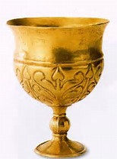
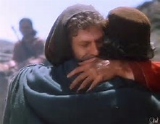
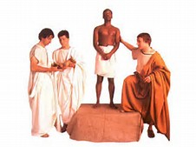
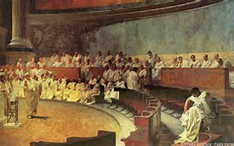
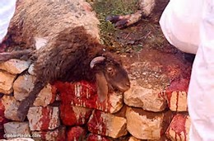
Salvation
Redemption
Sanctification
Reconciliation
Justification
Propitiation
7

Slide 9

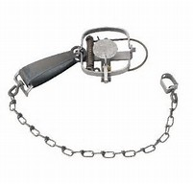
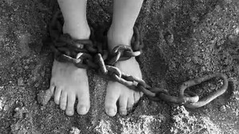
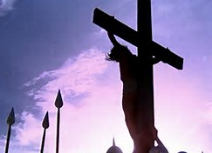

Sin Captivates
Satan Captures
Held in bondage. Servant of sin
Redemption
Christ redeems us. Buys us. Servant of Christ.
Christ paid ransom
8

Slide 10
So Great A Salvation. Hebrews 2:1-4
We all need salvation.
So what saves us?
9

Slide 11
So Great A Salvation. Hebrews 2:1-4
A number of things work together to bring about man’s salvation.
God Saves. “For this is good and acceptable in the sight of God our Saviour; Who will have all men to be saved…” (1 Tim. 2:3-4).
Christ Saves. “And she shall bring forth a son, and thou shalt call his name JESUS: for he shall save his people from their sins” (Mt. 1:21).
Grace Saves. “For by grace are ye saved…” (Eph. 2:5, 8).
Faith Saves. “Therefore being justified by faith, we have peace with God through our Lord Jesus Christ” (Rom. 5:1).
Blood Saves. “In whom we have redemption through his blood, the forgiveness of sins, according to the riches of his grace” (Eph. 1:7).
10

Slide 12
So Great A Salvation. Hebrews 2:1-4
The Gospel Saves. “For I am not ashamed of the gospel of Christ: for it is the power of God unto salvation to every one that believes; to the Jew first, and also to the Greek” (Rom. 1:16).
Preaching Saves. “…it pleased God by the foolishness of preaching to save them that believe” (1 Cor. 1:21).
Works Save. “Ye see then how that by works a man is justified, and not by faith only” (Jas. 2:24).
Confession Saves. “For with the heart man believeth unto righteousness; and with the mouth confession is made unto salvation” (Rom. 10:10).
Baptism Saves. “The like figure whereunto even baptism doth also now save us…” (1 Pet. 3:21).
11

Slide 13
So Great A Salvation. Hebrews 2:1-4
Nowhere does the Bible teach that a person is saved by any one thing alone.
12

Slide 14
So Great A Salvation. Hebrews 2:1-4
Rom. 1:14-16
14 I am a debtor both to Greeks and to barbarians, both to wise and to unwise.
15 So, as much as is in me, I am ready to preach the gospel to you who are in Rome also.
16 For I am not ashamed of the gospel of Christ, for it is the power of God to salvation for everyone who believes, for the Jew first and also for the Greek.
Rom 10:16 But they have not all obeyed the gospel.
13

Slide 15
So Great A Salvation. Hebrews 2:1-4
Rom. 10:8-15 But what does it say? "The word is near you, in your mouth and in your heart" (that is, the word of faith which we preach):
9 that if you confess with your mouth the Lord Jesus and believe in your heart that God has raised Him from the dead, you will be saved.
10 For with the heart one believes unto righteousness, and with the mouth confession is made unto salvation.
11 For the Scripture says, "Whoever believes on Him will not be put to shame."
12 For there is no distinction between Jew and Greek, for the same Lord over all is rich to all who call upon Him.
13 For "whoever calls on the name of the LORD shall be saved."
14 How then shall they call on Him in whom they have not believed? And how shall they believe in Him of whom they have not heard? And how shall they hear without a preacher?
15 And how shall they preach unless they are sent? As it is written: "How beautiful are the feet of those who preach the gospel of peace, Who bring glad tidings of good things!"
14

Slide 16
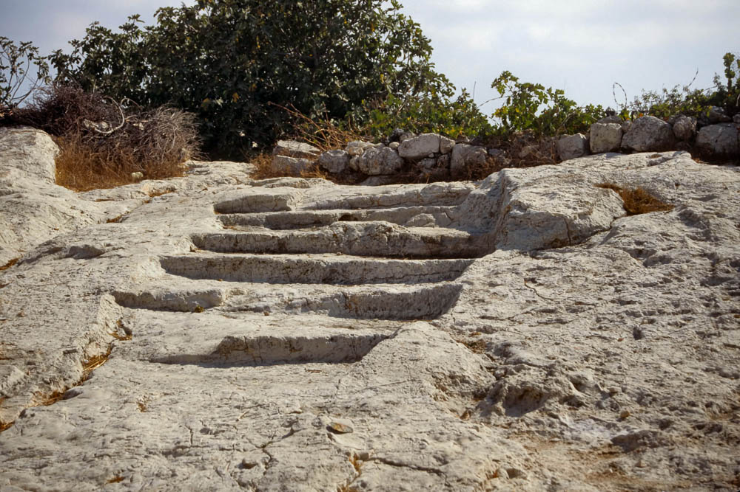

The Roman Road To Salvation
Romans 10:10
Romans 10:9
Romans 5:8
Romans 6:23
Romans 3:23
15

Slide 17
The Roman Road To Salvation
All Have Sinned – Rom.3:23
Wages of sin is death – Rom.6:23
God proved His love for us – Rom.5:8
Must confess Christ, believe DBR- Rom. 10:9
Must believe unto righteousness – Rom.10:10
(must obey gospel – Rom. 10:16)
16

Slide 18
So Great A Salvation. Hebrews 2:1-4
Acts 18:8 Then Crispus, the ruler of the synagogue, believed on the Lord with all his household.
And many of the Corinthians, hearing, believed and were baptized.
Some have used Acts 18:8 to prove baptism is not essential. Crispus was saved believing on the Lord.
17

Slide 19
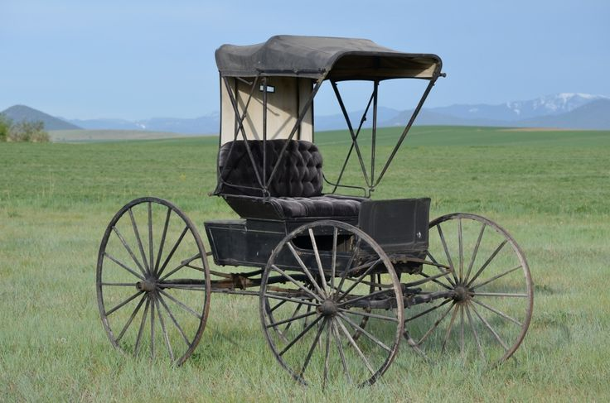
18
1Cor. 1:13-15 Psalm 119:160

Slide 20
So Great A Salvation. Hebrews 2:1-4
1Cor. 1:13 Is Christ divided? Was Paul crucified for you? Or were you baptized in the name of Paul?
14 I thank God that I baptized none of you except Crispus and Gaius,
15 lest anyone should say that I had baptized in my own name.
16 Yes, I also baptized the household of Stephanas. Besides, I do not know whether I baptized any other. (Psalm 119:160. The SUM of thy word is truth).
19

Slide 21
Christ and the church He built.
Does believing or baptism save us from all sins?
Past – Present -and Future?
What does the Bible teach?
John 12:48 "He who rejects Me, and does not receive My words, has that which judges him--the word that I have spoken will judge him in the last day.
20

Slide 22
Eph.2:8,9 For by grace you have been saved through faith, and that not of yourselves; it is the gift of God, 9 not of works, lest anyone should boast.
Acts 19:1 And it happened, while Apollos was at Corinth, that Paul, having passed through the upper regions, came to Ephesus. And finding some disciples ---
Acts 19:5 When they heard this, they were baptized in the name of the Lord Jesus.
6 And when Paul had laid hands on them, the Holy Spirit came upon them, and they spoke with tongues and prophesied.
21

Slide 23
Christ and the church He built.
Paul’s reference to salvation in the past perfect tense as something done and accomplished already has no reference to final destiny but to the primary obedience that makes a true child of God.
Eph.2:8
22

Slide 24
So Great A Salvation. Hebrews 2:1-4
Let’s talk now about how confident can we be in our salvation?
As confident as God’s word outlines for us! We can not go beyond God’s revelation and expect to be saved.
23

Slide 25
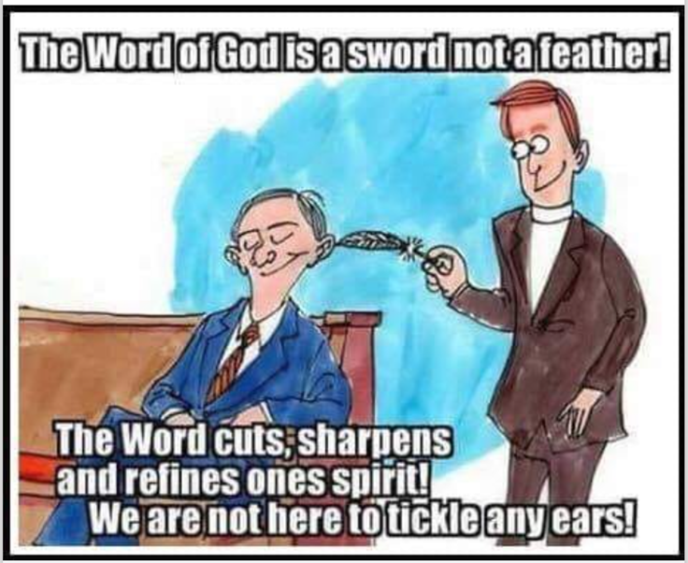
Hebrews 4:12
For the word of God is living and powerful, and sharper than any two-edged sword, piercing even to the division of soul and spirit, and of joints and marrow, and is a discerner of the
thoughts and intents of the heart.
24

Slide 26
So Great A Salvation. Hebrews 2:1-4
We cannot violate “the word of His grace” and continue to abide in “the true grace of God" (Acts 20:32; 1 Pet. 5:12).
Any attempt to maintain fellowship with God and keep unity with His people, while going beyond the boundary of revealed truth, is destined for failure (Gal. 1:6-10).
God’s grace does not save us when we transgress against God’s truth.
25

Slide 27
So Great A Salvation. Hebrews 2:1-4
To suggest otherwise is not the “true grace of God” in which we stand (Rom. 5:1-2; 1 Pet. 5:12).
We cannot be disobeying the teachings and commands of the Lord yet claim that since His grace “is greater than our sin”, (scripture please) God accepts us in disobedience.
“What shall we say then? Shall we continue in sin that grace may abound? Certainly not! How shall we who died to sin live any longer in it?” (Rom. 6:1-2)
26

Slide 28
So Great A Salvation. Hebrews 2:1-4
To stand in grace, we must live by faith (Eph. 2:8-10; 2 Cor. 5:7
Nowhere does the Bible teach that a person is saved by any one thing alone.
Until we get people to understand this, we will have people baptized and then head back into the world, rationalizing in their mind that
baptism = salvation = home in heaven.
27

Slide 29

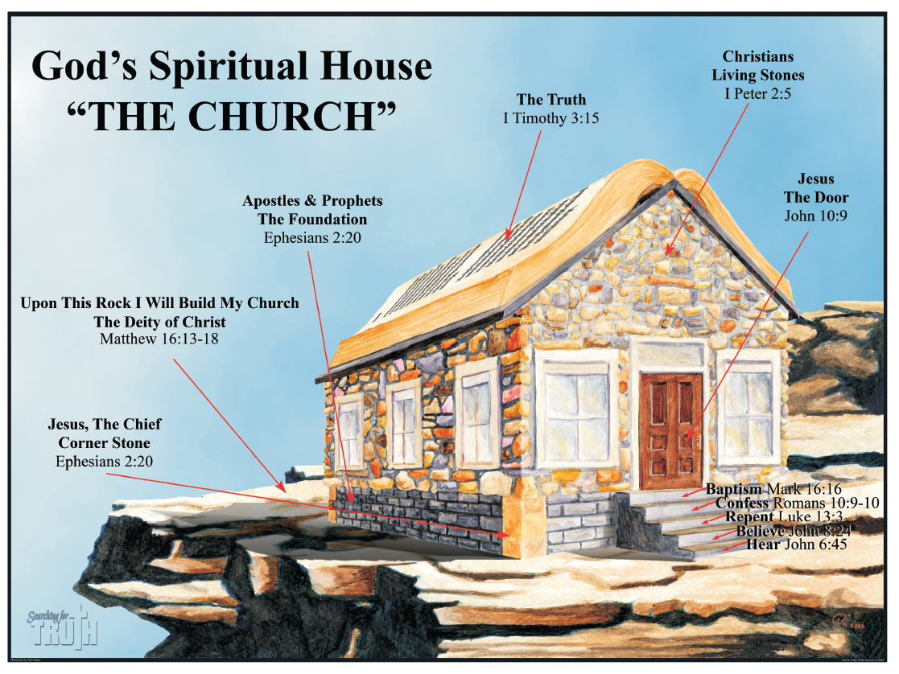
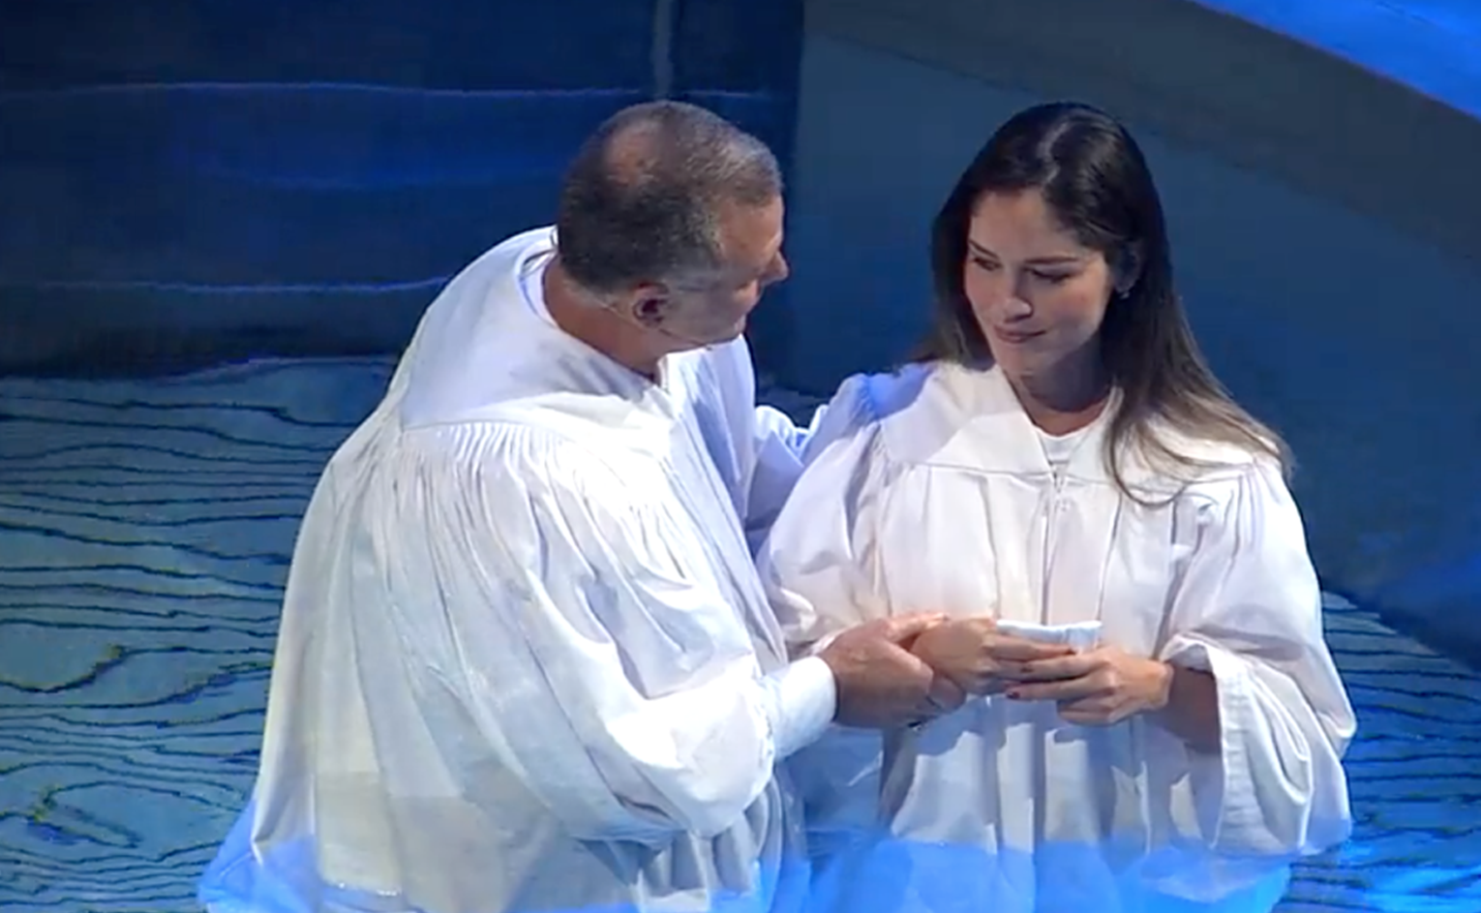
Jesus is the only way to the Father. John 10:9, John 14:6.
The only way we can get into Christ is to be baptized into Christ. Gal. 3:27.
When we are baptized into Christ, we are added to the church. Acts 2:47
1Cor. 15:24 Then comes the end, when He delivers the kingdom to God the Father, when He puts an end to all rule and all authority and power.
Matt. 5:12 Rejoice, and be exceeding glad: for great is your reward in heaven
28

Slide 30
So Great A Salvation. Hebrews 2:1-4
What did Peter tell those on the Day of Pentecost when they cried out What Must We Do To be Saved?
Nothing. Christ already forgave you on the cross
Repent, and let every one of you be baptized in the name of Jesus Christ for the remission of sins Acts 2:38
Be faithful until death, and I will give you the crown of life. Revelation 2:10
29

Slide 31
So Great A Salvation. Hebrews 2:1-4
So, can we fall from grace?
a) no
b) maybe
c) yes, absolutely!
Gal. 5:1, 4. Stand fast therefore in the liberty by which Christ has made us free, and do not be entangled again with a yoke of bondage. ... 4 You have become estranged from Christ, you who attempt to be justified by law;
you have fallen from grace.
30

Slide 32

So Great A Salvation. Hebrews 2:1-4
Does God’s grace allow us to keep one foot in the church and our other foot in the world?.... God forbid!
Rom. 6:1-2 KJV What shall we say then? Shall we continue in sin, that grace may abound? God forbid. How shall we, that are dead to sin, live any longer therein?
church
world
31

