Slide 1
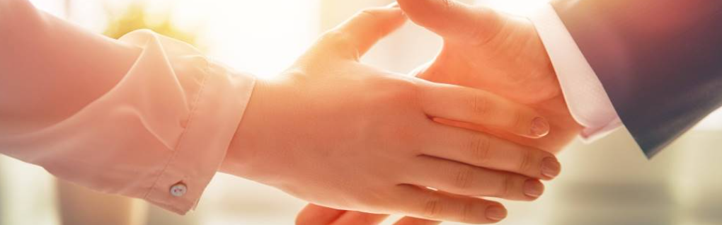
Welcome to our services
New Lebanon Church of Christ
We are Simply Christians.
Our Emphasis is Spiritual, Not Material or Social.
We are striving to be The Same Church as Described in The New Testament.
Please Come Back Again

Slide 2
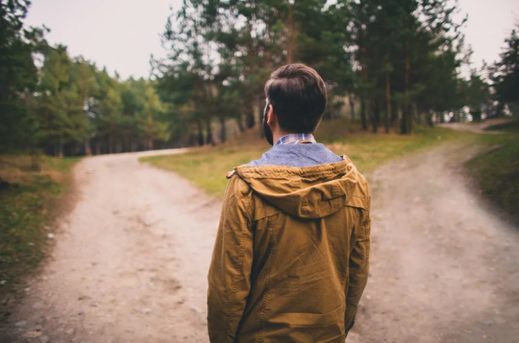

Slide 3
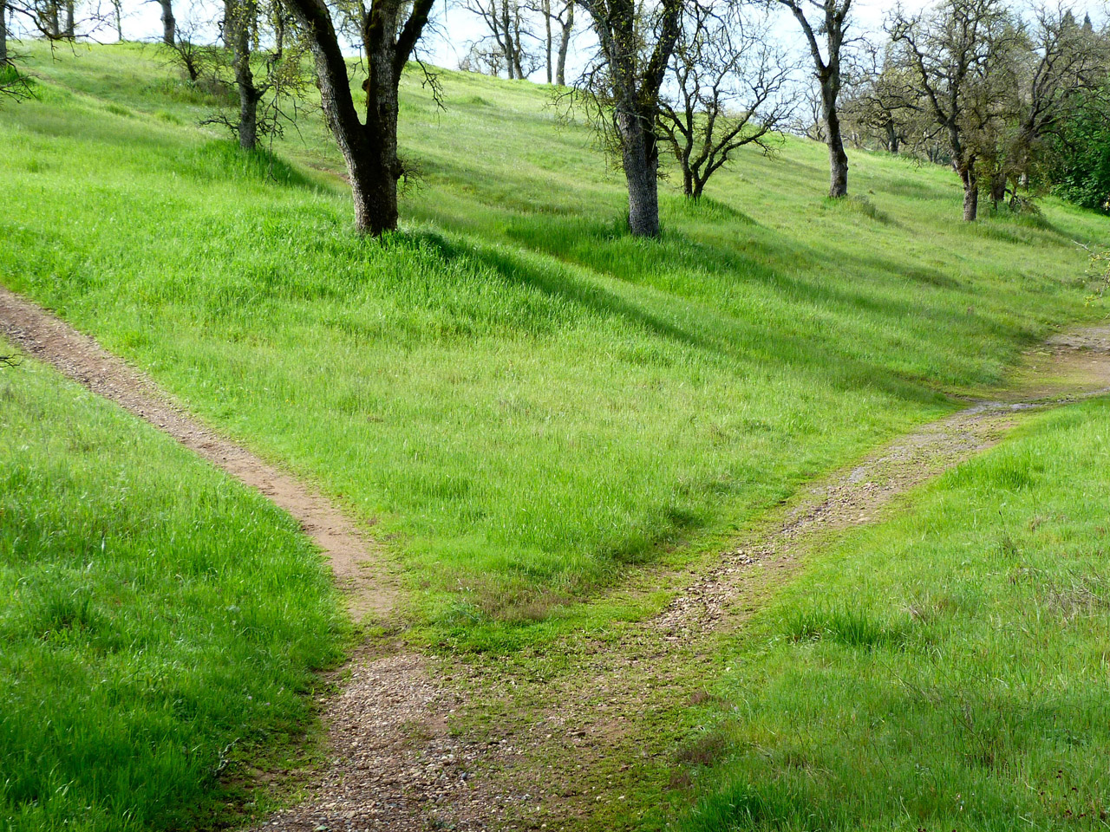
Return To The Old Paths
Jeremiah 6:16 Thus says the LORD: "Stand in the ways and see, And ask for the old paths, where the good way is, And walk in it; Then you will find rest for your souls. But they said, 'We will not walk in it.'
Jeremiah 31:21 "Set up signposts, Make landmarks; Set your heart toward the highway, The way in which you went. Turn back, O virgin of Israel, Turn back to these your cities.
newlebanoncoc.com

Slide 4
Return To The Old Paths
1. To return to the old paths, we need to -
Return to an absolute respect for the scriptures as God’s inspired revelation to us,
Return to book-chapter-verse preaching,
Return to contending for the faith,
newlebanoncoc.com

Slide 5
Return To The Old Paths
2. It is mandatory for our salvation.
Matt. 28:18; And Jesus came and spoke to them, saying, "All authority has been given to Me in heaven and on earth.
2 Tim. 1:13 Hold fast the pattern of sound words which you have heard from me, in faith and love which are in Christ Jesus.
Matt. 7:21-23 "Not everyone who says to Me, 'Lord, Lord,' shall enter the kingdom of heaven, but he who does the will of My Father in heaven.
newlebanoncoc.com

Slide 6
Return To The Old Paths
Matt. 7:24-29
24 "Therefore whoever hears these sayings of Mine, and does them, I will liken him to a wise man who built his house on the rock: 25 "and the rain descended, the floods came, and the winds blew and beat on that house; and it did not fall, for it was founded on the rock
26 "But everyone who hears these sayings of Mine, and does not do them, will be like a foolish man who built his house on the sand: 27 "and the rain descended, the floods came, and the winds blew and beat on that house; and it fell. And great was its fall."
28 And so it was, when Jesus had ended these sayings, that the people were astonished at His teaching, 29 for He taught them as one having authority, and not as the scribes.
newlebanoncoc.com

Slide 7
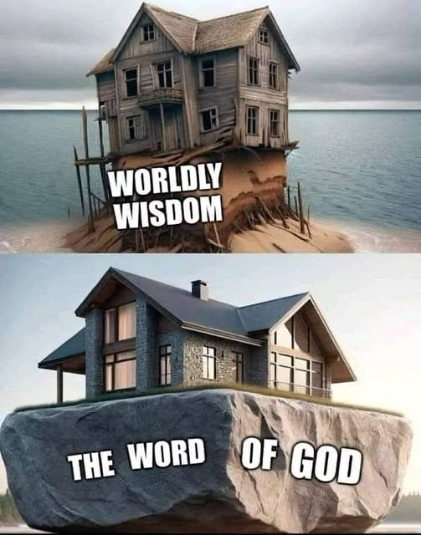
Return To The Old Paths
newlebanoncoc.com

Slide 8
Return To The Old Paths
3. What will returning to the old paths do?
Returns Hearts to God,
Returns Sinners to Christ’s Law of Pardon
Returns Christians to the Acceptability of True Worship
Returns the Local Church to its God-Ordained Order and Unity,
Returns the Importance of Doctrinal Accuracy,
Returns Us to Moral Purity and Holy Living,
newlebanoncoc.com

Slide 9
Will YOU return?

Slide 10
Questions?
Want to learn more about the Bible?
We will be glad to study the Bible with you.
New Lebanon
New Lebanon
Church of Christ
Church of Christ
New Lebanon, OH
newlebanoncoc.com
newlebanoncoc@gmail.com

