Slide 1
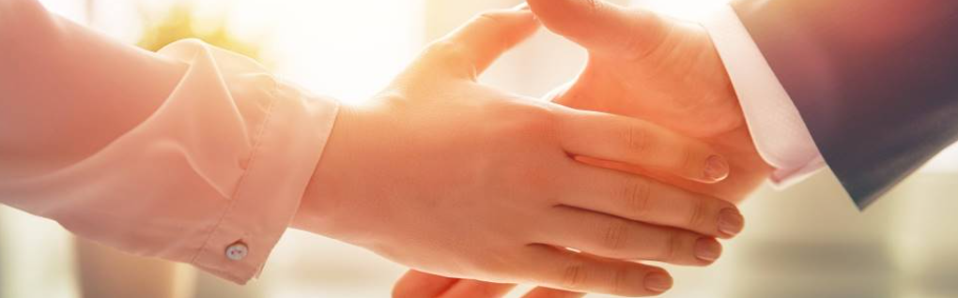
Welcome to our services
New Lebanon Church of Christ
We are Simply Christians.
Our Emphasis is Spiritual, Not Material or Social.
We are striving to be The Same Church as Described in The New Testament.
Please Come Back Again

Slide 2

Holy Women Who Trusted In God
1Peter 3:5 For in this manner, in former times, the holy women who trusted in God also adorned themselves, being submissive to their own husbands,

Slide 3

Holy Women Who Trusted In God
Proverbs 31:28 Her children rise up and call her blessed; Her husband also, and he praises her:
Proverbs 19:26 He who mistreats his father and chases away his mother Is a son who causes shame and brings reproach.
Proverbs 15:20 A wise son makes a father glad, But a foolish man despises his mother.
Proverbs 10:1, The proverbs of Solomon: A wise son makes a glad father, But a foolish son is the grief of his mother.

Slide 4
Holy Women Who Trusted In God
1Peter 3:1-6
submissive – obedient, hearing with reverence and obedient agreement
chaste conduct - pure from defilement, not contaminated
Fear – reverence (NOT being afraid)
the hidden person of the heart,
incorruptible beauty- will not decay or fade away
a gentle and quiet spirit,- meekness, kindness, forbearance
very precious in the sight of God. – of great price, costly
newlebanoncoc.com

Slide 5
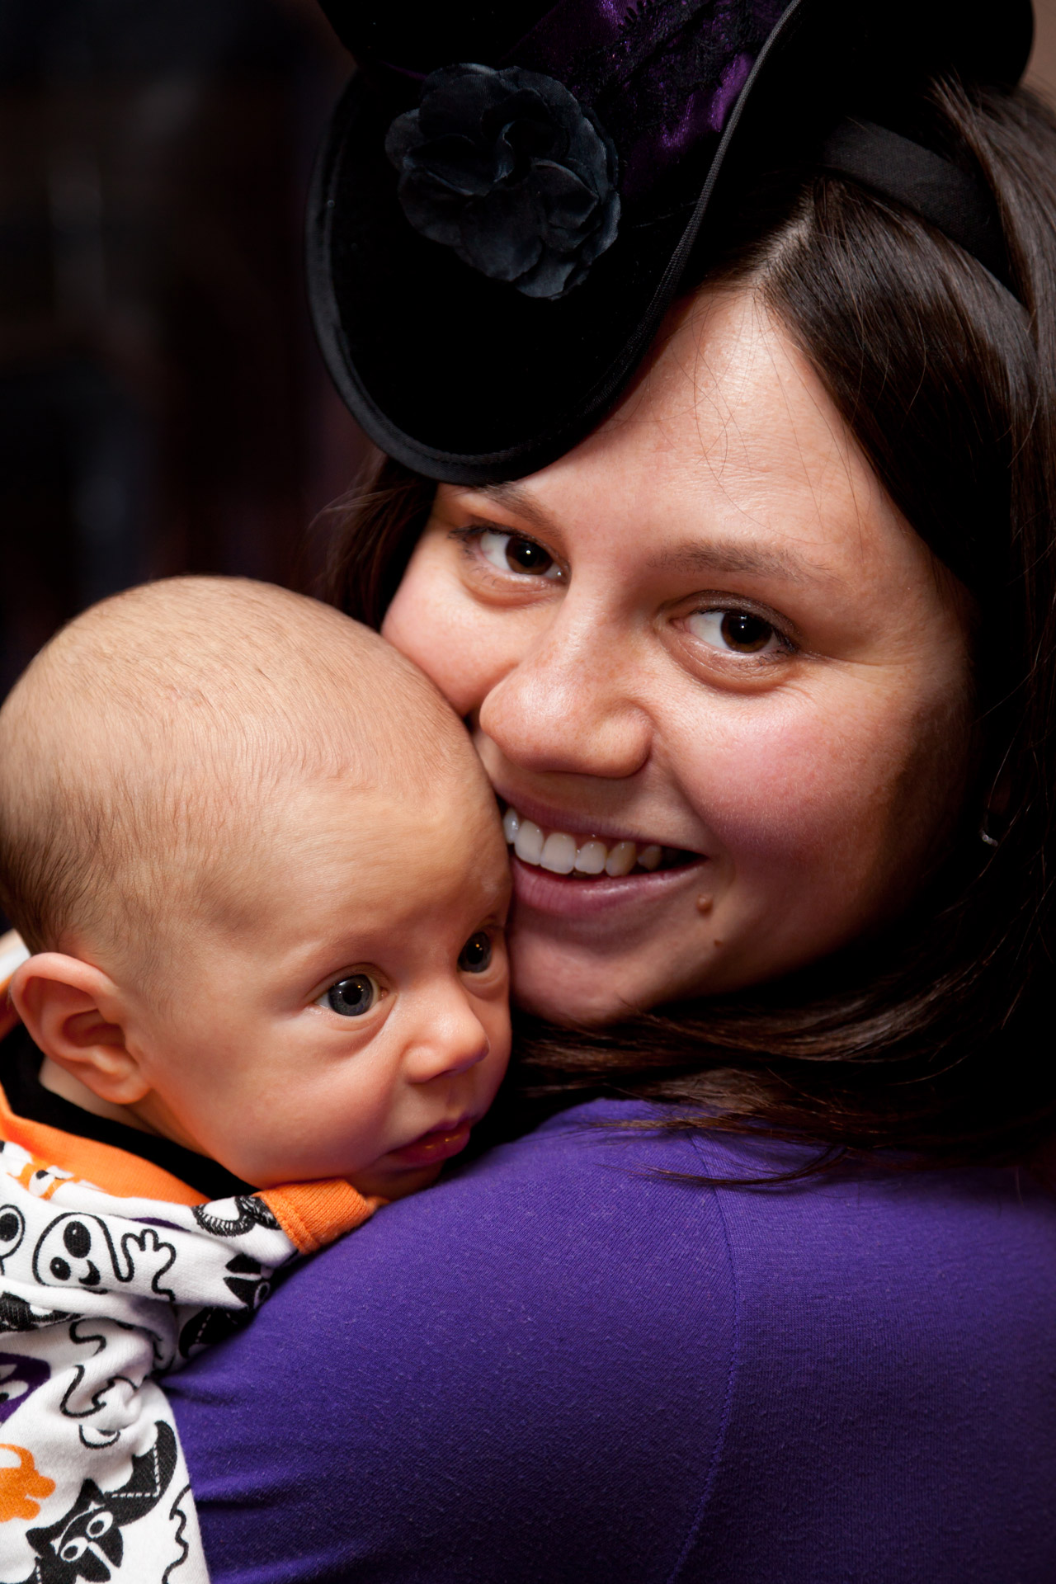
Holy Women Who Trusted In God
Sarah
Jochebed
Hannah
newlebanoncoc.com

Slide 6

Holy Women Who Trusted In God
Gentleness.
Quietness
Holiness
Submission
newlebanoncoc.com

Slide 7


Relationships are one of the most important things in life. Build great ones.

Slide 8
Questions?
Want to learn more about the Bible?
We will be glad to study the Bible with you.
New Lebanon
New Lebanon
Church of Christ
Church of Christ
New Lebanon, OH
newlebanoncoc.com
newlebanoncoc@gmail.com

