Slide 1
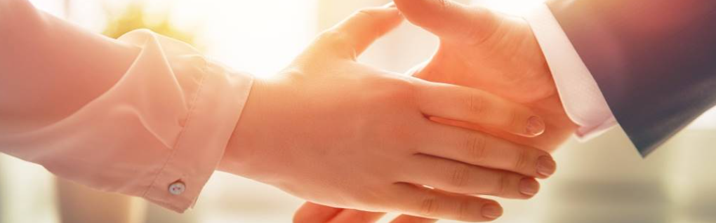
Welcome to our services
New Lebanon Church of Christ
We are Simply Christians.
Our Emphasis is Spiritual, Not Material or Social.
We are striving to be The Same Church as Described in The New Testament.
Please Come Back Again

Slide 2

Genesis 13:5-8 Lot also, who went with Abram, had flocks and herds and tents. 6 Now the land was not able to support them, that they might dwell together, for their possessions were so great that they could not dwell together. 7 And there was strife between the herdsmen of Abram's livestock and the herdsmen of Lot's livestock. The Canaanites and the Perizzites then dwelt in the land. 8 So Abram said to Lot, "Please let there be no strife between you and me, and between my herdsmen and your herdsmen; for we are brethren. ...

Slide 3

Let There Be No Strife

Slide 4
Let There Be No Strife
Proverbs 17:14 The beginning of strife is like releasing water; Therefore stop contention before a quarrel starts.
Proverbs 17:19 He who loves transgression loves strife, And he who exalts his gate seeks destruction.
Proverbs 20:3 It is honorable for a man to stop striving, Since any fool can start a quarrel.

Slide 5
Let There Be No Strife
Philippians 2:1-3 Therefore if there is any consolation in Christ, if any comfort of love, if any fellowship of the Spirit, if any affection and mercy, 2 fulfill my joy by being like-minded, having the same love, being of one accord, of one mind. 3 Let nothing be done through selfish ambition or conceit, but in lowliness of mind let each esteem others better than himself.
Psalm 133:1 Behold, how good and how pleasant it is for brethren to dwell together in unity!

Slide 6


Let There Be No Strife
Let there be no strife among brethren
Let there be no strife in the congregation
Let there be no strife in the home

Slide 7
Questions?
Want to learn more about the Bible?
We will be glad to study the Bible with you.
New Lebanon
New Lebanon
Church of Christ
Church of Christ
New Lebanon, OH
newlebanoncoc.com
newlebanoncoc@gmail.com

