Slide 1
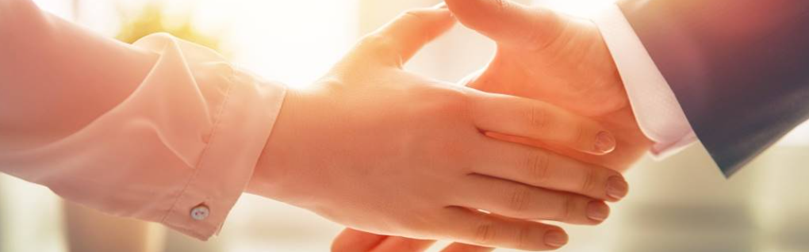
Welcome to our services
New Lebanon Church of Christ
We are Simply Christians.
Our Emphasis is Spiritual, Not Material or Social.
We are striving to be The Same Church as Described in The New Testament.
Please Come Back Again

Slide 2


Seasoned With Salt
Let your speech always be with grace, seasoned with salt, that you may know how you ought to answer each one.
Colossians 4:6
dreamstime.com

Slide 3


Slide 4


Slide 5

Transmitter And Receiver ar.inspiredpencil.com

Slide 6
Seasoned With Salt
Jesus called believers to be the salt of the earth (Matt. 5:13). Salt is an important mineral; it preserves food, brings out flavor, soothes and heals, and is necessary for life: it balances fluids in the blood and is vital for nerve and muscle function.
dreamstime.com

Slide 7
Seasoned With Salt
Gracious in speech. -The goal is to bring out the best in others in a conversation, not put them down, and not cut them out.”
Our words should impact our conversations for the better as we bring a different “flavor” to our interactions, build others up, and share as well as defend the gospel.
dreamstime.com

Slide 8
Seasoned With Salt
The salt of the earth metaphor applies to the way believers talk as well as how they live, The content and tone of our words should impact those around us for the better,
The right amount of salt in food brings out flavor and transforms a meal.
dreamstime.com

Slide 9
Seasoned With Salt
Proverbs 12:18
Matthew 12:36
1 Thess. 5:11
Proverbs 16:24
Ephesians 4:29
Hebrews 3:13
James 1:19-20
dreamstime.com

Slide 10
Seasoned With Salt
Proverbs 10:19
Proverbs 13:3
Proverbs 29:20
James 3:2-12
dreamstime.com

Slide 11
Seasoned With Salt
a horse’s mouth and bits / ship and a rudder
a fire / and a poisonous snake
a fountain of water / and a fig tree
dreamstime.com

Slide 12
Seasoned With Salt
Power of Direction
a horse’s mouth and bits / ship and a rudder
Power of Destruction
a fire / and a poisonous snake
Power of Life
a fountain of water / and a fig tree
dreamstime.com

Slide 13
Questions?
Want to learn more about the Bible?
We will be glad to study the Bible with you.
New Lebanon
New Lebanon
Church of Christ
Church of Christ
New Lebanon, OH
newlebanoncoc.com
newlebanoncoc@gmail.com

