Slide 1

Welcome to our services
New Lebanon Church of Christ
We are Simply Christians.
Our Emphasis is Spiritual, Not Material or Social.
We are striving to be The Same Church as Described in The New Testament.
Please Come Back Again

Slide 2
Cause me to hear Your lovingkindness
Hear my prayer, O LORD, Give ear to my supplications! In Your faithfulness answer me, And in Your righteousness. Do not enter into judgment with Your servant, For in Your sight no one living is righteous. For the enemy has persecuted my soul; He has crushed my life to the ground; He has made me dwell in darkness, Like those who have long been dead.
Therefore my spirit is overwhelmed within me; My heart within me is distressed. I remember the days of old; I meditate on all Your works; I muse on the work of Your hands. I spread out my hands to You; My soul longs for You like a thirsty land. Answer me speedily, O LORD; My spirit fails! Do not hide Your face from me, Lest I be like those who go down into the pit.
Cause me to hear Your lovingkindness in the morning, For in You do I trust; Cause me to know the way in which I should walk, For I lift up my soul to You. Psalm 143:1-8
newlebanoncoc.com

Slide 3
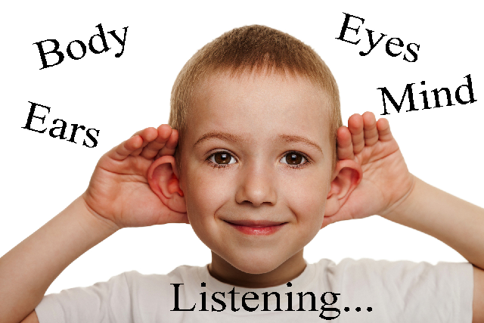
Cause me to hear Your lovingkindness
thefactfactor.com
Psalm 143:8

Slide 4


Slide 5
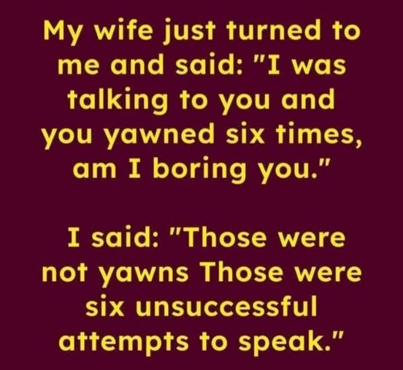

Slide 6
Cause me to hear Your lovingkindness
How good are we at Listening???
2Kings 17:13-14 Yet the LORD testified against Israel and against Judah, by all of His prophets, every seer, saying, "Turn from your evil ways, and keep My commandments and My statutes, according to all the law which I commanded your fathers, and which I sent to you by My servants the prophets." 14 Nevertheless they would not hear, but stiffened their necks, like the necks of their fathers, who did not believe in the LORD their God.
newlebanoncoc.com

Slide 7
Cause me to hear Your lovingkindness
Job 27:8-9 For what is the hope of the hypocrite, Though he may gain much, If God takes away his life? 9 Will God hear his cry When trouble comes upon him?
Job 37:1-5 1 "At this also my heart trembles, And leaps from its place. 2 Hear attentively the thunder of His voice, And the rumbling that comes from His mouth. 3 He sends it forth under the whole heaven, His lightning to the ends of the earth. 4 After it a voice roars; He thunders with His majestic voice, And He does not restrain them when His voice is heard. 5 God thunders marvelously with His voice; He does great things which we cannot comprehend…
newlebanoncoc.com

Slide 8
Cause me to hear Your lovingkindness
Psalm 4:1 Hear me when I call, O God of my righteousness! You have relieved me in my distress; Have mercy on me, and hear my prayer.
Psalm 130:2 Lord, hear my voice! Let Your ears be attentive To the voice of my supplications.
newlebanoncoc.com

Slide 9


Slide 10
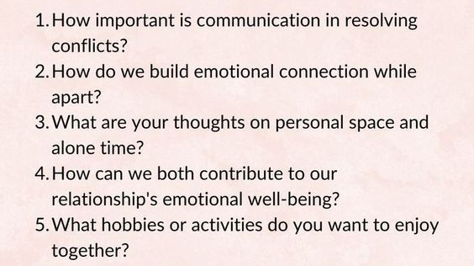

Slide 11
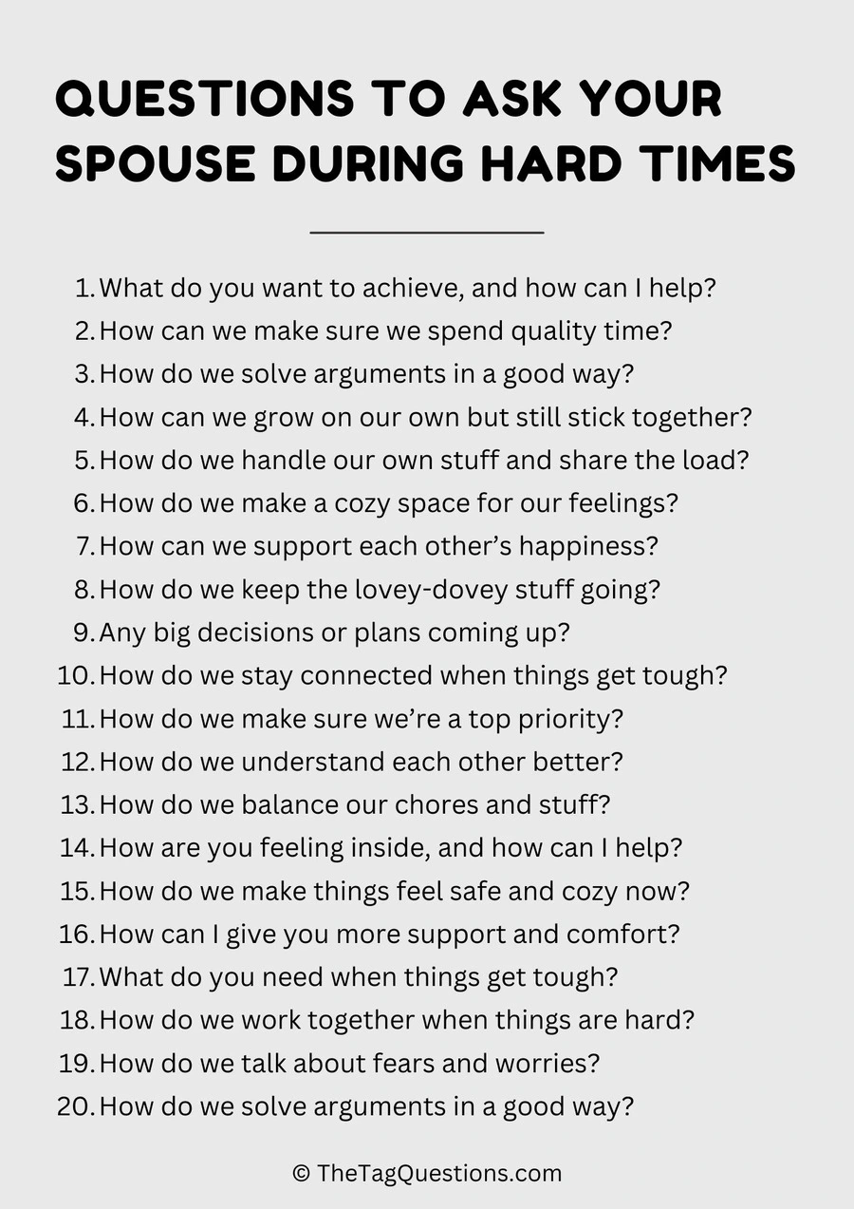

Slide 12
Cause me to hear Your lovingkindness
Prov. 1:5 A wise man will hear and increase learning, And a man of understanding will attain wise counsel,
Ecc. 5:1 Walk prudently when you go to the house of God; and draw near to hear rather than to give the sacrifice of fools, for they do not know that they do evil.
newlebanoncoc.com

Slide 13
Cause me to hear Your lovingkindness
Isaiah 59:1-2 Behold, the LORD's hand is not shortened, That it cannot save; Nor His ear heavy, That it cannot hear. 2 But your iniquities have separated you from your God; And your sins have hidden His face from you, So that He will not hear.
newlebanoncoc.com

Slide 14

Cause me to hear Your lovingkindness

Slide 15
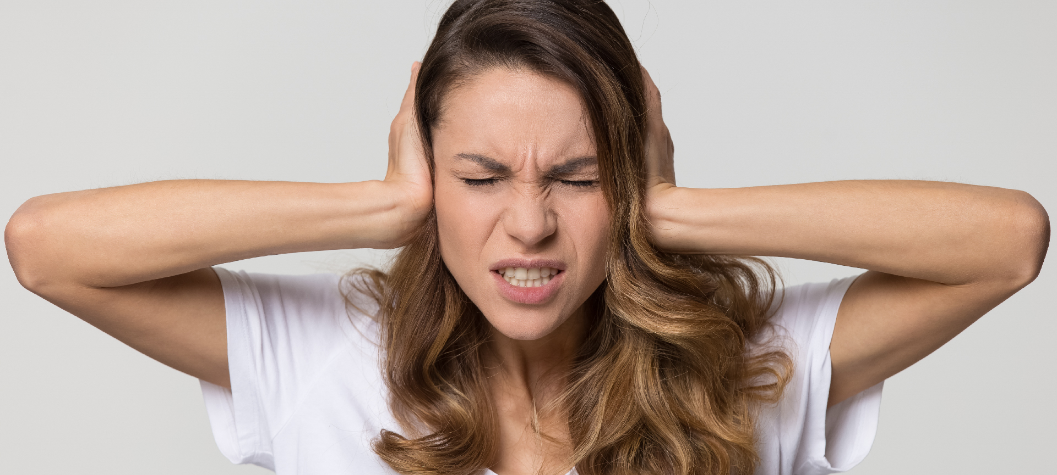
Cause me to hear Your lovingkindness

Slide 16

Cause me to hear Your lovingkindness

Slide 18
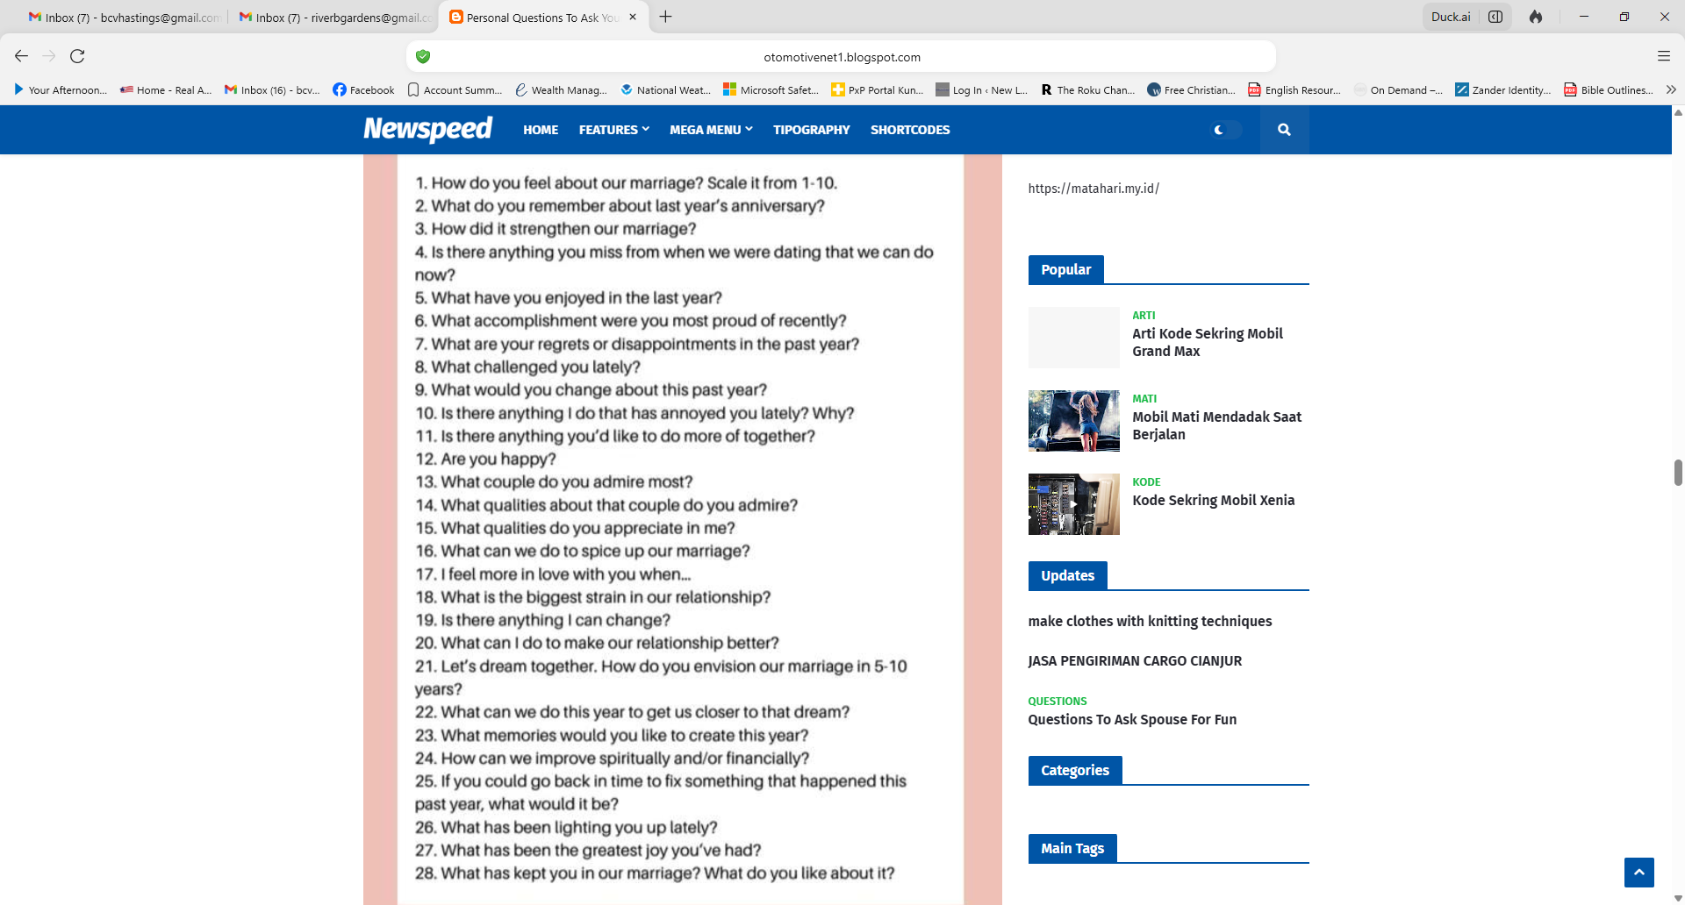

Slide 20

Cause me to hear Your lovingkindness

Slide 21
Questions?
Want to learn more about the Bible?
We will be glad to study the Bible with you.
New Lebanon
New Lebanon
Church of Christ
Church of Christ
New Lebanon, OH
newlebanoncoc.com
newlebanoncoc@gmail.com

