Slide 1
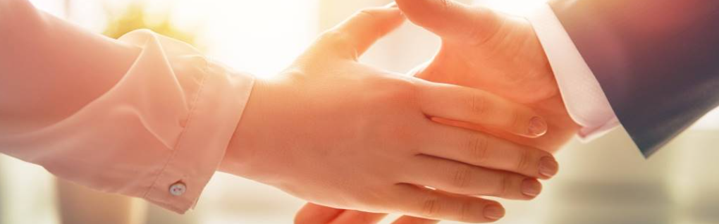
Welcome to our services
New Lebanon Church of Christ
We are Simply Christians.
Our Emphasis is Spiritual, Not Material or Social.
We are striving to be The Same Church as Described in The New Testament.
Please Come Back Again

Slide 2
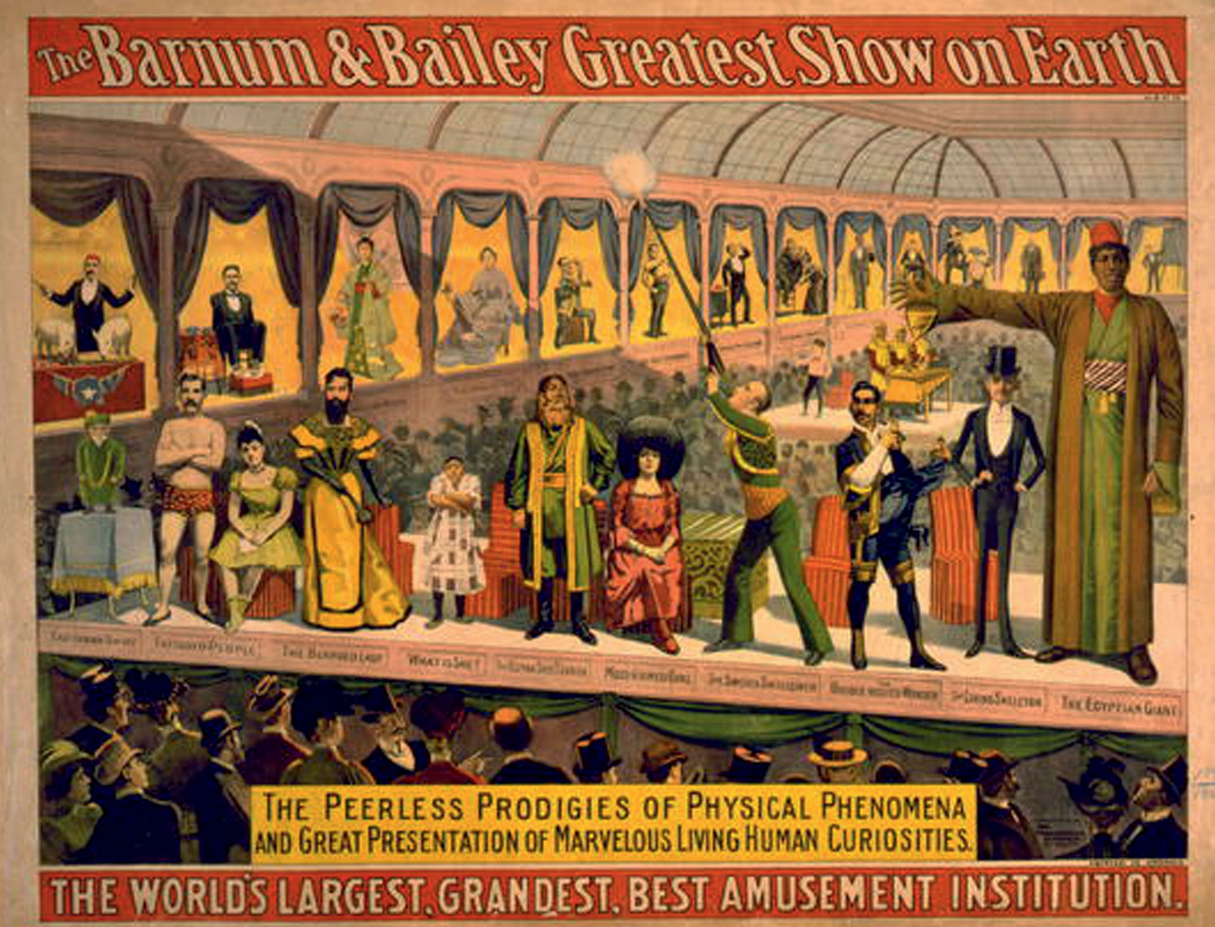

Slide 3
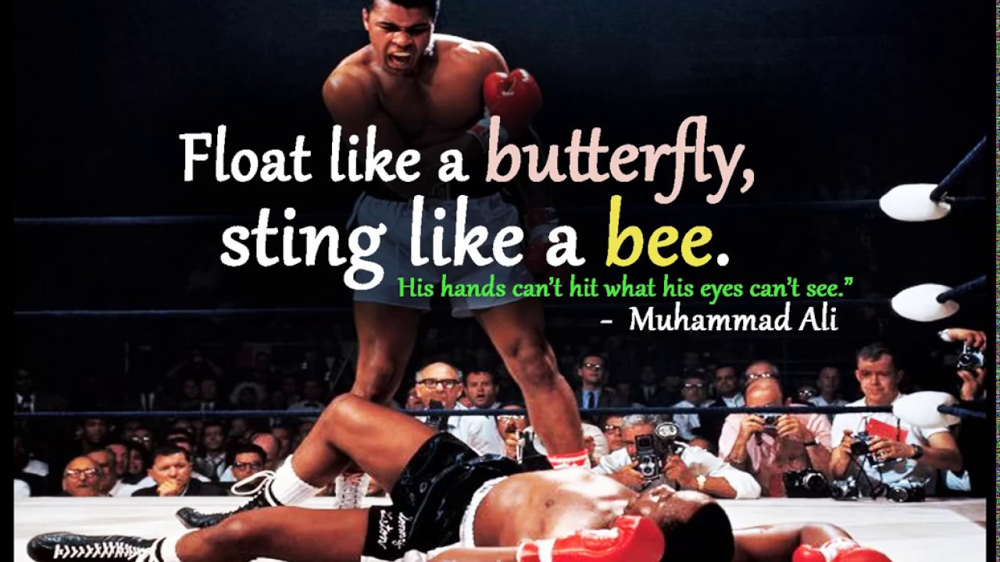
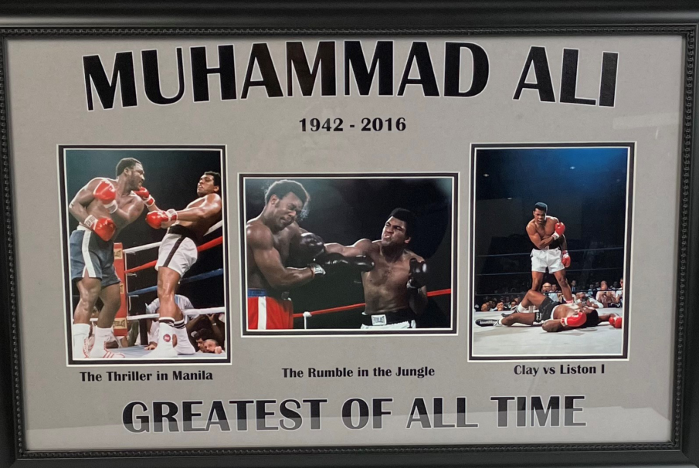

Slide 4
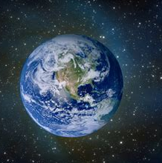
the
Greatest
in the
world
1 Corinthians 13:11-13

Slide 5
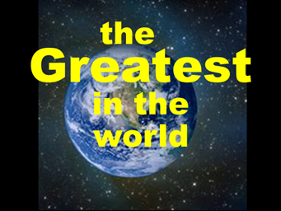
The Greatest in The World.
The Soul
Is the Greatest possession that man has.
Matt.10:28 And do not fear those who kill the body but cannot kill the soul. But rather fear Him who is able to destroy both soul and body in hell.
Matt.16:26) For what profit is it to a man if he gains the whole world, and loses his own soul? Or what will a man give in exchange for his soul?
1

Slide 6
The Greatest in The World.
SIN
Is the Greatest evil.
Isaiah 59:1-2 Behold, the LORD'S hand is not shortened, That it cannot save; Nor His ear heavy, That it cannot hear. 2 But your iniquities have separated you from your God; And your sins have hidden His face from you, So that He will not hear.
2

Slide 7
The Greatest in The World.
The Gospel
Is The Greatest Power.
Rom.1:16 For I am not ashamed of the gospel of Christ, for it is the power of God to salvation for everyone who believes, for the Jew first and also for the Greek
3

Slide 8
The Greatest in The World.
Love
Is The Greatest Principle In The World.
Col. 3:12-14 Therefore, as the elect of God, holy and beloved, put on tender mercies, kindness, humility, meekness, longsuffering; 13 bearing with one another, and forgiving one another, if anyone has a complaint against another; even as Christ forgave you, so you also must do. 14 But above all these things put on love, which is the bond of perfection.
4

Slide 9
The Greatest in The World.
The Blood Of Christ
Is The Greatest Remedy In The World For Man.
Lev. 17:11 For the life of the flesh [is] in the blood, and I have given it to you upon the altar to make atonement for your souls; for it is the blood that makes atonement for the soul.’
Heb. 9:22 And according to the law almost all things are purified with blood, and without shedding of blood there is no remission.
5

Slide 10
The Greatest in The World.
The Lord’s Supper
Is The Greatest Monument In The World.
Acts 20:6-7 But we sailed away from Philippi after the Days of Unleavened Bread, and in five days joined them at Troas, where we stayed seven days. Now on the first day of the week, when the disciples came together to break bread, Paul, ready to depart the next day, spoke to them and continued his message until midnight.
6

Slide 11
The Greatest in The World.
The Church
Is The Greatest Institution In The World.
Eph. 3:10-11 to the intent that now the manifold wisdom of God might be made known by the church to the principalities and powers in the heavenly places, 11 according to the eternal purpose which He accomplished in Christ Jesus our Lord,
7

Slide 12
Questions?
Want to learn more about the Bible?
We will be glad to study the Bible with you.
New Lebanon
New Lebanon
Church of Christ
Church of Christ
New Lebanon, OH
newlebanoncoc.com
newlebanoncoc@gmail.com

Slide 13
the
Greatest
in the
world

Slide 14


