Slide 1
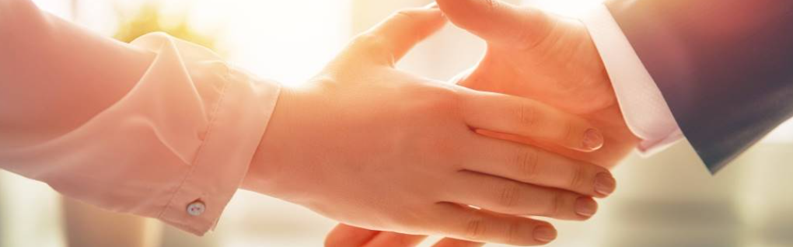
Welcome to our services
New Lebanon Church of Christ
We are Simply Christians.
Our Emphasis is Spiritual, Not Material or Social.
We are striving to be The Same Church as Described in The New Testament.
Please Come Back Again

Slide 2

God, Lesson Six
Amos 4:1-12

Slide 3
Justice demands the judgment
We will ALL stand before our judge to be judged.
The Bible will be the standard of judgment .
The meeting will be at an hour when we do not expect it.
The time to prepare for the judgment is today

Slide 4
Questions?
Want to learn more about the Bible?
We will be glad to study the Bible with you.
New Lebanon
New Lebanon
Church of Christ
Church of Christ
New Lebanon, OH
newlebanoncoc.com
newlebanoncoc@gmail.com

