Slide 1

Welcome to our services
New Lebanon Church of Christ
We are Simply Christians.
Our Emphasis is Spiritual, Not Material or Social.
We are striving to be The Same Church as Described in The New Testament.
Please Come Back Again

Slide 2

Easter. From God Or The Traditions Of Men?
dreamstime.com
What Does The Bible Say?

Slide 3
Easter. From God Or The Traditions Of Men?
For the time will come when they will not endure sound doctrine, but according to their own desires, because they have itching ears, they will heap up for themselves teachers; 4 and they will turn their ears away from the truth, and be turned aside to fables. 2Timothy 4:3-4

Slide 4
Easter. From God Or The Traditions Of Men?
I don’t read
anywhere in the Bible of
an annual special celebration
of the resurrection.

Slide 5
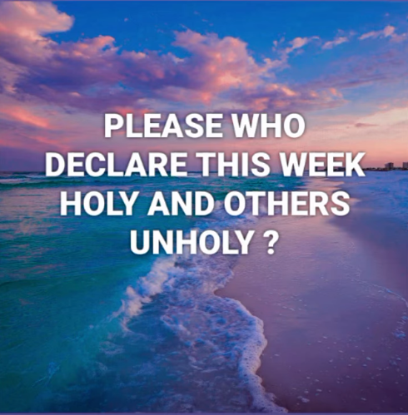
Alex Nwankwo
Nigeria

Slide 6
Easter. From God Or The Traditions Of Men?
Acts 12:4 intending after Easter to bring him forth to the people. (KJV) (PASCHA)
Acts 12:4 intending after the Passover to bring him forth to the people. (ASV) (PASCHA)
Acts 12:4 intending after the Passover to bring him out to the people. (RSV) (PASCHA)
Act 12:4 NKJV intending to bring him before the people after Passover. (PASCHA)
Easter was not in the Bible (KJV) until 1611
And only them because of the influence of the Catholic church. Easter is not in the original and not authorized By Christ. Added over 1500 years after the death of Christ.

Slide 7
Easter. From God Or The Traditions Of Men?
Matthew 15:8-9 These people draw near to Me with their mouth, And honor Me with their lips, But their heart is far from Me. And in vain they worship Me, Teaching as doctrines the commandments of men.
Malachi 1:6 A son honors his father, And a servant his master. If then I am the Father, Where is My honor? And if I am a Master, Where is My reverence?

Slide 8
Questions?
Want to learn more about the Bible?
We will be glad to study the Bible with you.
New Lebanon
New Lebanon
Church of Christ
Church of Christ
New Lebanon, OH
newlebanoncoc.com
newlebanoncoc@gmail.com

