Slide 1
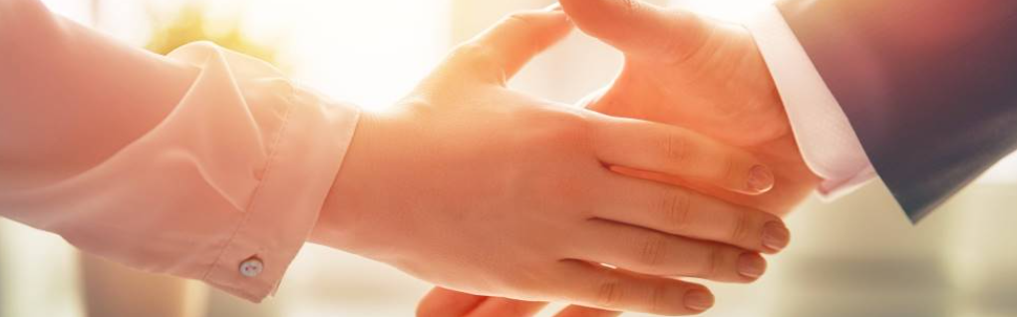
Welcome to our services
New Lebanon Church of Christ
We are Simply Christians.
Our Emphasis is Spiritual, Not Material or Social.
We are striving to be The Same Church as Described in The New Testament.
Please Come Back Again

Slide 2

Does Jesus Rule Your Heart?
mindfulminutes.com
Isaiah 57:15 For thus says the High and Lofty One Who inhabits eternity, whose name is Holy: "I dwell in the high and holy place, With him who has a contrite and humble spirit, To revive the spirit of the humble, And to revive the heart of the contrite ones.

Slide 3
Joshua 24:15 "And if it seems evil to you to serve the LORD, choose for yourselves this day whom you will serve,
whether the gods which your fathers served that were on the other side of the River,
or the gods of the Amorites, in whose land you dwell.
(3)
But as for me and my house, we will serve the LORD."
Matthew 6:24 No one can serve two masters; for either he will hate the one and love the other, or else he will be loyal to the one and despise the other. You cannot serve God and mammon.

Slide 4
Does Jesus Rule In Your Heart?
Do You Serve Jesus?
Are You Poor In Spirit?
Do You Mourn Over Your Sins?
Are You Meek?
Do You Hunger And Thirst For Righteousness?
newlebanoncoc.com

Slide 5
Does Jesus Rule In Your Heart?
Do You Serve Jesus?
5. Are You Merciful?
6. Are You Pure In Heart?
7. Are You A Peacemaker?
8. Do You Suffer Persecution?
newlebanoncoc.com

Slide 6
Matthew 6:24
No one can serve two masters;
for either he will hate the one and love the other,
or else he will be loyal to the one and despise the other.
You cannot serve God and mammon.

Slide 7

Does Jesus Rule In Your Heart?

Slide 8
Questions?
Want to learn more about the Bible?
We will be glad to study the Bible with you.
New Lebanon
New Lebanon
Church of Christ
Church of Christ
New Lebanon, OH
newlebanoncoc.com
newlebanoncoc@gmail.com

