Slide 1
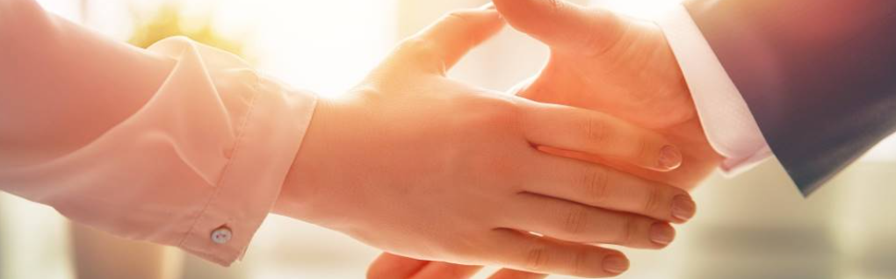
Welcome to our services
New Lebanon Church of Christ
We are Simply Christians.
Our Emphasis is Spiritual, Not Material or Social.
We are striving to be The Same Church as Described in The New Testament.
Please Come Back Again

Slide 2
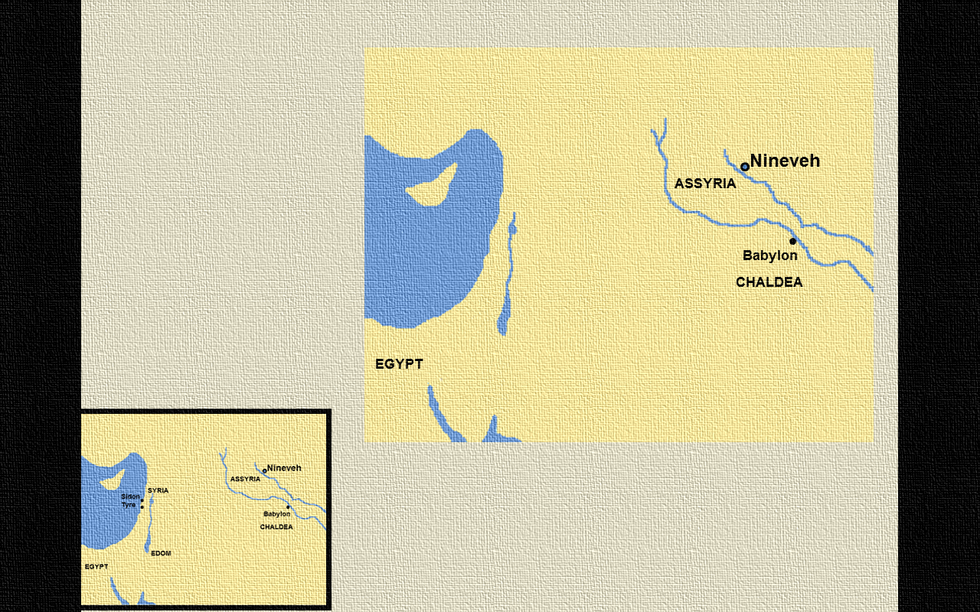
King Nebuchadnezzar ruled the powerful Babylonian Empire.
It was during his reign that Judah and Jerusalem were captured and destroyed.
Babylon Empire
SYRIA
Cyprus
SAMARIA
Jerusalem
JUDAH
Sinai
ARABIA

Slide 3
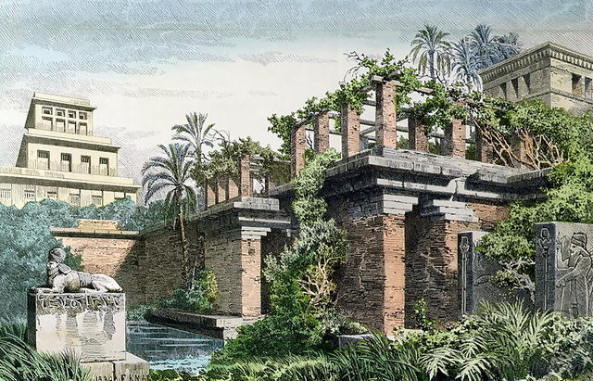
I, Nebuchadnezzar, was at ease in my house and prospering in my palace
Gateway into Nebuchadnezzar’s palace in Babylon
4:4
Notes:
Although the Hanging Gardens of Babylon are not mentioned in this text (or in the Bible), writers of antiquity wrote of them and were astounded by their beauty. The Babylonian priest and author Berossus described them (about 290 BC), as did the Jewish writer Josephus (about AD 70–100). These authors attribute their construction to Nebuchadnezzar as a way to please his Median wife Amytis. They are described as being filled with a lush variety of trees, herbs, vines, and shrubs, requiring substantial irrigation. The gardens were so famous that they were often included among the Seven Wonders of the Ancient World. This provides a likely backdrop for Nebuchadnezzar’s pleasant palace setting as described in this verse. This image comes from Ferdinand Knab and is in the public domain, via Wikimedia Commons: https://commons.wikimedia.org/wiki/File:Hanging_Gardens_of_Babylon_by_Ferdinand_Knab_(1886).png.
wiki122220150034

Slide 4
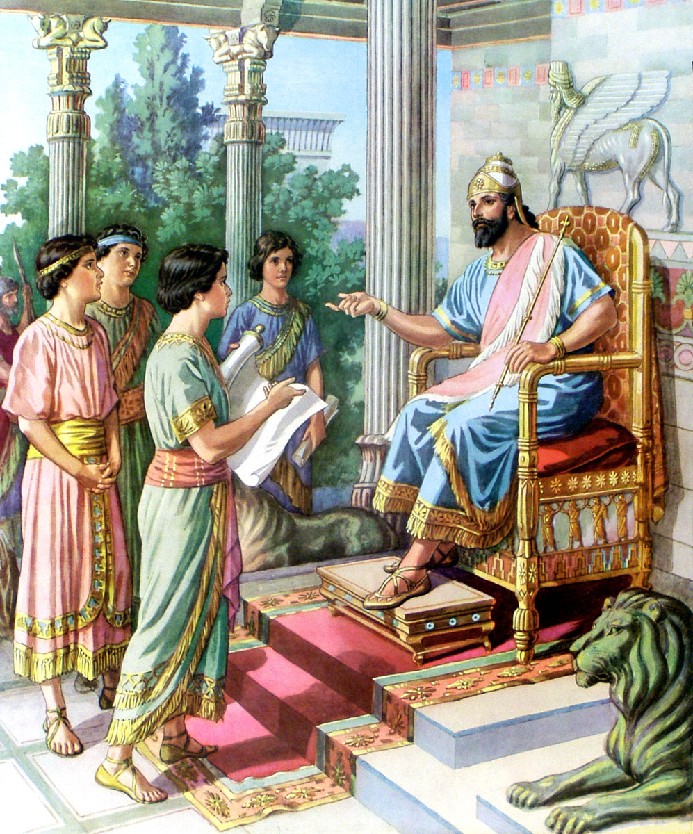
But He Purposed In His Heart. Daniel 1:8
Daniel 1:8 But Daniel purposed in his heart that he would not defile himself with the portion of the king's delicacies, nor with the wine which he drank; therefore he requested of the chief of the eunuchs that he might not defile himself.

Slide 5
But He Purposed In His Heart. Daniel 1:8
LOOK AT THE HARDSHIPS DANIEL FACED—
He was taken prisoner.
He suffered the loss of his family.
He witnessed a savage war.
He was made a eunuch.
He had to learn the language of the Chaldeans.
Daniel 1
“⁴Children in whom was no blemish, but well favoured, and skilful in all wisdom, and cunning in knowledge, and understanding science, and such as had ability in them to stand in the king’s palace, and whom they might teach the learning and the tongue of the Chaldeans.”
King Nebuchadnezzar took captives from Jerusalem that were the brightest and best.

Slide 6
But He Purposed In His Heart. Daniel 1:8
Daniel (God is my judge)
*Belteshazzar (a servant of Bel)
Hananiah (the Lord is gracious)
*Shadrach (inspired by the sun god)
Mishael (who is, what God is?)
*Meshach (who is what the moon god is?)
Azariah (the Lord helps)
*Abed-Nego (servant of Nebo)

Slide 7
But He Purposed In His Heart. Daniel 1:8
Daniel made a commitment
How did Daniel keep his commitment...
He did it with politeness
He did it with God's help
He did it through persistence
through willingness to test his
faith

Slide 8
But He Purposed In His Heart. Daniel 1:8
Applications From Daniel's Faith
Be polite
Seek God's help
Be persistent
Be willing to test your faith

Slide 9
Questions?
Want to learn more about the Bible?
We will be glad to study the Bible with you.
New Lebanon
New Lebanon
Church of Christ
Church of Christ
New Lebanon, OH
newlebanoncoc.com
newlebanoncoc@gmail.com

