Slide 1
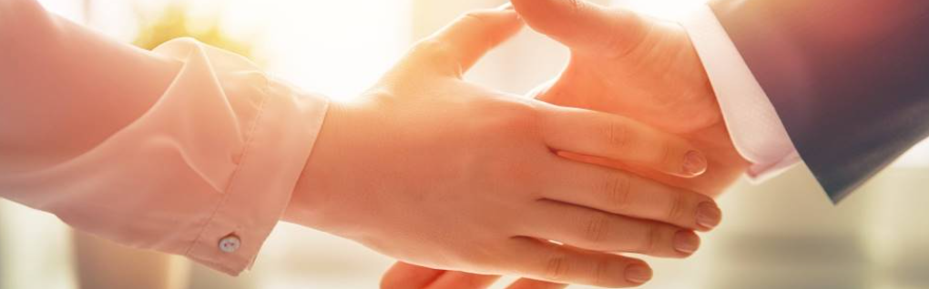
Welcome to our services
New Lebanon Church of Christ
We are Simply Christians.
Our Emphasis is Spiritual, Not Material or Social.
We are striving to be The Same Church as Described in The New Testament.
Please Come Back Again

Slide 2
That Whoever Believes In Him. John 3:16
1. Believers - Who Do Nothing.
Jewish Rulers
King Agrippa
Demons
newlebanoncoc.com

Slide 3
That Whoever Believes In Him. John 3:16
2. Believers - Who Do The Wrong Thing.
Scribes and Pharisees
People on day of Judgment
Saul of Tarsus
newlebanoncoc.com

Slide 4
That Whoever Believes In Him. John 3:16
3. Believers - Who Do The Right Thing.
Jews on Day of Pentecost
Ethiopian Eunuch
Philippian Jailor
newlebanoncoc.com

Slide 5
That Whoever Believes In Him. John 3:16
1. Believers - Who Do Nothing.
2. Believers - Who Do The Wrong Thing.
3. Believers - Who Do The Right Thing.
newlebanoncoc.com

Slide 6
Questions?
Want to learn more about the Bible?
We will be glad to study the Bible with you.
New Lebanon
New Lebanon
Church of Christ
Church of Christ
New Lebanon, OH
newlebanoncoc.com
newlebanoncoc@gmail.com

