Slide 1
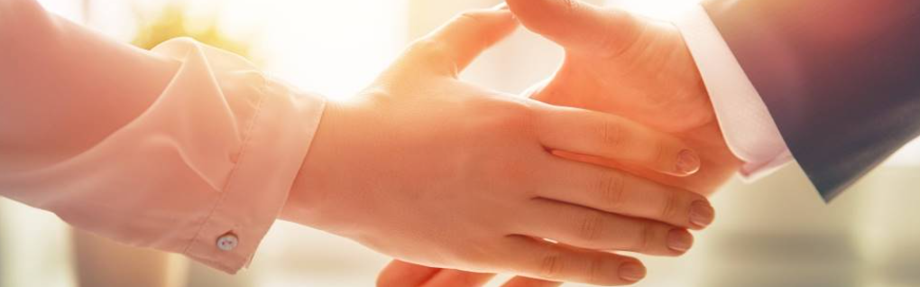
Welcome to our services
New Lebanon Church of Christ
We are Simply Christians.
Our Emphasis is Spiritual, Not Material or Social.
We are striving to be The Same Church as Described in The New Testament.
Please Come Back Again

Slide 2

The Richest Document in The History Of Mankind
Eph 3:20-21.
Now to Him who is able to do exceedingly abundantly above all that we ask or think, according to the power that works in us,
to Him be glory in the church by Christ Jesus to all generations, forever and ever. Amen.

Slide 3
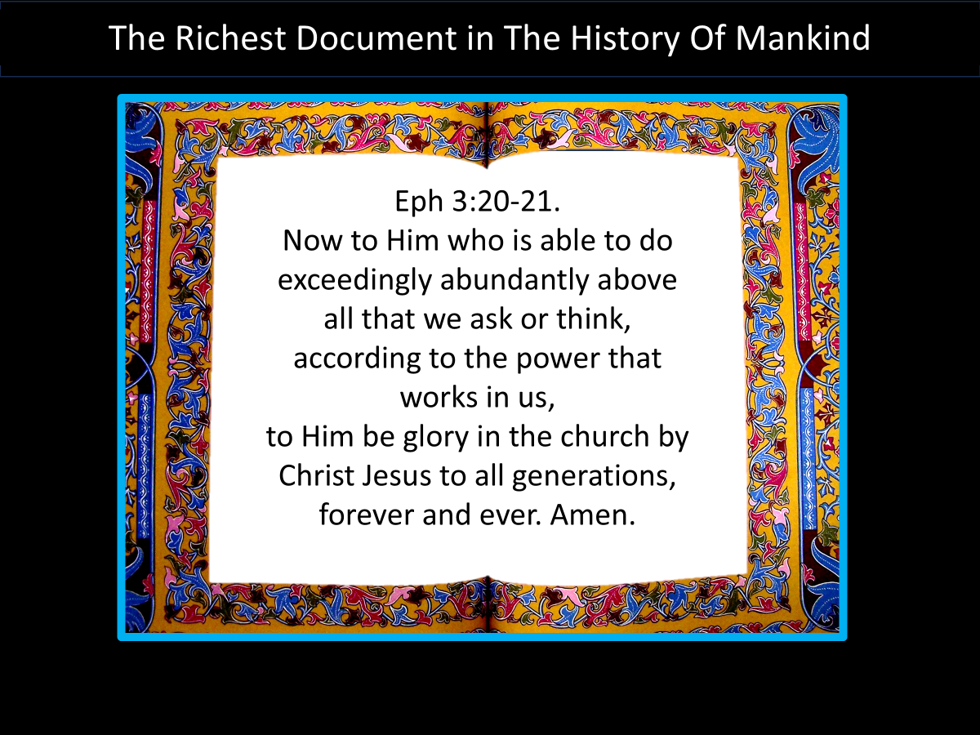
The Richest Document in The History Of Mankind
The Bible is its own best commentary.
It was written to be studied. Not written to be read like a novel.
Must look at all verses on a subject before you draw a conclusion (example – salvation).

Slide 4
Title
The Richest Document in The History Of Mankind
Gospels
Matthew -J
Mark -R
Luke -G
John -U
Paul’s Letters
Romans
1st Cor
2nd Cor
Gal.
Eph.
Phil.
Col
1Thess
2Thess
1Tim
2Tim
Titus
Phil.
General letters
Hebrews
James
1Peter
2Peter
1 John
2 John
3 John
Jude
The life of Christ
History
Acts
History of the church.
How to be a Christ-ian
These 21 letters tell us how to LIVE the Christian life.
Revelation –
Tells us how to DIE in Christ.
Be faithful unto death.

Slide 5
CASE STUDIES OF CONVERSION
Acts | Preaching | Believed | Repented | Confessed | Baptized | Saved
2:22-41 | Pentecost |  | vv. 37-38 |  | vv. 38-41 | Remission Of Sins
8:12 | Samaritans | v. 12 |  |  | v. 12 | Believed
8:13 | Simon | v. 13 |  |  | v. 13
8:35-39 | Eunuch | vv. 36-37 |  | v. 37 | v. 38 | Rejoiced
9:17-18 | Saul |  |  |  | v. 18 | Sins Washed Away
10:34-48 | Cornelius | v. 43 |  |  | v. 48 | Remission Of Sins
16:13 | Lydia | v. 14 |  |  | v. 15
16:31-34 | The Jailer | v. 31 |  |  | v. 33 | Rejoiced
18:8 | Corinthians | v. 8 |  |  | v. 8
19:5 | Ephesians |  |  |  | v. 5
Baptized

Slide 6
Jerusalem Council
Trials
Paul Before Caesar
Second Missionary Journey
Macedonia
Achaia
Greece
Third Missionary Journey
Asia
First Roman Imprisonment
60 - 63
Rome
Second Roman Imprisonment
67 - 68
Rome
A.D. 51 53 57 60 66 68 70
1 Thess.
Place: Corinth
Date: 51 - 52
1 Corinthians
Place: Ephesus
Date: 56 - 57
Ephesians
Place: Rome
Date: 60 - 63
1 Timothy
Place: Macedonia
Date: 63 - 66
A.D. 70
Destruction of Jerusalem, continued scattering, and growth of the church
Date: 70
2 Thess.
Place: Corinth
Date: 51 - 52
2 Corinthians
Place: Macedonia
Date: 56 - 57
Colossians
Place: Rome
Date: 60 - 63
Titus
Place: Macedonia
Date: 63 - 66
Galatians
Place: Antioch
Date: 57?
Philemon
Place: Rome
Date: 60 - 63
2 Timothy
Place: Rome
Date: 67 - 68
Romans
Place: Corinth
Date: 57?
Philippians
Place: Rome
Date: 60 - 63

Slide 7
The Richest Document in The History Of Mankind
Acts gives the historical setting for the letters that are to follow in the N.T.
It’s important that we don’t skip over this.
Before you read Gal. - read Acts 13 & 14
Before you read Phil. - read Acts 16
Before you read 1st,2nd Thess. - read Acts 17
Before you read 1st,2nd Cor. - read Acts 18
Before you read Eph. - read Acts 19&20

Slide 8
The Richest Document in The History Of Mankind
Corinthians 1 – why it was written
1Cor. 7:1 Now concerning the things of which you wrote to me: It is good for a man not to touch a woman.
1Cor. 7:25 Now concerning virgins
1Cor. 8:1 Now concerning things offered to idols:
1Cor. 8:4 Therefore concerning the eating of things offered to idols, we know that an idol is nothing in the world, and that there is no other God but one.

Slide 9
The Richest Document in The History Of Mankind
Draw a line in your Bible at 1Cor.11:17
1 Cor. 11:17 begins addressing behavior and worship in the ASSEMBLY
  • When you come together
  • When you come together as a church
  • When you come together in one place
1Cor. 12:1 Now concerning spiritual gifts, brethren, I do not want you to be ignorant:
1 Cor. 14:23 – assembly - gift of singing praying and prophesying
1Cor. 16:1 Now concerning the collection for the saints,

Slide 10
Title
The Richest Document in The History Of Mankind
Gospels
Matthew -J
Mark -R
Luke -G
John -U
Paul’s Letters
Romans
1st Cor
2nd Cor
Gal.
Eph.
Phil.
Col
1Thess
2Thess
1Tim
2Tim
Titus
Phil.
General letters
Hebrews
James
1Peter
2Peter
1 John
2 John
3 John
Jude
The life of Christ
History
Acts
History of the church.
How to be a Christ-ian
These 21 letters tell us how to LIVE the Christian life.
Revelation –
Tells us how to DIE in Christ.
Be faithful unto death.

Slide 11
Questions?
Want to learn more about the Bible?
We will be glad to study the Bible with you.
New Lebanon
New Lebanon
Church of Christ
Church of Christ
New Lebanon, OH
newlebanoncoc.com
newlebanoncoc@gmail.com

