Slide 1
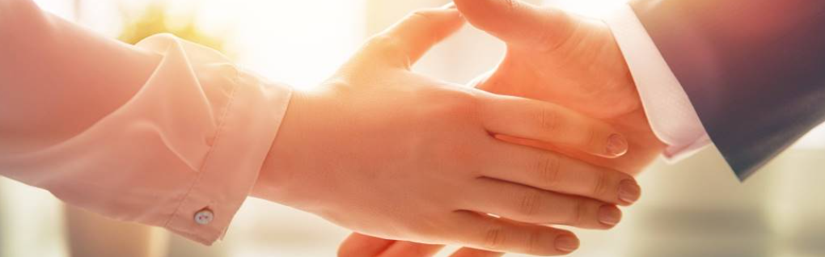
Welcome to our services
New Lebanon Church of Christ
We are Simply Christians.
Our Emphasis is Spiritual, Not Material or Social.
We are striving to be The Same Church as Described in The New Testament.
Please Come Back Again

Slide 2
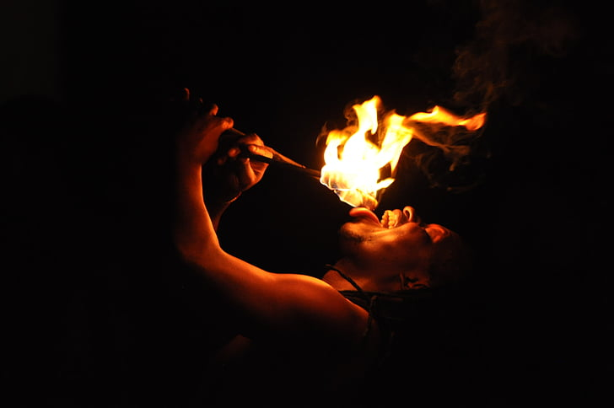
Proverbs 6:20 My son, keep your father's command, And do not forsake the law of your mother. 21 Bind them continually upon your heart; Tie them around your neck. 22 When you roam, they will lead you; When you sleep, they will keep you; And [when] you awake, they will speak with you.
23 For the commandment is a lamp, And the law a light; Reproofs of instruction are the way of life, 24 To keep you from the evil woman, From the flattering tongue of a seductress.
25 Do not lust after her beauty in your heart, Nor let her allure you with her eyelids. 26 For by means of a harlot A man is reduced to a crust of bread; And an adulteress will prey upon his precious life.
27 Can a man take fire to his bosom, And his clothes not be burned? 28 Can one walk on hot coals, And his feet not be seared? 29 So is he who goes in to his neighbor's wife; Whoever touches her shall not be innocent.

Slide 3
Playing With Fire
Hippopx
Proverbs 6:20-29

Slide 4
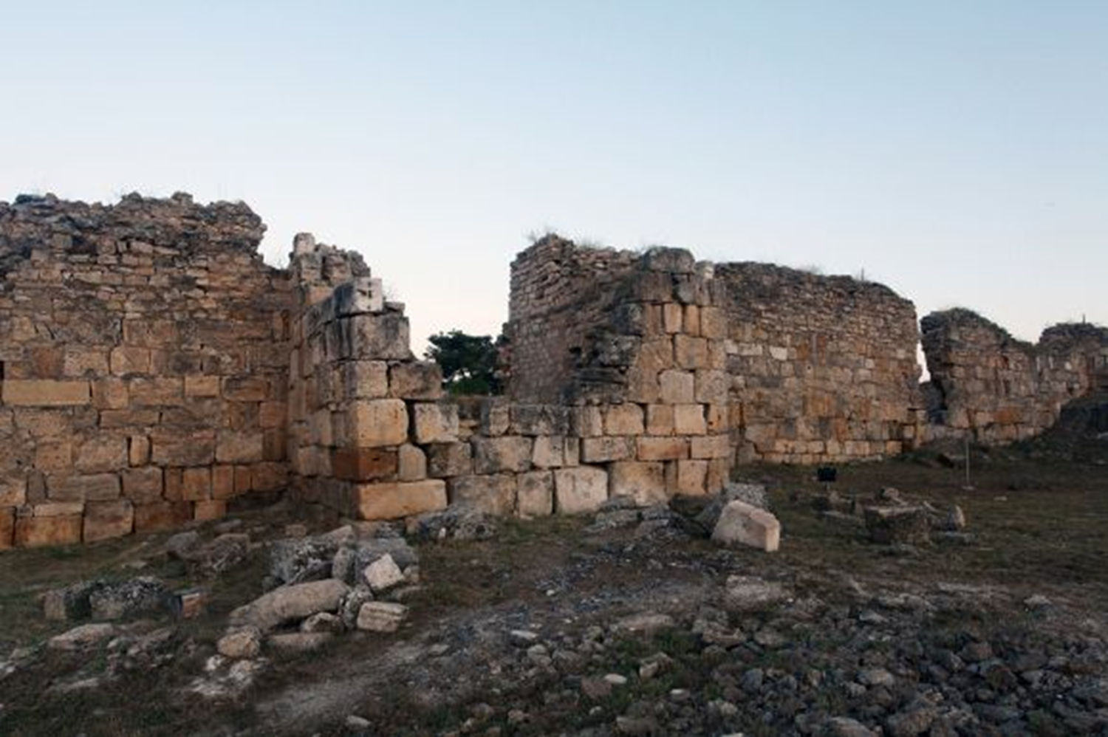
Proverbs 25:28 Like a city that is broken
into and without walls
so is a man who has no
control over
his spirit.

Slide 5

We Must Have A Strong Wall Around Our Heart
If our enemy compromises our heart, he will defeat us!

Slide 6
Playing With Fire
1. Intro. – A few opening
thoughts and principles

Slide 7
Playing With Fire
2. Lust - STRONG DESIRE:
TO LONG AFTER -
SET THE HEART UPON.
-epithumia: Morally neutral word, of any strong desire, longing, craving. Context of usage explains the nature of the desire,

Slide 8
Playing With Fire
3. Don’t Market Yourself
To The Opposite Sex.

Slide 9




3. Don’t Market Yourself To The Opposite Sex.
available
available
Look
Smile
Touch

Slide 10

4. Do you want WARFARE in your relationship?

Slide 11
4. Do you want WARFARE in your relationship?
Stress – Money, Parenting, Career, Family, -
how do you handle the stress of life???

Slide 12
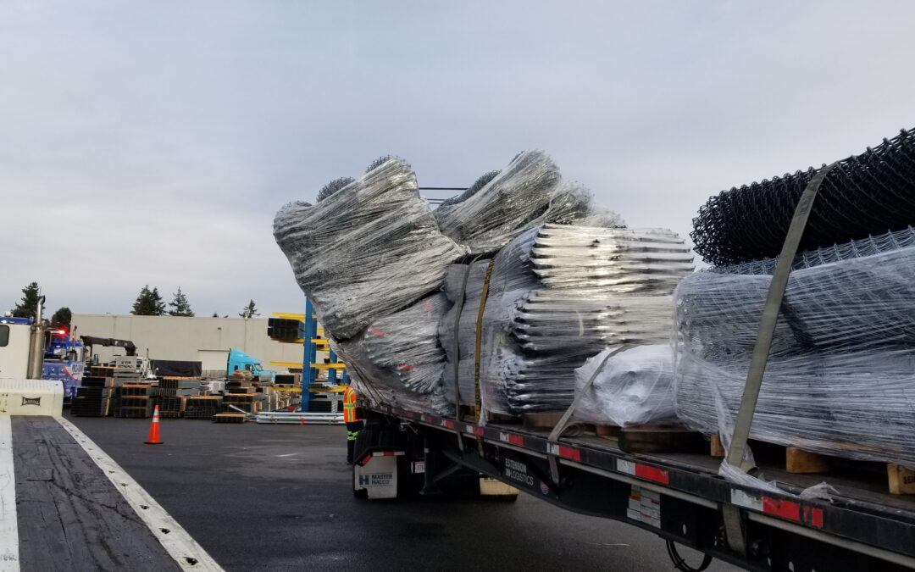
Playing With Fire

Slide 13
Playing With Fire
5. REMEMBER –
Marriage does not change character
it only EXPOSES it.

Slide 14
Playing With Fire
We play with fire when;
We do the wrong thing.
We fail to do the right thing.

Slide 15
Playing With Fire
6. What is the Answer?

Slide 16
Questions?
Want to learn more about the Bible?
We will be glad to study the Bible with you.
New Lebanon
New Lebanon
Church of Christ
Church of Christ
New Lebanon, OH
newlebanoncoc.com
newlebanoncoc@gmail.com

